Slide 1
EEE4120F
High Performance
Embedded Systems
Lecture 23
HPES Development Process and Management Aspects
Many of these aspects will be removed from 2023 exam syllabus
Spiraling to
success
* Relates to Martinez, Bond and Vai Ch 4.
towards happy projects
Lecturer:
Simon Winberg
Attribution-ShareAlike 4.0 International (CC BY-SA 4.0)
Notes:
Welcome to the H PES productivity lecture!
This topic discusses the development process and team management aspects of H PES development.
My reasoning for including this slide set, as one of the last topics covered, is to connect with the aspects of development practice and quality inspection, now that you have a good idea of what sort of work an H PES development team is involved with. Consequently, we are now taking a bit of a broader view on the process, after having gained some hands-on experience. We’re delving into this because a university graduate should really be aware of these more work management aspects, not just the work itself.

Slide 2
Today’s theme –
HPES development process and methodology
– towards happy projects
Notes:
I’m trying to give this a positive theme. I know H PES development can involve a lot of effort. But let us look on the happy side of H PES, it is really satisfying building an super fast and fancy machine!

Slide 3
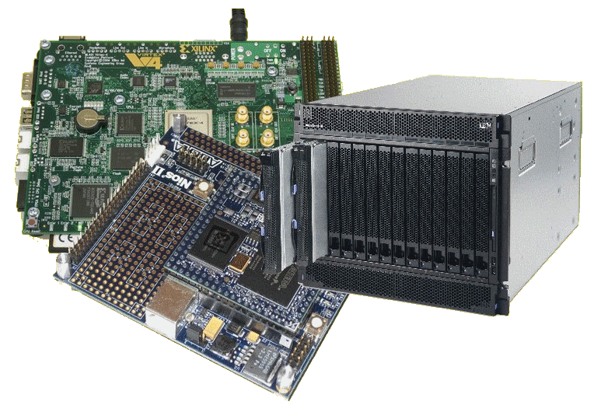
Lecture Overview
Where work is done, division of labour
HPEC* management
HPES development process
Setting system objectives
Costs & risks
Monitoring progress
Documentation
Effort, Productivity and Progress
(Optional extra slides re intro to Doxygen)
*HPEC = High Performance Embedded Computer, term used by Martinez et al.

Slide 4
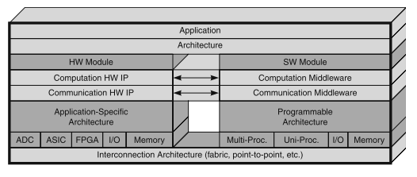
HPEC System – where work is done
Useful to consider ‘where work is done’ in relation to Martinez et al.’s “canonical framework” (illustrated below) that identifies key subsystems and components of a High Performance Embedded Computing (HPEC) system…
These projects many members of the development team, involved at various levels of the system.
Where would you like to fit in?
Notes:
Before we get into specifics, let’s take a broader look at the different levels at which H PES work is performed. This diagram, the canonical framework by Martinez et al., gives a good view on the structure of a H PES system. At the lowest level we have the interconnection architecture. That is the connectivity fabric and circuitry upon which the other layers are structured or instantiated. At the top level is the Application you want to run and the Application Architecture.

Slide 5
HPES Design: Personnel and Division of Labour
HPES system development is influenced by the usual suspects:
requirement, plans, and implementation decisions for the systems.
There is likely separation between significant subsystems, e.g. between backend and frontend, as well as between hardware and software.
May draw on a range of experts from various disciplines … (lets consider some …)
Notes:
An H PES system is, of course, designed and built by people. At least, they currently still are. Although, the building part may be automated to some extent.
What H PES it to be built is influenced by the usual suspects. That is to say. The requirements, planning and implementation decisions for what the system does.
But now we get further into the people aspect. There is likely separation between the different sub-systems, or layers of the H PES. As illustrated on the previous slide.
Oh, and certainly even from the requirements phase there will be people involved. Probably more people than just the CEO having a friendly chat with a business associate and offering a system to solve any problems.
The development practices may draw from experts from various disciplines, some examples are given on the next slide.

Slide 6
HPES Design: Personnel and Division of Labour
Application expects e.g.
Radar experts to advise on radar system design & processing algorithms
Medical system experts to design on standards, fault tolerance and safety requirements
Masses of others…
Notes:
H PES projects may draw on various consultants or experts. These could include Application Experts. Such as radar experts that may design on radar system design and radar processing. Medical systems experts. Certainly, masses of other types of experts that could be drawn upon.

Slide 7
HPES Design: Personnel and Division of Labour
Application expects e.g.
radar experts to advise on radar system design & processing algorithms
Medical system experts to design on standards, fault tolerance and safety requirements
Hardware specialists e.g.
Computer platform design experts
Radio Frequency (RF) experts for design of the RF hardware
Experts to design of power supplies to provide the power needed by the system
Notes:
There may be Hardware specialists in the development team. For example computer platform design experts. Or RF engineers that will provide radio hardware.

Slide 8
HPES Design: Personnel and Division of Labour
Application expects e.g.
radar experts to advise on radar system design & processing algorithms
Medical system experts to design on standards, fault tolerance and safety requirements
Hardware specialists e.g.
Computer platform design experts
Radio Frequency (RF) experts for design of the RF hardware
Experts to design of power supplies to provide the power needed by the system
Software & HDL specialists e.g.
Personnel experienced in high performance signal processing
And these individuals need to work effectively together on the system being constructed…
Notes:
Of course software and HDL specialists as well. Such as personnel experienced in high-speed signal processing.

Slide 9
Roles for division of labour
Manager
Team leader
Hardware designer
Software designer
Implementer / Programmer
Engineering Technician
Test Designer, Test Analyst
Tester
Tool specialist
Documentation writer
Librarian
These are also some ideas for the roles you might give team members in the YODA project
Notes:
Considering that these teams may be large, one needs to think of suitable roles that the people involved will be responsible for. Most roles may be more technical, such as tools specialist and hardware designer. But there could be other roles that depend more on social connections, working with others – not necessarily other engineers but clients – and leadership roles.
I know YODA is a very small project. But still. You could define roles for your team mates.

Slide 10
HPES Management
The management of the development must be tailored to meet the particular technology choices, which could comprise a variety of technologies and tools…
Each technology has its own development cycle, cost, technical limitations, and risks. E.g.:
Developing a custom ASIC
tends to slow down the implementation.
Could have high risk (e.g. cannot afford more than one run prior to initial release);
Need strategies to mitigate these potential risks (e.g. backup plan of using an FPGA)
Programmable processors
also have various risks (e.g. licensing tools, what happens if they go out of production).
Some thinking points
Notes:
The management of the development must fit with the particular technology choices for the project. It could comprise various technologies and tools.
Furthermore, each technology may have its own development cycle, costing, technical limitations, and risks. That need to be considered to improve the likelihood of being successful.
The last two points provide some thinking points for contrasting the development cycle for ASIC with a programmable processors approach.

Slide 11
HPES Development Process
EEE4120F
Notes:
Let us get in to the H PES development process. You already have some hands-on experience of this from the pracs, and insights from previous lectures.

Slide 12
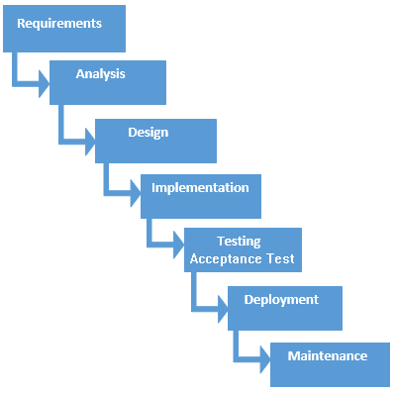
HPES Process Model
Commonly planned broadly with the waterfall model in mind to cover all needed steps
Relevant to both the software and hardware aspects of the system
In practice
The spiral model provides a better guide to HPES projects overall, with the waterfall model being applicable to iterations of HW/SW development within cycles of the spiral model
Classic representation of the Waterfall model
Notes:
(I haven’t finished adding annotations to these slides…)

Slide 13
Spiral Model: the natural way
As per general development projects, HPES, Reconfigurable and High-performance computing systems tend to follow the Spiral Model (Bloehm 1988) with phases of…
Main phases
of development
(usually starts with
requirements; the
subsequent iterations start with a requirements review and deciding what next to do.)
Starting small (i.e. start from centre of spiral and expand out) with little risk. Adding features and mitigating risk with each additional iteration.
Review
Analysis
Testing /
Release /
Planning
Design and
Implementation
A spiral* model overview of development
* B. W. Boehm, “A spiral model of software development and enhancement,” Computer, vol. 21, pp. 61-72, 1988.
Notes:
(some of these models you may have come across in the Design Course already).

Slide 14
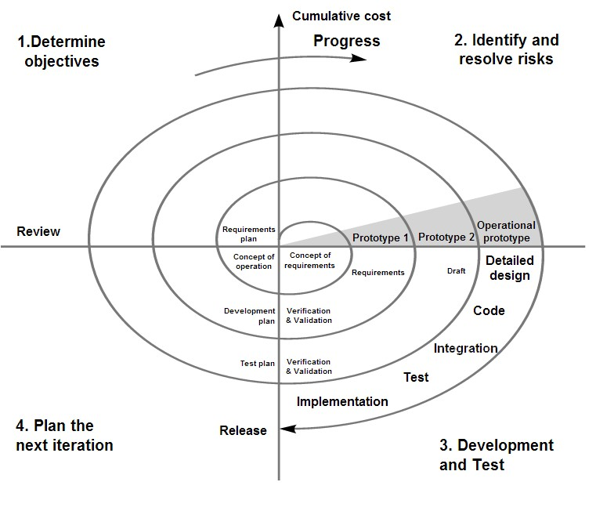
Spiral model (Boehm, 1988)
More detailed classic model.
Each cycle begins with the identification of the objective of the portion of the product
to be elaborated
When does it end?
Image from Wikipedia open commons
See discussion in Martinez, Bond and Vai, 2008, “High Performance Embedded Computing Handbook”, CSC Press, pg 43.

Slide 15
HPES System Objectives
Objectives of each cycle
specified in terms of the overall system into which the computing resource/processing is to be incorporated
In early stages of the process
System objectives are usually more in terms of algorithms and processing needed (see next slide).
Subsequent stages (after a few iterations)
More high-level design and experimental rapid prototyping of subsystems (e.g. writing a rough C routine version of a decided upon algorithm to evaluate its performance)
Later stages (after a good understanding of processing needs and algorithms to use)
More focused on hardware subsystems fabrication
Software implementation
Testing
Final stage(s)
Preparing and performing acceptance test(s)
Installation and post installation maintenance

Slide 16
System level goals
Functional requirements
What the system should do
Operations to perform
Input → Output relations
Use cases (to be satisfied)
Non-functional requirements
The ‘ilities’
Availability, Scalability, Reliability, Reusability, Maintainability
Performance
Speed of operation, throughput, response time (max. latencies)
Size, Weight, And Power (SWAP)

Slide 17
Goals of the Early Cycles
In the early cycles, the goal is typically: reduce the largest technical risks and initiate lengthy tasks that may influence the overall (contractual) schedule.
If can’t eliminate big risks need to reconsider continuing
Some common risks addressed in early cycles of HPES development:
Form-factor constraints
Algorithm and functional uncertainty
Synchronization and control (exploiting regularity of data flow in computation)
Software complexity
Selecting COTS components
Custom ASIC design (high volume production only)

Slide 18
Costing and Risk management
Once the requirements, alternatives, and constraints are established, risk analysis is performed.
Once development has progressed successfully, it should be feasible to retire certain risks at a Plan (stage 4) iteration
At this point, management may review the cost of the previous cycle, scheduling of the next iteration and also revise the overall costing and development timeline.

Slide 19
Monitoring development progress & productivity
EEE4120F

Slide 20
Monitoring progress
An important management tasks for HPES projects is developing accurate estimates for, and ways to measure development ‘PECS’:
Progress
Effort
Cost and
Schedule
This may need to be tailored according to activities and types of technologies used during the project e.g.
MATLAB/Simulink coding vs. C coding vs. Assembly coding vs. FPGA HDL coding

Slide 21
Monitoring productivity/progress
Need ways to measure both performance and progress for
Hardware development progress and
Software development progress

Slide 22
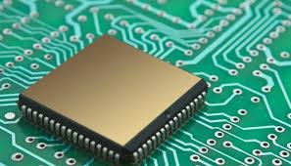
Hardware design progress
EEE4120F

Slide 23
Hardware progress
A often mentioned method:
Determining the number of transistors, components and interconnects used in a design…
… surely that will give you a good impression of where the design is at?
Do you think this is a valid and fair approach?
Q

Slide 24
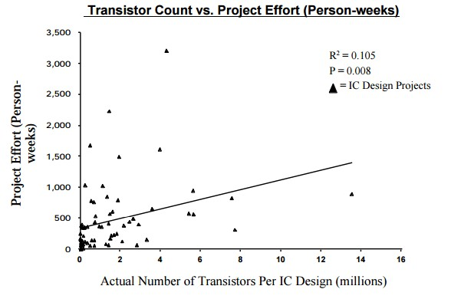
Hardware progress
Not necessarily
The graph on left shows number of transistors vs. weeks of design effort
As can be seen there may be little correlation in number of components in a design to amount of effort
Consider further there are usually cycles of design-test-optimization, so over time there may be increases and decreases in components used
But agreeably it is likely the number of components will increase over long time periods when looking at one project
It is better to consider the completion of functional units (or required functionality)
* Numetrics Management Systems (2000) “Measuring IC and ASIC Design Productivity”

Slide 25
Hardware progress
Factors indicating progress
Requirements/Specifications provided
Number subsystems completed
Functionality completed (i.e. not looking necessarily in relation to specific requirements but more functions given, e.g. counter added to design)
System complexity (interconnects & modules)
Design size
IP usage
Considered in relation to
Technology/tools used
Application domain
Frequency/speed of operation (e.g. high frequency, faster systems are more difficult to build)
Based on http://www.eetimes.com/document.asp?doc_id=1276032

Slide 26
Design Complexity Measures
Two aspects of system design complexity*
Structural design complexity
Depth of hierarchies
Number of components
Number of connections
Interconnections between components
Functional design complexity
Number of functions provided
Complexity of the functions (e.g. symbols needed to describe the operation)
Sophistication of communication, handshaking protocols, flow control
Data management
Simple
More complex
* Dan Braha and Oded Maimon, 1998, “The Measurement of a Design Structural and Functional Complexity” In IEEE Transactions On Systems, Man, and Cybernetics

Slide 27
Cyclomatic Complexity
Cyclomatic complexity is a software metric (measurement), used to indicate the complexity of a code section (or whole program). It is a quantitative measure of the number of linearly independent paths through a program's source code.
The approach is usually to think of (or visualize) the code section of interest as a graph, relating separable blocks of closely interdependent sequenced code (see next slide).
Good introductory starting point if you want to get more into this technique:
https://www.geeksforgeeks.org/cyclomatic-complexity/ (recommended tut)
more in-depth: https://dev.to/designpuddle/coding-concepts---cyclomatic-complexity-3blk
Read more about it at: https://en.wikipedia.org/wiki/Cyclomatic_complexity
Notes:
The Cyclomatic Complexity measure is a code analysis method to measure of the complexity of a code section.
Technically, it is usually not used to assess an entire program. It is unwieldy for doing that. You don’t want to do that for thousands of lines. Unless you are using a tool to do so. Although knowing the complexity of a massive piece of code is not necessarily so useful. This method is more commonly applied to critical sections of code. That is to say, pieces of the program code that are the most essential to its operation.
This concept leads on from the point of design complexity. In which Design Complexity is typically measure in terms of either structural complexity. Which is how pieces connect up. Or functional complexity. Which is about the number of functions and their interdependence on other functions or data.
Cyclomatic Complexity can be considered a bit of both.
It is more sophisticated than L O C. i.e., lines of code. More sophisticated that the somewhat better S L O C. No, the ‘S’ here is not for ‘Sophisticated’ lines of code. It just means ‘Source’ lines of code. Meaning you are ignoring comments and stuff like information about authors, project name and other useful things that I might try to get you into the practice of providing.

Slide 28
McCabe’s Cyclomatic Complexity Metric
Considers design as a graph representation.
Uses the formula of “cyclomatic complexity”, which is as follows:
M = V(G) = e – n + 2p
where:
V(G) = cyclomatic number of Graph G
e = number of edges
n = number of nodes
p = number of separate connected components* of the graph (or system**)
(2p as connections between parts potentially more difficult to manage and design around that individual parts)
*Connected components can be considered blocks of the code that are separated from the main sequence (e.g. the ‘then’ code that runs of when an if condition is true, an if causes a 1-part component separation).
** The graph represents the system being designed, although it could be extended to the ‘development’ system, i.e. people working on different parts using possibly different tools.
McCabe, 1976

Slide 29
Cyclomatic Complexity Metric
Need to find the linearly independent paths in the code section
Usually done using the control flow graph of the program… essentially separating the part before the IF, and the two options after the IF (which might be doing an operation, or not doing the operation if there’s no ELSE).
See example on next slide

Slide 30
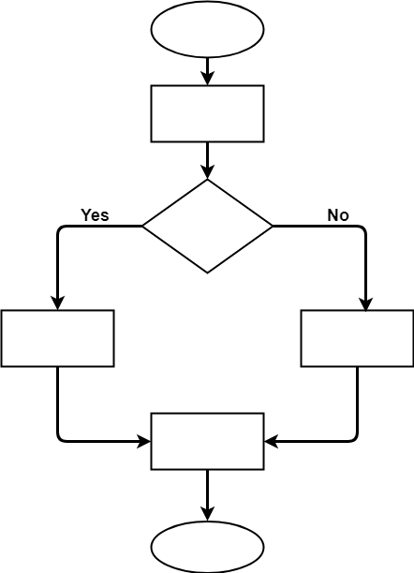
Cyclomatic Complexity Metric – Example 1
Example block of code to consider:
void main ()
{
int a = 100;
if (a > c)
a = b;
else
a = c;
printf(“%d %d %d”,a,b,c);
}
start
a=100
a>c
As can be seen in the flow graph (or a flow chart) there are:
n = 7 nodes (we’re including start and stop, don’t have to),
e = 7 edges (including links to start and stop, don’t have to).
p = 1 connected component (i.e. The if splitting the path into two options)
using M = e – n + 2p
M = 7 – 7 + 2(1) = 2
a=b
a=c
Print
a,b,c
stop

Slide 31
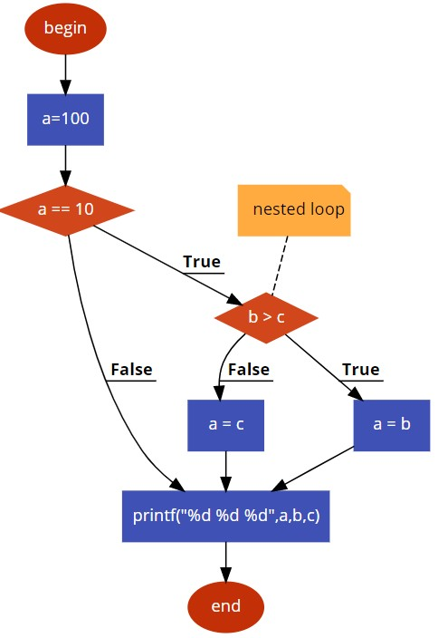
Cyclomatic Complexity Metric – Example 1
Example block of code to consider:
if (a == 10){
if (b > c) // nested loop
a = b
else
a = c
}
printf(“%d %d %d”,a,b,c);
As can be seen in the flow graph there are:
n = 8 nodes (we’re including start and stop, don’t have to),
e = 9 edges (including links to start and stop, don’t have to).
p = 1 connected component
using M = e – n + 2p
M = 9 – 8 + 2(1) = 3
flow graph of code on left
Flow chart developed using https://app.code2flow.com/

Slide 32
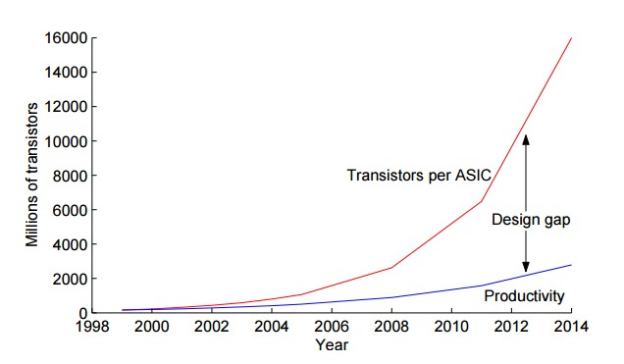
Design Productivity Gap
Design productivity gap:
The difference between the transistors (resources) available in a single semiconductor die and the ability for the transistors to be used effectively in a design
1980s leading chip needing 100 transistors/month *
2002 leading chip needing 30,000 transistors/month *
Productivity in K transistors/staff member
Can (to some extent) substitute vertical axis for complexity of the system
* Vahid, Frank, and Tony Givargis. Embedded system design: a unified hardware/software introduction. Vol. 52. New York: Wiley, 2002.

Slide 33
Software design progress
EEE4120F

Slide 34
Monitoring progress of software
Usual (easy) approach:
Measuring Lines Of Code (LOC) is one way
SLOC: a possible improvement (mentioned in seminar 2)
SLOC = non-blank, non-comment source lines of code (SLOC) : some relation to the complexity of the code
Potential inaccuracies and unfairness?
Well documented code is typically considered more valuable and reusable… but taking longer to get a solution could cause a product to fail.
… (next slide) …

Slide 35
Difficulty of monitoring progress based on LOC
Potential inaccuracies and unfairness of using SLOC to measure progress / performance …
May have sudden needs for large blocks of code to be provided due to library limitations or incompatibility (e.g. textbook example, needing to fill in functions that were expected to be in the library)
Commented code is often better (and possibly easier to understand and share) than uncommented code.
Some difficult problems may have a short but non-obvious answer (e.g. coding a FIR filter)
Some easy problems may have a long and obvious answer (e.g. GUI code)
Some development tasks end in dead ends not contributing to the final design
Code/design may be thrown away
Some development tasks might be the result of a lot of learning (and the design team gaining skills) but having slower code production

Slide 36
Monitoring software progress
Size of application
Function points: measuring the functionality offered by a system
Average number LOC between bugs
Coupling (of classes, functions)
Measure of the strength of association between different entities
Cohesion
Degree to which methods in a class (or functions in a module) are related to each other
Various other OO metrics can be considered, not included or examined in this course

Slide 37
Function Points (my preferred metric)
Function Points gauge the functionality offered by a system
A function can be defined as a collection of executable statements that performs a certain task
Function points can be calculated before a system is developed
They are language and developer independent (could apply to C / Java / Python / assembly / HDL)

Slide 38
Function Points
A function point count is calculated as a weighted total of five major components that comprise an application, these are:
External Inputs
External Outputs
Logical Internal Files/modules
External Interface Files – files accessed by the application but not maintained by it
External Inquiries – types of online inquiries supported

Slide 39
Calculating a Function Point
A simple way to calculate a function point count is as follows:
Function point count (or fpc) = (Number of external inputs x 4) +
(Number of external outputs x 5) +
(Number of logical internal files x 10) +
(Number of external interface files x 7) +
(Number of external enquiries x 4)
These weightings are decided based on the degree of complexity of the development

Slide 40
Quick Class Activity:
Function Points Calculation

Slide 41
Function Point Example
See handout
Build a system that allows customers to submit product ratings of company X. These ratings will be stored in a file and company X staff will receive daily updates with new ratings. Customers can subscribe to weekly updates of product ratings that were submitted. Management can query the system for a summary of product ratings for a particular period.
Fill in a count
for each of
these items
External Inputs
Logical Internal Files
External Outputs
External Enquiries

Slide 42
Quick Class Activity:
Function Points Calculation
My
Solution

Slide 43
Function Point Example
Build a system that allows customers to submit product ratings of company X. These ratings will be stored in a file and company X staff will receive daily updates with new ratings. Customers can subscribe to weekly updates of product ratings that were submitted. Management can query the system for a summary of product ratings for a particular period.
1
External Inputs
1
Logical Internal Files
2
External Outputs
1
External Enquiries

Slide 44
Functional Points Example (cont.)
Functional Point Count calculation:
External Inputs: 1
External Outputs: 2
Logical Internal Files: 1
External Interface Files: 0
External Enquiries: 1
∴Function Point Count = (1x4) + (2x5) + (1x10) + (0x7) +(1x4) = 28

Slide 45
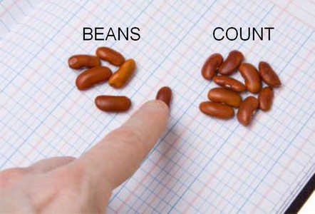
Future Productivity Measurement
For individual developers or teams:
Cost per Function Point
Mean Time required to develop a Function Point
Defects produced per hour
Defects produced per function point
This is probably not used much in industry at present, but things are moving towards this direction. In my view it seems draconian and doesn’t allow for how varied development work, especially embedded systems development, can be. Maybe for more straightforward programming (e.g. simpler web service development) it could be applicable. Basic moral of the story: don’t tell the managers because they might just like this, and we likely would not!

Slide 46
Intermission
Eric Taylor Music - royalty free tracks
https://www.youtube.com/watch?v=gdJIE9lzNIQ
Spiral of Project Management
Notes:
Perhaps I should have divided this slide set into two…. Although the next lot of slides continues on the topic of productivity and performance metrics… and getting into the topic of “Expressive Power vs Developer Efficiency” which I’m rather interested in.

Slide 47
Functional Point Extensions
The original Functional Points (shown in previous slides) are adequate for many applications
However these have been extended for specialized domains (e.g. embedded systems) where the weightings need adjustment due to the nature and complexity of the applications developed.

Slide 48
Effort, Productivity and Progress
Development effort, productivity and progress are not all the same thing
Effort = amount of time involved (person hours; this is a simplistic view of effort)
Productivity = rate of progress (high productivity → progress happening quickly)
Progress = extent to which the desired objectives are complete (measured usually in terms of functionality provided and requirements satisfied)

Slide 49
Issues of Effort & Productivity
Some tasks need more effort than others to gain a desired level of productivity
Tools, programming language, prior knowledge, learning aptitude (among many other factors) can all clearly impact this significantly
The expressive power of a language can influence the productivity achieve by using that language…

Slide 50
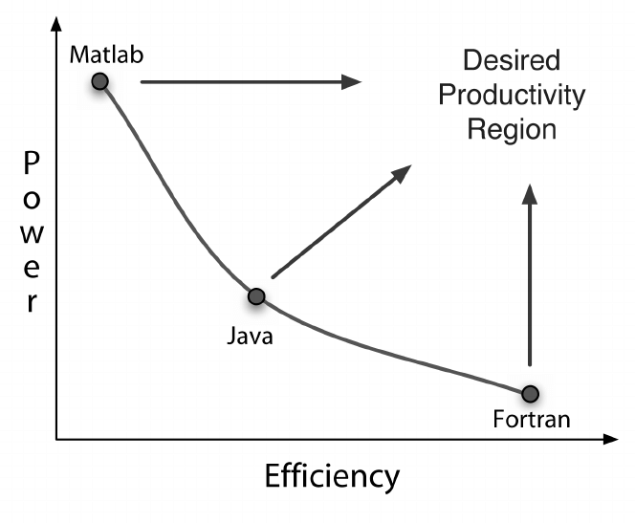
Expressive Power vs Developer Efficiency
Expressive Power = ability of a language to provide advanced primitives and constructs to reduce the amount of effort required to program a solution
Might be the “silver bullet” of software development
Often there is a tradeoff between the expressive power of a language and its efficiency. For example according to the study by Kennedy et al. they demonstrated how certain commonly used languages can have noticeable tradeoffs between the expressive power
Expressive Power
Kennedy, K., Koelbel, C., Schreiber, R., Kennedy, K., Koelbel, C., and Schreiber, R. Deﬁning and measuring the productivity of programming languages. The International Journal of High Performance Computing Applications, (18)4, Winter 2004 (2004), 441–448.

Slide 51
Mythical man month
The Mythical Man-Month * also known as “Brooks's law”:
Central theme is adding manpower to a late project makes it even later…
The second-system effect *:
The tendency of small, elegant, and successful systems to be plagued with feature creep due to inflated expectations.
* Brooks, Jr., Frederick P. (December 2006) [1975]. "The Second-System Effect". The Mythical Man-Month: essays on software engineering (Anniversary ed.). Addison Wesley Longman. p. 53. ISBN 0-201-83595-9.

Slide 52
Documentation
Documentation is important for the reuse and maintainability of designs
A major barrier to reuse is lacking or poor documentation (the web is full of useful code libraries suffering from this)
Automated documentation generation tools are a means to save time and improve the accuracy of design documents, such as use of Doxygen

Slide 53
Processes and trends
Please ready through the rest of CH4 on your own. We’ve already seen much of what is said there, and experienced simplified instances of the development issues in pracs.
The slides that follow is a brief discussion of automated documentation
generation using the Doxygen tool, it is optional reading and can be skipped for test purposes

Slide 54
Doxygen
EEE4120F
These slides are aimed more at additional reading and for application to Prac4 in which a brief intro to Doxygen is given.

Slide 55
Doxygen – code documentation tool
Doxygen is a highly recommended tool for generating code documentation from comments in the code.
It is a documentation system for C, C++, Java, among other programming languages.
It helps to
Generate on-line or offline reference manuals from commented source files.
Extracting the code structure and visualising relations between software components using dependency graphs, and various UML modelling techniques such as inheritance diagrams, and collaboration diagrams that are generated automatically.
NOTE: This doesn’t mean to say you can skip the software design phase of development but it can help synchronize what your implementation becomes with its design visualization

Slide 56
Where to get Doxygen
Doxygen website
http://www.stack.nl/~dimitri/doxygen/

Slide 57
Using Doxygen
Initial setup
Step 1: Create a Configuration File
Doxywizard is a GUI program for creating the config file
Construct templates (to copy and paste to save typing)
Following cycle repeats:
Step 2: Document the Code
Step 3: Run the Doxygen
Don’t usually run doxygen for each compile in code-compile-test cycle as it can take a while to complete.

Slide 58
How to use Doxygen
Techniques for documenting
Code blocks or lines
Functions / member functions
Classes and structures
Class attributes
Code structures (e.g. for loop, if then else)

Slide 59
How to use Doxygen
Doxygen comments start with a * or !
Examples:
/** description of function. */
/*! Another description */
//! Another Doxygen comment
/// Also Doxygen comment with 3 x ‘/’

Slide 60
Documenting code
int var1; //! Document member or variable
/*** Document function,
at top of declaration */
void myfunc (int a, int b)
{
}

Slide 61
Doxygen formatting
Bulleted lists
Unnumbered: Use a column aligned minus sign –
Numbered Use a column aligned minus sign – followed by a # (i.e. -# blurb)
Nested lists: indent the – or -#
Arbitrary HTML code can be added
HTML commands (e.g. <b>blurb</b> ) can be used inside comment blocks

Slide 62
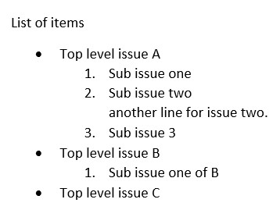
Doxygen list example
/**
* List of items
* -Top level issue A
* -#Sub issue one
* -#Sub issue two \n
* another line for issue two.
* -#Sub issue 3
* -Top level issue B
-#Sub issue one of B
* -Top level issue C
*/

Slide 63
Doxygen
These slides were meant as a brief into, for more details on Doxygen commands and syntax please see the Doxygen online manual
http://doxygen.nl/manual.html

Slide 64
General causes making a…
Success!
OR
Failure!

Slide 65
Common causes of failure
Requirements Analysis
Nothing recorded / no written requirements
Requirements vague or insufficiently described
Leaving it ‘till too late to actually formalize requirements
No directions on user interface
No end-user involvement (occasionally difficult to organize)
Design
Insufficient design and planning done
No documents (or poorly formed)
Inefficient data structures / file formats
Infrequent or no design reviews
Lack of consultation/input from experts and senior engineering staff
You?
Poorly Planned Project?

Slide 66
Common causes of failure
Implementation
Lack of, or insufficient coding standards (incl. inconsistent coding style etc.)
Infrequent or no code reviews
Poor in-line code documentation
Subsystem/component testing & Integration
Insufficient component testing
Incomplete testing or running ineffective tests
No quality assurance

Slide 67
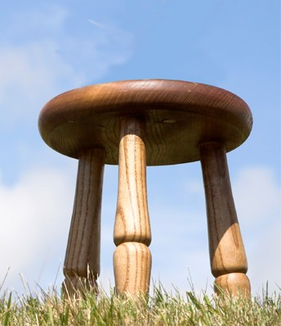
Most common cause of success??
How can we avoid making the mistakes that lead to project failure? Besides the obvious point of having competent staff?
Apparently* the answer is simply:
By using “simple common sense… which is often ignored in systems projects.”*
Need the three pillars of success:
A sound methodology
Solid technical leadership by someone who’s successfully done a similar project
Management support
A happy project
sound methodology
Good leadership
Management
support
(a likely question or bonus question )
* M. I. Sanchez-Segura, J. García, A. Amescua, F. Medina-Dominguez, and A. Mora-Soto, “A Study on How Software Engineering Supports Projects Management,” Innovative Techniques in Instruction Technology, E-learning, E-assessment, and Education, pp. 161-165, 2008.

Slide 68
Class Activity on Development Process
EEE4120F

Slide 69
Reflections – short activity
Keep in mind the main recurring phases of the spiral model:
Analysis
Review
Design /
implementation /
prototype
Testing and
Planning of
next iteration
Consider that you are embarking on a project that involves developing a face recognition system for The Hawks *. The system is accessed via possibly (very low budget) workstation PCs, which are used to upload photos to a remote central computing site where the face recognition functions are run. The central computing site comprises a fast PC with one or more digital accelerator to do the main number crunching. (to next slide..)
Face detection (green boxes) followed by face identification
* The Hawks, officially called the ‘Police's Directorate for Priority Crime Investigation’, is the South African current take on the US’s version of the FBI.
Image source – Wikipedia open commons

Slide 70
Todo – group task
Form into groups to discussion:
How would the first step of the spiral model be carried out for the face recognition system
What are some of the risks to content with for the first thing to carry out
What would you do to test and analyse the results (if applicable)
What would the next cycle involve?

Slide 71
Any Questions?
End of Slideshow

Slide 72
Disclaimers and copyright/licensing details
I have tried to follow the correct practices concerning copyright and licensing of material, particularly image sources that have been used in this presentation. I have put much effort into trying to make this material open access so that it can be of benefit to others in their teaching and learning practice. Any mistakes or omissions with regards to these issues I will correct when notified. To the best of my understanding the material in these slides can be shared according to the Creative Commons “Attribution-ShareAlike 4.0 International (CC BY-SA 4.0)” license, and that is why I selected that license to apply to this presentation (it’s not because I particulate want my slides referenced but more to acknowledge the sources and generosity of others who have provided free material such as the images I have used).
Image sources:
Face identification image; crowd scene – Wikipedia open commons
Group task image – OpenClipart.org
Human thinking, man clicking - Pixabay
Sunset – flickr open commons
Composite project success image – sources include flickr and openclipart.org

