Slide 1
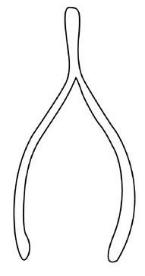
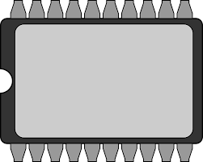
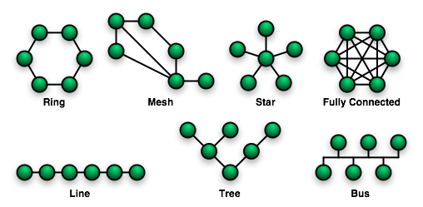
EEE4120F
High Performance
Embedded Systems
Lecture 22
Memories Controllers (part 2), On-chip Interfacing Standards, Wishbone
Lecturer:
Simon Winberg
wishbone
Attribution-ShareAlike 4.0 International (CC BY-SA 4.0)

Slide 2
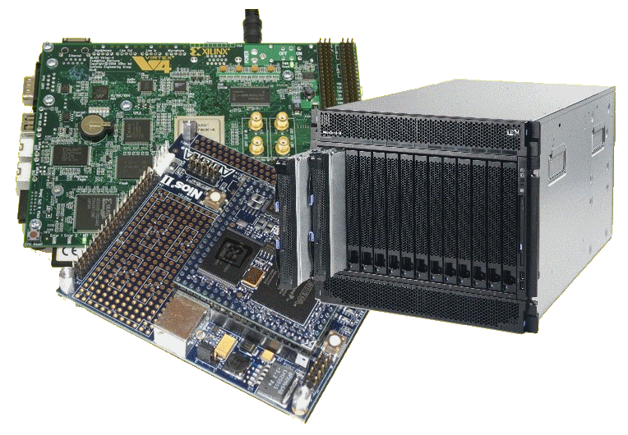
Lecture Overview
Memory Control Units (part 2 of 2)
Dual-port memory control unit
Setting up memory in code & simulation
FIFO and LIFO memory modules
On-chip Interfacing Standards*
Wishbone
The Altera/Intel Avalon Bus
* The topics on these two commonly used interfacing standards are optional (supplementary reading) this year

Slide 3
Memory Controllers (part 2 of 2)
EEE4120F

Slide 4
Dual-port Memory Control Unit half-duplexed channels, one read/one write
This is a usual (implicit handshaking) interface for a memory control unit
clk
we
/
r_data
w_addr
/
Half-duplex
Dual-port
Memory
w_data
/
re
r_addr
/
Note:
The cs port isn’t necessarily needed.
You could simplify this to dropping the re and we (assume always active) and use instead a cs line to decide whether or not to activate the module.
This module allows up to one read and one write simultaneously
It is undefined what the r_data will be if you try and write and read at the same time to the same address (the w_data will get written to the location but the returned read value might be the old or the new value)
cs
Explanation of ports:
clk : clock input
w_addr, w_data : write address and data
r_addr, r_data : read data address and data
we, re : write enable, read enable
cs : chip select (i.e. chip ignores inputs if cs=0)
https://www.edaplayground.com/x/4eSi

Slide 5
Dual-port Memory Control Unit
// a simple dual-port RAM in Verilog
// Test in EDAPlayground at: https://www.edaplayground.com/x/4eSi
module hdp_ram (
clk , // clock input
we , // write enable
w_addr , // write address
w_data , // write data
re , // read enable
r_addr , // read address
cs , // chip select (i.e. chip ignores inputs if cs=0)
r_data // output for read operation
);
// Setup some parameters
parameter DATA_WIDTH = 8; // word size of the memory
parameter ADDR_WIDTH = 8; // number of memory words, e.g. 2^8-1
parameter RAM_DEPTH = 1 << ADDR_WIDTH;
// Define inputs
input clk, we, re, cs;
input [ADDR_WIDTH-1:0] r_addr, w_addr;
input [DATA_WIDTH-1:0] w_data;
output reg [DATA_WIDTH-1:0] r_data;
// Private registers
reg [DATA_WIDTH-1:0] mem [0:RAM_DEPTH-1]; // Set up the memory array
// Write to or read from memory
always@ (posedge clk)
begin
if (cs)
begin
if (we) mem[w_addr] <= w_data;
if (re) r_data <= mem[r_addr];
end
end
endmodule
As you can see, the implementation is easier than the single port MCU as it does not need to use a inout tristate port for the data.
https://www.edaplayground.com/x/4eSi

Slide 6
Dual-port Memory Control Unit Testbench
// EEE4120F Memory Control Unit Example
// Testbench for the dual port dp_ram RAM control memory unit
module hdp_ram_tb ();
reg clk, cs, we, re;
reg [7:0] w_data; // this is the connection to dp_ram write data port
reg [7:0] w_addr; // address to write to
reg [7:0] r_addr; // address to read from
wire [7:0] r_data; // link to data returned on a read
// Instantiate the module to be tested
hdp_ram hdp_ram_uut(clk,we,w_addr,w_data,re,r_addr,cs,r_data);
initial begin
// set up initial conditions
clk = 0; cs = 0; we = 1;
re = 0; r_addr= 1; w_addr= 1;
w_data= 100;
$display("clk cs we re raddr waddr rdata wdata");
$monitor("%b %b %b %b %03d %03d %03d %03d",
clk,cs,we,re,r_addr,w_addr,r_data,w_data);
// set up to write to 100 to [1] and disable read:
cs <= 1; #5 $display("write 100 to [1]"); // (the #5 is here to force the display output)
#5 clk = ~clk; #5 clk = ~clk; // do a clock pulse
re <= 1; w_addr <= 2; w_data <= 101;
#5 $display("write 101 to [2] and read from 1");
#5 clk = ~clk; #5 clk = ~clk; // do a clock pulse
end
endmodule
https://www.edaplayground.com/x/4eSi

Slide 7
Full Dual-port Memory Control Unit full-duplex channels, read&write per channel
This is basically like the dual port memory, but it has a write enable for both data ports, and separate datain and dataout ports so that a dual read or write can be done.
clk
a_we
/
a_rdata
a_addr
/
a_wdata
Full-duplex
Dual-port
Memory
/
b_rdata
/
b_we
b_addr
/
b_wdata
/
Note:
This module supports reading or writing to memory channel a or b at the same time.
cs
Explanation of ports:
clk : clock input
a_we, b_we: write enable/read enable for a,b
a_addr, b_addr : address for channel a and b
a_wdata, b_wdata : data to write for a,b if we=1
a_rdata, b_rdata : data read for a,b if we=0
cs : chip select (i.e. chip ignores inputs if cs=0)
The code for this is fairly easy to construct using the previous examples. See below link to access the code.
https://www.edaplayground.com/x/64Vt

Slide 8
Full Dual-port Memory Control Unit with bidirectional channels
This is basically like the dual port memory, but it has a write enable for both data ports, and separate datain and dataout ports so that a dual read or write can be done.
clk
a_we
a_addr
/
a_data
/
Bidirectional
Dual-port
Memory
b_we
b_addr
/
b_data
/
Note:
This module supports reading or writing to either memory channel a or b at the same time
cs
Explanation of ports:
clk : clock input
a_we, b_we: write enable/read enable for a,b
a_addr, b_addr : address for channel a and b
a_data, b_data : data to write/read for a,b
cs : chip select (i.e. chip ignores inputs if cs=0)
The code for this is fairly easy to construct using the earlier examples of single-port and half-duplex ram. A link to a completed example is below:
https://www.edaplayground.com/x/5d3t

Slide 9
FIFOs and LIFOs (a specialized type of memory)
EEE4120F

Slide 10
FIFOs and LIFOs
First In First Out (FIFO)
These are useful for I/O buffering, e.g. for streaming data from serial
Last In First Out (LIFO) or stack
A stack can be used similarly to how it is used in software, or to sequences operations (e.g. reverse polish calculator).

Slide 11
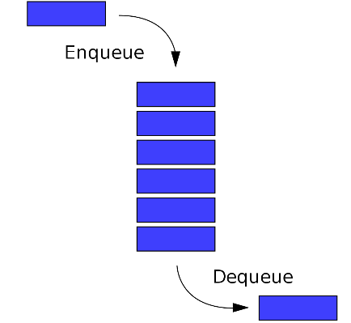
FIFO Verilog Interface
clk
reset
data_out
cs
Synchronized
FIFO
empty
full
FIFO structure
rd_en
wr_en
data_in
/
The module would be designed around a certain size, e.g.:
// 4-element memory array for fifo queue
reg [7:0] fifomem [0:3];
The working of the module would be as expected, the empty line will be high when no data is in the queue, and full will be high when the queue is full. A head and tail wrapping index would likely be used. But, when the queue is full and a new item is added, the head and tail would both need to increment to make the last item ‘fall’ out of the queue.
module sfifo (
clk , // Clock input
reset , // high reset
cs , // chip select
rd_en , // read enable
wr_en , // write enable
data_in , // data input
data_out , // data output
empty , // FIFO empty
full // FIFO full
);

Slide 12
Examples FIFOs online
See example code at:
https://opencores.org/projects/generic_fifos
https://www.fpga4student.com/2017/01/verilog-code-for-fifo-memory.html
Notes on comms: if you are just sending data, and not at a very fast rate, then you probably do not need to worry with a FIFO, to save space. But if you are streaming serial data, where it is a problem to have the accastional missing byte, then you will probably want a FIFO – and likely handshaking logic if not flow control to avoid the potential for data being lost.

Slide 13
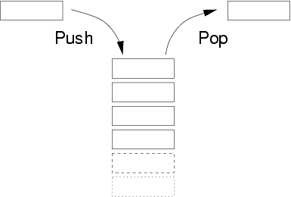
LIFO Interface
clk
reset
data_out
empty
LIFO structure
cs
Synchronized
LIFO
rd_en
full
wr_en
data_in
/
The module can use the same interface as a FIFO, it’s just that the internal workings will be such that input will be extracted in the reverse order that they are put into the stack. A top index (as apposed to a head and tail) would be used. Like the FIFO, the most recent addition is typically the most desirable to keep when the stack is full, so the top pointer will just continue being incremented (wrapping at the last address) which will keep the most recent data in the stack.

Slide 14
Setting up memory in simulation
You could hardcode ROM / initialize RAM, e.g.
Initializing the memory
reg [7:0] mem [7:0] = {
7'b101_1001, // [0]
7'b001_1100, // [1]
7'b101_1011, // [2]
7'b010_1001, // [3]
7'b110_0110, // [4]
7'b011_1001, // [5]
7'b101_1001, // [6]
7'b100_0001, // [7]
};
Using a case statement in a RAM MCU
always @ (re or address)
begin
case (address)
0 : data = 99;
1 : data = 12
2 : data = 140;
3 : data = 110;
…
endcase
end

Slide 15
Initializing memory in simulation (using a macro)
// You can also intialize your memory as follows…
module mymod_tb (); parameter MEM_SIZE = 256 reg [7:0] mem [0:MEM_SIZE -1] initial begin for (i = 0; i < MEM_SIZE - 1; i = i + 1) begin mem[i][0] = 0; end end
endmodule
Note that for used here is usable in simulation and when used to implement a module the for is unravelled to generate logic, it does not necessarily handle loop dependencies well.

Slide 16
Initializing memory in simulation (reading from file)
Usually the simulator expects mem.csv to have numbers in text, one column per row, e.g.:
module rom (
addr , // Address input
data , // Data output
re , // Read Enable
cs // Chip Select
);
input [7:0] addr;
output [7:0] data;
input re, cs;
reg [7:0] mem [0:255] ;
assign data = (cs && re)? mem[addr] : 8'b0;
initial begin
$readmemb("mem.csv", mem); // mem.csv is memory file
end
endmodule
mem.csv:
00000000
00000001
00000010
00000011
….
(stores 0,1,2,3… as binary)

Slide 17
Wishbone bus
Optional supplementary reading
Slides 17 – 34 not examined this year!
A brief view of the wishbone bus architecture
*Image source: ‘book’ PNG Designed By Grafix Point from https://pngtree.com

Slide 18
Interfacing Standards
Optional supplementary reading
The Avalon bus by Altera – Open Standard
Advanced Microcontroller Bus Architecture (AMBA) by ARM – Open Standard
On-chip Peripheral Bus (OPB) by Xilinx
Wishbone bus (originally developed by Silicore Corporation) – Open Standard

Slide 19
Wishbone bus
Optional supplementary reading
A brief view of the wishbone bus architecture

Slide 20
Wishbone
Optional supplementary reading
Initially developed by Silicore Corporation.
OpenCores has chosen to recommend Wishbone compatability for all open IP cores particularly ones added to their repository
The Wishbone bus structure and protocol is not copyrighted and can be freely copied and distributed
Wishbone is made to let designers combine several designs written in Verilog, VHDL or some other HDL for reuse and electronic design automation

Slide 21
Wishbone
Optional supplementary reading
There are two main interfaces for Wishbone:
Master and slave interfaces
Master interface
These are IP cores that are capable of initiating bus use cycles.
Slave interface
These capable of accepting and responding to bus use cycles.
Various interconnection topologies are supported by this standard, including:
Point-to-point connection
Daisy chain / Dataflow interconnection
Shared bus
Hierarchical topology / crossbar switches

Slide 22
Wishbone
Optional supplementary reading
Bus size: 8, 16, 32, 64-bit
Signals are synchronous to a single clock but some slave responses must be generated combinatorial for maximum performance.
Wishbone permits addition of a "tag bus" to describe the data. But reset, simple addressed reads and writes, transfer of data blocks, and indivisible bus cycles all work without tags.
Technically (by decree of OpenCores) “A device does not conform to the Wishbone specification unless it includes a data sheet to describe what it does, bus width, utilization, etc”. This promotes reuse of design.
Information Source: https://en.wikipedia.org/wiki/Wishbone_(computer_bus

Slide 23
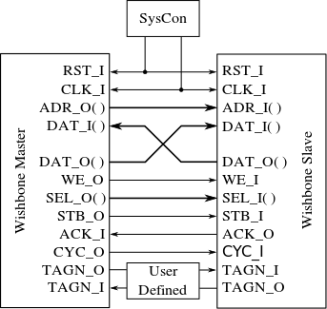
Wishbone – the interface
Optional supplementary reading
Global signals / SysCon control module
CLK_O : system clock output generated by SysCon module. It coordinates all activities for the internal logic. Connects to CLK_I on MASTER and SLAVE
RST_O: The reset output generated by the SysCon module. Forces all Wishbone interfaces to restart. All internal self-starting state machines are forced into an initial state.
RST_O
CLK_O
Standard connection for timing diagrams.
Image source: https://en.wikipedia.org/wiki/Wishbone_(computer_bus)

Slide 24
Wishbone – the interface
Optional supplementary reading
Signals Common to MASTER and SLAVE Interfaces
CLK_I: The clock input, coordinates all activities for the internal logic within the Wishbone interconnect.
All Wishbone input signals are stable before the rising edge of CLK_I.
Wishbone output signals are registered at the rising edge of CLK_I
RST_O
CLK_O
Standard connection for timing diagrams.

Slide 25
Wishbone – the interface
Optional supplementary reading
Signals Common to MASTER and SLAVE Interfaces
RST_I: Force Wishbone interface to restart.
DAT_I: Data input port to slave/master. The bus size is
determined by the port size (8, 16, 32 or 64-bit).
DAT_O: Data output port used. Bus size as above, max 64bits.
RST_O
CLK_O
Standard connection for timing diagrams.

Slide 26
Wishbone – the interface
Optional supplementary reading
Signals Common to MASTER and SLAVE Interfaces
TGD_I: Tag for Data. Contains information that is associated with the data input array (e.g. type of data sent), and is qualified by signal STB_I. e.g. parity protection, error correction and time stamp information can be attached to the data bus. These tag bits simplify the task of defining new signals because their timing (in relation to every bus cycle) is pre-defined by this specification. The name and operation of a data tag must be defined in the Wishbone Datasheet for the device.
TGD_O: as per above for output
RST_O
CLK_O
Standard connection for timing diagrams.

Slide 27
Wishbone – the interface
Optional supplementary reading
MASTER Interfaces
ACK_I: Acknowledge input, indicates the normal termination of a bus cycle (see also ERR_I & RTY_I for exception handling)
ADR_O: The address output bus, used to indicate address if device accessed.
CYC_O: The cycle output marker.
When asserted, indicates a valid bus cycle is in progress.
Signal is asserted for duration of all bus cycles. (e.g. during block transfer CYC_O is asserted for first data transfer and remains asserted to last data transfer)
Useful for interfaces with multi-port interfaces such as dual port memories.
Standard connection for timing diagrams.

Slide 28
Wishbone – the interface
Optional supplementary reading
MASTER Interfaces
WE_O: Write enable output indicates whether the current local bus cycle is a READ or WRITE cycle. The signal is negated during READ cycles, and is asserted during WRITE cycles.
SEL_O: The select output array indicates:
when valid data is expected on the DAT_I bus during READ cycles, and
when it is placed on the DAT_O signal array during WRITE cycles.
STB_O: The strobe output indicates a valid data transfer cycle. Qualifies various other signals on the interface such as SEL_O.
The SLAVE asserts either ACK_I, ERR_I or RTY_I in response to every assertion of STB_O by master.
Standard connection for timing diagrams.

Slide 29
Wishbone – the interface
Optional supplementary reading
MASTER Interfaces – special error handing signals
STALL_I: pipeline stall input indicates current slave is not able to accept the transfer in the transaction queue (used in pipelined mode). ERR_I: indicates an abnormal cycle termination.
LOCK_O: The lock output when asserted indicates the current bus cycle is uninterruptible. Lock is asserted to request complete ownership of the bus.
RTY_I: The retry input indicates the interface is not ready to accept or send data, and that the cycle should be retried. (when and how the cycle is retried is defined by the IP core supplier).
Standard connection for timing diagrams.

Slide 30
Wishbone – the interface
Optional supplementary reading
SLAVE Interfaces
ACK_O: Acknowledge output, when asserted, indicates the termination of a normal bus cycle.
ADR_I: Address input array passes a binary address. Bus size is specific to the address width of the core. NB: Lower array boundary is determined by the data port size. E.g. 32-bit data port has ADR_O [31:2].
CYC_I: When asserted, indicates that a valid bus cycle is in progress
Standard connection for timing diagrams.

Slide 31
Wishbone reset
Optional supplementary reading
Reset can be asserted for any length of time
All Wishbone interfaces must initialize themselves at the rising CLK_I edge following the assertion of RST_I.
They must stay in the initialized state until the rising CLK_I edge that follows the negation of RST_I.
RST_I must be asserted for at least one complete clock cycle.
Note: CLK_I line schedules the process as to by when signals are asserted and sensed (e.g. the order of asserting STB_O and CYC_I is arbitrary, but must be done before a positive clock edge)
There is method in this clock-triggered approach because it simplifies the interfacing logic and the statemachines for the master and slave by having them only trigged by posedge CLK_I and not anything else (FPGAs typically are designed around making the clock accessible and synched, also save space for other modules).

Slide 32
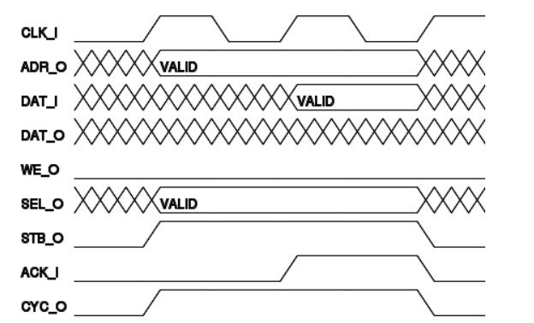
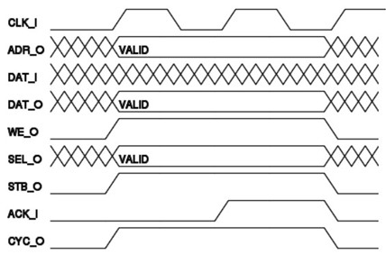
Wishbone Standard Read/Write Cycle
Optional supplementary reading
MASTER initiate a transfer cycle by asserting CYC_O
MASTER MUST assert CYC_O for the duration of READ/WRITE cycle
MASTER asserts STB_O when ready to transfer data
STB_O remains asserted until SLAVE asserts one of the cycle terminating signals ACK_I], ERR_I or RTY_I
At every rising edge of CLK_I the slave/master samples the signals and must respond by asserting relevant signals before the next rising clock edge.
Slave will sense signals here
Slave must
assert signals before here
Slave will sense signals here
Slave must
assert signals before here
Master senses signals here
Standard SINGLE WRITE cycle
Standard SINGLE READ cycle

Slide 33
Wishbone examples / templates
Optional supplementary reading
Recommended
Simple starting point provided by OpenCores: https://opencores.org/forum,Cores,0,608

Slide 34
Altera/Intel Avalon Bus
Optional supplementary reading
Altera Avalon interface bus used as Nios embedded processor peripheral bus
Designed (originally) to accommodate peripheral development for the System-On-a-Programmable-Chip (SOPC) environment.
Qsys now replaces SOPC tool
The generated switch fabric logic includes several chip select signals for
data-path multiplexing, address decoding, wait-state generation, interrupt-priority assignment, dynamic-bus sizing, multi-muster arbitration logic and advanced switch fabric transfer.
Mainly intended for implemented on Altera devices using Qsys / SOPC Builder
Avalon Bus is generated automatically, when a new Nios core with peripherals is created in Sys/SOPC-builder
Is an open standard (can develop own Avalon modules)

Slide 35
End of Lecture
Any Question??

Slide 36
Disclaimers and copyright/licensing details
I have tried to follow the correct practices concerning copyright and licensing of material, particularly image sources that have been used in this presentation. I have put much effort into trying to make this material open access so that it can be of benefit to others in their teaching and learning practice. Any mistakes or omissions with regards to these issues I will correct when notified. To the best of my understanding the material in these slides can be shared according to the Creative Commons “Attribution-ShareAlike 4.0 International (CC BY-SA 4.0)” license, and that is why I selected that license to apply to this presentation (it’s not because I particularly want my slides referenced but more to acknowledge the sources and generosity of others who have provided free material such as the images I have used).
Image sources:
man working on laptop – flickr
scroll, video reel, big question mark – Pixabay http://pixabay.com/ (public domain)
some diagrammatic elements are from Xilinx ISE screenshots
book icon - https://pngtree.com
https://commons.wikimedia.org/wiki/Category:Images (creative commons)

