Slide 1
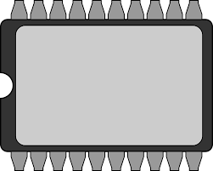
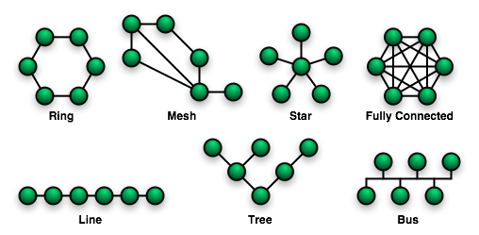
EEE4120F
High Performance
Embedded Systems
Lecture 21
On-chip Interconnection, Memory types,
Memory Control Units (part1)
FLASH
Lecturer:
Simon Winberg
RAM
ROM
Attribution-ShareAlike 4.0 International (CC BY-SA 4.0)

Slide 2
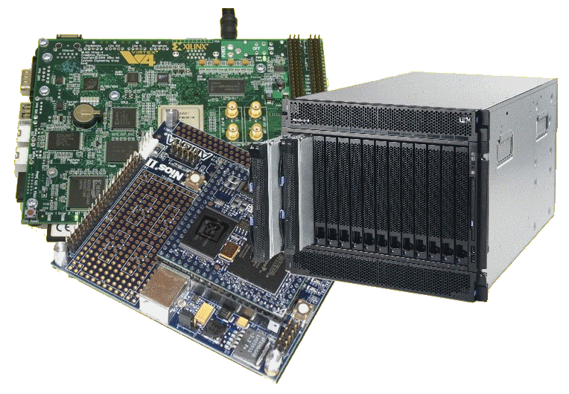
Lecture Overview
On-chip interconnection bus topologies
Interfacing standards
Memory types
Memory Control Units (part 1 of 2)
Using Memory & MCU in Verilog
Comments on this topic:
These are aspects a computer engineer or an embedded systems developer should know about. Regards of which YODA project chosen, the first three parts are relevant to both OpenCL or FPGA. The last three parts (covering the bulk of this lecture) is more closely relevant to FPGA-based, and special-purpose computer, development techniques.

Slide 3
On-chip communication topologies
EEE4120F
Thoughts on how you can get your on-chip processing ‘civilization’ working together effectively (if not creatively) and surviving.

Slide 4
On-chip interconnection topologies
Point-to-point direct coupling (or dedicated peer interface)
One-to-one connection, or one to many
Benefits: simple (simplest, isn’t really a bus), fast, allows high bandwidth, low area, quick & easy, low power (closely coupled), efficient to implement (no need for driver lines, separate arbitrator etc.).
Drawbacks: only direct connections. Often non-standard control lines.
(may lead to daisy chaining)

Slide 5
On-chip daisy chain topologies / dataflow interconnects
Chain of point-to-point directly coupled links
A sequence of one-to-one connections
Benefits: (fairly) simple, natural approach for much signal processing (feed forward data flow), supports pipelining, fast neighbour links allows high bandwidth, low area, typically no need for separate arbitrator (if sequenced right).
Drawbacks: Comprise only direct links between neighbours. Often non-standard control lines. Challenges in different processing speeds for each core (can lead to trickey buffering).
(may lead towards ring topology)

Slide 6
On-chip bus topologies
Shared bus topology
Multiple masters and slaves on a shared bus.
Requires a bus arbiter (or bus arbitrator module, the BAM; ‘master’ could be this)
Benefits: simple, extensible, low area cost, easy to build & efficient to implement.
Drawbacks: Larger load per data bus line, longer delay for data transfer, larger energy consumption, and lower bandwidth.
(see next lecture for more on this)

Slide 7
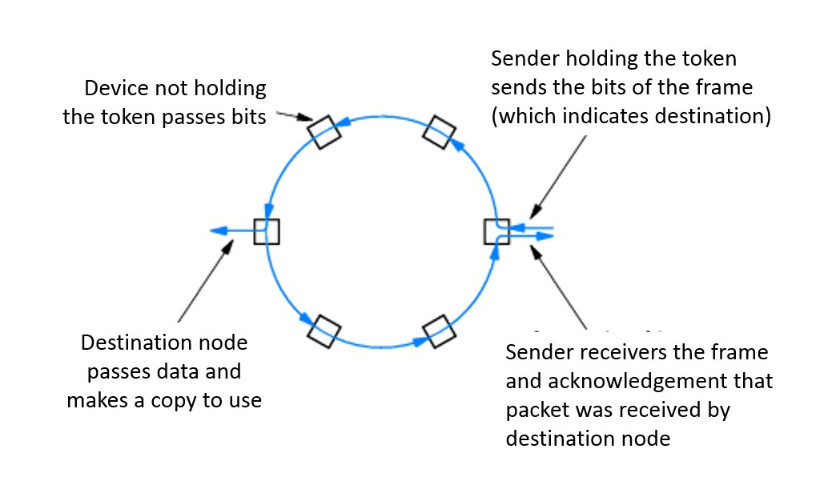
On-chip bus topologies
Ring topology
Each node alternates between master/slave to receive and transmit over the ring interface.
Need a ring communication protocol, usually a token-pass protocol.
Benefits: somewhat scalable; comprises only closely-coupled connections between neighbouring devices (i.e., not all components needing to be coupled to the same bus lines); Low power for driving signals (not needing to drive signals far and to many receivers); Possibly higher bandwidths.
Drawbacks: limited scalability; potentially high latencies (long delay between getting token and forwarding data), and possibly lower bandwidth. May cause collectively higher power (due to having to relay signals, albeit each relay using little power)

Slide 8
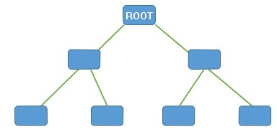
On-chip bus topologies
Hierarchical bus:
Several shared buses interconnected by bridges forming a hierarchy / tree.
Components placed at an appropriate level in the hierarchy according to the performance level they require and which nodes they speak to.
Disadvantages: Transactions across the bridge involve additional overhead; during transfer both buses inaccessible to other nodes.
Advantages: Larger throughput using this model (than simple bus) because:
Decreased load per bus segment,
Potential for simultaneous parallel transactions on different buses
Multiple transfers can be preceded bridges in a pipelined manner.
BRIDGE

Slide 9
Interfacing Standards
The Avalon bus by Altera – Open Standard
Advanced Microcontroller Bus Architecture (AMBA) by ARM – Open Standard
On-chip Peripheral Bus (OPB) by Xilinx
Wishbone bus (originally developed by Silicore Corporation) – Open Standard
(see next lecture for more on this)

Slide 10
Memories (recap)
FLASH
RAM
ROM
EEE4120F
What you learned previously about memories and memory types (e.g. in ES2) are of course relevant to FPGA-based embedded systems as well. A super fast recap of the essential points follows…

Slide 11
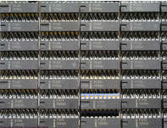
Memory types
Rather forgetful, but with volatile memory can get things done.
Volatile
Non-volatile
ES Engineer
0K Volatile
0K Non-volatile
Knowledge
Knowledge
Bank
Bank

Slide 12
Volatile memory
DRAM
Capacitor stores “memory” that leaks away and needs to be periodically refreshed
High memory capacity
SDRAM = Synchronous DRAM
Runs in synch with system* clock
DDR SDRAM = Double-data rate SDRAM, runs at 2x the system clock
* Note the system clock in this case is closer to the “motherboard” clock. Usually considerably slower than the processor clock (standard DRAM may have its own even slower clock and synchronization hassles)

Slide 13
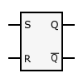
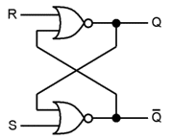
Volatile memory
SR Latch to hold
a bit of SRAM *
SRAM
Static RAM
Does not need refreshing
Uses “bistable latching circuitry” (i.e. a flip flop) to store each bit
Can be very fast compared to DRAM
A small amount of SRAM (~16 Kb) is typically used within a microcontroller / FPGA to hold things such as a boot loader and interrupt vectors, and as CACHE
SR Latch implemented using two NOR gates *
* Images from http://en.wikipedia.org/wiki/Latch_(electronics)

Slide 14
Volatile Memory
BRAM or Block RAM
This refers to a small block of RAM (a few Kilobytes) integrated within the FPGA (connected some LBs)
Generally only found in higher-end FPGAs (e.g. 16Kb takes ~ 256K transistors if not more for connection and addressing logic)
Block SRAM is more common and easier to use; the FPGA may include Block DRAM
Generally can be set to RAM or ROM
As ROM it can be used as a (big) LUT
Usually not directly accessible form outside the FPGA (need to provide circuitry / softcore and comms protocol to access it from a PC)

Slide 15
Volatile memory
Under development
Z-RAM : Zero-capacitor RAM
Single transistor
Higher density than DRAM
Although it is called zero-capacitor, the capacitor is actually there in the form of a “floating body effect” caused by the transistor substrate
See: http://www.innovativesilicon.com/

Slide 16
Non-Volatile Memory types
Now things are looking better.. both volatile and non-volatile allows more smarts and longer-term benefit.
ES Engineer
0K Volatile
0K Non-volatile
Knowledge
Knowledge
Bank
Bank

Slide 17
Non-Volatile memory
Trusty old ROM and EEPROM
Still widely used as it is highly robust
Current versions store large amounts of data
Fairly simple technology (i.e. fused connections) and (in EEPROM ability to fuse and then program/un-fuse connections)
Usually ROM is slower than RAM
Shadowing ROM (i.e. copy to RAM) to make it faster – especially for EEPROMs
EEPROM very slow write; faster read

Slide 18
Non-Volatile Memory
Flash memory
Can be electrically erased and programmed
High capacity (e.g., millions of bytes/chip)
Needs to be programmed one block at a time (~8Kb / block)
Erased (all bits in block set to 1)
Programmed one block at a time
Memory wear
Limited to about 100,000 erase – write cycles
Usually a file system (e.g. ext3) will keep track of bad sectors (i.e., mark deteriorated blocks). But this deterioration might happen a certain time after the erase and write is complete and verified.

Slide 19
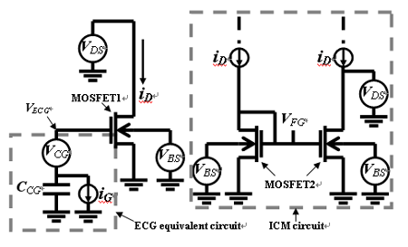
NAND Flash memory model
(don’t need to know for examination)
Image source: IEEE Electron Device Letters, Vol. 26, No. 8, AUGUST 2005, pg 564 Available at: http://koasas.kaist.ac.kr/bitstream/10203/1570/1/01468223.pdf
*
The above diagram provides a macro circuit model for a single flash memory cell, showing a Effective-Control-Gate (ECG) equivalent circuit and the Ideal-Current-Mirror (ICM) used to calculate the floating gate (FG*) voltage. MOSFET1 is the equivalent N-MOSFET model of a flash memory cell, and MOSFET2 is the model of a N-MOSFET test structure that is identical with the flash memory cell (excluding the short between FG and CG).

Slide 20
Using Memory in Verilog
EEE4120F

Slide 21
Using memory in Verilog
Very simple approach:
(NB this isn’t explicitly interfacing to a RAM chip or even emulating a memory chip)
parameter DATA_WIDTH = 8; // word size of your memory
parameter RAM_DEPTH = 128; // amount of words you want
reg [DATA_WIDTH-1:0] mem [0:RAM_DEPTH-1];
And there you go; you can now do operations such as:
mem[addr] = dataword;
dataword = mem[addr];
(write to memory)
(read from memory)

Slide 22
Setting up a Memory module
The array access technique used in the previous slide you probably already knew… and that’s fine if you don’t need to use much data (e.g. < 32Kb)
That array will be more like cache memory; it will be fast, tightly coupled, and eat lots of your logic elements.
What we often need is a memory module that may connect to external memory (i.e. on the platform but not in the FPGA) or large chunks of dedicated memory in the FPGA chip.

Slide 23
Memory Control Unit (part 1 of 2)
EEE4120F

Slide 24
The Memory Control Unit
A memory module or memory control unit (MCU) is used to wrap access to a memory device. It is usually going to use an implicit or explicit handshaking communication, as the access to the memory might not be done at the same speed as the FPGA is clocked. If you are using SRAM it can handle high speed, but, being possibly on a different chip, the memory and your FPGA logic might not be perfectly synchronized.
In these examples we are not actually using external memory, rather BRAM or BROM but we may want multiple modules accessing the same memory, and that is where a memory control unit is needed.

Slide 25
Memory Control Unit Interface
This is a usual (implicit handshaking) interface for a memory control unit
clk
Note: The CS port isn’t necessarily needed.
The oe line is to be able to decide if data is latched to the output data or not
address
data
Memory
cs
we
oe
Explanation of ports:
clk : clock input
address : address of memory to access
data : data word (bi-directional / inout)
cs : chip select (i.e. chip ignores inputs if cs=0)
we : write enable / read enable (if RAM chip)
oe : output enable (a safety precaution to prevent data from returned)
https://www.edaplayground.com/x/2gb7

Slide 26
Memory Control Unit Interface
MCU with dedicated input and output data lines (often easier & more reliable).
This is a usual (implicit handshaking) interface for a memory control unit
clk
address
datain
Memory
dataout
we
oe
Explanation of ports:
clk : clock input
address : address of memory to access
datain : data input
dataout : data output
cs : chip select (i.e. chip ignores inputs if cs=0)
we : write enable / read enable (if RAM chip)
oe : output enable (a safety precaution to prevent data from returned)

Slide 27
Memory Control Unit in Verilog
// RAM control unit
module ramcu (
clk , // Clock Input
address , // Address Input
data , // Data bi-directional
cs , // Chip Select
we , // Write Enable/Read Enable
oe // Output Enable
);
// Setup some parameters
parameter DATA_WIDTH = 8; // word size of the memory
parameter ADDR_WIDTH = 8; // number of memory words, e.g. 2^8-1
parameter RAM_DEPTH = 1 << ADDR_WIDTH; // i.e. RAM_DEPTH = 2^ADDR_WIDTH
// Define inputs
input clk, cs, we, oe;
input [ADDR_WIDTH-1:0] address;
// data is bidirectional
inout [DATA_WIDTH-1:0] data;
// Private registers
reg [DATA_WIDTH-1:0] mem [0:RAM_DEPTH-1]; // Set up the memory array
reg [DATA_WIDTH-1:0] r_data; // copy of data value to return
reg r_oe; // delayed oe, r_oe updates only when rdata updated
// START OF OPERATION: ///////////////////////////////////////////////
// Tri-State Buffer control:
// The data item is defined as an inout, only when oe, output enabled
// is high, should it send a value to data, otherwise it should keep
// the data port linked to high impedence (z) so as not to drive a value.
// i.e. output to data happens when oe = 1 & cs = 1 & we = 0
// Write to memory when: we = 1 & cs = 1
always@ (posedge clk)
begin
if (cs)
begin
if (we) mem[address] <= data;
r_data <= mem[address];
end
r_oe <= oe;
end
assign data = (oe && cs && !we)? r_data : 8'bz;
endmodule // end ramcu
Try it at: https://www.edaplayground.com/x/2gb7

Slide 28
Memory Control Unit Test Bench
// EEE4120F Memory Control Unit Example
// Testbench for the ramcu RAM control unit
module ramcu_tb ();
wire [7:0] data; // this is the connection to ramcu data port
reg [7:0] data_value; // need a register to store value to send on a write
reg clk, cs, we, oe;
reg [7:0] addr;
// Instantiate the module to be tested
ramcu ramcu_uut(clk,addr,data,cs,we,oe);
assign data = !oe ? data_value : 'bz;
initial begin
// set up initial conditions
clk = 0; cs = 0; we = 0; oe = 0; addr = 0;
$display("clk cs we oe addr data");
$monitor("%b %b %b %b %03d %03d",
clk,cs,we,oe,addr,data);
// try doing a clock change just when nothing should happen (cs=0)
#5 clk = ~clk; #5 clk = ~clk;
// let is do a memory write...
// note that you need to deselect the chip before setting up data
$display("write 99 to mem[1]");
oe = 0; we = 1; cs = 1; addr = 8’d1; data_value = 8'd99;
#5 clk = ~clk; #5 clk = ~clk; // do a clock pulse
// now disconnect data_value from data line
$display("write junk into toplevel data_value buffer");
cs = 0; we = 0; oe = 0; data_value = 8'd2;
#5 clk = ~clk; #5 clk = ~clk; // do a clock pulse
// let's read the value back
$display("check reading back data");
addr = 8’d1; cs = 1; we = 0; oe = 1; // ask module to write out data
#5 clk = ~clk; #5 clk = ~clk; // do a clock pulse (reads the data)
// you should now have back the value that was written to memory
// disable chip select and write some more junk to local buffer
$display("write more junk into toplevel data_value");
cs = 0; data_value = 8'd123;
#5 clk = ~clk; #5 clk = ~clk; // do a clock pulse to see what happens
end // end initial
endmodule
// You could add this to the end of the code to see
// what it is memory:
// OPTIONAL: repeat loop to dump part of the memory
addr = 0;
#5
$display("dump some memory:");
repeat (5)
begin
$display("mem[%d]=%d",addr,ramcu_uut.mem[addr]);
addr = addr + 1;
end
Try it at: https://www.edaplayground.com/x/2gb7

Slide 29
End of Lecture
Any Question??

Slide 30
Disclaimers and copyright/licensing details
I have tried to follow the correct practices concerning copyright and licensing of material, particularly image sources that have been used in this presentation. I have put much effort into trying to make this material open access so that it can be of benefit to others in their teaching and learning practice. Any mistakes or omissions with regards to these issues I will correct when notified. To the best of my understanding the material in these slides can be shared according to the Creative Commons “Attribution-ShareAlike 4.0 International (CC BY-SA 4.0)” license, and that is why I selected that license to apply to this presentation (it’s not because I particularly want my slides referenced but more to acknowledge the sources and generosity of others who have provided free material such as the images I have used).
Image sources:
man working on laptop – flickr
scroll, video reel, big question mark – Pixabay http://pixabay.com/ (public domain)
some diagrammatic elements are from Xilinx ISE screenshots
https://commons.wikimedia.org/wiki/Category:Images (creative commons)

