Slide 1



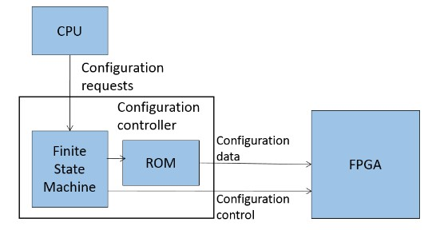
EEE4120F
High Performance
Embedded Systems
Lecture 20
More Verilog. Configuration Architectures. RC Building Blocks (IP Cores), basic handshaking, latches and other interface ingredients
(slide 46 onwards not in syllabus)
Lecturer:
Simon Winberg
Attribution-ShareAlike 4.0 International (CC BY-SA 4.0)

Slide 2
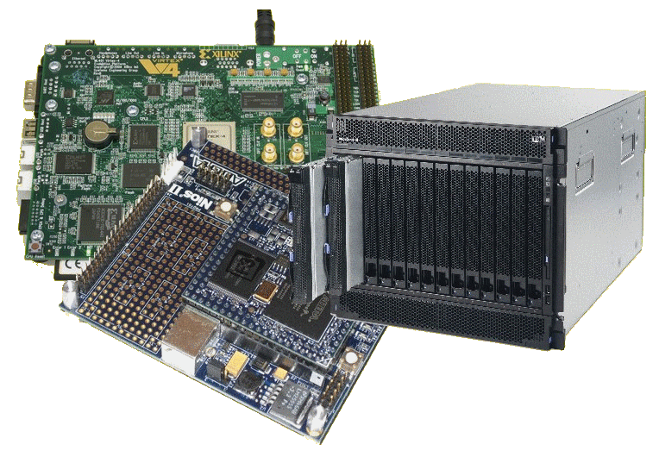
Lecture Overview
When to use assign
Blocking & non-blocking simulation and potential pitfalls
The unconditional always
Configuration architectures
Digital signals,
Interface basics,
Using latches
Large & Small RC
platform case studies

Slide 3


Purpose of this lecture
This lecture provides theories may assist you in the design of your YODA system, how subsystems you may be using in your design might cooperate in a robust and dependable way.
(The configuration architectures section is largely theory you should know about, connecting with thoughts of designing an FPGA into a larger system, but which you aren’t like to use further in this course)
(This lecture includes syllabus topics that is part of HPES, but understandably more immediate practical use of this would be more towards students who select to do a FPGA-based YODA project).
Towards sharpening your digital logic design lightsabre

Slide 4
When to use assign?
Assign is a continuous driver, it essentially links some source on the RHS to a wire
Assign is
  Used outside an always blocks
  Has a net or wire on the LHS
The syntax is:
  always netname <= RHS_expression
Assign is used for driving a source (on the RHS) to some wire or net type element on the LHS.
The wire on the LHS changes value in response to the source driving it, so whenever any source on the RHS changes, the RHS expression is evaluated and assigned to LHS.

Slide 5
Using blocking and non-blocking assignments in simulation
While one typically things to use blocking and non-blocking assignments in implementing cores, it is also useful (almost essential sometimes) for simulation. Consider these examples:
module blocking ();
reg a, b, c, d , e, f ;
// Blocking assignments
initial begin
$monitor("%g a=%b b=%b c=%b",
$time,a,b,c);
a = #10 1'b1;
// sim assigns 1 to a at time 10
b = #20 1'b0;
// sim assigns 0 to b at time 30
c = #30 1'b1;
// sim assigns 1 to c at time 60
end
endmodule
module nonblocking();
reg a, b, c ;
// Nonblocking assignments
initial begin
$monitor("%g a=%b b=%b c=%b",
$time,a,b,c);
a <= #10 1'b1;
// sim assigns 1 to a at time 10
b <= #20 1'b0;
// sim assigns 0 to b at time 20
c <= #30 1'b1;
// sim assigns 1 to c at time 30
end
endmodule
iverilog output:
0 a=x b=x c=x
10 a=1 b=x c=x
30 a=1 b=0 c=x
60 a=1 b=0 c=1
iverilog outpt
0 a=x b=x c=x
10 a=1 b=x c=x
20 a=1 b=0 c=x
30 a=1 b=0 c=1
https://www.edaplayground.com/x/25Yx
https://www.edaplayground.com/x/ars

Slide 6
Potential pitfalls
If blocking assignments are not properly ordered, a race condition could occur
  A race condition is an undesirable situation that may occur when a device attempts to perform two or more operations at the same time, but due to the nature of the device the operations must be done in the proper sequence to be completed correctly.
When blocking assignments are scheduled to execute in the same time step (e.g. in different always blocks), then order of execution is unknown
Example:
always @(posedge clock)
  x = y;
always @(posedge clock)
  y = x;
clock
x
y
 | 10 | 15 | 20 | 25 | 30
Case where the first always block execute first… but maybe just luck.

Slide 7
The unconditional always
The always block does not necessarily need to always have a sensitivity list. In such a case the always block is activated continuously
This is commonly used for simulation, e.g. to generate a clock…
let’s see a quick example

Slide 8
Example: simulating a clock
let’s first implement a module that we want to send a clock to
// Implement a simple 4-bit counter
module counter4 (clock,reset,count);
input clock;
input reset;
output reg[3:0] count;
always @(posedge clock)
begin
if (reset)
count = 0;
else
count = count + 1;
end
endmodule
Run example at: https://www.edaplayground.com/x/28dF

Slide 9
Example: simulating a clock
Now let’s generate some code that first initializes the counter and then sends a clock to it. The clock will have a period of 100 simulation units, and the simulation will terminate after 1000 simulation units.
// generate a simulated clock that is connected to a 4-bit counter
module sim_clockgen (output clock);
parameter half_cycle = 50; // specify 1/2 clock period
parameter max_time = 1000; // max sim units to run for
reg clock; // the simulated clock
reg reset; // the simulated reset line
reg[3:0] count; // counter value to link to counter
initial // let's first reset the clock
begin
// tell the simulator what wires we want to monitor
$monitor("%g clock=%b count=%d",$time,clock,count);
clock <= 0;
reset <= 1; #200
reset <= 0;
end
… // …

Slide 10
Example: simulating a clock
In this simulation we use an unconditional always to generate a clock
// generate a simulated clock that is connected to a 4-bit counter
module sim_clockgen (output clock);
… // …
// here is an unconditional always that continuously runs
always
begin
#half_cycle clock = ~clock;
end
// instantiate the 4-bit counter
counter4 mycounter (clock,reset,count);
initial // tell the simulator when to end
#max_time $finish;
endmodule

Slide 11


Configuration Architectures
RC Architecture
Why cover this topic?
This topic is covered so that you have some understanding of what architectural aspects, outside of the FPGA, is needed in order to enable the programming of an FPGA. Generally, when an FPGA gets turned on, it has no ‘program’, or more accurately, the configuration of its interconnects is not set up; at startup all its interconnects are linked to high impedance to ensure the FPGA doesn’t blow up when you first turn it on. The configuration hardware connects to the FPGA in order to get the FPGA set up and then to start running useful combinational logic.

Slide 12
Configuration Architectures
Configuration architecture =
  Underlying circuitry that loads configuration data and keeps it at the correct locations
Could store pre-configured bitmaps in memory
on the platform without having to send it each time
from the CPU. Include hardware for programming
the hardware (instead of the slower process of e.g.,
programming devices via JTAG from the host)
CPU
Configuration
requests
Configuration
controller
FPGA
Finite State Machine
Configuration
data
ROM
Configuration
control
Adapted from Hauck and Dehon Ch4 (2008)

Slide 13
Configuration Architectures
Larger systems (e.g., the VCC*) may have many FPGAs to be programmed)
Models:
  Sequentially programming FPGAs by shifting in data
  Multi-context – having a MUX choose which FPGA to program
Configuration
clock
FPGA
FPGA
FPGA
Configuration
bit
…
IN
OUT
IN
OUT
IN
OUT
Configuration
enable
Image adapted from Hauck and Dehon Ch4 (2008)
* As in the Virtual Computer Corporation’s (VCC) Virtual Computer (or Virtual Compacted Computer) architecture. See Case Study slides at end of slideshow.

Slide 14
Configuration Architectures
Partially reconfigurable systems
  Not all configurations may need entire chip
  Could leave parts of chips unallocated
  Partial configuration decreases configuration time
  Modifying part of a previously configured system
    E.g., a placement and routing configuration based on a currently configured state
Initial Configuration
Updated Configuration

Slide 15
Configuration Architectures
Block configurable architecture
  Not the same as “logical blocks” in an FPGA
  Relocating configurations to different blocks at run time also referred to as “swappable logic units” (SLUs)
Example: SCORE* relocatable architecture in which configurable blocks are handled in the same way as a virtual memory system
* Capsi & DeHon and Wawrzynek. “A streaming multithreaded model” In Third workshop on media and stream processors. 2001

Slide 16
Optional Additional Reading
(for configuration architectures)
Reading
  Hauck, Scott (1998). “The Roles of FPGAs in Reprogrammable Systems” In Proceedings of the IEEE. 86(4) pp. 615-639.
This optional reading will not examined

Slide 17

RC Building Blocks:
Digital Signals and
Data Transfers
Reconfigurable Computing
Developing reusable gateware components / IP Cores

Slide 18
Overview of digital signals
Although one of our main objective is High Performance and parallelized operation, there are still sequential issues involved… for, example a device B waiting for a device A to provide input.
Furthermore the input to device A might disappear (become invalid) before device A has completed its computations.
Device A
Device B
In
Out
When input to A changes, A’s output may be invalid, yet B might still be busy.
Input might not stay here for the length of time A works on it
Likewise. input to B is changing this output may become invalid / corrupted while read by external device

Slide 19
Overview of digital signals
There are various issues involved such as:
  How does device A know when new data has arrived?
  How does device B know when device A has completed?
  What if both devices need to be clocked, but aren’t active all the time?
  What if you want to share address and data lines?
.. That is where ‘handshaking’ can come to the rescue
Device A
handshaking
lines
Device B
In
Out

Slide 20
Digital logic modular design issues
A sequential logic system typically involves two parts:
  Storage (aka “bistable” device)
  Combinational logic (OR, AND, etc. gates)
INPUTS
Combinational Logic Device
OUTPUTS
Another
combinational logic device(s)
Another
combinational logic device(s)
Data
Data
potentially shared data busses. Possibly 2 separate busses for full-duplex; one for read and one for write
control lines (e.g., do you want to read or write. Are you done setting all the bits. etc.)
Storage

Slide 21

Handshaking – making sure the data gets there
Reconfigurable Computing
Notes:
DMA moved to later lecture

Slide 22
Interface Handshaking basics
Handshaking is a means to ensure reliable transfer of data and/or control between two devices that could be far apart (long latencies between pins) or could be operating at different clock frequencies.
Essentially, handshaking provides additional pins to synchronize the transfer of data, so that data is sent when the receiver is ready.
Handshaking is essentially a form of blocking or synchronous communication (i.e. leading from the lecture series on parallel system design but now in the context of combinational logic designs).

Slide 23
Handshaking
For effective data exchange:
  Sender needs to first know when receiver is able to receive data, and when the data has been successfully received.
  Receiver needs to know when the data is ready to be sent to it, and when the sender has determined that the receiver has acquired the data.

Slide 24
Handshaking
There are many types of handshaking, but they are generally either:
  Explicit handshaking
  Implicit handshaking
Information based on Digilent training resources available at: https://reference.digilentinc.com/learn/courses/unit-3/start

Slide 25
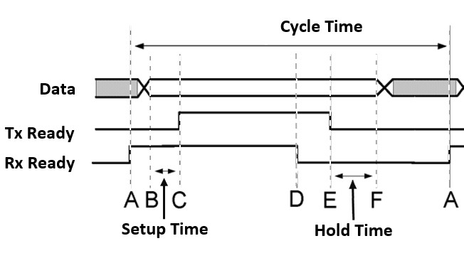
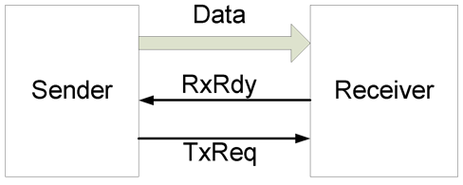
Explicit Handshaking
Explicit handshaking, basic 4-phase handshake:
  This form of handshaking uses dedicated control signals (e.g. Rx Ready and Tx Ready) to indicate the impending action from the sender and readiness of the receiving device.
  The receiving device must indicate when it is ready to receive data, and when it is done.
  The sending device must strobe (tell) the receiving device when new data is ready for it, and when the data is no longer available.
Rx Ready
Tx Ready
Standard 4-phase handshaking

Slide 26
Implicit Handshaking
In terms of implicit handshaking it usually an assumption that the receiver is ready to receive provided timing constraints (such as synchronization with a clock) is met.
Clock
WE
DATA
data written
E.g. devise sending data assume receover will be ready. Data must remain on the bus for at least one clock

Slide 27
Digital Signal Interfaces
Generally need the following
  Address bus
  Data bus
  Control lines
    Chip / Device select lines (CS)
    Write enable lines (WE)
    Read enable lines (RE)
Looks familiar to Embedded Eystems I/O issues?
Well it is! But this time you are deciding the control lines. ☺

Slide 28
Interface / Handshaking Standards
Next lecture we look at a selection of interfacing standards for developing your own reusable IP cores.
We also look at standard memory interfaces and DMA transfers
See SerialStream example to reinforce the handshaking topics presented here
For now though we continue on with some latching and signal capture which are essential ingredients in reliable gateware interfaces

Slide 29
Example: Handshaking in Verilog
Consider that you have system in which a module produces an 8-bit result. But this result, provided as a bus output, needs to stream this byte out as a bit stream (that could be sent to an UART).
The block diagram of this system is provided below illustrating what is needed
GenResult
clk
SerialStream
result
tx
/
8
ask
A positive edge on the ‘ask’ input causes GenResult to produce a result which is then sent to SerialStream
The 8-bit result of GenResult is sent to SrialStream to convert to serial data.
When SerialStream receives the data it sends bit 0 .. 7 of result, each bit on a positive edge of clk. SerialStream should not receive any other input until is has completed this task.

Slide 30
Example: Handshaking in Verilog
BUT there are problems posed in the initial design as is:
GenResult
clk
SerialStream
result
tx
/
8
ask
A positive edge on the ‘ask’ input causes GenResult to produce a result which is then sent to SerialStream
The 8-bit result of GenResult is sent to SrialStream to convert to serial data.
When SerialStream receives the data it sends bit 0 .. 7 of result, each bit on a positive edge of clk. SerialStream should not receive any other input until is has completed this task.
This is, at present, not a very robust design what happens if GenResult is send an ‘ask’ while it is still busy? Does the asker need to know that GenResult has send on the result? What of SerialStream; it should now allow a result to be sent before it is ready to send it. And, how will SerialStream know when it has received a new input, e.g. if you want to send 0 and another 0, how will it know that you want to send two 0s and not just one? No, in summary this initial version of the design is not robust. Propose a better design that uses Handshaking to make it more robust….

Slide 31
Example: Handshaking in Verilog
More robust design for GenResult and SerialStream:
reset
reset
clk
SerialStream
GenResult
ready
ready
we
tx
result
8
ask
/
wa
The ready line is high when GenResult is ready to be sent an ‘ask’. A positive edge on the ‘ask’ input causes GenResult to set ready low, and later produces a result which is then sent to SerialStream
GenResult waits until SerialStream has its ready line high before it sends result. To send a result, write enable (we) is set low. Then result is set. Then we is set high. When serial stream sets ready low and send a write ack (wa), GenResults sets we low (which confirms that the result has been sent to SertialStream). GenResult only sets its ready back to high when SerialStream sets its ready to high.
Initially SerialStream has its ready line high. When we it receives a we it reads data from the result input and then sets ready low. It then sends bit 0 .. 7 of result, each bit on a positive edge of clk. SerialStream sets ready back to high after the last bit has been sent.
Understandably, there are still some shortcomings to this design (e.g. GenResult could do with a timeout incase SertialStream gets stuck), but it is a lot more robust than the earlier design.

Slide 32
GenResult
SerialStream
module GenResult (reset, ask, ss_ready, ss_wa, ss_we, ready, result);
input rese, ask;
input ss_ready, ss_wa;
output reg ss_we;
output reg ready;
output reg [7:0] result;
// private registers
reg handle_ask;
// wait for a reset
always@ (reset)
begin
result <= 10;
ss_we <= 0;
ready <= 1;
handle_ask <= 0;
end
always@ (ask)
begin
if (handle_ask == 0)
begin
if (ss_ready == 1)
begin
handle_ask <= 1;
ready <= 0;
result <= result + 1;
ss_we <= 1;
end
end
end
always@ (posedge ss_wa)
begin
// assume that SerialStream is now busy with
// the request and will raise ready once ready again.
ss_we <= 0; // handshaking, that the write enable has been done
end
always@ (posedge ss_ready)
begin
ss_we <= 0; // just in case we missed the ack
handle_ask <= 0;
ready <= 1;
end
endmodule
module SerialStream (clk, reset, we, result, ready, wa, tx);
input clk, reset;
input we;
input [7:0] result; output reg ready; output reg wa; output reg tx;
// internal registers
reg start; reg endoff;
reg [8:0] mask; reg [7:0] sendb;
reg lower_wa; // used to set wa back to 0 after a clock
always@ (reset)
begin
start <= 0; ready <= 1;
endoff <= 0; tx <= 0;
wa <= 0; lower_wa <= 0;
mask <= 9'b0;
end
// wait for a we to arrive...
always@ (posedge we)
begin
ready <= 0; start <= 1;
mask <= 1; sendb <= result;
wa <= 1; lower_wa <= 1;
end
// wait for a we to arrive...
always@ (posedge clk)
begin
if (endoff == 1)
begin
endoff <= 0;
ready <= 1;
end else
begin // send the next bit
if (sendb & mask) tx = 1; else tx = 0; // not blocking assign
mask = mask << 1;
if (mask == 9'd256) endoff <= 1;
end
if (lower_wa == 1)
begin
wa <= 0;
lower_wa <= 0;
end
end
endmodule
You can access these files at: https://www.edaplayground.com/x/68ZH

Slide 33
Testbench for GenResult and SerialStream
// EEE4120F Example for demonstrating use of handshaking in Verilog
module toplevel_tb ();
// Define registers that will be inputs and outputs to the modules being tested
reg clk; reg reset; reg ask;
wire ss_ready; wire ss_wa;
wire ss_we; wire ready;
wire tx; // wire that connects to some transmit line
wire [7:0] result;
GenResult uut_gr (reset, ask, ss_ready, ss_wa, ss_we, ready, result);
SerialStream uut_ss (clk, reset, ss_we, result, ss_ready, ss_wa, tx);
initial
begin
$display("reset ask ss_ready ss_wa ss_we ready result tx");
$monitor("%b %b %b %b %d %d %d %02d %b",
clk, reset, ask, ss_ready, ss_wa, ss_we, ready, result, tx);
// set up default values for data and control lines
clk = 0;
reset = 1;
ask = 0;
// generate a clock pulse to make sure reset takes
#5 clk = ~clk;
// lower reset
reset = 0;
#5 clk = ~clk;
// ask to generate and set a value
ask <= 1;
#5 clk = ~clk;
ask <= 0;
#5 clk = ~clk;
// run the clock for a while
repeat (30)
begin
#5 clk <= ~clk;
end
end
endmodule
You can access these files at: https://www.edaplayground.com/x/68ZH

Slide 34
Testbench example output (when GenResult sends 11)
reset ask ss_ready ss_wa ss_we ready result tx
0 1 0 1 0 0 1 10 0
1 0 0 1 0 0 1 10 0
0 0 1 0 1 0 0 11 0
1 0 0 0 0 0 0 11 1
0 0 0 0 0 0 0 11 1
1 0 0 0 0 0 0 11 1
0 0 0 0 0 0 0 11 1
1 0 0 0 0 0 0 11 0
0 0 0 0 0 0 0 11 0
1 0 0 0 0 0 0 11 1
0 0 0 0 0 0 0 11 1
1 0 0 0 0 0 0 11 0
0 0 0 0 0 0 0 11 0
1 0 0 0 0 0 0 11 0
0 0 0 0 0 0 0 11 0
1 0 0 0 0 0 0 11 0
0 0 0 0 0 0 0 11 0
1 0 0 0 0 0 0 11 0
0 0 0 0 0 0 0 11 0
1 0 0 1 0 0 1 11 0
0 0 0 1 0 0 1 11 0
SerialStream starts sending here. It’s sending in little endian, i.e. the lowest bit is sent first (which is 1 in the byte 00001011₂ that is sent.
As you can see ss_ready gets set when the 8 bits have been sent.

Slide 35
RC Building Blocks:
Latching
(capturing Signals)
Reconfigurable Computing
Notes:
DMA moved to later lecture

Slide 36
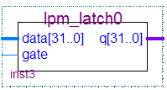
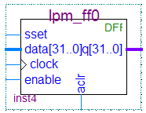
Digital Signal Capture and Storage
In order to capture the signals, you need some storage
Two basic types of storage:
Latches
Flip-flops

Slide 37
Difference between latch and flip-flop
Latches Q = D
  Changes state when the input states change (referred to as “transparency”)
  Can include an enable input bit – in which case the output (Q) is set to D only when the enable input is set.
Flip-flop Q = D (Q changes when clocked)
  A flip-flop only change state when
  the clock is pulsed.

Slide 38
When to use a latch or a flip-flop
Latches are used more in asynchronous designs wire X, Y; assign X <= A; assign Y <= B;
Flip-flips are used in synchronous designs reg X, Y; X = A; Y = B;
A “synchronous design” is a system that contains a clock
You can of course mix synchronous and asynchronous, and this is particularly applicable to parallel systems in which different parts of the system may run at different speeds (e.g., the main processor working at 1GHz and specialized hardware possibly operating asynchronously as fast as their composite pipelined operations are able to complete)

Slide 39
SR Latch
S
S | R | Q | Q
0 | 0 | 1 | 1
0 | 1 | 0 | 1
1 | 0 | 1 | 0
1 | 1 | x | x
Q
R
Q
S-R Latch (set / reset latch)
Symbol
S=R=1 is often called the memory or no-change state, by x I mean the line doesn’t change from what it was before.
A basic NAND latch has two stable states:
State 1 Q = 1 not_Q = 0
State 2 Q = 0 not_Q = 1
And an unstable state in which both S and R are set (which can
cause the Q and not Q lines to toggle)
Example circuit available at: https://www.edaplayground.com/x/P4Sw

Slide 40
Gated SR Latch: a latch with enable
Combinational logic circuit with a clock (or enable) input connected.
Usually, this type used in digital systems.
It of course costs more in transistors!!
or “gate” input
Example signals
Gated SR-Latch
Symbol
Only changed on clock pulse

Slide 41
The JK and D Flip-flops
The standard JK flip-flop is much the same as a gated SR latch, modified so that Q toggles when J = K = 1
JK flip-flop
The D-type flip flop (which you may want to use in Prac5 to store data) is a JK flop flop modified (see left) to hold the state of input D at each clock pulse.
clock | D | Q
0 | 0 | X
1 | 1 | 0
2 | 1 | 1
3 | 0 | 1
… | … | …
D flip-flop

Slide 42
T-type Flip-flop
Clock | T | Q
0 | 1 | 0
1 | 0 | 1
2 | 1 | 1
3 | 0 | 0
… | … | …
The T-type flip-flops toggle the input. Q = not Q each time T is set to 1 when the clock pulses
T flip-flop

Slide 43
Preset and Clocking
Preset line (PR) and clear line (CL) are asynchronous inputs used to set (to 1) or clear the value stored by the flip-flop.
This is a type of structure one may need to use if init blocks were synthesised to initialize register values.

Slide 44
Edge triggered devices
A note on notation:
Edge-triggered inputs are shown using a triangle.
Negative edges triggered inputs are shown without a circle on the incoming line.
in
in
Positive edge triggered
Negative edge triggered

Slide 45
End of Lecture
Any Question??

Slide 46
RC Platform Case Studies
Large & small FPGA-based RC systems
NOT IN EXAM
EEE4120F
(These slides, 46- onwards, planned to be a separate lecture and discussion of these innovative designs)

Slide 47
Why should we look at some
RC Platform Case Studies?
NOT IN
EXAM
This provides some interesting examples of what various companies and research organizations have done with FPGA platforms.
It’s to broaden your perspective on how FPGAs might be used…

Slide 48
List of Case Studies
NOT IN
EXAM
Large-scale FPGA-based RC system examples
  PAM, VCC, Splash
Small-scale FPGA-based RC system examples
  PRISM
  Algotronix CAL,
  XC620,
  Cray Research XD1,
  SRC
  Silicon Graphics RASP

Slide 49
Large-scale RC Systems
NOT IN
EXAM
A look at platforms architectures

Slide 50
Large RC System - PAM
NOT IN
EXAM
Programmable Active Memories (PAM)
  Produced by Digital Equipment Corp (DEC)
  Used Xilinx XC3000 FPGAs
  Independent banks of fast static RAM
SRAM
SRAM
SRAM
SRAM
Host
CPU
FPGA
FPGA
FPGA
FPGA
FPGA
FPGA
FPGA
FPGA
DRAM
SRAM
SRAM
SRAM
SRAM
Digital Equipment Corp. PAM system (1980s)
Image adapted from Hauck and Dehon (2008) Ch3

Slide 51
Large RC System - VCC
NOT IN
EXAM
Virtual Computer Corporation (VCC)*
First commercially commercial RC platform**
Checkerboard layout of
  Xilinx XC4010 devices and
  I-Cube programmable interconnection devices
  SRAM modules on the edges
SRAM
FPGA
FPGA
FPGA
FPGA
…
FPGA
FPGA
SRAM
SRAM
FPGA
I-Cube
FPGA
I-Cube
…
I-Cube
FPGA
SRAM
…
…
…
…
…
…
…
…
SRAM
FPGA
I-Cube
FPGA
I-Cube
…
I-Cube
FPGA
SRAM
VCC Virtual Computer
** Hauck and Dehon (2008)
* The Virtual Computer Corporation’s (VCC) Virtual Computer (or Virtual Compacted Computer) architecture. http://commacorp.com/Virtual_Computer.pdf

Slide 52
Large RC System - Splash
NOT IN
EXAM
Dev. by Super Computer Research (SCR) Center ~1990
Well utilized (compared to previous systems).
Comprised linear array of FPGAs each with own SRAM *
Summary of the Splash system
Developed initially to solve the problem of mapping the human genome and other similar problems. Design follows a reconfigurable linear logic array. The SPLASH aimed to give a Sun computer better than supercomputer performance for a certain types of problems. At the time, the performance of SPLASH was shown to outperform a Cray 2 by a factor of 325. FPGAs were used to build SPLASH, a cross between a specialized hardware board but more flexible like a supercomputer. The SPLASH system consists of software and hardware which plugs into two slots of a Sun workstation. **
Illustration of the
SPLASH design
(adapted from *)
FPGA
FPGA
…
FPGA
SRAM
SRAM
SRAM
…
SRAM
FPGA
Crossbar
Dedicated
controller
FPGA
FPGA
…
FPGA
SRAM
SRAM
…
SRAM
* Hauck and Dehon (2008)
SRC Splash version 2
**Adapted from: Waugh, T.C., "Field programmable gate array key to reconfigurable array outperforming supercomputers," Custom Integrated Circuits Conference, 1991., Proceedings of the IEEE 1991 , vol., no., pp.6.6/1,6.6/4, 12-15 May 1991 doi: 10.1109/CICC.1991.164051

Slide 53
Small-scale RC Systems
NOT IN
EXAM
A look at platforms architectures

Slide 54
Small RC Systems
NOT IN
EXAM
Brown University’s PRISM
  Single FPGA co-processor in each computer in a cluster
  Main CPUs offloading parallelized functions to FPGA
Algotronix
  Configurable Array Logic (CAL) – FPGA featuring very simple logic cells (compared to other FPGAs)
  Later become XC6200 (when CAL bought by Xilinx)
* Hauck and Dehon (2008)

Slide 55
Conclusion & Suggested Reading
NOT IN
EXAM
Reading
  Hauck, Scott (1998). “The Roles of FPGAs in Reprogrammable Systems” In Proceedings of the IEEE. 86(4) pp. 615-639.
This paper by Hauck gives a view on where FPGAs where expected to be utilized and how they could significantly change the way systems are designed. It’s a fairly early paper, considering the short history of FPGAs, and indeed the Hauck’s views are accurate but also underestimates the versatility and the breadth of domains that these technologies have reached.

Slide 56
Disclaimers and copyright/licensing details
I have tried to follow the correct practices concerning copyright and licensing of material, particularly image sources that have been used in this presentation. I have put much effort into trying to make this material open access so that it can be of benefit to others in their teaching and learning practice. Any mistakes or omissions with regards to these issues I will correct when notified. To the best of my understanding the material in these slides can be shared according to the Creative Commons “Attribution-ShareAlike 4.0 International (CC BY-SA 4.0)” license, and that is why I selected that license to apply to this presentation (it’s not because I particularly want my slides referenced but more to acknowledge the sources and generosity of others who have provided free material such as the images I have used).
Image sources:
man working on laptop – flickr
scroll, video reel, big question mark – Pixabay http://pixabay.com/ (public domain)
Processing Gears and Spanner – MaxPixel https://www.maxpixel.net (CC0)
some diagrammatic elements are from Xilinx ISE screenshots
References: Verilog code adapted from
http://www.asic-world.com/examples/verilog

