Slide 1
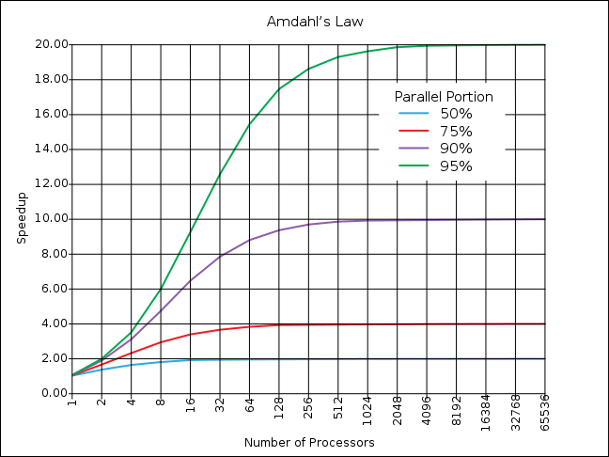
EEE4120F
High Performance
Embedded Systems
Lecture 19
HDL Imitation Method, Benchmarking and Amdahl's for FPGAs
Lecturer:
Simon Winberg
HDL
HDL Imitation
Amdahl’s for FPGA
Attribution-ShareAlike 4.0 International (CC BY-SA 4.0)
Notes:
The HDL Imitation Method … I use sometimes use this when experimenting or exploring potential HDL design solutions. Not, of course, for developing an entire system, only for experimenting with crucial algorithms, or how they might be implemented in a FPGA rather than in software on a CPU. I find that the imitation method can be quicker and easier, allowing full debug functionality such as available in a decent IDE, such as Code::Blocks or Visual Studio.

Slide 2
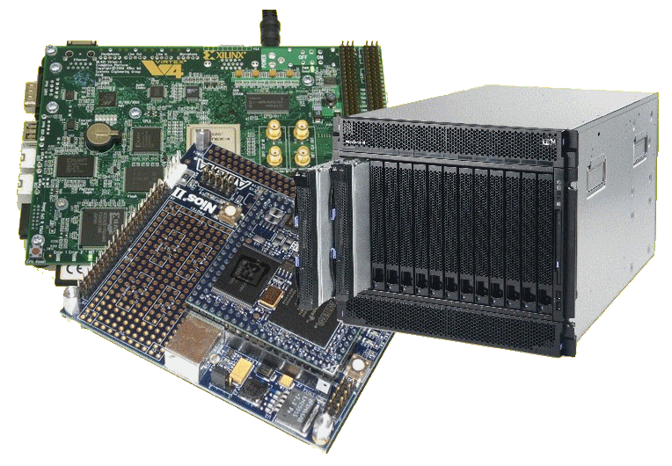
Lecture Overview
HDL Imitation Method
Using Standard Benchmarks for FPGAs
Amdahl’s Law and FPGA
Notes:
I’ll start off by introducing the HDL imitation method, and then (around slide 18) get into aspects of benchmarking – which is typically something one wants to do as part of a development project… and which you will be expected to do in your YODA project, to show how your specialized digital accelerator’s performance would compare to some more standard baseline implementation.
This lecture concludes with a discussion of applying Amdahl’s Law, which was initially aimed around speedup comparison for CPU type processors, to applying this for FPGAs (which can do processing but aren’t necessarily proecssors in the sense of a CPU that runs through instructions).

Slide 3
HDL Imitation Method
or ‘C-before-HDL approach to starting HDL designs.
An approach to ‘golden measures’ & quicker development
C
HDL
void mymod (char* out, char* in)
{
out[0] = in[0]^1;
}
module mymod (output out, input in) {
out = in^1;
}
The same method can work with Python, but C is better suited due to its typical use of pointer.

Slide 4
HDL Imitation Method
This method can be useful in designing both golden measures and HDL modules in (almost) one go …
It is mainly a means to validate that you algorithm is working properly, and to help get into a ‘thinking space’ suited for HDL.
This method is loosely based on approaches for C→HDL automatic conversion (discussed later in the course)

Slide 5
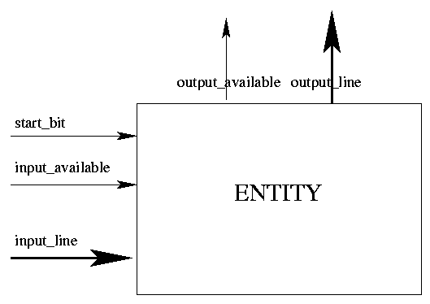
HDL Imitation approach using C
C program: functions; variables;
based on sequence (start to end) and the use of memory/registers operations
VHDL / Verilog HDL:
Implements an entity/module for the procedure
C code converted to VHDL

Slide 6
HDL Imitation in C & good references to review in using this method
Standard C characteristics
Memory-based
Variables (registers) used in performing computation
Normal C and C programs are sequential
Specialized C flavours for parallel description & FPGA programming:
Mitrion-C , SystemC , pC (IBM Parallel C) System Crafter, Impulse C , OpenCL
FpgaC Open-source (http://fpgac.sourceforge.net/) – does generate VHDL/Verilog but directly to bit file

Slide 7
HDL Imitation: where it’s useful
Best to simplify this approach, where possible, to just one module at a time
When you’re confident the HDL works, you could just leave the C version behind
Getting a whole complex design together as both a C-imitating-HDL program and a true HDL implementation is likely not viable (as it may be too much overhead to maintain)

Slide 8
HDL Imitation: Example
Example Task:
Implement an countup module that counts up on target value, increasing its a counter value on each positive clock edge. When the target value is reached set the counter_done flag and stop counting.
Approach:
Sketch the design of the needed module and its interface.
Think what registers are needed, including any regs to test the module.
Write a quick C implementation that can act as both a quick starting point and test of the plan, and which can then be easily converted to HDL.
Test the C program, make sure it is behaving as anticipated.
Covert the program to HDL
Test the HDL and make sure it is also working.
Note: obviously this is a very simple example for illustrative purposes. You are unlikely to use this approach for such simple situations especially once you are feeling confident in HDL coding; but for more complex problems that can be a valuable time-saver and ‘sanity-check’ for your HDL code.

Slide 9
HDL Imitation: Example
Example Task:
Implement an countup module that counts up on target value, increasing its a counter value on each positive clock edge. When the target value is reached set the counter_done flag and stop counting.
1. Sketch the design of the needed module and its interface….
clk
counter_done
enable
/
32
counter
reset
countup
upto
/
32
Design note: In standard Verilog you cannot have global signals. Each module needs to be quite stand-alone, it can only be connected to via its ports; you cannot somehow link to a global register without connecting through a port. You can have a ‘tristate’ register that you can either read or write (like a variable parameter).

Slide 10
HDL Imitation: Example
2. Think what registers are needed, including any regs to test the module.
Looking at the module interface design (copied below) it is clear that we will need to have registers for:
clk : a bit
enable : a bit
reset : a bit
upto : a bus (the same size as counter)
counter : a bus (of 32 bits, could consider it an unsigned int)
counter_done : a bit
The inputs to the module are: clk, enable, reset and upto.
The outputs are: counter and counter_done
Note that here counter is considered an output, the value to be stored within countup.
clk
counter_done
enable
/
32
counter
reset
countup
upto
/
32

Slide 11
HDL Imitation: Example
3. Write a quick C implementation that can act as both a quick starting point and test of the plan, and which can then be easily converted to HDL.
We can start with implementing the module… then we can think about implementing the testbench, essentially same approach as using Verilog.
// Modules to test //////////////////////////////////
void countup (
// inputs:
bit clk, bit enabled, bit reset, UNSIGNED_BUS upto,
// outputs
UNSIGNED_BUS& counter, // note would be defined as reg in countup, i.e. stores value
bit& counter_done )
{
static bit reached;
// check if reset
if (reset.now == 1) {
counter = 0;
CLR(reached); // not yey reached the upto target
} else
// this would be an always@ in Verilog....
if (POSEDGE(clk)) {
if ((enabled.now == 1) && (reached.now==0)) {
counter = counter + 1;
if (counter==upto) {
SET(counter_done);
SET(reached);
}
} // end if enabled==0
}
}
Note the .now is explained in a moment, as is CLR, SET and POSEDGE.
As well as why ‘&’ is there.

Slide 12
(explaining the C macros used in previous HDL imitation code)
For bits we usually want to know if it has changed, if there was a posedge or negedge so we need the previous value, thus using a struct.
// define a bit type
typedef struct bit_struct {
unsigned char pre, now;
} bit;
// define a unsigned bus type, for unsigned values
typedef unsigned UNSIGNED_BUS;
// define a bus type
typedef int SIGNED_BUS;
#define SET(x) {x.pre=x.now; x.now=1;}
#define CLR(x) {x.pre=x.now; x.now=0;}
#define TOGGLE(x) {x.pre=x.now; x.now=!x.now;}
#define POSEDGE(x) (x.now>x.pre)
#define NEGEDGE(x) (x.pre<x.now)
This is to more remind us that we need to implement this as a bus, e.g. input [31:0] bus;
Since we defined a bit type we need some operations for that. I we used proper C++, a bit class could have been implemented to do the same thing more elegantly. In Verilog you define a function for each of these so that the code looks the same.
This is the equivalent of a positive and negative edge, since we know the previous value of a bit. Again, if we used C++ this could become a function that receives a bit as input

Slide 13
HDL Imitation: Example
4. Test the C program, make sure it is behaving as anticipated.
For this we essentially need to write a testbench for the imitated module.
int main() {
// Define output and inputs for top-level module
unsigned n_clk; // for iterating clock pulses
bit clk; // clock bit
// registers to be used to pass to 'toplevel' module to test
UNSIGNED_BUS counter, upto;
bit enable, reset, counter_done;
// initialize values, this is kind of equivalent initial block in Verilog...
CLR(clk); // remember we defined CLR to do equivalent of Verilog clk=0
CLR(counter_done); SET(reset); SET(enable);
counter = 0; upto = 10; // set target to count up to
// print tables of register log
printf("clk,counter,counter_done\n");
// clock iterator
for (n_clk=0; n_clk<CLOCKS; n_clk++) {
// this is somewhat like a monitor statement
printf(" %d,%07d,%01d\n",clk.now,counter,counter_done.now);
// call te top-level module to be tested
countup(clk,enable,reset,upto,counter,counter_done);
// toggle the clock
TOGGLE(clk);
// see if a few clocks have passed to lower reset
if (n_clk == 2) CLR(reset);
}
return 0;
}
Note here we are kind of setting the simulation duration by having a counter for the number of clocks (n_clk) to iterate through.

Slide 14
HDL Imitation: Example
$ CasHDL
Test C-like-HDL Module!
clk,counter,counter_done
0,0000000,0
1,0000000,0
0,0000000,0
1,0000000,0
0,0000001,0
1,0000001,0
0,0000002,0
1,0000002,0
…
0,0000009,0
1,0000009,0
0,0000010,1
1,0000010,1
0,0000010,1
…
0,0000010,1
1,0000010,1
Running the result
And you can see from this log that the program words as anticipated, after counter reaches 10 (the upto value) it stops counting up.
So this basically means that you C program is working properly. It would then be a matter of translating the C into Verilog….

Slide 15
HDL Imitation: Example
// Countup module counts up to 'upto' value
module countup (
// inputs:
clk, enabled, reset, upto,
// outputs
counter, counter_done );
// toplevel module to test
input clk, enabled, reset;
input [31:0] upto;
output reg counter_done;
// local regsiters
reg reached;
output reg [31:0] counter;
always@(reset or posedge(clk))
begin
// check if reset
if (reset == 1) begin
counter = 31'b0;
reached = 0; // not yet reached the upto target
counter_done = 0;
end else
// this would be an always@ in Verilog....
if ((enabled==1) & (reached==0)) begin
counter = counter + 1;
if (counter==upto) begin
counter_done <= 1;
reached=1;
end
end // end if done==0
end // always
endmodule
5. Covert the program to HDL
Try on: https://www.edaplayground.com/x/4ELg

Slide 16
HDL Imitation: Example
// countup_tb testbench
module countup_tb ();
wire [31:0]counter;
reg [31:0] upto;
reg enable;
reg reset;
reg clk;
wire counter_done;
// instantiate the module
countup uut (clk,enable,reset,upto,counter,counter_done);
initial
begin
$monitor("%b %d %b",clk,counter,counter_done); // Print the welcome message
clk = 0;
reset = 1;
enable = 1;
upto = 10; // set target to count up to
#5 clk = ~clk; // apply the reset
reset = 0;
#5 clk = ~clk; // apply the dropped reset
repeat (20) // print tables of register log
begin
#5 clk = ~clk;
end
end
endmodule
6. Test the HDL and make sure it is also working.
Let’s see what happens when run…
Try on: https://www.edaplayground.com/x/4ELg

Slide 17
HDL Imitation: Example
iverilog '-Wall' '-g2012' design.sv testbench.sv && unbuffer vvp a.out 0 0 0 1 1 0 0 1 0 1 2 0 0 2 0 1 3 0 0 3 0 1 4 0 0 4 0 1 5 0 0 5 0 1 6 0 0 6 0 1 7 0 0 7 0 1 8 0 0 8 0 1 9 0 0 9 0 1 10 1 0 10 1 1 10 1 0 10 1 Done
Test the HDL and make sure it is also working. (run the Verilog version to see same result as for C version)
$ CasHDL
Test C-like-HDL Module!
0,0000000,0
1,0000000,0
…
0,0000002,0
1,0000002,0
…
0,0000009,0
1,0000009,0
0,0000010,1
1,0000010,1
0,0000010,1
…
0,0000010,1
1,0000010,1
Can see that they both deliver the same result, equivalent operation.

Slide 18
Benchmarking HDL
&
Amdahl’s for FPGA

Slide 19
But First …
A Terminology Moment

Slide 20
Terminology buffs?
Every heard of DMIPS?
In relation to a VAX?
How bizarre… how is that possibly of any relevance to HPEC or FPGAs?...
Well, let’s find out in the next slide …

Slide 21
Why MIPS and FLOPS are not enough
Limitations of MIPS and FLOPS
MIPS alone are not all that meaningful for benchmarking because 1 CISC instruction may be worth many RISC instructions (but the CISC might still complete the task faster)
Similarly MFLOPS alone, while a bit more useful, do not give a sufficiently full picture, the processor could do lots of FLOPS but be low on other things (e.g. memory operations)
DMIPS =
Dhrystone MIPS (Million Instructions Per Second). Shows number of iterations of the Dhrystone loop repeated per second. More holistic performance measure aligned to likely processing needs
DMIPS = Dhrystone_score / 1,757
The value 1,757 is the number of Dhrystones per second obtained on the VAX 11/780, nominally a 1 MIPS machine

Slide 22
Whetstone, Dhrystone and CoreMark
I’ll explain each of these …

Slide 23
Whetstone, Dhrystone and CoreMark
Whetstone is a collection of commonly used computation tasks, repeated in a loop, and the time the loop takes to complete equates to the Whetstone rating.
For further details see:
http://www.coremark.org/home.php

Slide 24
Whetstone, Dhrystone and CoreMark
The Dhrystone benchmark contains no floating point operations; it is works similarly to the Whetstone, but uses computations appropriate for fixed-point or integer based applications.
For further details see:
http://www.coremark.org/home.php

Slide 25
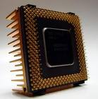
Whetstone, Dhrystone and CoreMark
CoreMark is a smaller benchmark
Developed by the Embedded Microprocessor Benchmark Consortium (EEMBC)
Focuses on the CPU core, similar to Dhrystone.
CoreMark is intended to
Execute on any processor, incl. small micro-controllers.
Avoid issues such as the compiler computing the work during compile time
Use real algorithms rather than being mostly synthetic.
CoreMark has established rules for running the benchmark and for reporting the results.
For further details see:
http://www.coremark.org/home.php

Slide 26
Relevance to FPGA
Clearly Whetstone, Dhrystone and CoreMark are relevant to HPC generally (and were originally developed with microprocessors in mind)
HOWEVER: These techniques apply to FPGAs as well, especially nowadays where you may want to use an FPGA for e.g. intensive signal processing and want to compare your FPGA implementation to a more standard CPU implementation.

Slide 27
Using Dhrystone with an FPGA
(a case study)
Hint: if you want to be rather ambitious and fancy you might consider using a benchmark approach similar to this in your YODA project!

Slide 28
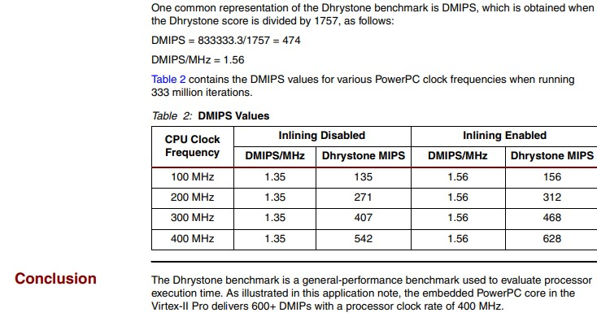
Using Dhrystone with an FPGA
Case
Study
Example of when & why you might use a benchmark such as Dhrystone on a FPGA.
The below right presents results on an investigation by Glover (2005) on running the PowerPC softcore processor on an FPGA using different configurations. As you can see, the Dhrystone performance of the platform in response to increased clock speed was pretty much 1:1. This was not necessarily expected as increasing the clock could cause higher temperatures and greater resistance in gate delays.
Clock Increase | Clock Speed (MHz) | DMIPS | Perfect linear
1 | 100 | 135 | -
2 | 200 | 271 | 270
3 | 300 | 407 | 406.5
4 | 400 | 542 | 542.531
Ref source: “Running the Dhrystone 2.1 Benchmark on a Virtex-II Pro PowerPC Processor” by Paul Glover, 2005.
Available: https://www.xilinx.com/support/documentation/application_notes/xapp507.pdf

Slide 29
Applying Amdahl to FPGAs
(a case study)
Hint: you might want to consider using this sort of approach in your YODA project!
Another hint …. Your lecture might well be infatuated with this topic of applying Amdahl to FPGAs, so it might well appear in a test or exam ☺

Slide 30
Applying Amdahl to FPGAs
When contrasting FPGA-based solutions to CPU-based solutions, in considering speedup of an operation, the comparison is likely around a multicore perspective, i.e. looking at both the FPGA side and CPU side fitting in with Flynn’s MIMD model (i.e. multiple instructions on multiple different data source – see diagram on right).
Instruction Pool
Speedup = T_{p1} /T_{p2}
Where
T_{p1} = Run-time of original (or non-optimized) program
T_{p2} = Run-time of optimised program
core
core
Amdahl’s Law
1
Data Pool
Speedup_{parallel} =
f
core
( 1 – f ) +
n
core
f = fraction of computation that can be parallelized
1-f = fraction that cannot be parallelized / startup

Slide 31
Applying Amdahl to FPGAs
CPU-based
FPGA-based
Initialization
Loading in the data
Creating the threads
Data partitioning
Starting the threads
Parallel Work
Threads working on tasks
Possible comms/IO blocks
Join / finalizing (if need)
Waiting for threads to complete
Combining results etc.
Initialization / start-up
Programming the FPGA
Reset operations
Host->FPGA comms; configuring cores (setting parameters / regs)
Parallel Work
Cores doing processing
Possible IO/synch blocks
Finalizing (if need)
Doing clean-up operations
FPGA->Host comms; e.g. writing results back to host.

Slide 32
Applicability of Amdahl to FPGAs
(Basic) Amdahl’s Law for FPGA-based processors
1
Speedup_{parallel} =
f
( 1-f ) +
n
start-up
cores working
finalize
f = fraction of computation running on the cores
1-f = fraction of start-up and configuration time
n = number of parallel processors / cores
BUT a major problem with this is that ‘n’ is a potentially faulty component for CPU vs FPGA or even FPGA vs FPGA performance predictions. It assumes an approach of using multiple of the same cores to boost the parallel performance.
So, applying Amdahl in this case is not necessarily fair or logical… although one often does want a means to compare speedup between a CPU-based and a FPGA-accelerated system. Some parts of Amdahl’s basic formula given here is useable, but you are comparing potentially very different systems, e.g. a bit like comparing a rocket to an airplane for getting a payload from A to B; they can both get the job done but they have different loading and other mechanisms to do so.. ultimately it is the speedup T1/T2 that you want out at the end.
Still going to have a similar view if you assume that the parallel section provides acceleration as doing the parallel part ‘n’ times as fast.

Slide 33
End of Lecture
Back to some Verilog…
(next learning set)

Slide 34
Disclaimers and copyright/licensing details
I have tried to follow the correct practices concerning copyright and licensing of material, particularly image sources that have been used in this presentation. I have put much effort into trying to make this material open access so that it can be of benefit to others in their teaching and learning practice. Any mistakes or omissions with regards to these issues I will correct when notified. To the best of my understanding the material in these slides can be shared according to the Creative Commons “Attribution-ShareAlike 4.0 International (CC BY-SA 4.0)” license, and that is why I selected that license to apply to this presentation (it’s not because I particulate want my slides referenced but more to acknowledge the sources and generosity of others who have provided free material such as the images I have used).
Image sources:
Flickr
Pixabay http://pixabay.com/ (public domain)
Product logos/icons from applications concerned
Chip image – Wikipedia open commons
Desert photo snippet – segment from photo on flickr
Ruler – Open Clipart www.openclipart.org (public domain)
ImpulseC – images from http://www.impulsec.com/products.htm

