Slide 1



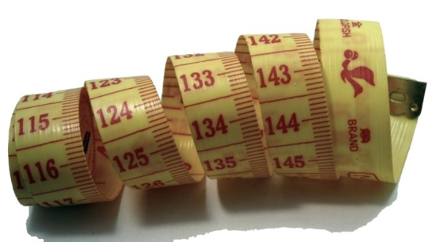

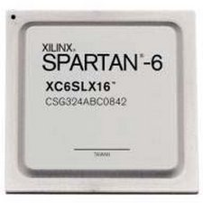

EEE4120F
High Performance
Embedded Systems
Lecture 18
FPGA & CPU Performance Comparison
FPGA Families
Click on speaker icon to hear narration
Lecturer:
Simon Winberg
Attribution-ShareAlike 4.0 International (CC BY-SA 4.0)
Notes:
Welcome to the FPGA and CPU performance comparison lecture.

Slide 2
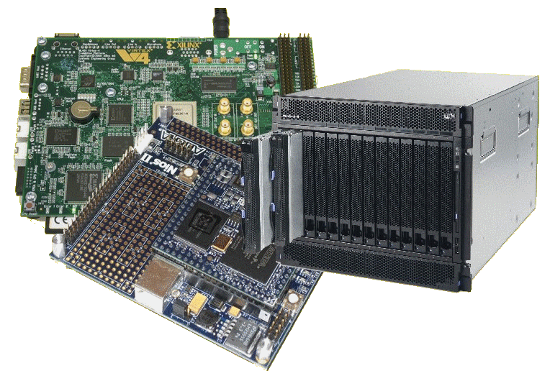
Lecture Overview
FPGA performance evaluation
FPGA vs CPU performance
FPGA families
YODA issues
Notes:
Why might you want to compare CPU and FPGA performance? We will get to that in a moment. We touch on an approach to do this sort of comparison analytically without running solutions. We end off with a discussion of FPGA families –the FPGA you select can impact the performance as well as other factors such as cost and power usage of a design.

Slide 3
Evaluating Performance
Evaluating synthesis (simplified) of an FPGA design
… a useful exercise, which you could be tested on, and which is more relevant to PLDs…
but which is unlikely to be used for even remotely complex FPGAs designs.
Notes:
In the next few slides we are going to look at performance calculations for doing theoretical performance evaluation between a digital logic design and a CPU-based design. An investigation as small as the one that is presented here, or which might be asked in a test, has potential relevance to a more industry context, for example where you might be deciding if you are going to use a PLD or a low-cost microprocessor to do something. For example, you might prefer to use a low-cost microprocessor because it is so customizable and allows for upgrade options without changing the hardware… but I expect it is not going to be all that often to attempt doing a comparison following this very manual approach for large designs using FPGAs – that is more likely to be done using prototyped implementations and reports generated from tools such Xilinx Vivado.

Slide 4
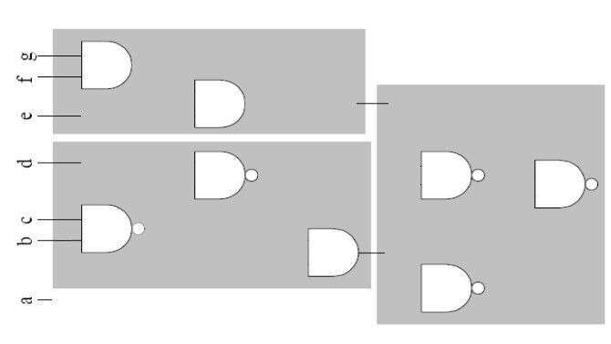
HDL to FPGA execution & LE cost (1)
In order to implement an HDL design, the design need to be decomposed and mapped to the physical LBs on the FPGA and the interconnects need to be appropriately configured.
In this explanatory scenario, we are using a very basic FPGA that has three logic blocks (LBs), each logic block having only a few logic elements. The logic elements in this example are just AND gates and OR gates.
AND Gate
LB
NAND Gate
LE
LB
LB
out
Notes:
In order to implement an HDL design, the design needs to be decomposed and mapped to the physical logic blocks on the FPGA and the interconnects need to be appropriately configured.
In this explanatory scenario, we are using a very basic FPGA that has three logic blocks (called el bees, here). Each el bee having only a few logic elements. The logic elements (or el eez) in this example are just AND gates, and OR gates.

Slide 5
HDL to FPGA execution & LE cost (2)
Let us consider that we want to map the following example logic functions to the FPGA. In other words, we want to figure out how the FPGA will be set up so that it will complete the desired operation when input is applied.
Example logic functions are:
x = AND(e,f,g)
y = AND(b,NAND(NAND(b,c),d))
out = NAND((NAND(x,y),NAND(a,y))
Note that x and y are intermediate wires
(2)
AND Gate
LB
NAND Gate
LE
(1)
LB
LB
out
Notes:
Let us consider that we want to map the following example logic functions to the FPGA. In other words, we want to figure out how the FPGA will be set up so that it will complete the desired operation when input is applied.
Note that x and y are intermediate wires. Out is the output pin of the circuit. But the status of out depends on the status of the intermediate values x and y.

Slide 6
HDL to FPGA execution & LE cost (3)
Example logic functions are:
x = AND(e,f,g)
y = AND(b,NAND(NAND(b,c),d))
out = NAND((NAND(x,y),NAND(a,y))
Note that x and y are intermediate wires
This is a view of how this logic circuit would get mapped to contain the required logic function (or combinational logic circuit). It happens that there is just enough logic elements to satisfy this design.
AND Gate
LB
NAND Gate
LE
x
LB
LB
out
y
Notes:
This is a view of how this logic circuit would get mapped to satisfy the required logic function (or, which is more correctly called, combinational logic circuit). It happens that there are just enough logic elements to satisfy this design. I’m not going to elaborate the process of going from the HDL code to the connections, assume it is a well-documented and understood process ... and regardless something you should be quite good at now having had experience with various digital logic circuits in previous digital electronics courses.

Slide 7
But what is the execution time cost of this circuit?
You can listen to some of my discussion about working this out
by listening to the next sound clip …
Otherwise,
if you’re impatient and want to just get into the process of manually
working out performance of a simple circuit, then skip to the next slide.
AND Gate
LB
NAND Gate
LE
x
LB
LB
out
y
LE cost = 8 and LB cost = 3
Notes:
But what is the execution time cost of this circuit? <break time="0.5s"/>
You can listen to some of my discussion about working this out by staying on this slide to hear the next sound clip.
Otherwise. If you’re impatient and want to just get into the process of manually working out performance of a simple circuit, then skip to the next slide.
The cost of this design is 3 logic blocks, with a combined total of 8 logic elements. The el bees comprise multiple el ees. Each el bee has a limited number of input and outputs. This limits the connections that can be made between el ees in the FPGA. Furthermore, there may be a slight latency between el bees due to the switching fabric between them. This switching fabric may be considered as multiplexers, or some sort of switching mechanism, that connects the output from one el bee to another. This aspect will not be included in the following manual performance analysis done in the next slide. But, of course, a tool like Xilinx Vivado would account for these additional propagation delays of the switching fabric.
This following analysis will investigate the speed at which a combination logic circuit will operate at, based only upon gating latencies of the implementation. Generally, this will be an over-estimate for the time taken to complete the operation. Effectively, what we are trying to figure out is the longest delay from any one of the inputs through to any one of the outputs – obviously for those cases where there is a path from an input to the output.
As a ‘blind’ test, for this circuit, we could consider all the possible permutations, i.e. a → out, b → out c→ cout, etc. That would be a lot of unnecessary work.
The approach we rather do is back-tracing. Go on to the next slide to see the example worked out.

Slide 8
HDL to FPGA execution & LE cost
In order to implement an HDL design, the design need to be decomposed and mapped to the physical LBs on the FPGA and the interconnects need to be appropriately configured.
Animation showing back-tracing
Applied to determine execution time.
Example:
x = AND(e,f,g)
y = AND(b,NAND(NAND(b,c),d))
out = NAND((NAND(x,y),NAND(a,y))
In this example, LE are the gates and LBs are the grey blocks they are within.
Map ‘AND(e,f,g)’ to LB1
LB
Map ‘NAND((NAND(x,y),NAND(a,y))’ to LB2
LE
x
LB
back-tracing
LB
out
y
Map ‘AND(b,NAND(NAND(b,c),d)) ’ to LB3
Costing: 3 LBs, 8 LEs (assuming LBs have LEs that are AND or NAND gates)
Notes:
In this slide we are using the process of back-tracing.
The method is to selected an output and determine the propagation delays to inputs that connect through to the selected output.
We want to find the longest path from an output traced to the most distant input.
We would need to check each output.
In this case there is only one output. So, it is rather simple.
In back-tracing you can cull a path traced when it is obvious that there are less gates on that path than on an alternate path. But, beware that some gates might take longer to operate than others, so only cull a back-tracing option if it is clear that the path will take less time than an alternate path.
In this example, the back-tracking paths followed are indicated by an arrow, and the animation indicates the culled paths using an X. The longest path was the one that connected back to c through four nan duh gates and an, AND, gate.
out → NAND → NAND → AND → NAND → NAND → c or three NANDS and an AND.

Slide 9
Timing calculations
The previous slide didn’t show whether the connections were synchronized (i.e., a shared clock) or asynchronous – since they are all logic gates and, no clocks imply it is probably asynchronous.
Determining the timing constraints for synchronous configurations are generally easier. Because everything is related to the clock speed. Still, you need to keep in mind cascading calculations.
For asynchronous use, the implementation could run faster. But can also become a more complicated design. And make it more difficult to work out the timing…

Slide 10
Async Timing calculations
Keep in mind that the propagation delays for the various gates / LUTs may be different. In the previous example circuit we could assume each AND takes 6ns to stabilise, and the NANDs 10ns to stabilise.
So, time taken to compute output out is =
  MAX OF (time to compute x, time to compute y) + 2x10ns = (2x10ns+6ns) + 20ns = 46ns = pretty fast!! Or is it??
  Compared to a 1GHz CPU using just registers (and no mem access)?
  Try this calculation for yourself ...
  (assume each instruction takes on avg. 3 clocks due to pipeline,
  data dependencies, etc, as worst case performance on a
  RISC processor)
Notes:
Keep in mind that the propagation delays for the various gates or look up tables in the circuit may be different.
In the previous example circuit, we could assume each AND gate takes 6 nanoseconds to stabilise, and the NAND gates 10ns to stabilise.
So, time taken to compute output out is...
The maximum of the two alternate paths, from the inputs, either via x, or via y. Plus the NAND gates leading to the output.
This works out to be 46 nanoseconds. That looks pretty fast! ... Or is it? Let us compare to a 1 gigahertz CPU which is just using registers (i.e. no memory access in use). You could try that calculation yourself. <break time=“0.5s”/>
You are probably asking but how? Must I run it on my PC and use the time command in Linux to measure the speed? <break time=“0.5s"/> No, that isn’t the objective, this is aimed as an on-paper analytical analysis that you might be asked in a test. If you think about it a bit you probably know what needs to be done. You need to convert the computation into assembly instructions. You could use ARM processor instructions. You can also assume a wost case situation where despite having a 3 stage pipeline each instruction takes a full 3 clock cycles, that is to say 3 nanoseconds, to complete. Have a go at working that out yourself. The next slide provides a sample solution to the time it takes a CPU to run that computation and then we compare it to this 46 nanosecond hardware case.

Slide 11
Comparing to CPU speed
CPU running at 1GHz → each clock 1ns period
Assume each instruction takes ~ 3 clocks each due to pipeline etc
CODE:
int doit ( unsigned a, b, c, d, e, f, g ) {
unsigned x = AND(e,f,g);
unsigned y = AND(b,NAND(NAND(b,c),d))
out = NAND((NAND(x,y),NAND(a,y))
return out;
}
But some of these
Can’t be done as just 1
RISC instruction.
unsigned t1 = AND(e,f); → 1 instruction, i.e. AND t1,e,f
unsigned x = AND(t1,g);
unsigned t1 = NAND(b,c)
unsigned t2 = NAND(t1,d)
unsigned y = AND(b,t2)
t1 = NAND(x,y)
t2 = NAND(a,y)
out = NAND(t1,t2)
in all 8 instructions → 8 x 3 clocks ea.
= 24 ns (assuming all registers pre-loaded)
A speed-up of 1.92 over the FPGA case
Notes:
Here you see the computation written as a C function.
I’ve rewritten it below more closely to assembly instructions. We have a sequence of three, AND, gates. Plus a sequence of 5, NAND, gates. In total we have 8 instructions. Each instruction takes 3 clock cycles. That gives a total time of 24 nanoseconds to run this code.
What is the, Amdal's law, speedup?
It is 46 divide by 24. Which equals one point 92.
In other words, the CPU is running this almost twice as fast, despite the worst-case performance of its pipeline where no parallelization is happening.
But don’t despair. There is merit for knowing how to design digital circuits.
Such as a CPU. Which after all is essentially a digital circuit, albeit ones that are very highly optimized and run efficiently as an ASIC.

Slide 12
Digital Clock Manager (DCM) blocks
An important element included in FPGA designs nowadays are Digital Clock Manager (DCM) blocks.
These are used to eliminate* clock distribution delays.
They can also increase or decrease the frequency of the clock.
We will look at PLLs later in the course.
* or at least greatly reduce these clock distribution delays
Notes:
An important element included in FPGA designs nowadays are Digital Clock Managers. Called DCM blocks.
These are used to eliminate clock distribution delays. Or, more accurately, to at least reduce them.
They can also increase or decrease the frequency of the clock.
We will look at PLLs, one of the ways this is done, later in the course.

Slide 13
FPGA Families
EEE4120F
Providing a broad variety of different performance, costing, size and tolerance options.
Notes:
Of course, the speed that your FPGA design works at, depends on what FPGA you are using.
There are a number of different manufacturers. And a broad variety of different performance, costing, size, and tolerance options, that are available to choose from.

Slide 14
The FPGA Manufacturers
The ‘Big 2’ (most commonly used)
  Xilinx, now owned by AMD, around 2984 employees (in Xilinx division)
  Intel FPGA (i.e. Intel’s acquisition of Altera) (guessing from, Altera stats) around 2500 employees*
The others pretty big ones…
  Actel (Microsemi Corp) – around 2200 employees*
  Lattice Semiconductor Corp – around 700 employees*
* These stats are a couple of years old.
Notes:
The two big FPGA manufactures, that you surely already know about, are Xilinx, which is now actually owned by AMD, and Intel FPGA which is largely Intel’s acquisition of Altera. Other pretty big ones are Actel and Lattice.

Slide 15

Audio annotations end at this point
Please look over the following slides to become a bit more familiar with these FPGA manufactures, and types of FPGAs that are available.
Image source: Max Pixel CC0
https://www.maxpixel.net/Memo-Paper-Sticky-Note-Post-it-Office-Note-150262
Notes:
Audio annotations end at this point.
Please look over the following slides to become a bit more familiar with these FPGA manufactures, and the types of FPGAs that are available.

Slide 16
About the FPGA Families
Xilinx
  Focusing on high performance and high capacity
    Vertex family (such as Vertex 7)
    Virtex UltraScale+
      Extremely (some might say insanely) high-performance
      9 million logic cells, up to 1.5 terabits/sec DDR4 bandwidth and up to 4.5 terabits/sec transceiver bandwidth
  Provides lower-cost options with high capacity (e.g. Spartan 6 family)
  Range of variations, e.g. low power options, economy (lower capacity) models.
Note that the top performance FPGA changes over time and is not necessarily consistently one or other of the manufacturers

Slide 17
About the FPGA Families
Altera
  Stratix: higher performance and density models (e.g. Startix-10)
  Arria: mid-range, lower-power, but also lower performance and denisity compared to Stratix.
  Cyclone: lowest cost option, also aimed at low power, cost sensitive and mobile applications

Slide 18
About the FPGA Families
Actel
  Focuses on providing the lowest power, and widest range of small packages
  IGLOO : low power, small footprint
  SmartFuson : Mixed FPGA and ARM processor
  RTAX/RTSX : radiation tolerant and very high reliability.

Slide 19
About the FPGA Families
Lattice
  Range of options (low power; high performance; small package)
  Own specialized development tools
  (of these four, this one is the only firms not in California; they are currently in Oregon)

Slide 20
About the FPGA Families
Others
  Achronix – focusing on building the fastest FPGAs (not necessarily highest capacity)
  Tabula – unique FPGA technology ‘SpaceTime’, focusing on highest capacity and memory capabilities

Slide 21
Memory jogger…
Q: Name a high-capacity FPGA family.
A: Xilinx Vertex (e.g. ver 7+) / Altera Stratix (ver 10+)
Q: Which of the following is a FPGA manufacturer ?
(a) Acrobatics
(b) Geometrix
(c) Achronix
Note that the producers are constantly bringing out new versions so this slide may get stale quite quickly.

Slide 22
End of Lecture
Onwards to distributed and shared memory architecture models …

Slide 23
References & Acknowledgements
References sources used include:
  Todman, Timothy J., et al. "Reconfigurable computing: architectures and design methods." Computers and Digital Techniques, IEE Proceedings-. Vol. 152. No. 2. IET, 2005.
  Stavinov, Evgeni. 100 Power Tips for FPGA Designers. Evgeni Stavinov, 2011.
Acknowledgement
  Thanks to John-Philip Taylor (TA) for time taken to review slides and spotting typos and inaccuracies.

Slide 24
Disclaimers and copyright/licensing details
I have tried to follow the correct practices concerning copyright and licensing of material, particularly image sources that have been used in this presentation. I have put much effort into trying to make this material open access so that it can be of benefit to others in their teaching and learning practice. Any mistakes or omissions with regards to these issues I will correct when notified. To the best of my understanding the material in these slides can be shared according to the Creative Commons “Attribution-ShareAlike 4.0 International (CC BY-SA 4.0)” license, and that is why I selected that license to apply to this presentation (it’s not because I particularly want my slides referenced but more to acknowledge the sources and generosity of others who have provided free material such as the images I have used).
Image sources:
man working on laptop – flickr
measuring tape – Wikimedia Open Commons https://commons.wikimedia.org
(public domain)
scroll, video reel – Pixabay http://pixabay.com/ (public domain)
References: Verilog code adapted from
http://www.asic-world.com/examples/verilog

