Slide 1
EEE4120F
High Performance
Embedded Systems
Lecture 17
Attributes, Constraints and UCF files
Lecturer:
Simon Winberg
Attribution-ShareAlike 4.0 International (CC BY-SA 4.0)

Slide 2
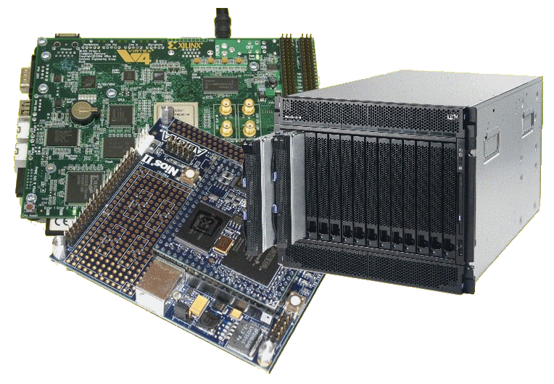
Lecture Overview
Attributes
Constraints
UCF Files
Xilinx Design Constraints

Slide 3
Attributes and Constraints
A Xilinx Perspective

Slide 4
Difference between Attributes and Constraints
Two types of attributes:
Predefined attributes (a part of the 1076 standard*)
Those outside the standard provided by the designer or by the design tool supplier (such as Xilinx or Altera)
* http://vhdl-manual.narod.ru/books/ieee_manual.pdf

Slide 5
Design Constraints
Keep in mind that you are essentially describing hardware… it is not a program running on a CPU.
Issues of design constraints are very necessary for efficient implementations, and so important and prevalent (for large systems) … that it’s turned into a type of specialized programming of its own*.
These are leading to ‘constraint languages’ (as yet largely unstandardized between tools), e.g.:
Xilinx: .ucf User Constraint File, or .xdc Xilinx Constraint File
Intel / Altera: .qsf Quartus II Setting File
Synopsis: .sdc Synopsis Design Constraints (de facto standard)
Two main types of constraints:
Placement Constraints (the geographical position of pins and related aspects)
Timing constraints (clock and timing related aspects of the design)
These are others types of constrains (see next slide) but we will look into those later in the course
* Indeed if you were an expert in using constrains languages you’d probably be in high demand by companies using FPGAs in their designs, it can probably make for a challenging and rewarding career. If you like Sudoku you might light constrains programming ☺

Slide 6
Classes of FPGA constraints
Grouping Constraints
Timing Constraints
Logical Constraints
Physical Constraints
Mapping Directives
Placement Constraints
Routing Directives
Synthesis Constraints
Configuration Constraints
Source: http://xilinx.eetrend.com/files-eetrend-xilinx/forum/201103/1746-3205-02a_ucf_editing_12.pdf

Slide 7
Where constrains can be defined
Depending on a attribute they can be defined in various places:
Constraints Editor for Timing Constraints
Floorplanner for Non-timing placement constraints
PACE for IO placement and area constraints
Floorplan Editor for IO placement and area constraints
Schematic and Symbol Editors for IO placement and RLOC constraints
The UCF (User Constrains File) is where you can manually (and quickly!!) define constraints, we will focus on this option.

Slide 8
UCF
Xilinx User Constraints Files
We will look at “Xilinx Design Constraints” (XDC), which is the more recant version of specifying Xilinx constrains editor later. However, I like using UCFs if possible as the syntax is quicker and easier to work with.

Slide 9
UCF Files
UCF files are in ASCII
They are used to specify constraints on the logical design
You can use your favorite text editor to edit them UCF (can edit in ISE)
NCF file:
this often goes with UCT file.
The Netlist Constraint File (NCF) is also an ASCII file that is usually generated by some synthesis programs

Slide 10
UCF Files Syntax
UCF files are generally case sensitive
However any Xilinx constraint keyword (e.g., LOC, PERIOD, LOW, HIGH) may be entered in all uppercase, in all lower-case, or mixed case.
Each statement is terminated by a semicolon (;) - the errors are sometimes cryptic, not obviously indicating a missing ‘;’.
Keep a blank line at the end of the file
Comments are started with # and end at the end of the line. The C or C++ comments // and /**/ are also supported

Slide 11
UCF Files Syntax
Each line has a structure such as:
{NET|INST|PIN} "name" constraint;
Particular bus lines on a bus are indicated by using name<n> where n is the bit (counted from 0) that you want to refer to
Typical usage: setting location of pins
NET reset LOC=P16;
NET leds<0> LOC=P23;
NET leds<1> LOC=P24;

Slide 12
UCF quick features
Wildcards can be used for the naming, such as
The asterisk (*): represents any string of zero or more characters
The question mark (?): represents a single character
Examples:
NET "leds*" SLOW;
NET "CLK?" FAST;

Slide 13
XDC
Xilinx Design Constraints Files
The Xilinx Design Constraints (XDC) are now more mainstream for use of Xilinx Vivado (although Vivado still has compatibility with the more classical and simpler UCFs files).

Slide 14
Xilinx Constraints Editor
The Xilinx Constraints Editor is useful for enter timing constraints
The GUI simplifies constraint entry by using wizards to guide the user through constraint creation, without needing to understand UCF file syntax.
Although it is useful to see what kinds of constrains result in the file as this could help speed up constrains entry/reuse in future projects

Slide 15
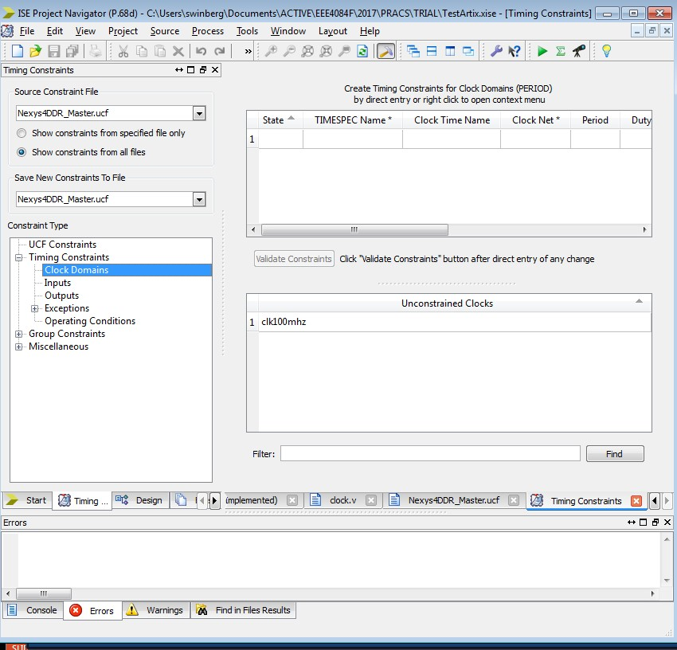
Constraints Editor
Runs synthesize etc.
Provides functions to find pins, to assign wires to groups, to structure clock domains.
Can view the UCF file lines in the “UCF Constraints” tab (this includes the comment lines).

Slide 16
PERIOD constraints
The PERIOD constraint provide accurate timing requirements, so it indicates…
Clock skew between the source and destination registers / flip-flops
Synchronous elements clocked on edge
Unequal clock duty cycles
Clock jitter
ISE uses this information to place and route elements of your design in an attempt to satisfy these requirements (and thus make the design work on hardware)

Slide 17
Example PERIOD constraint
The PERIOD statement covers all timing paths that start or end at a register, latch, or synchronous RAM that are clocked by the reference net
Assumptions…
50% duty cycle on CLK line
PERIOD constraint of 10 ns
Clocking
Because reg2 will be clocked on the falling edge of CLK, the link between the flip-flops will be constrained to 50% of 10 ns = 5 ns
The implementation tools will automatically account for triggering the one flip-flop on the rising edge and another on the falling edge
FF1
FF2
CLK
BUFG
INV
NET clock PERIOD = 10ns ;

Slide 18
Tutorial on using UCF files
Recommended tutorial by Xilinx on understanding and using UCF files
http://xilinx.eetrend.com/files-eetrend-xilinx/forum/201103/1746-3205-02a_ucf_editing_12.pdf
Exam hint: statemachines are highly likely to come up in the exam or class test, building statemachines is an essential skill for HDL developers.

Slide 19
Disclaimers and copyright/licensing details
I have tried to follow the correct practices concerning copyright and licensing of material, particularly image sources that have been used in this presentation. I have put much effort into trying to make this material open access so that it can be of benefit to others in their teaching and learning practice. Any mistakes or omissions with regards to these issues I will correct when notified. To the best of my understanding the material in these slides can be shared according to the Creative Commons “Attribution-ShareAlike 4.0 International (CC BY-SA 4.0)” license, and that is why I selected that license to apply to this presentation (it’s not because I particularly want my slides referenced but more to acknowledge the sources and generosity of others who have provided free material such as the images I have used).
Image sources:
man working on laptop – flickr
scroll, video reel, big question mark – Pixabay http://pixabay.com/ (public domain)
References: Verilog code adapted from http://www.asic-world.com/examples/verilog

