Slide 1
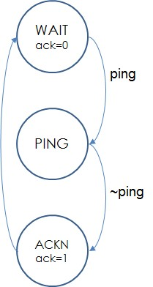
EEE4120F
High Performance
Embedded Systems
Lecture 16
More Verilog & Statemachine
module myveriloglecture ( wishes_in, techniques_out );
…
// implementation of today’s lecture
…
endmodule
Cosmic Detector Version
Lecturer:
Simon Winberg
statemachine
Attribution-ShareAlike 4.0 International (CC BY-SA 4.0)

Slide 2
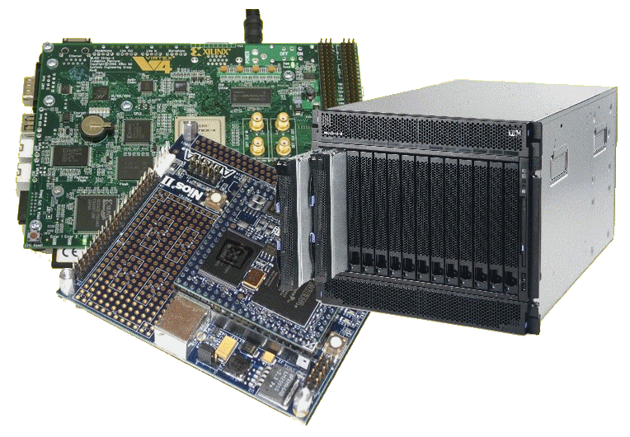
Lecture Overview
Brief recap
Busses and Endianness
Functions in Verilog
Implementing state machines

Slide 3
Module declaration (recap)
Modules are defined in Verilog as follows:
module mymodule (a, b, x, y);
input a, b; // these are inputs, usually first
output x, y; // outputs, listed usually after inputs
x <= or(a,b); // these all executed at same time:
y <= and(a,b);
endmodule // no semicolon needed after endmodule

Slide 4
Initial block
module testbench; // top level module
wire a, b, x; // set up some signals
add myadd(a,b,x); // module to test
myAnd_tb1 tb(a, b, x); // use this test
endmodule
module myAnd_tb1(a,b,x);
input a,b;
output x;
reg a, b; // registered inputs
initial begin
// log these signals as follows:
$monitor ($time,
"a=%b, b=%b, x=%b", a, b, x);
// exercise the signals
a = 0; b = 0;
#10 b = 1;
#10 a = 1;
#10 b = 0;
#10 $finish; // tell simulator to quit
end // end initial
endmodule
The initial block is like a constructor for a Verilog module in simulation. It is activated the first time the module starts up.
Used in simulation to set up conditions and to implement test benches.

Slide 5
Monitor : a standard Verilog simulation operation
The monitor operation is sensitive to a selection of signals. Whenever one of the signals change, it prints out whatever is requested to be printed, using a printf type formatting
$monitor(text,signals) — give it a string (or multiple strings) followed by a list of variables.
e.g. $monitor(“mysigs: ”, “a=%b b=%b:”, a,b);
Examples:
$monitor($time,”a=%b”,a); // displays time value followed by a=xx (bin val)
// $time is actually a string value

Slide 6
The always@ (sensitivity_list)
The always@ expression is used within a Verilog module to group operations that activate whenever the sensitivity list is triggered
Syntax:
always @ (<sensitivity1, sensitivity2, …>)
begin
<actions>
end
Used in behaviour descriptions and statemachines
Example: Implementing a D-type flip-flop …

Slide 7
always@ Example : D-type Flip Flop
module flipflop (din, clk, rst,q);
input din, clk, rst;
output q;
reg q; // q is a registered output
always @ (posedge clk) // whenever clk
begin
if (rst == 1) q = 0; // keep q low in reset
else q = din;
end
endmodule

Slide 8
Busses & endian
Busses or bit signal vectors are specified as follows:
reg [20:0] dataA; // little endian LSB in bit 0
reg [0:20] dataB; // big endian MSB in bit 0
It doesn’t really matter if you are using them just as busses, it is only relevant when applying operations such as add.
Question: Can you say dataA <= dataB without an error?

Slide 9
Functions in Verilog
functions are not modules in Verilog
Functions can be used as macros within the body of a Verilog module.
These can effectively save typing.
They work differently to module instantiations.
These are defined inside a module.
Can only have input parameters
Example:
reg [15:0] a;
wire [15:0] x;
assign b = negate (a); initial begin a=10;
a = add(1, a); $display(" a=%b -a=%b”, a, b); end
function [31:0] negate; input [31:0] a; negate = ~a; endfunction

Slide 10
Example function: Converting endianness
If need be you can construct a function to convert endianness, e.g.:
function [31:0] toBigEndian;
// transform data from little-endian to big-endian
input [31:0] x;
toBigEndian = {x[7:0], x[15:8], x[23:16], x[31:24]};
endfunction

Slide 11
Vectors & Signal concatenation { }
Syntax for concatenating wires: { x1, x2, … xn } the collective can be used just the same as any other variable.
module adder4 (a, b, cin, sum, cout);
input [3:0] a, b; // 2x 4 bit vector inputs
input cin; // carry input
output [3:0] sum; // 4-bit little endian vector
output cout; // carry out
// perform the adder operation
assign {cout,sum} = a + b + cin;
// the leftmost is MSB since it is little endian
endmodule
i.e. if the input is little endian so is the output
If you said {sum,cout}=A

Slide 12
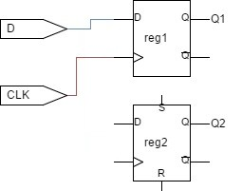
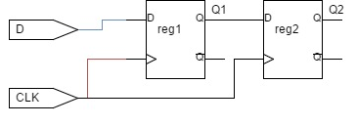
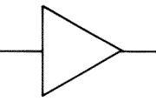
Blocking/Non-blocking statemets
Blocking
Non-blocking
module blockFFs (
input D, input clk,
output reg Q1, output reg Q2)
always @ (posedge clk)
begin
Q1 = D;
Q2 = Q1;
end
endmodule
module nonblockFFs (
input D, input clk,
output reg Q1, output reg Q2)
always @ (posedge clk)
begin
Q1 <= D;
Q2 <= Q1;
end
endmodule
This diagram is fairly accurate to what is happening in the blocking case. Reg2 is slightly delayed so that the first operation, Q1 = D; completes first before the Q2 = Q1 is done.
reg Q1
reg Q2
On a clock, value of D feeds into Q1 and value of Q1 at same point, before Q1 changes to D, feeds into Q2.
See simulation example of these cases at: https://www.edaplayground.com/x/9dxx

Slide 13
Implementing a FSM
Creating finite state machines in Verilog

Slide 14
Statemachines
A state machine has:
Input events
Output events
Set of states
A function that maps (state,input) → (state,output)
A indication of the initial state
A Finite State Machine (FSM) has a limited number of states

Slide 15
Implementing a FSM with Verilog
The state machine needs a register to store its state
It is sensitive to zero or more inputs, which can change state and/or produce an output

Slide 16
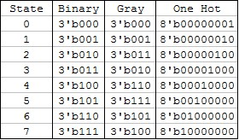
The state register
States could be numbered in sequence 0 .. 2^{n}-1 where n is the number of bits for the state.
Or a different encoding / ordering scheme could be used to make state changes more robust, e.g.:
use of grey scale or ‘one hot’ encoding (where ‘one hot’ means there is just one pin in the state set at a time)

Slide 17
The states and state changes
Need a means to force initial state at startup (i.e. reset state register)
Typically a reset handler does this.
Specifying and changing states
Usually a case construct is used to define the states, but could use ifs and elses
Need to decide if the statemachine
is synchronous (clocked) or
asynchronous (activates whenever an input changes)
May need recovery mechanism (e.g. watchdog or recovery default state)

Slide 18
State-machine triggering
There are three basic approaches to state-machines:
Clock-triggered: Those that are trigged only by the clock (a hot-running FMS)
Clock-disciplined: Those that are activated only on a clock pulse
Input/event triggered: triggered by various events possible including the clock

Slide 19
Clock-triggered state machine
Also called “polled” or “hot loop”
May trigger on: posedge, megedge or level of clock
Generally respond to edge levels of inputs checked each clock
But beware:
Danger if missing inputs that change rapidly or do not say on the required level for more than a clock pulse (i.e. Nyquist sampling problem).
May need ‘latch’ or ‘locking’ circuit to grab inputs that may change rapidly.
Check inputs
Wait for
next clock
clock
input
input latch
Pros and cons…
Benefit
Easier to implement and (to some extent) debug.
Drawback
Might miss input transitions.
May need latch. Possibly less efficient.
Posedge triggered FSM responds only here to the input blip

Slide 20
Clock-disciplined state machine
Or clock-synchronized state machine
This design is one that responds to inputs but only after at clock pulses (or on suitable levels of a clock pulse)
clock
Pros and cons…
Benefit
Generally the ‘preferred’ professional approach
Robust
Easier to debug
Drawback
More effort to code
Not as responsive as a purely event triggered state machine (e.g. might miss a input changing rapidly between clocks)
input
Respond to negative input edge on clock low
Respond to input on positive edge
Respond to input on negative edge
Respond to positive input edge on clock high
Output
(responding to input after posedge on clock)

Slide 21
Event-triggered state machine
This type of a state machine triggers on particular inputs, possibly including clock changes. You might see a Verilog sensitivity list using ‘*’ to say trigger on anything that is read in the code block, i.e. whether a positive or negative edge.
input1
Pros and cons…
Benefit
likelihood of your code working, i.e not neglecting something in the sensitivity list
Easier, less thinking work needed
Drawback
is it can be wasteful
Change of quickly re-entering the statemachine if inputs change very quickly but with a tiny delay
input2
Respond to negedge on input1
Respond to negedge on input2
Respond to posedge on input2
Respond to posedge on input1

Slide 22
Example Statemachine
AliveFSM
Sends blip out ack if pinged
// Code your design here
module alivefms (input clk, input reset, input ping, output reg ack,
output reg[1:0] state);
parameter [1:0] WAIT = 2'b11;
parameter [1:0] PING = 2'b01;
parameter [1:0] ACKN = 2'b10;
always @(posedge clk or posedge reset or
posedge ping or negedge ping)
begin
if (reset)
begin
state <= WAIT;
ack <= 0;
end else
begin
case(state)
WAIT: begin
if (ping) state <= PING;
else state <= WAIT;
ack <= 0;
end
PING: if (ping) state <= PING;
else state <= ACKN;
ACKN: begin
ack <= 1;
state <= WAIT;
end
default: state <= WAIT;
endcase
end
end
endmodule
ping
ack
clk
← Activation
WAIT
ack=0
(i.e. activation is clock and event-triggered)
← Start up
ping
PING
← States
~ping
ACKNack=1
← Recovery
…
Notes: Must only send ack only after ping goes low

Slide 23
Create a testbench
// testbench for alivefsm
module alivefms_tb ();
reg clk, reset, poke;
wire ack;
wire [1:0] state;
integer i;
// instantiate the FSM
alivefms alivefsm_tb (clk,reset,poke,ack,state);
initial // method for testing the FSM:
begin
// enable monitoring of wires of interest
$monitor("reset=%d state=%d poke=%d ack=%d\n",
reset,state,poke,ack);
clk = 0; reset = 1; #5 // do the reset
reset = 0; clk=0; #5
poke = 1; clk=1; #5 // poke the fsm
poke = 0; #5 // release poke
clk = 0; #5 // needs a clk transition
clk = 1; #5
if (ack == 1) // check if worked as planned
begin
$display("SUCCESS\n");
end
end
endmodule
Avail online at: https://www.edaplayground.com/x/25N5

Slide 24
Run on iverilog (or other sim)
$ iverilog '-Wall' design.sv testbench.sv && unbuffer vvp a.out reset=1 state=3 poke=x ack=0 reset=0 state=3 poke=x ack=0 reset=0 state=1 poke=1 ack=0 reset=0 state=2 poke=0 ack=0 reset=0 state=3 poke=0 ack=1 SUCCESS Done

Slide 25
That’s essential it for
state machines
But I am giving an impression of over-simplification… state machines can get challenging. But they are considered by many (including me) as recommended, indeed the appetizing defecto favorito, for elegant and understandable Verilog.
Let me throw you a more tasty and real problem to try….
BUT WAIT… THERE’S MORE!!

Slide 26
Take-home Activity
A (hypothetical) cosmic ray detector system is able to detect particles passing its sensors¹. But there is also an occasional backscatter effect or false detection (caused e.g. by reflected energy) which can also be detected. The aim is to have a system that counts the valid particles detections and also tallies false event (which may actually be true detections but is determine later in post-processing)… technically the backscatter could be determined by the trajectory of particles if there are multiple detectors panels, but we won’t get into those complications).
The diagram on right illustrates the situation.
A C program was written to explain what this detector needs to do (see next slide…) but even C is hopelessly too slow for this application; the code it is only provided to explain what the system needs to do.
TODO: Attempt a Verilog state machine for this problem
Implement a Verilog equivalent of the particle detector code that will count the number of true particle detections tp (when backscatter is low), as well as the number of potential false detections fp (when backscatter is high) for each slow clock (sclk) period.
See further details in the code on the next slide and module interface on slide 28.
Notes: You can make various simplifications or just attempt to implement a part of the task. This exercise is provided to get you practicing your Verilog, as well as seeking the awesome responsive power of Verilog and FPGA systems 😉
cosmic particle
detector
potential backscatter or detection from wrong direction (e.g. from terrestrial source)
1 Note: technically it is not the cosmic particle itself that is detected but one of many particles from the grammar-ray shower that result from a super high-energy cosmic particle colliding with e.g. an air particle in the atmosphere. Info on this at https://en.wikipedia.org/wiki/Cosmic-ray_observatory

Slide 27
//! FPGA Particle Detector Simulation ('golden' measure)
#include <stdio.h>
#include <stdlib.h>
int printlog = 1; //! Debug various, set to 1 to generate log report
unsigned sclk = 20; // slow clock (i.e. observation interval)
unsigned clk = 0; // fast clock
int detect_particle()
{ //! A dummy function to simulate input indicating particle is present
// detecting particles when sclk%4 and clk is %4
if (sclk%4==0) if (clk%4==0) return 1;
return 0;
}
int detect_backscatter()
{ //! A dummy function to simulate reading an input
// detecting backscatter particles when sclk==8 and clk is 5
if (sclk==8) if (clk==5) return 1;
return 0;
}
void out_tp(unsigned tp)
{
//! simulate outputting value of tp
}
void out_fp(unsigned fp)
{
//! simulate outputting value of fp
}
void out_fptime(unsigned time_fp)
{
//! simulate outputting value that fp backscatter triggered
}
…. cont →
int main()
{
unsigned count = 0; // timer counter
unsigned time_fp = 0;
unsigned countdown_fp = 0;
int backscatter = 0;
unsigned tp; // number true particles
unsigned fp; // number of false particles / backscatter
if (!printlog) printf("Particle detector simulation!\n");
if (printlog) printf("sck,clk,tp ,tp ,b,tfp\n"); // print headings out log output
while (sclk) // slow clock
{
out_tp(tp); out_fp(fp);
out_fptime(time_fp);
time_fp = 0;
tp = fp = 0;
clk=10; // fast clock
while (clk) {
count++;
if (countdown_fp) {
countdown_fp--;
if (countdown_fp==0) backscatter = 0;
}
if (detect_backscatter() && (countdown_fp==0)) {
time_fp = count;
countdown_fp = 10;
backscatter = 1;
}
if (detect_particle()) {
if (backscatter == 0) tp++; else fp++;
}
if (printlog) printf("%03d,%03d,%03d,%03d,%01d,%03d\n",sclk,clk,tp,fp,backscatter,time_fp);
clk--;
}
sclk--;
}
return 0;
}

Slide 28
Cosmic Detector Module
detect
/
16
out_tp
backscatter
Cosmic
Detector
/
16
out_fp
sclk
clk
/
32
fp_time
reset
cosmic particle
detect
detector
potential backscatter or detection from wrong direction (e.g. from terrestrial source)

Slide 29
Disclaimers and copyright/licensing details
I have tried to follow the correct practices concerning copyright and licensing of material, particularly image sources that have been used in this presentation. I have put much effort into trying to make this material open access so that it can be of benefit to others in their teaching and learning practice. Any mistakes or omissions with regards to these issues I will correct when notified. To the best of my understanding the material in these slides can be shared according to the Creative Commons “Attribution-ShareAlike 4.0 International (CC BY-SA 4.0)” license, and that is why I selected that license to apply to this presentation (it’s not because I particularly want my slides referenced but more to acknowledge the sources and generosity of others who have provided free material such as the images I have used).
Image sources:
man working on laptop – flickr
scroll, video reel, big question mark – Pixabay http://pixabay.com/ (public domain)
References: Verilog code adapted from http://www.asic-world.com/examples/verilog

