Slide 1
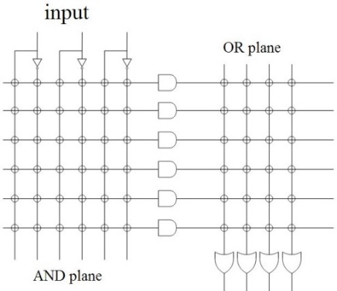
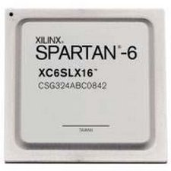
EEE4120F
High Performance
Embedded Systems
Lecture 14
Programmable Logics & FPGAs (recap)
FPGA Interns
Lecturer:
Simon Winberg
Attribution-ShareAlike 4.0 International (CC BY-SA 4.0)
Notes:
The objective of this lecture is to review different types of programmable logic devices, and to have a brief look at the internal structure of an FPGA, what makes it work.

Slide 2
Outline for today
Recommended Reading on Verilog HDL
Programmable Logic Devices
What is so special about FPGAs
FPGA interns
Xilinx Slices

Slide 3
Recommended Reading
ES2* provided an introduction to HDL and the Verilog HDL, and getting started in Xilinx Vivado and/or the open-source Icarus Verilog Simulator
If you are not already familiar with Verilog or VHDL, you are encouraged to read Deepak Tala’s (founder of ASIC-World) ”Verilog Tutorial and Introduction to ASIC-World”
I recommend ASIC-World.com as a first, go-to place for:
Solutions to Common HDL Problems,
Additional Tutorials, and
Examples of Useful Modules often needed in designs.
* Embedded System II EEE3096S 3rd year course

Slide 4
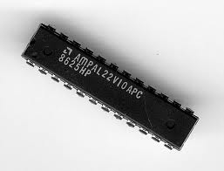
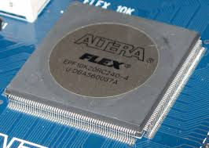
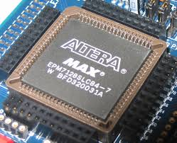
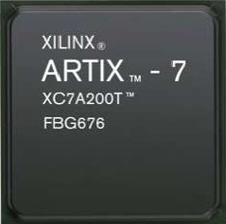
Programmable Logic Devices
EEE4120F
PLA
PLD + SoC
CPLD
FPGA
Notes:
There are three main categories of ‘programmable logic devices’, namely PLAs, PLDs, CPLDs, and FPGAs. Many of the pre-FPGA technologies (i.e. PLAs) are still in use and appropriate for smaller type design needs.

Slide 5
Programmable Chips
In comparison to hard-wired chips, a programmable chip can be reconfigured according to application or user needs
Provides a means to use the same chip(s) for a variety of different applications.
Makes programmable chips attractive for use in many products, e.g. prototyping products.
Further benefits are:
Low starting cost (e.g. Web pack+ FPGA dev kit)
Risk reduction
Quick turnaround time
The term PLD refers to “Programmable Logic Device” which could technically be any of the programmable devices (i.e. PLA / CPLD / FPGA), in early work it often referred to a PLA but this is no longer a correct assumption.

Slide 6
ASICs vs. Programmable Chips
Application Specific Integrated Circuit (or ASICs) have a longer design cycle and higher engineering cost than using programmable chips.
Still a need for ASIC: faster performance and lower cost for high volume
Generally, programmable chips are suited to low to medium product production. (e.g. product runs needing under 10,000 chips)

Slide 7
PLAs, CPLDs and FPGAs
Programmable logic chips variety in terms simple→complex cheap→expensive
PLA = Programmable Logic Array
Simple: just AND and OR gates; but Cheap
CPLA = Complex PLA
Midrange: compose interconnected PLAs
FPGA = Field Programmable Gate Array
Complex: programmable logic blocks and programmable interconnects; but Expensive
FPGA orders of magnitude larger than CPLD

Slide 8
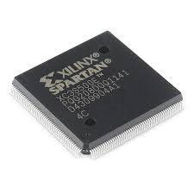
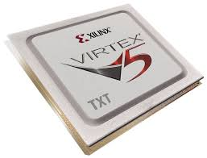
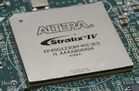
Some examples of PLDs
PLA:
TIBPAL22V10-7C from Texas Instruments is a commonly used
CPLD:
The Altera MAXII and arguably the Altera FLEX as well
FPGA:
Xilinx Spartan and Virtex range;
Altera Cyclone and
The Xilinx, Altera FPGA are probably the most commonly known manufacturers, others include: Lattice, Microsemi / Actel, Achronix

Slide 9
So what? What is so special about FPGAs?
?

Slide 10
So what? What is so special about FPGAs?
FPGA
A sea of possibilities…
01001010101000100101001010010100 10010010010100100101101001 100100110101011010011101
Notes:
Compared to the the earlier programmable logic technologies (such as PLAs), an FPGA has orders of magnitude more interconnects and complex logic (e.g. adds, floating point dsp modules, etc.) that can be connected together to implement sophisticated digital design.

Slide 11
FPGAs – “A sea of possibilities”
The huge number of logic elements (LEs) within these chips, and their many PIO pins, makes it possible to implement large & complex digital systems in them.
The ease and speed of programming them provides the ability to rapidly change the hardware (within ms timing) to adapt to application needs.
Greater potential for testing and tweaking designs before fabricating them as ICs

Slide 12
Any Drawbacks?
Here’s just a few drawbacks
Only does the digital part – still need analogue components, user interface, and circuitry that interacts with the outside world.
Has a limited number of IO pins that can connect up with external signals.
Susceptible to EM disturbances, PCB and other components needs to be suitably placed to avoid interfering with functioning of FPGA.
Typically a slower clock than most fast CPUs nowadays (e.g. 100MHz clock speed).
Eeek!
Often can’t achieve full utilization of PLBs
Typically has lots of pins that need to be soldered on, needing small track width and multilayer PCBs
Limitations of internal interconnects
Place & route can take a long time to complete
A specialized form of development, combines the challenges of both s/w and h/w
Things can get rather… muddy!

Slide 13
Structure of FPGA
A completely different architecture for PLAs was introduced in the mid-1980’s that uses RAM-based lookup tables instead of AND-OR gates to implement combinational logic
These devices are called field programmable gate arrays (FPGAs).
The device consists of an array of configurable logic blocks (CLBs) surrounded by an array of I/O blocks
FPGAs really don’t have AND and OR gates, (they have a few) but rather just RAM look-up tables.

Slide 14
FPGA Interns (recap)
EEE4120F
Somewhat of a recap of ES2, but scan through these slides to ensure you are well versed in these issues.

Slide 15
FPGA internal structure (simplified)
Terminology note:
One often simplifies PLE to LE (i.e. logic element), and PLB to LB (or logic block). So this example has 6x LBs (assuming each block here is a LB not an LE).
Programmable logic element (PLE) (or FPLE*)
Image adapted from Maxfield (2004)
Note: one programmable logic block (PLB) may contain a complex arrangement of programmable logic elements (PLE). In this example, it suggests the PLEs are LUTs (look-up tables), and there is just one LUT per PLB; but rather assume here there are actually multiple LUTs, let’s say 9 of them, per PLB.
The size of a FPGA or programmable logic device (PLD) is measured in the number of LEs (i.e., Logic Elements) that it has.
* FPLE = Field Programmable Logic Element

Slide 16
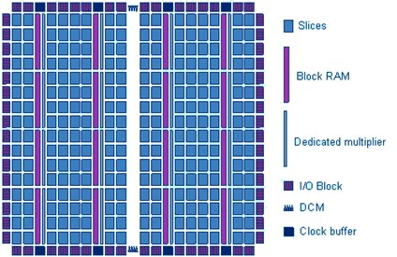
FPGA internal structure (more accurate)
The FPGA array structure (found in more modern FPGAs) comprises:
Slices (which comprise one or more PLBs, kind of like a sub-FPGA), composed of:
LUTs to implement combinatorial logic, but may have other ‘PLEs’
Flip-Flops (FF) to implement sequential logic (e.g. x=1; delay; y=1;)
Routing Network (or ‘routing net’) to interconnects logic resources / PLBs
I/O logic to communicate with the outside world (rest of the PCB)
Clock Management:
Phase Locked Loops (PLLs)
Digital Clock Managers (DCMs)
Hard-Macros: (specialized resources)
SRAMs blocks
Digital Signal Processing (DSP) cells (e.g. multiplier)
PCIe interface
Gigabit Transceivers
etc.
FPGAs may have one or more type of ‘slice’. A basic slice comprises Look-Up Tables (LUTs) and flip flops

Slide 17
Logic Elements (LEs) – Remember your logic primitives
You already know all your logic primitives…
The primitive logic gates
AND, OR, NOR, NOT, NOR, NAND, XOR
AND3, OR4, etc (for multiple inputs).
Pins / sources / terminators
Ground, VCC
Input, output
Storage elements
JK Flip Flops
Latches
Others items: delay, mux
OR
Input Pin
Output Pin
Altera Quartus II representations
Disclaimer: In reality, nowadays, FPGAs often don’t comprise individually routable LEs. LUTs are a more versatile approach. Often including a number of pre-build ‘hard macros’ (e.g. adders or multipliers) in PB that are commonly used in combinational logic designs. So, we are effectively considering LEs as primitive gates for education purposes.

Slide 18
Look Up Tables (LUTs)
The usual strategy for implementing PLBs
A simple but powerful approach to FPGA design is to use lookup tables for the PLBs. These are usually implemented as a combination of a multiplexer and memory (even just using NOR gates)
Essentially, this approach is building complex circuits using truth tables (where each LUT enumerates a truth table)
Note: Most FPGAs are not really just a combination of LUTs connected with multiplexers (switching fabric). While an FPGA may well have lots of LUTs for general logic, they usually also have hardened operations / ‘hard-macros’ (usually DSP blocks) that implement efficient adders, comparators etc… see Mainstream PLBs a little later.
examples follows…

Slide 19
Simple 3-LUT implementation for a PLB
input values
000
0
001
1
010
1
011
0
1-bit output
100
1
101
0
Any guesses as to what logic circuit this LUT implements?
110
0
111
1
8-bit static memory
3
3-bit input bus

Slide 20
Simple 3-LUT implementation for a PLB
It’s an XOR of the 3 input lines!!!
input lines
in out
output
000
0
001
1
010
1
011
0
100
1
101
0
110
0
111
1

Slide 21
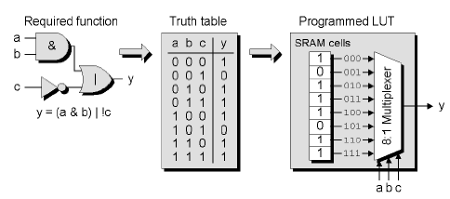
Mainstream* Programmable Logic Block (PLB)
Configure synchronous or asynchronous response (i.e. a line from another big LUT).
config_sync
k-input LUT
0
k inputs
output
…
DFF
1
clock
Another example for implementing an alternate logic function.
Image adapted from Maxfield (2004)
* Used by manufacturers like Xilinx

Slide 22
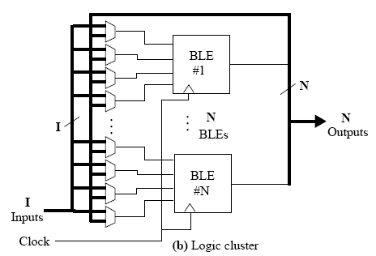
Logic block clusters (LBCs) and Configurable logic blocks (CLBs)
Assume a k-input LUT for each logic block (LB)
Assume N x LBs per logic cluster
BLEs in each logic clusters are fully connected or mostly connected
The diagram shows the same input lines (I) are sent to each LB, in addition to each of the N LBs’ output lines. Each LB operates on 4 input lines at a time, and a MUX is used to decide which input to sample. The MUXs may be configured from a separate LUT, or could be controlled by the LB it is connected to.
LB
…
N x LBs
LB
Diagram adapted from Sherief Reda (2007), EN2911X Lecture 2 Fall07, Brown University

Slide 23
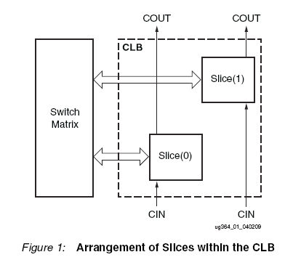
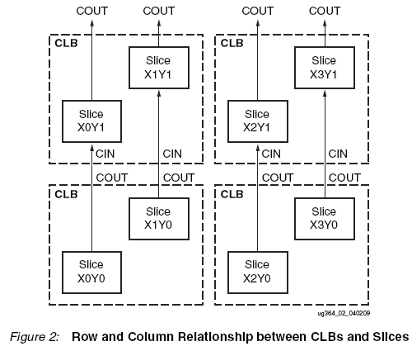
Xilinx L and M Slices Approach for configurable logic blocks (CLBs)
“Every slice contains four logic-function generators (or LUTs), eight storage elements, wide-function multiplexers, and carry logic. These elements are used by all slices to provide logic, arithmetic, and ROM functions. In addition to this, some slices support
two additional functions: storing data using distributed RAM and shifting data with 32-bit registers. Slices that support these additional functions are called SLICEM; others are called SLICEL. SLICEM represents a superset of elements and connections found in all slices. Each CLB can contain zero or one SLICEM. Every other CLB column contains a SLICEMs.
In addition, the two CLB columns to the left of the DSP48E columns both contain a SLICEL
and a SLICEM.”
Source: http://www.xilinx.com/support/documentation/user_guides/ug364.pdf pg 8

Slide 24
Xilinx Slices
EEE4120F
(A more accurate view on FPGA internal structures)

Slide 25
Note: Xilinx tends to use ‘CLB’ for ‘PLB’, basically means the same thing (textbooks often use the term PLB).
The Xilinx Spartan6 is a fairly good representative of how the logic in a FPGA is structured and connected. The Xilinx FPGAs are based around slides, where a slice (a substantive portion of the FPGA) is structured to support particular design characteristics. For example SliceX provides maximum flexibility for arbitrary logic but not designed around carry logic; whereas the SlideL supports carry logic and bigger muxes (to allow a LB to tap into more wires) but these features might be redundant for less complex designs.

Slide 26
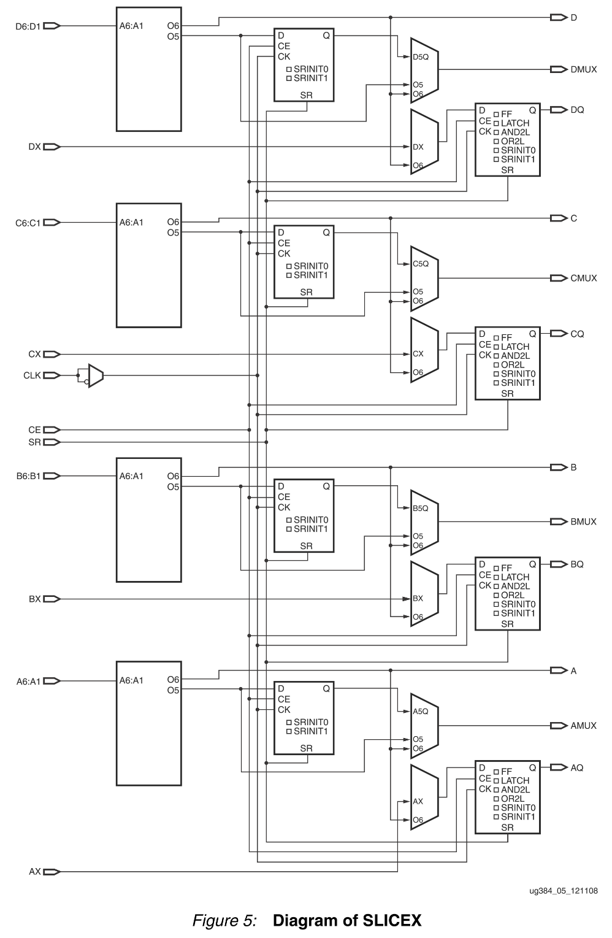
SLICEX slices are generally the most basic of slices, but also the most flexible. The LEs essentially contain LUTs and flip flops (e.g. to store registers and to configure clocked or un-clocked LE operation)
Source: https://www.xilinx.com/support/documentation/user_guides/ug384.pdf

Slide 27
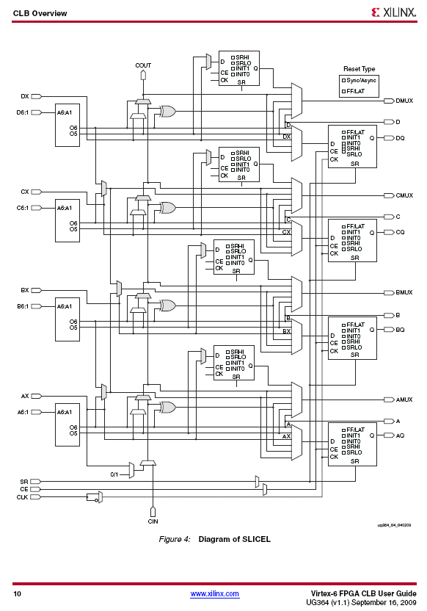
SLICEL slices contain the standard set of LEs for the particular FPGA concerned. As the diagram shows, it looks a little more complicated than the SLICEX but it is less complicated than the design of a SLICEM (see next slide).
Source: http://www.xilinx.com/support/documentation/user_guides/ug364.pdf pg 10

Slide 28
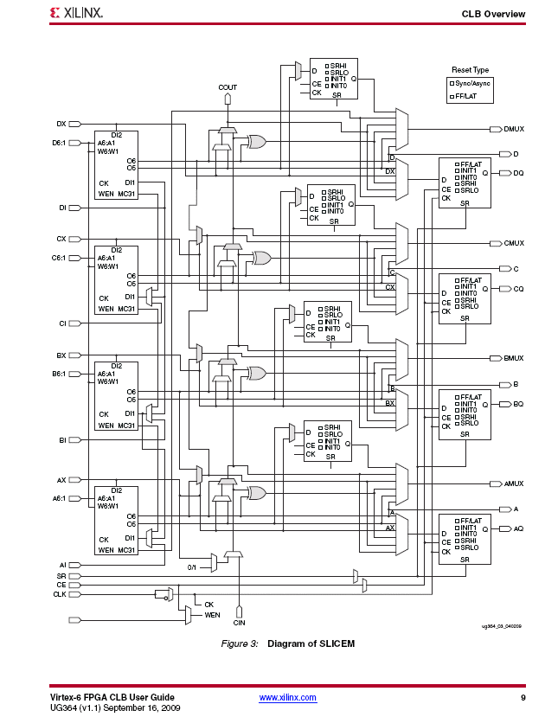
SLICEM slices support additional functions; they are a superset of SLICELs; i.e. the have all the standard LEs plus some additions.
Source: http://www.xilinx.com/support/documentation/user_guides/ug364.pdf pg 9

Slide 30
next episode:
Verilog Coding
Onwards to Xilinx Vivado and [recapping] Verilog programming …

Slide 31
Disclaimers and copyright/licensing details
I have tried to follow the correct practices concerning copyright and licensing of material, particularly image sources that have been used in this presentation. I have put much effort into trying to make this material open access so that it can be of benefit to others in their teaching and learning practice. Any mistakes or omissions with regards to these issues I will correct when notified. To the best of my understanding the material in these slides can be shared according to the Creative Commons “Attribution-ShareAlike 4.0 International (CC BY-SA 4.0)” license, and that is why I selected that license to apply to this presentation (it’s not because I particulate want my slides referenced but more to acknowledge the sources and generosity of others who have provided free material such as the images I have used).
Image sources:
PLD illustration on title slide - Wikipedia Open Commons
FPGA chip illustrations - Wikipedia Open Commons
Stuck in Mud – fickr (CC2 for free reuse and modification)
Typing ninja – Pixabay http://pixabay.com/ (public domain)

