Slide 1
EEE4120F
High Performance
Embedded Systems
Lecture 13
YODA Project & Discussion of Digital Accelerators
Presented by
Simon Winberg
Attribution-ShareAlike 4.0 International (CC BY-SA 4.0)
Notes:
Welcome to the YODA Project presentation. In this case, YODA does not refer to a clever green alien. Rather, it stands for <prosody rate="slow">Your Own Digital Accelerator.</prosody>. And you are going to be prototyping such a thing, utilizing existing computing facilities, as opposed to building your own accelerator from scratch. Which could take a long time depending on what is involved.

Slide 2
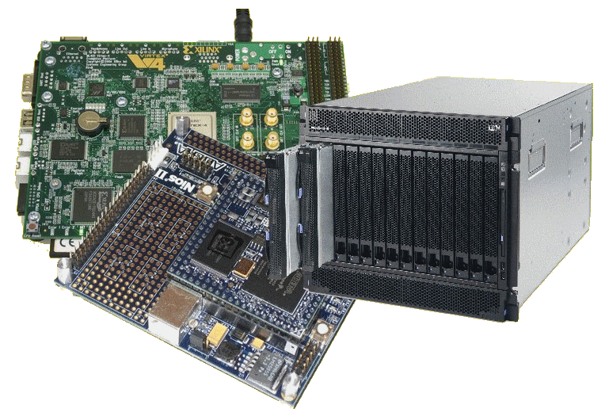
Lecture Overview
YODA Project
Digital accelerators
Project Milestones
YODA ‘Conference’
Notes:
Here’s the outline. We will start with a scenario to set the scene… and then go into details.

Slide 3
Reconfigurable Computing
A Scenario…
EEE4120F

Slide 4
The Reconfigurable Hardware Platform
More colloquially, at the start
of the mission: “The Doorstop”
In the not too distant future,
There was a device…
Indeed, your own galaxy…
Very close to home…
In a galaxy

Slide 5
The Reconfigurable Hardware Platform
More colloquially, at the start
of the mission: “The Doorstop”
Like most doorstops, this one starts out being a
lump that is in the way; although it may have
all sorts of potential if you…
… apply your mind, you must!
Notes:
But what is this. This thing that lay men might colloquially call a doorstop? It may be something that starts life like a regular doorstop. Being a lump that is in the way. Although. Unlike a regular doorstop, it may achieve all sorts of potential... If you ... apply your mind. You must.

Slide 6
Scenario: Reconfigurable platform
LCD
reconfigure
MP3
player
Doorstop
Jabba the Hutt says:
I need a
MP3 player!
(you may need some additional
external items in order to make
use of the reconfigured system)
Notes:
The doorstop we speak of has the ability to transform from one thing ... A useless lump of metal. To another thing. That a, possibly fussy client, wants. Which might provide streaming music enhancements so that your laptop does not need to deal with decoding and producing music but can allocate that task to the doorstop.

Slide 7
MP3
player
reconfigure
IP phone
The Hutt is satisfied.
But now wants more…
Now I need an IP phone!
Yak yak *
In case you’re wondering what sort of client Jabber is like, especially if he had an MP3 player, you could watch this amusing skit: https://www.youtube.com/watch?v=H2ftVPk-WZw
Notes:
And it have the potential that, if your fussy client decided the doorstop should be changed to an IP phone, that is something that at least this one could provide.

Slide 8
With the expanding product line your RC development firm is likely to get more and more (and even more unlikely) clients… such as
IP phone
Compressor
110111001101
110100
But I (beep beep) need a
data stream
compressor
(click squeak)
Notes:
Working for an astute development company, the management might decide to extend their product line and get increasing more, and possibly weird, clients. Such as this one who wants to have a data stream compressor for their unique communication protocol.

Slide 9
But what is this “doorstop” of which you speak?
Your Doorstop
A “doorstop” for your enlightenment and education…
But first: patience you must have as this knowledge will be
revealed once you are ready…
Notes:
But my dear fellow. What is this door stop? Of which you speak? It is a door stop for your enlightenment. And education. But wait. patience you must have, as this knowledge will be revealed once you are ready. And know what you are to deal with regarding the practical assignments and project work which we will engage within term two.

Slide 10
Using FPGA Evaluation Kit: e.g. Nexys 4 or Nexys A7
Getting ready for your “doorstop”…
Choice of either …
A real
doorstop …
OR
Simulation-based system e.g. iVerilog or Vivado Simulator
A virtual
doorstop
Reconfigurable Computing EEE4120F
A brief overview of Reconfigurable Computing operation…
Notes:
Let us get you ready for your door stop.
You will have the choice of one of two Digital Accelerator design approaches, although you might decide to do a bit of both.
A real doorstop making use of an FPGA kit. A virtual one making use of a simulation running in iVerilog or Xilinx Vivado.

Slide 11
Option A: FPGA-based Digital Accelerator
EEE4120F
Notes:
The voice annotations end at this point. Please read over the next slides. Additional annotations will be added later to this lecture.

Slide 12
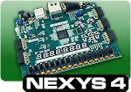
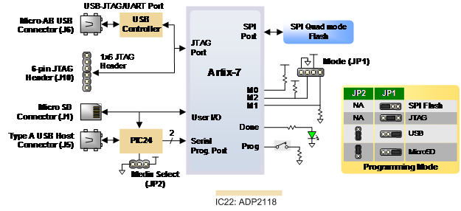
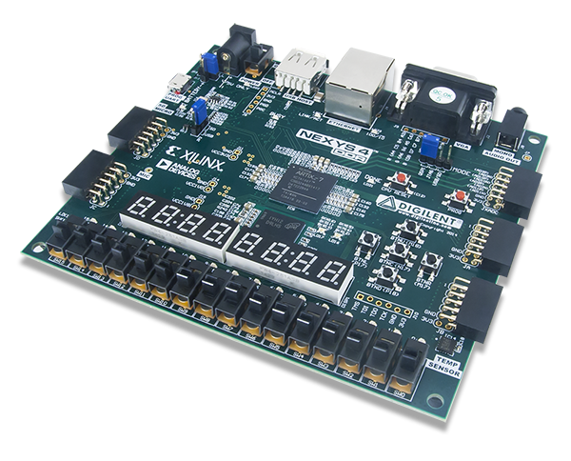
Nexys4 DDR: The evaluation board to be used
in the laboratories…
The other Nexys versions are quite similar
Source:
https://digilent.com/reference/programmable-logic/nexys-4/reference-manual

Slide 13
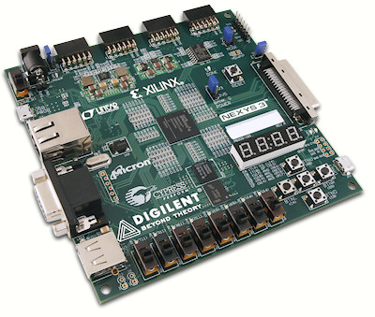
Nexys: The evaluation board to be used
in the laboratories…
Simplified Model
16 bit Pmods (4x)
Flash 16MByte
DATA
PORT BUS
(USB, JTAG)
45 bit memory ADDRESS
BUS
FPGA
43 bit extra IO
32 bit LEDs, PB PIO
SRAM

Slide 14
Nexys:
Simplified Model
16 bit Pmods (4x)
USB
DEVICE
Flash 16MByte
ETHERNET
DEVICE
Soft
Processor
Logic
USB
45 bit memory ADDRESS
BUS
DATA
PORT BUS
(USB, JTAG)
FPGA
BLOCK RAM
Your own
peripheral
43 bit extra IO
32 bit LEDs, PB PIO
SRAM

Slide 15
Want your own Nexys?
If you want your own Nexys you can order one from the DigilentInc website. The Nexys A7 is somewhat pricier than the Nexys4 and 3 (of which stock may be limited, if not discontinued). Nexys4 about $179 with education discount. The lower cost (and simpler) option is the Basys™3 Artix-7 FPGA Board, about $79; it has much of the peripherals as the Nexys4 has but cut down in other aspects. There is of course also ebay.com (still pricy, maybe save 50%).
There are enough to go round for labs if working as teams. If enough students would like their own Nexys board it’s a good idea to group all into one order to save on the postage costs (the postage is about $50 or R500, only courier options are available).
If you decide to get your own Nexys, I recommend the NexysA7 or lower cost the CmodA7 (which I plan to use next year) if you can afford it since they’re the bigger and more fancy FPGA options.
http://www.digilentinc.com/Products/Detail.cfm?NavPath=2,400,1184&Prod=NEXYS4
http://www.digilentinc.com/Products/Detail.cfm?NavPath=2,400,897&Prod=NEXYS3
http://www.digilentinc.com/Products/Detail.cfm?NavPath=2,400,1288&Prod=BASYS3

Slide 16
Option B: Simulation-based Digital Accelerator
EEE4120F

Slide 17
Simulated Digital Accelerator
The simulator can’t access real IO. You would need to plan test vectors that you somehow load into the simulator.
Similarly, if you have a front-end you may need to have a bit of a manual intervention in your demonstration, e.g.:
A simple GUI that outputs a test vector, that your testbench can then load and the simulator shows how signals change.
A simulated approach is nevertheless a useful and authentic learning experience, as this approach is often applied in industry and in research projects to inspecting viability of a potential hardware / SoC design without going to the expense of fabricating it.
For some applications, e.g. needing large input data, a simulation approach may offer much benefit and flexibility (as the evaluation boards we use do allow for very many input or output pins which may be required for systems working with long words and large data volumes).

Slide 18
Choosing an option: Arguing you case
Ideally, you should provide motivation for why you decided to go for Option A of using a real FPGA or Option B using a simulator (not just because you want to hone your skills in the one or the other technology)
Obvious crossover aspect: generally, all projects will involve aspects of Option B… i.e. would need simulation. No coincidence for naming this one: Option B can be a backup or fallback position for an Option A project.

Slide 19
YODA Project: Your Own Digital Accelerator
About YODA
Reconfigurable Computing
Final Hand-in date: 15 May (last week of lectures)

Slide 20
What’s A Digital Application Accelerator?
An add-on card* or [reconfigurable] co-processor used to speed-up processing for a particular solution
‘Digital’ - comprises digital logic/circuitry to speed-up computation
A GPU could be considered an example (except GPUs often have analogue circuitry as well to connect to monitors)

Slide 21
Application 1 and 2
For the project, you are to attempt two versions of your application, namely:
Application 1:
A baseline version (i.e. what you start with)
Application 2:
An extended or enhanced version of application1 that has more functions or features (e.g. GUI) included.
Just to clarify: it is not really two different applications! It is rather a basic starting application that you attempt to make into a more complete application.
Consider application 1 worth 70% marks and application 2 the remaining 30% (i.e. increasingly high marks → increasingly more effort)

Slide 22
YODA Example and Scenario
Delta modulator that grabs set of 8 bytes and outputs 1 byte
128 | 200 | 220 | 201 | 201 | 201 | 127 | 108
=> 100 = 01100100₂
Application 1
Flash LEDs according to data send from PC
Application 2
Perform delta compression on data sent from PC, send compressed steam back to PC
Decisions decisions … to use a GPU or FPGA for this? Application 1 sure would be more FPGA relevant, Application 2 looks more that a GPGPU could be a good option especially if it is just about the encryption happening on the same PC and being forwarded to one of its other (e.g. network) cards.

Slide 23
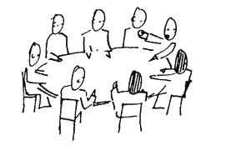
YODA Project Structure
(Form
Groups)
#0
YODA Feature List
Due: 12-Apr 11:55pm
#1
Blog
blogging
#2
Status Update
#3
Draft Paper (report)
#4
Demo & Acceptance Test (conference)
#5
Final Paper (report)
& Code/Resource submission
(Celebrate
)
Notes:
These are the stages of the YODA project. From stage [0] to stage [5]. All the stages, except the zeroth [0] are worth marks (indeed you probably also now know that zeroth is not some sort of monster like an ancient mammoth creature – see if you can confuse anyone with that wonderful ordinal number that is before the first).

Slide 24
Project Teams & Marking
Projects done as teams of 4 or 3 members
(confirm other team sizes with lecturer)
Milestone Dates – leading-up to ‘YODA Conference’
Milestone 0: Group formed and topic Selection | 23 Mar
Milestone 1: Proposal Blog | 12 Apr
Milestone 2: Status Update * (need to schedule with your ‘Team Manager’) | 21 Apr
Milestone 3: Draft paper | 28 Apr
Milestone 4: Demo / Acceptance Test * (need to schedule with your ‘Team Manager’, team manager from other group attend too) | 8 – 12 May
Milestone 5: Final Project Report and Code Repository Hand in | 15 May (final submit)
* Need to actually have something to show beyond just discussion of plans.

Slide 25
The ‘YODA Demo/AT’* approach
*AT = Acceptance Test, used this year
Why?
It is essentially planned around being a small scale experience of the typical ‘R&D progress’ …
The usual Research & Development process (simplified)…
Come up with an idea (or discover a problem to solve)
[do research to see if the problem has been solved perfectly already, lets assume you’re taking the opinion your team wants to do it regardless]
Elucidate the problem and propose a solution (e.g. a conceptual design)
Take on board the feedback to help decide what else to do with the solution
Write about and present what you have achieved to see what others in the feel think of it (peer review)
Prepare a prototype of the solution to test it out
Conference/Demo

Slide 26
Yoda Paper & ‘Conference’
The usual process is as follows.
Prepare and submit an initial paper [in out case a draft]
Usually around 4-6 pages double column
Explain the solution, incl. some background.
Give sufficient explanation, but not too much detail
Get feedback from reviewers [in our case, a team manager]
Reviewers give feedback on what they think, any aspects they found unclear, if it is it useful / sufficiently novel, appropriateness of topic for conference, etc.
Revise the paper
Respond to reviewer requests
Submit revised paper + brief report describing responses made to reviewers’ comments
Present the paper [at an emulated conference]
Usually 8-15 minutes for an engineering conference presentation.
This larger audience (i.e. more than the reviewers) ask questions and give further insights beyond what was gained from the reviewers.

Slide 27
Project Teams & Marking
Important: final report counts the most !
Breakdown of marking
Milestone 0: Group formed and topic Selection | 0%
Milestone 1: Proposal Blog | 5%
Milestone 3: Status update * | 5%
Milestone 4: Draft paper | 5%
Milestone 5: Demonstration / Acceptance Test** | 20%
Milestone 6: Final Project Report and Code Repository Hand in | 65%
* May be more than one ‘status update’ which carries a small mark weight, as in sense and quality of teams response to queries during the project leading up to the main status update meeting.
** Would technically be Alpha Type Acceptance Testing, meaning it would largely have just the usual project team members, maybe some invited viewers / consultants too.
YODA Project counts 15% of course mark

Slide 28
YODA – Purpose
At the end of the course you should have an understanding of how to developed an application accelerator for a PC using either
FPGA / FPGA-simulation and Xilinx-based development tools (and possibly evaluation board if using hardware)
or
Good understanding of using FPGA simulation and means to tested simulated input and output

Slide 29
YODA Design Strategy
In order to trial the reconfigurable aspect, your YODA prototype should support two applications
Application 1: something very simple (i.e., for testing your setup, send/receive data)
Application 2: more sophisticated / meaningful application (e.g., parallel pattern searches)

Slide 30
YODA Plan
Offloads
processing to
PC
(Lab computer)
Windows / Ubuntu
Soft processor
YODA
Your Own
Digital Accelerator
YODA
Form 1
Application 1
Supports
YODA Form 2
Supports
Application 2
Custom logic defined using
Public / freely available VHDL or Verilog HDL code
Peripherals
(e.g. Ethernet device)
Your VHDL or Verilog HDL code
Adapted
from

Slide 31
YODA
Option A or B
App 1 & 2
App 2 = All the bells and whistles, may not be sufficient time to do
App 1 = Backup / fall-back design more achievable in a short time
Let’s see possible examples…

Slide 32
Example Scenario
App 2 = Music synthesizer that can play MIDI files (or similar type) and allows for multiple concurrent instruments, able to
provide smooth sounds with a wide dynamic range.
FPGA Full Synth demo (A).mp4
App 1 = Music Beep Box, has a hard-coded tune sequence
(stored in an array in BRAM) that specifies tone and
duration. Can play one tone at a time.
FPGA Music Beep Box (B).mp4

Slide 33
YODA Presentation
The presentation gives a clear impression of what was done
You choose what to showcase (in the short time available)
Should be close to the final version (the resources of which are submitted to provide evidence of having completed the work), but doesn’t necessarily need to be the final final version.

Slide 34
YODA Report (‘YODA conference paper’)
Use the paper template, and follow the guidelines for the sections (some flexibility in the headings)
Introduction
Brief indication of background / context
Recap your topic and purpose of the solution
Methodology
Procedure followed to design, implement and test the system
Design
High level design
Finite State Machine (FSM) documenting your digital accelerator operation
Pseudo code (if relevant)
VHDL / Verilog snippets (indicating how your FSM was implemented)
Experimentation and Testing procedure
Conclusion and discussion (+ suggested future work, e.g. if another student group were to build upon the work next year)

Slide 35
What you need to do…
for the first two steps of the project

Slide 36
First step on the YODA project
Please start trying to form a YODA team
Teams need to be 4 members (i.e. two prac groups joined together)
Don’t need to choose a topic yet.. can start thinking about it in your teams
Later on
If you’ve chosen your team, please update the YODA team list (Google sheet for this)
Can use the rest of the lecture to continue finding team mates or start discussing possible topics (you might need a smartphone/laptop to visit the website to facilitate this)
Already done?!

Slide 37
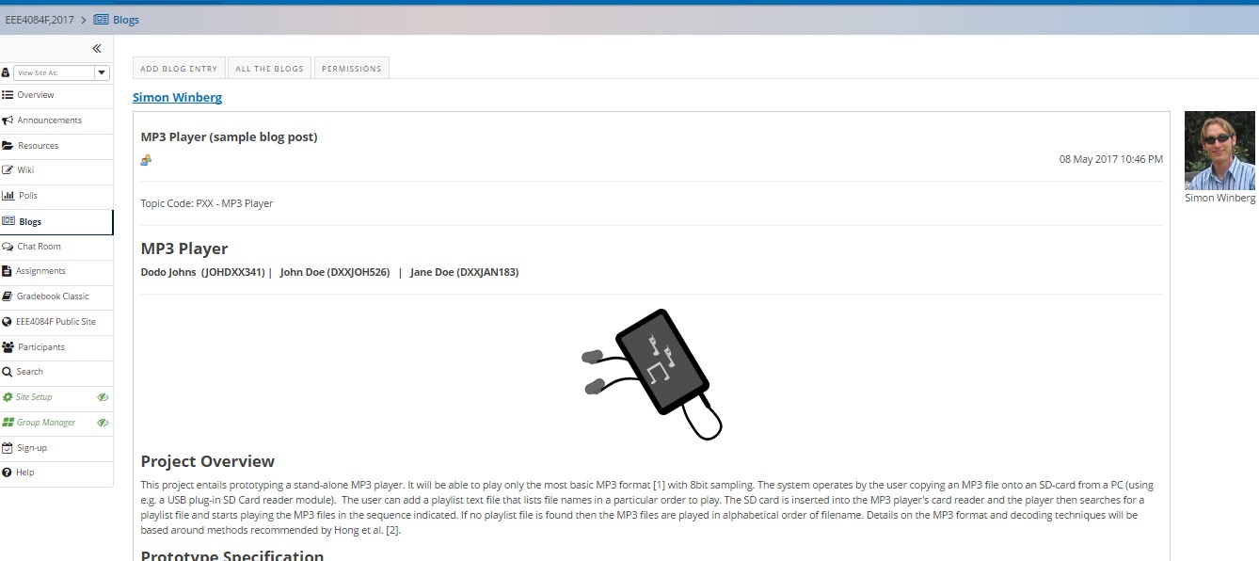
The second step – Milestone 1
Once you’re formed a team you need to get together a conceptual design description and add a blog entry to the Vula site for this
Example of a blog entry showing what is needed

Slide 38
Conclusion of YODA Project Intro
EEE4120F

