Slide 1
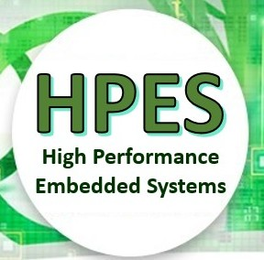

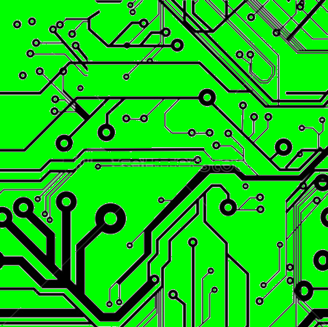
EEE4120F
High Performance
Embedded Systems
Lecture 12a:
Distributed and Shared Memory
Architectures
(This provides a fairly high-level discussion of these issues which are explored in more depth next term)
Presented by
Simon Winberg
Attribution-ShareAlike 4.0 International (CC BY-SA 4.0)
Notes:
Greetings students, this lecture is about distributed memory and shared memory. These terms do not refer to the same thing, even though at first glance it may sound that way. Distributed memory is split between machines, whereas shared memory is located on a machine and shared between multiple processors.

Slide 2
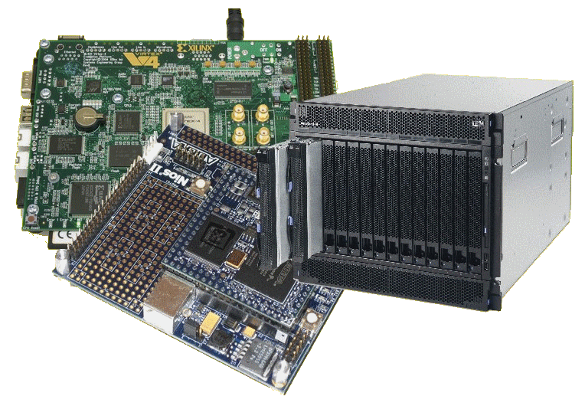
Lecture Overview
Distributed memory infrastructure
Shared memory infrastructure
Hybrid memory infrastructure
Warming up for MMU, DMA and memory considerations to get into next term
(this version does not include Verilog scenarios, those moved to later lecture)
Notes:
Here’s the overview of this lecture.
These terms are not limited to thinking about parallel computing, they are also useful in referring to computer system design and application program design strategies. When you use a distributed memory library in software, you of course need underlying and hardware and computing infrastructure to accommodate such needs. Similarly for shared memory, you can only use a software library like OpenML if you have some sort of underlying shared memory infrastructure on the platform used.

Slide 3
Distributed vs. Shared Memory
We discussed communication for shared memory in Lecture 11… and that such communication is likely invisible.
Message passing, often used in distributed memory, is often more visible communication.
But what are the hardware approaches to implement shared and distributed memory?
The aim of this lecture is to touch on those aspects briefly so that you have an understanding of how it can be done.
Notes:
In lecture 11 there was a brief mention of visibility of communications regarding shared memory, more specifically the visibility of communication in shared memory systems versus distributed memory systems.
Message passing, which is often used in distributed memory, have more visible communication… then compared to shared memory which may have entirely invisible communications.
But what are the hardware approaches to implement shared versus distributed memory systems?
The aim of this lecture is to touch on these aspects briefly so that you have an understanding of how this cab be done.

Slide 4
Distributed memory infrastructure
EEE4120F
Notes:
We’re going into distributed memory first. In terms of infrastructure, this tends to demand less complex hardware. Certainly, even an old-style Von Neumann could probably provide an adequate – if slow and cumbersome - infrastructure on which a distributed memory application program could run.

Slide 5
Distributed Memory – the model
The distributed model of memory is based around interconnected processing nodes, each having have their own memory. It involves: interconnects, the processors, and the processors’ memory, as illustrated:
Interconnect
P1
P2
…
Pn
These processing nodes only have direct access to memory that they control.
M1
M2
…
Mn
Notes:
The distribution memory model is based around interconnected processing nodes. Each node has a processor and memory that is it directly attached to, as is illustrated in the model below.
If we think, for a moment, about processor and memory interaction, such as a link, P1 to M1, this goes though some sort of direct memory control interface. This memory interface is only accessible by P1, not any of the other processors. Clearly, this alludes to a simpler design. In a typical Von Neuman for example, you’d just need instructions for load and store (e.g. LDR and STR in the ARM instruction set). There is no need for specific instructions to request access to the memory interface, because it is only the processor that is using it. You might be wondering about DMA peripherals – in other words direct memory access peripherals like a GPU – guess what; that’s generally not classified as distributed memory because the GPU generally has access to memory that is shared with the processor (and indeed in that situation there is need for additional instructions for memory sharing).
My reasoning for mentioning this is because you should be thinking of computer architecture, not just memory use at the software level.
In summary, distributed memory can be considered both an architectural approach as well as a software approach, in which the memory concerned is only accessed directly – as in via a connected address bus – by one of the processors in the system.

Slide 6
Distributed Memory – advantages
Main advantages of distributed memory:
Memory is scalable, although limited by number of connected processors (i.e. can add processors with memory to the network to get more memory)
Can build very large systems, possibly many 1000s of processing nodes!
Each processor has rapid access to its own memory without interference or cache coherency problems cause by other processors
Cost effective. Easier to build (just use off-the-shelf / easily purchased parts)
Notes:
Main advantages of distributed memory…
It is scalable but limited by number of connected processors in the connected system.
This approach is highly scalable, it can be used for building very large systems, possibly even 1000s of processing nodes.
Each processor has rapid access to its own memory without interference or cache coherency problems cause by other processors accessing the same memory.
It is cost effective. Easier to build, for instance just using off-the-shelf parts connected using a network protocols like TCP/IP – or an API library such as the Message Passing Interface (MPI) that provides functions for distributed memory.
Reminder about Horizontal vs. Vertical scalability of computing. The primary difference is:
Horizontal scaling involves adding more machines or nodes to a system
Vertical scaling involves adding more power (more CPU or RAM/storage, etc.) to the existing machine (or replacing / upgrading the machine)

Slide 7
Distributed Memory – disadvantages
To read or write information from/to another processor’s memory, a message must be sent over the network to processor concerned.
Need to keep track somehow of where the memory is, i.e. who has it. (although things like memory brokers can be used instead to offload this task)
Programmer is responsible for many of the details of the memory access and possibly communication – more places that mistakes can creep in
May be difficult to distribute a complex data structure, and parallelize how maintenance and synchronization of such a data structure is done (e.g., think of possibly many processor working collaborating on an image, there may be stages where multiple processors are contending for access simultaneously).
Notes:
Main disadvantages of distributed memory…
Needing to send messages between processors to read or write data.
Need to keep track of where memory is, and likely software-level management of who currently has write and/or read access to it.
Programmer has responsibility for providing ways to access and manage the distributed memory.
May be difficult to distribute a complex data structure, such as one that depends on many pointers that could link to pieces of data that reside on various machines.

Slide 8
Distributed Memory – Programming Models
You might already know about the most popular one:
Message Passing Interface (MPI)
Others:
Parallel Virtual Machine (PVM): https://en.wikipedia.org/wiki/Parallel_Virtual_Machine
LibDSM: (quite different to MPI): https://github.com/Micrified/libdsm
OpenSHMEM (some similarities to MPI, at least OpenMPI and can translate between easily): http://openshmem.org/site/About
Notes:
Here are some popular distributed memory programming models.
The most significant and most commonly used ne is the MPI, the Message Passing Interface.
Other libraries include:
The Parallel Virtual Machine, or PVM, libraries
Lib DSM and Open SH MEM (this last one being somewhat like an extension of MPI)

Slide 9
Distributed Memory – is it No Remote or Remote?
Basically indicate if an external network, e.g. needing switches, are involved…
NORMA = NO Remote Memory Access
Nodes connected via network adaptors to external switches
RMA = Remote Memory Access
Processing nodes connected via internal special interconnect hardware (e.g. SMP)
Often allows one-sided memory transfers (i.e. a get, or a put at a time)
Notes:
Distributed memory models can generally be divided into two forms:
NORMA or RMA
NORMA stands for NO remote memory access. This is where nodes are generally connected via network adapters. A basic von Neumann would fit into this class. This tends to imply a simpler architecture design, where each processor may be on a separate machine that is connected to a network.
RMA stands for the Remote Memory Access model. This is where processing nodes connect via special interconnection hardware… so this implied a potentially complex computer architecture and specialized instructions. But this is not deemed shared memory because the processors need to chat a bit to handle transfers. This tends to involve one processor asking another one to do a get or put of data. So this is effectively not shared memory as multiple processors cannot directly access all parts of a shared block of memory. For a processor to access a block of memory it is not directly connected to, it would need to get another processor involved in assisting with the data transfer.
(Illustration needed? Tend to scribble something on the board. Bit too much detail perhaps).

Slide 10
Shared memory infrastructure
EEE4120F
Notes:
Now, let us switch over to consideration for a shared memory computing infrastructure …

Slide 11
Shared Memory – the model
To be more precise, this is more accurately described as “shared memory address space accessible by all processors”
Shared Memory
The physical memory hardware modules storing the data may still be distributed somehow, but the different processing nodes use the same address to access a particular data item.
…
Interconnect
P1
P2
…
Pn
Notes:
The shared model can be more accurately described as a computer system with a shared memory address space that is accessible by all processors. Just to say this in another way, to be even clearer, these computer system have at least some, not necessarily all, of its memory that can be accessed directly by other processors on the same platform.
A model of this structure is given below.
As shown, there is an interconnect hardware structure that enables the processors to directly access shared memory. The shared memory is accessible by all the processors using the same addresses. The sophistication of this interconnect might differ significantly between architectures. A simple approach would be that only one processor can connect to the interconnect for either read or write at a time. This may involve a interconnect request instruction, and once access is provided the processor does a read or write operation, possibly both at the same time if there are separate address and data lines for this. Note that this is not the same as the get or put as in the distributed memory case; these reads or writes for shared memory would not involve asking another processor to do those operations, the processor would be connecting directly to the memory.
Further point is that this model is a bit of a simplification, for a case of instruction-based processors. Nowadays (or the past decade or so) it would be unusual for a CPU, in a multicore architecture, not to have some sort of local, non-shared memory dedicated to it, at least cache memory. Although this model, as is with only shared memory, sometimes does applies to FPGA-based computing where it may be effective for all sorts of processing elements to connect to a block of shared memory without having dedicated local memory.

Slide 12
Shared Memory – complications for cache and local memory
The processors may have their own local memory (e.g. caches) to hold copies of some global memory to boost performance.
Maintaining the consistency of such copies (caches) is usually done by specialized hardware

Slide 13
Shared Memory – Programming Models
You already know about the most popular ones:
pThreads (in Linux)
OpenMP
(not necessarily MPI… although it might end up using shared memory, possibility not knowing it is shared memory, or the library might be design to leverage shared memory for nodes that can access it)

Slide 14
Shared Memory – Advantages
Global address space is more user-friendly for the programmer.
Allows potential to use data structures, possibly even reusing the code without needing changes, and for the programmer to do so efficiently and with little modification
Overall, Typically easier to program, less worry about explicit messaging between processors; provides:
Implicit communication in response to use of shared data (i.e. happens behind-the scenes, out of sight of programmer)
May, highly likely, will still need explicit synchronization and/or use of semaphores (i.e. to avoid multiple processors writing to the same location at once)
Data sharing (communication) between tasks is very fast (not needing to be packed into messages send between processors)
(Many of these points are mentioned in the OpenMP lecture)
Notes:
Here are some advantages of shared memory….
Global address space is more user-friendly for the programmer.
Allows potential to use data structures, possibly even reusing the code without needing much if any changes… since the shared memory libraries are typically about supporting memory or pointer type access to the shared memory.
Overall, it is typically easier to program methods that use share memory competed needing explicit messaging and memory transfer techniques for distributed memory,
Shared memory still needs explicit synchronization and/or semaphores to manage access to the memory. This is something that can be more implicit, as in non-programmed, when using distributed memory since it involves processors ‘talking’ with one another to get and put data.

Slide 15
Shared Memory – Disadvantages
Needs specialized and likely expensive hardware for efficient (and scalable) memory access and cache coherence
Tends not to be so scalable, may be limited to what is provided by the computer system (e.g. limited to say 10s to 100s of nodes; although in the case of GPUs many 100s available … but GPU kernels are usually much smaller and more focused than full application programs)
Notes:
Shared Memory – some Disadvantages
Needs specialized and likely expensive hardware for efficient and scalable memory access together with cache coherence.
Tends not to be as scalable as distributed memory (for instance limited to around maximum of 10s of nodes otherwise the memory interconnects become prohibitively complex and expensive.

Slide 16
Shared Memory – Access Time Classifications
UMA (Uniform Memory Access)
Equal access times to memory from each processor (most SMP provide this)
Almost always cache-coherent
Interconnects tends to be either*:
Bus: easier, and cheaper, but less scalable access time. (i.e. multiple processors share common memory bus to access global memory).
Crossbar: more difficult to implement, and more expensive (e.g. on FPGA takes more logic, essentially an exponential growth problem) but the very scalable speed.
* This is one of the important trade-off decision in designing these systems… A bus is highly scalable for adding systems, but not scalable in speed: more systems means more traffic and likelihood of slower transfers. Whereas the crossbar is the option: a specific crossbar design is fixed to connect only the chosen number of nodes, but provide good speed between any of the nodes wanting to connect.
Notes:
Illustration?!

Slide 17
Shared Memory – Access Time Classifications
NUMA (Non-Uniform Memory Access)
Usually this is just a linking of multiple UMA nodes with a switching network (much like the Hybrid model which is next)
Nodes that share UMA can share memory more efficiently… but there may still be issues of synchronizing with all the other nodes / maintaining chace coherence on other machines
The cc-NUMA: a NUMA system enhanced to maintain fast cache coherence with other nodes.
* This is one of the important trade-off decision in designing these systems… A bus is highly scalable for adding systems, but not scalable in speed: more systems means more traffic and likelihood of slower transfers. Whereas the crossbar is the option: a specific crossbar design is fixed to connect only the chosen number of nodes, but provide good speed between any of the nodes wanting to connect.
Notes:
Illustration?!

Slide 18
Hybrid Memory
Hybrid Memory is the logical extension of combining the best aspects of the distributed and shared memory architectures
This brings us back to the ideal coupling of the MPI and the OpenMP households… essentially uses:
Message passing between nodes + Multi-threading within nodes
Other (commercial) examples of using Hybrid memory: IBM BlueGene/P; Cray XT4
Notes:
If the MPI vs. OpenMPI lecure was not given this year (to cut down on content) you can still ask for these slides and related links to be shared with you (this could be useful for preparing for a career direction where you would be keen on using these commonly used tools and libraries, there are many industries that look for developers that have this experience.

Slide 19

Hybrid Memory
Two typical forms of hybrid memory…
Clusters of shared memory nodes, where:
Number of nodes >> number processors within node
Often use small, cheap SMP nodes (rack-mounted)
(These are sometimes called clumps within a cluster)
Commonly uses a standard network (e.g., Gigabit Ethernet)
Constellation systems
Number of processors inside node > number of nodes
Comprises larger, more costly UMA or cc-NUMA nodes
Commonly uses special high-speed interconnects
Jellybean bags case

Slide 20
MMU, DMA and other specialized memory hardware facilities …
This lecture has intentionally not gone into issues of datapaths connecting with memory, FPGA memory solutions, or Digital Accelerators and memory … it is just a mild warm-up to get you thinking about these memory models and ways to share memory between collaborating processors (not necessary just CPUs)
Topics that will be covered next term include:
Memory Management Units (essential component of implementing an effective memory architecture for a computer or digital accelerator)
Direct Memory Access (DMA) and their flavors
Other considerations for memory
Notes:
What of Memory Management Units (or MMUs), Direct Memory Access and other specialized memory hardware facilities.
Well, this lecture has intentionally not gone into issues of datapaths and ways of connecting memory or FPGA memory solutions for Digital Accelerators.
I’m taking something of a top-down approach in this course. We’ve looked at high-levels of connecting and using memory, we are yet to go into implementation and hardware design specifics for this.
So, this has been something of a mild warm-up to get you thinking about memory models, as well as terms that are used in discussing memory design strategies.
This lecture bridges towards more Verilog and digital hardware design issues that is a major focus of next term.
On that issue, major points about memory that are discussed next term include:
Essentials for Memory Management Units (or moos and I sometimes call them)
Flavours of DMA (most of which are an acquired taste and hardly sweat)
And other memory related considerations.

Slide 21
Concluding high-level system design considerations
This lecture concludes high-level design concepts for parallel systems
You might now be wondering what is next in this course… let’s get directly into that!

Slide 22




ready for launch into…
HDL, FPGA &
Digital Accelerator Design

Slide 23

Next week (next term!) plans …
The YODA mission begins!
Thoughts of using iVerilog and where and how that can be used in exploring digital system / SoC design

Slide 24
Disclaimers and copyright/licensing details
I have tried to follow the correct practices concerning copyright and licensing of material, particularly image sources that have been used in this presentation. I have put much effort into trying to make this material open access so that it can be of benefit to others in their teaching and learning practice. Any mistakes or omissions with regards to these issues I will correct when notified. To the best of my understanding the material in these slides can be shared according to the Creative Commons “Attribution-ShareAlike 4.0 International (CC BY-SA 4.0)” license, and that is why I selected that license to apply to this presentation (it’s not because I particulate want my slides referenced but more to acknowledge the sources and generosity of others who have provided free material such as the images I have used).
Image sources:
Pixabay
commons.wikimedia.org
Images from flickr

