Slide 1
EEE4120F
High Performance
Embedded Systems
Lecture 11:
Design of
Parallel Systems
PART 3/3
Presented by
Simon Winberg
Attribution-ShareAlike 4.0 International (CC BY-SA 4.0)

Slide 2
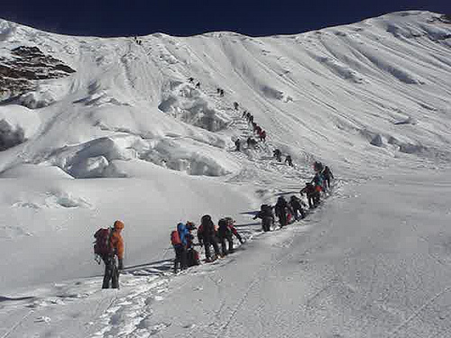
Steps in Designing Parallel Programs
Hardcore competent HPES programmers
(leading the way to greater feats)
Continuing the path to HPES Applications
EEE4120F
Sequential programmers in their comfort zone.

Slide 3
The steps in designing parallel programs
The hardware may be done first… or later.
The main steps:
Understand the problem
Partitioning (separation into main tasks)
Granularity
Communications
Identify data dependencies
Synchronization
Load balancing
Performance analysis and tuning
…
PART 3/3
this lecture
see
lecture 10
PART 2/3
prev. lecture

Slide 4
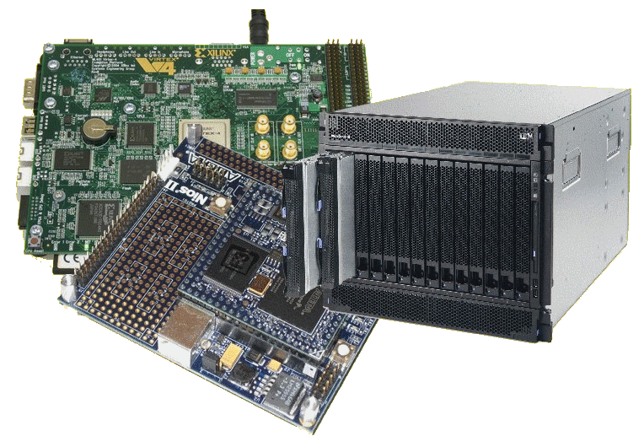
Lecture Overview
Step 4: communication
Factors related to Communication
Cost of communications
Latency vs. Bandwidth
Baud rate vs. Bandwidth
Effective bandwidth
Visibility of Communications
Synchronous vs. asynchronous
Scope of comms
Collective communications
Efficiency of communications
A lot going on with communications!

Slide 5
Brief mention of systems thinking …
Not examined
EEE4120F
Reasoning for why this is mentioned:
Systems thinking gives a useful perspective and thinking approach for thinking about the interconnectedness of complex computer systems, not just how their constituent pieces communicate with one another, but also how the system being built is part of a larger system, workplace, environment or ecology. Thus it encourages not just a focus on the system being designed but the awareness of relevant scientific knowledge and potential impact or dependence that the system has on related or broader systems it fits within. (These slides should were suppose to have been discussed prior to the GA assignment).

Slide 6
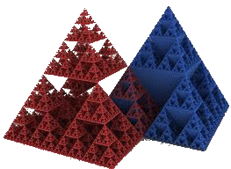
Different perspectives: Gaining a better understand of the problem
Not examined
General Systems Thinking (GST)
Critical Analysis
(& Critical Thinking)
Applying rational and logical thinking while deconstructing texts or subject matter studied.*
How does the problem of focus relate to more general problems?
What other systems are being depended on or are affected?
Has a systems approach been considered in addition to the usual divide and simplify approach?
Let’s consider what happens, in a logical scientific / deductive manner, if we discard or replace some of the traditions or ‘conditioned choices’.
Reflecting on choices and descriptions
Considering ‘what if…’ scenarios (e.g. what if a chair had only one leg instead of four)
See last page for suggested sites to learn more about critical analysis
* Adapted from: Browne, M & Keeley, S 2001, Asking the right questions: a guide to critical thinking, 6th edn, Prentice-Hall, Upper Saddle River, N.J.

Slide 7
Video Clip: Systems Thinking
Not examined
This is a suggested video clip to view for gaining an insight into what Systems Thinking is about.
YouTube clip: Systems thinking introduction
https://youtu.be/Fo3ndxVOZEo

Slide 8
Step 4: Communication
Like Bobby Womack says …
EEE4120F
* Media clip source: Quality sounds of ‘Communication’ by Bobby Womack https://youtu.be/jk-gP8oBihA

Slide 9
Lets try to…
Get the
Communications Right
to get our
Systems Right
( PS: that’s not necessarily a blast from the past!! You might still be making those noises but higher frequency ☺ )

Slide 10
Step 4: Communications
The communications needs between tasks depends on your solution:
Communications not needed for
Minimal or no shared data or results
E.g., an image processing routine where each pixel is dimmed (e.g., 50% dim). Here, the image can easily be separated between many tasks that act entirely independently of one other.
Usually the case for embarrassingly parallel solutions4

Slide 11
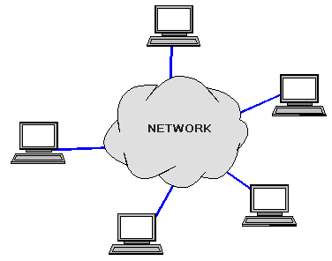
Communications
The communications needs between tasks depends on your solution:
Communications is needed for…
Parallel applications that need to share results or boundary information. E.g.,
E.g., modeling 2D heat diffusion over time – this could divide into multiple parts, but boundary results need to be shared. Changes to an elements in the middle of the partition only has an effect on the boundary after some time.

Slide 12
Factors related to Communication
Cost of communications
Latency vs. Bandwidth
Visibility of communications
Synchronous vs. asynchronous communications
Scope of communications
Efficiency of communications
Overhead and Complexity

Slide 13
Cost of communications
Communication between tasks has some kind of overheads, such as:
CPU cycles, memory and other resources that could be used for computation are instead used to package and transmit data.
Also needs synchronization between tasks, which may result in tasks spending time waiting instead of working.
Competing communication traffic could also saturate the network bandwidth, causing performance loss.

Slide 14
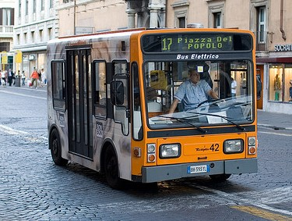
Latency vs. Bandwidth
Communication Latency =
Time it takes to send a minimal length (e.g., 0 byte) message from one task to another. Usually expressed as microseconds.
Bandwidth =
The amount of data that can be sent per unit of time. Usually expressed as bits per second (bps) or megabits/sec, and sometimes for convenience as megabytes/sec or gigabytes/sec.

Slide 15
Latency vs. Bandwidth
Many small messages can result in latency dominating communication overheads.
If many small messages are needed:
It can be more efficient to package small messages into a larger ones, to increasing the effective bandwidth* of communications.
* Explained soon!

Slide 16
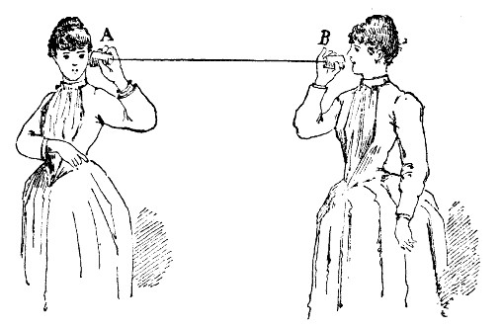
Baud rate vs. Bandwidth
Avoid misuse of these terms by using them interchangeably
The general public seem to think these refer to the same thing, and in some cases, from a user perspective, this may be OK.
Nevertheless an engineer should know that: baud specifies the symbol rate (or signal changes) per unit of time, and this could be an entirely analogue measure.
Bandwidth is different depending whether you are considering computer networks/telecoms or signals more generally (e.g. in a RF system). For computing Bandwidth is a measure of data rate in bits per second. But more generally in the electrical engineering Bandwidth refers to the frequency range within a particular band (typically a band that is used for transmitting some sort of signal).
My dear Alice, it is much the same as your end. About 200 Southern twangs per minute.
I say, Beatrice, how is the baud rate on your end?
B
A

Slide 17
Baudrate – an issue of standards (from a computing/telecoms perspective)
Baudrate is not always interpreted the same way for all applications when it comes to deciding the amount of bytes that the link provides.
This is due to other aspects of the protocol used, e.g. if each byte is surrounded by error detection bits.
Further reading: http://en.wikipedia.org/wiki/Baud

Slide 18
Baudrate – an issue of standards (from a computing/telecoms perspective)
Remember:
A byte is always understood as 8 bits – but the byte is just the ‘useful data’ that is being transferred.
If the connection is specified as a speed in bits per second, then it is 8 bits per byte.
When you specify the speed in baud rate, you're specifying symbol rate (see previous slide) in which case you might be using 10 symbols to a byte when using start-data-stop or 8b/10b encoding schemes.
So, in other words you may quite likely find yourself in a situation where you have a bandwidth of say 1Mbps but a baud rate of 1.25 mega symbols per second.
Further reading: http://en.wikipedia.org/wiki/Baud

Slide 19
Baudrate – an issue of standards (from a computing/telecoms perspective)
There is even an official SI unit for “baud”
It is written as "Bd" units for specifying symbol rate
This should not be confused with the more commonly known bps (bits per second) or Bps (bytes per second).
So you should now know: x MBd is not always = x Mbps
Example:
If you have an 8b/10b encoded line that has a bandwidth of 10 MBd, you can automatically say that it has a bandwidth of 8 Mb/s, or 1 MB/s (excluding other overhead such as packet headers, of course).
MBps
Further reading: http://en.wikipedia.org/wiki/Baud
Mbps

Slide 20
Suggested further reading on baud rate and bandwidth
Supplementary reading
If you’re one of those super keen students, you might like to look at these nuggets of knowledge and web pages for further reading on this topic:
PCIe 1.0 and 2.0 (including Ethernet and USB) uses 8b/10b encoding. PCIe 3.0 and 4.0 uses 128b/130b encoding. Read more at: http://en.wikipedia.org/wiki/PCI_Express#History_and_revisions
Historically, Hamming code refers to the Hamming (7, 4) code, which uses 7 symbols for every 4 data bits. There are many other variations on this which you can explore at http://en.wikipedia.org/wiki/Hamming_code
DVD encoding uses Reed-Solomon error correction in two stages (note, in case you were wondering, this encoding has nothing to do with grass or mines) read more at http://en.wikipedia.org/wiki/Reed%E2%80%93Solomon_error_correction#Data_storage.
There are even more interesting cases where run-length limited codes are used with error correction and (for argument sake) 16 QAM signal encoding. 1 MBd 16 QAM has a bandwidth of 4 Mb/s (rather interesting case because the baud rate here is a quarter of the bit-rate! You also get 32, 64, 128 and 256 QAM systems....)
(these readings are not examined)
Acknowledgement: thanks to John-Philip Taylor for these interesting reading suggestions.

Slide 22
Effective bandwidth
PS: a favourite thing to ask in tests and exams
Total latency =
Sending overhead + Transmission time + time of flight + Receiver overhead
Effective bandwidth = Message size / total latency
Sending overhead
Transmission time
Time of flight
Transmission time
Receive overhead
Transport latency
Total latency
time of flight is also referred to as ‘propagation delay’ – it may depend on how many channels are used. E.g. a two-channel path will give an effective lower propagation. With switching circuitry, the propagation delay can increase significantly.

Slide 23
Effective bandwidth calc.
CLASS ACTIVITY 1!
Sample Question…
Example:
You are wanting to connect two computers together using a copper wire.
The distance between them is: 100m
Raw bandwidth (limited by comms devices) of the channel is: 10Mbit/s
Message to send is: 10,000 bytes
Sending device overhead: 200us
Receiving device overhead: 300us
TODO: Calculate the Effective Bandwidth of this connection.
Get a copy of the handout. Can work in teams.

Slide 24
Effective bandwidth calc.
CLASS ACTIVITY 1
SOLUTION!
Message 10,000 bytes
Sending overhead 200us
Receiving overhead 300us
Example:
Distance 100m
Raw bandwidth 10Mbit/s
TODO: Calculate the Effective Bandwidth of this connection.
Solution: …
Transmission time = 80,000 bits
=
80,000 bits
=
8,000 μs
10Mbits/s
10bits/μs
Time of flight =
100m
=
1m
=
0.33 μs
3 x 10⁸ m/s
3 x 10⁶ m/s
Total latency =
Sending overhead + Transmission time + time of flight + Receiver overhead
Total latency =
200μs + 8,000μs + 0.33μs + 300μs = 8,500.33μs
Effective bandwidth = Message size / total latency
94% efficient
Effective bandwidth = 80,000bits / 8,500μs = 9.41 Mbits/s

Slide 25
Visibility of Communications
Communications is usually both explicit and highly visible when using the message passing (MP) programming model.
Communications may have poor visibility when using the data parallel programming model (e.g. shared memory).
For data parallel design on a distributed system, communications may be entirely invisible, in that the programmer may have no understanding (and no easily obtainable means) to accurately determine what inter-task communications is happening.

Slide 26
Synchronous vs. asynchronous
Synchronous communications
Require some kind of handshaking between tasks that share data / results.
May be explicitly structured in the code, under control of the programmer – or it may happen at a lower level, not under control of the programmer.
Synchronous communications are also referred to as blocking communications because other work must wait until the communications has finished.

Slide 27
Synchronous vs. asynchronous
Asynchronous communications
Allow tasks to transfer data between one another independently. E.g.: task A sends a message to task B, and task A immediately begin continues with other work. The point when task B actually receives, and starts working on, the sent data doesn't matter.
Asynchronous communications are often referred to as non-blocking communications.
Allows for interleaving of computation and communication, potentially providing less overhead compared to the synchronous case

Slide 28
Scope of communications
Scope of communications:
Knowing which tasks must communicate with each other
Can be crucial to an effective design of a parallel program.
Two general types of scope:
Point-to-point (P2P)
Collective / broadcasting

Slide 29
Scope of communications
Point-to-point (P2P)
Involves only two tasks, one task is the sender/producer of data, and the other acting as the receiver/consumer.
Collective
Data sharing between more than two tasks (sometimes specified as a common group or collective).
Both P2P and collective communications can be synchronous or asynchronous.

Slide 30
Collective communications
Typical techniques used for collective communications:
BROADCAST
SCATTER
Task
Task
Task
Task
Task
Task
Same message sent to all tasks
Different message sent to each tasks
Initiator
Initiator
REDUCING
GATHER
Task
Task
Task
Task
Task
Task
Only parts, or reduced form, of the messages are worked on
Messages from tasks are combined together
Task
Task

Slide 31
Efficiency of communications
There may be a choice of different communication techniques
In terms of hardware (e.g., fiberoptics, wireless, bus system), and
In terms of software / protocol used
Programmer may need to use a combination of techniques and technology to establish the most efficient choice (in terms of speed, power, size, etc).

Slide 32
Intermission
Onwards to distributed and shared memory architecture models …

Slide 33
Disclaimers and copyright/licensing details
I have tried to follow the correct practices concerning copyright and licensing of material, particularly image sources that have been used in this presentation. I have put much effort into trying to make this material open access so that it can be of benefit to others in their teaching and learning practice. Any mistakes or omissions with regards to these issues I will correct when notified. To the best of my understanding the material in these slides can be shared according to the Creative Commons “Attribution-ShareAlike 4.0 International (CC BY-SA 4.0)” license, and that is why I selected that license to apply to this presentation (it’s not because I particulate want my slides referenced but more to acknowledge the sources and generosity of others who have provided free material such as the images I have used).
Image sources:
Clipart sources – public domain CC0 (http://pixabay.com/)
PxFuel – CC0 (https://www.pxfuel.com/)
Pixabay
commons.wikimedia.org
Images from flickr

