Slide 1
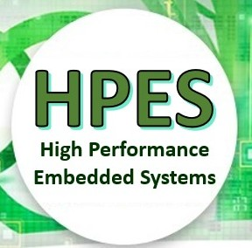
EEE4120F
High Performance
Embedded Systems
Lecture 10:
Design of
Parallel Systems
PART 2/3
Presented by
Simon Winberg
Attribution-ShareAlike 4.0 International (CC BY-SA 4.0)

Slide 2
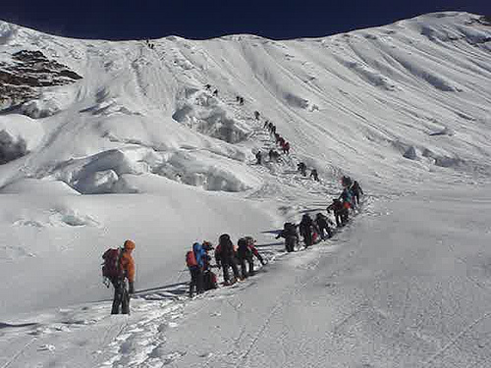
Steps in Designing Parallel Programs
Continuing the path to HPES Applications
Hardcore competent HPES programmers
(leading the way to greater feats)
Hey, guys!
I forgot my warm jacket, can we go back??
EEE4120F
Sequential programmers in their comfort zone.

Slide 3
The steps in designing parallel programs
The hardware may be done first… or later.
The main steps:
Understand the problem
Partitioning (separation into main tasks)
Granularity
Communications
Identify data dependencies
Synchronization
Load balancing
Performance analysis and tuning
next week
…
PART 2/3
this lecture

Slide 4
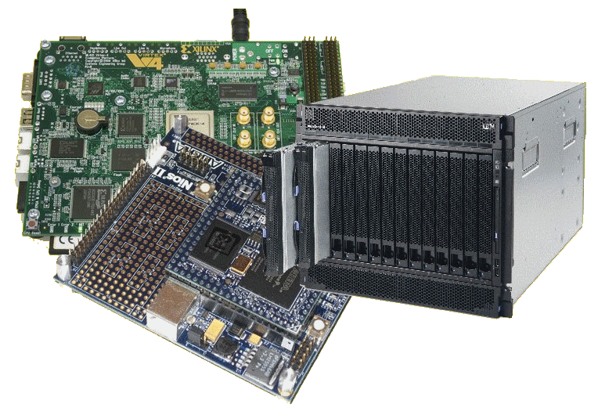
Lecture Overview
Step 6: Synchronization
Step 7: Load balancing
Step 8: Performance analysis and tuning

Slide 5
Steps in designing parallel programs
The hardware may come first or later
The main steps:
Understand the problem
Partitioning (separation into main tasks)
Decomposition & Granularity
Communications
Identify data dependencies
Synchronization
Load balancing
Performance analysis and tuning
later

Slide 6
Step 6: Synchronization
Design of Parallel Programs
EEE4120F

Slide 7
Types of Synchronization
Barrier
Locking / Semaphores
Synchronous communication operations

Slide 8
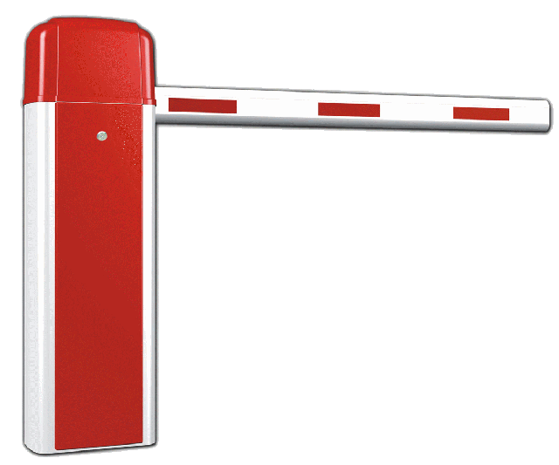
Barrier
All tasks are involved
Each task does work until it reaches the barrier, and then blocks.
When the last task reaches the barrier all the tasks are synchronized.
What happens next?…
Section of work is done or
Tasks are automatically released to continue their work… programmer usually decides.

Slide 9
Locking / Semaphores
May concern any number of tasks
Usually used to serialize / protect access to global data or critical section of code.
Only one task at a time may have the lock / semaphore.
Tasks can attempt to get the lock need to wait for the task that has the lock to release it, granted on a FCFS basis.
Usually blocking, could be non-blocking (i.e., do other work until lock is available)

Slide 10
Synchronous communication operations
Concerns only tasks executing a communication operation (or comms op)
When a task performs a comms op, some form of coordination is required with other task(s) involved with this communication.
For example, before a task can do a send operation, it needs to first receive a clear to send (CTS) signal from the task it wants to send to.

Slide 11
Step 7: Load Balancing
EEE4120F

Slide 12
Load Balancing
Distributing work among tasks so that all tasks are kept busy most of the time
Mainly a minimization of idle time
Relevant to parallel programs for optimizing performance.
e.g., if every tasks encounters a barrier synchronization point, the slowest task will end up limiting the overall performance.
Relevant to costing, e.g. deciding number of processors needed (can also be used in substantiating the need for a more, rather than less, expensive platform)

Slide 13
Load Balancing – simple trial technique
prog_start
logt[1].start
idle
…
typedef struct { unsigned start, end; } LogEntry;
LogEntry logt[1024];
int logn = 0;
unsigned prog_start, prog_end;
void* task (void* arg)
{
unsigned int end;
unsigned int start = clock();
// do work
// calculate time it took
end = clock();
// update time log
pthread_mutex_lock(&mutex);
logt[logn].start = start; logt[logn].end = end; logn++;
pthread_mutex_unlock(&mutex);
}
logt[0].start
logt[0].end
logt[1].end
busy
prog_end
… in main() get prog_start time, create mutex & threads, wait join, get prog_end time.

Slide 14
Load Balancing – simple trial technique (cont)
...
double calc_stat_stddev ()
{ // calculate standard deviation of busy times
int i;
double sum = 0;
for(i = 0; i < logn; i++) sum += logt[i].end - logt[i].start;
double mean = sum / logn;
double sq_diff_sum = 0;
for(i = 0; i < logn; ++i) {
double diff = logt[i].end - logt[i].start - mean;
sq_diff_sum += diff * diff;
}
double variance = (double)sq_diff_sum / logn;
return sqrt(variance);
}
…

Slide 15
Load Balancing
Well balanced – low standard deviation in busy time*
Task 1
time busy
Time idle
Task 2
time busy
Time idle
Task 3
time busy
Time idle
Task 4
time busy
Time idle
Overall
time busy
Time idle
Poorly balanced – high standard deviation in busy time
Task 1
time busy
Task 2
busy
Time idle
Task 3
time busy
Time idle
Task 4
busy
Time idle
Overall
time busy
Time idle
* You could obviously use idle time – but that’s probably more difficult if using code in prev. slide

Slide 16
Achieving load balance
Two general techniques…
Equally partition work as a preprocess
Workload can be determined accurately before starting the operation
Dynamic work assignment
For operations where the workload is unknown, or cannot be effectively calculated, before starting the operation

Slide 17
Achieving balance – Work assignment as pre-process
Examples include
Array or matrix operations for which each task performs similar work. Can evenly distribute the data set among tasks / available processors.
Loop iterations where the work in each iteration is similar, and can be evenly distributed.
May be less easy to do if using a heterogeneous mix of machines that have varying performance characteristics. In such cases, a comprehensive analysis tool may be needed to determine load imbalances and revise work disctribution.

Slide 18
Achieving balance – Work assigned dynamically
Examples include
Sparse arrays/matrices (i.e., if matrix simply divided equally, some tasks may have lots to do but others little to do)
N-body simulations (particles owned by some tasks may involve more work than others)
Adaptive grid refinement (some tasks may need to refine their grips)
General principle: tasks that are busier send a request for assistance, whereas tasks that complete quickly are available to help the busier tasks.

Slide 19
Vertical vs. horizontal load balancing
Recommended video clip to view
Load Balancing with Cloud Computing.mp4

Slide 20
Vertical vs. horizontal load balancing
Vertically:
More power, but centralized (one app. may run faster / more response / less latency for RT)
Adding CPUs + memory to one system
More dependent on one machine / group of closely coupled machines
Horizontally:
More power, but wider distribution (more apps able to run at one time)
Simpler scalability
More distribution / redundancy / better risk management
MOPS
…
MOPS

Slide 21
Step 8: Performance analysis
EEE4120F

Slide 22
Performance analysis
Simple approaches involve using timers (i.e., as shown in previous code snippet)
Usually quite straightforward for a serial situation or global memory
Monitoring and analyzing parallel programs can get a whole lot more challenging than for the serial case
May add comms overhead
Needing synchronization to avoid corrupting results, … could be a nontrivial algorithm itself

Slide 23
MPI Timing functions
NB: MPI optional in 2023
MPI_Wtime
Returns the elapsed wall clock time in seconds (a double) on the calling processor
MPI_Wtick
Returns the timer resolution in seconds (a double) of MPI_Wtime.
Note: MPI is the topic of a later lecture.

Slide 24
StdC: gettimeofday
gettimeofday
Very portable, part of the StdC library
Should be available on any Linux system
Returns time in seconds and microseconds since midnight January 1 1970
Uses struct timeval comprising
tv_sec : number of seconds
tv_usec : number of microseconds*
Converting to microseconds will use huge numbers, rather work on differences
* Word of caution: some implementations always return 0 for the usec field!!
On Cygwin, the resolution is only in milliseconds, so tv_usec in multiples of 1000.
Not provided in DevC++.

Slide 25
gettimeofday example
see timing.c code file
Provided previously
#include <stdio.h>
#include <sys/time.h>
#include <time.h>
struct timeval start_time, end_time; // variables to hold start and end time
int main() {
int tot_usecs;
int i,j,sum=0;
gettimeofday(&start_time, (struct timezone*)0); // starting timestamp
/* do some work */
for (i=0; i<10000; i++)
for (j=0; j<i; j++) sum += i*j;
gettimeofday(&end_time, (struct timezone*)0); // ending timestamp
tot_usecs = (end_time.tv_sec-start_time.tv_sec) * 1000000 +
(end_time.tv_usec-start_time.tv_usec);
printf("Total time: %d usec.\n", tot_usecs);
}

Slide 26
Benchmarking
Process of measuring performance of DS
A program that Quantitatively evaluates computer Hardware and software resources
Benchmark suites – sets of benchmarks defined to get better system picture
Suitable benchmark for a system leads to an effective system

Slide 27
Benchmarking (cont…)
(Recap mostly,
see earlier lecture)
What can be benchmarked? ( In DSP Compiler, Processor, Platform)
Compiler – Converts High Level Language to Assembly language thus we benchmark compiler efficiency
The Processor – code should be an Assembly (No more high level code)
Platform – Written in High Level language(Processor & Compiler)
Supplementary reading

Slide 28
Benchmarking: what to measure
Supplementary reading
In DSP/HPEC systems we benchmark Cycle count, Data and Program memory usage, Execution time and Power consumption
What can we benchmark in Databases/Web servers (i.e Oracle, MySQL, SQL Server)?
SPEC defined several benchmarks in the digital world - SPECweb99, SPECmail, etc.
(This point mentioned already, next two are new…)

Slide 29
Benchmark: Approaches
Metrics (MIPS, MOPS, MFLOPS, etc.) – some of these not really meaningful in RISC architectures (why?)
Complete DSP Application
consumes time and effort as well as memory because it measure the whole system
DSP Algorithm Kernels
extracted from real DSP programs and consist of small loops which perform number crunching, bit processing, etc.

Slide 30
Benchmarking: Types
Supplementary reading
EEMBC (pron. embassy) – For embedded System and written in C
BDTIMARK – a DSP benchmark suite
Check this paper for a List of FPGA benchmarking types: Raphael Njuguna: A Survey of FPGA Benchmarks Available at: http://www.cse.wustl.edu/~jain/cse567-08/ftp/fpga.pdf) -- might be in exam
More Reading: Performance evaluation and Benchmarking, Lizy K. John and Lieven Eeckhout, Taylor & Francis Group

Slide 31
Part 2 Done
Synchronization
Load balancing
Performance analysis and tuning
Over to you to work on OpenCL prac or have an early start on Prac3

Slide 32
Questions?
?
?
?
?
?
?
?
?
?
?
?
?
?

Slide 33
Further Reading / Refs
Suggestions for further reading, slides partially based / general principles elaborated in:
A Survey of FPGA Benchmarks Available at: http://www.cse.wustl.edu/~jain/cse567-08/ftp/fpga.pdf
Data dependencies suggested reading: http://sc.tamu.edu/help/power/powerlearn/html/ScalarOptnw/tsld036.htm
Load Balancing with Cloud Computing. https://www.youtube.com/watch?v=_xH5POea0Jc
FPGA benchmarking types: Raphael Njuguna: A Survey of FPGA Benchmarks Available at: http://www.cse.wustl.edu/~jain/cse567-08/ftp/fpga.pdf
“Performance evaluation and Benchmarking”, Lizy K. John and Lieven Eeckhout, Taylor & Francis Group

Slide 34
Disclaimers and copyright/licensing details
I have tried to follow the correct practices concerning copyright and licensing of material, particularly image sources that have been used in this presentation. I have put much effort into trying to make this material open access so that it can be of benefit to others in their teaching and learning practice. Any mistakes or omissions with regards to these issues I will correct when notified. To the best of my understanding the material in these slides can be shared according to the Creative Commons “Attribution-ShareAlike 4.0 International (CC BY-SA 4.0)” license, and that is why I selected that license to apply to this presentation (it’s not because I particulate want my slides referenced but more to acknowledge the sources and generosity of others who have provided free material such as the images I have used).
Image sources:
Man running up stairs - Wikipedia (open commons)
Chocolate Chip Biscuit - Wikipedia (open commons)
Scales, Checked Flag - Open Clipart (http://openclipart.org)
Calendar Planning Image, Note pad – Pixabay (Public Domain CC0)
Yoga lady - adapted from Open Clipart

Slide 35
Disclaimers and copyright/licensing details
I have tried to follow the correct practices concerning copyright and licensing of material, particularly image sources that have been used in this presentation. I have put much effort into trying to make this material open access so that it can be of benefit to others in their teaching and learning practice. Any mistakes or omissions with regards to these issues I will correct when notified. To the best of my understanding the material in these slides can be shared according to the Creative Commons “Attribution-ShareAlike 4.0 International (CC BY-SA 4.0)” license, and that is why I selected that license to apply to this presentation (it’s not because I particulate want my slides referenced but more to acknowledge the sources and generosity of others who have provided free material such as the images I have used).
Image sources:
Clipart sources – public domain CC0 (http://pixabay.com/)
PxFuel – CC0 (https://www.pxfuel.com/)
Pixabay
commons.wikimedia.org
Images from flickr

