Slide 1
EEE4120F
High Performance
Embedded Systems
(lecture for double period if including slide 29 activity)
Lecture 9:
Design of
Parallel Systems
PART 1/3
Presented by
Simon Winberg
Attribution-ShareAlike 4.0 International (CC BY-SA 4.0)

Slide 2
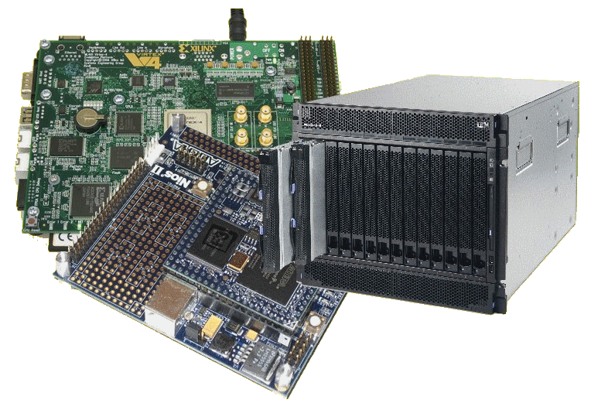
Lecture Overview
Towards HPES systems design and programming
Heterogeneous Computing Solutions
Steps in parallelizing programs
Understand the problem
Partitioning
Granularity
Identify data dependencies

Slide 3
Toward HPES system design and programming
We have looked into essential aspects of (single-core) processor design, and thinking about parallel systems.
Thinking point regards parallel system design:
Does it make more sense to start on the design of a parallel computing solution by
Deciding the parallel platform/hardware first… or
Deciding the data and processing needs first?
…
In this course, the direction is to start thinking about the data and processing, and then elaborating on methods and considering hardware constructs by which these are delivered.

Slide 4
… and that’s why we will delve into
Steps in Designing Parallel Programs

Slide 5
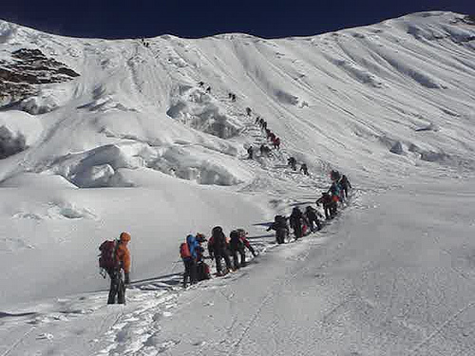
Steps in Designing Parallel Programs
Hardcore competent HPES programmers
(leading the way to greater feats)
Starting the somewhat long and arduous trek on the topic of designing parallel programs
EEE4120F
Sequential programmers in their comfort zone.

Slide 6
The steps in designing parallel programs
The hardware may be done first… or later.
The main steps:
Understand the problem
Partitioning (separation into main tasks)
Granularity
Communications
Identify data dependencies
Synchronization
Load balancing
Performance analysis and tuning
PART 1/3
…
this lecture
see
lecture 10
PART 2/3
PART 3/3

Slide 7
Step 1: Understanding the Problem
EEE4120F

Slide 8
Step 1: Understanding the problem
Make sure that you understand the problem, that is the right problem, before you attempt to formulate a solution
Some problems aren’t suited to parallelization – it just might not be parallelizable
(i.e. ‘problem validation’)
Example of non-parallelizable problem:
Calculating the set of Fibonacci series e.g., Fib(10²⁰) as quickly as possible.
Fib(n) = n } if n < 2
= Fib(n – 1) + Fib(n – 2) } otherwise

Slide 9
Step 1: Understanding the problem
Identify: Critical parts or ‘hotspots’
Determine where most of the work needs to be done. NB: Most scientific and technical programs accomplish the most substantial portion of the work in only a few small places.
Focus on parallelizing hotspots. Ignore parts of the program that don’t need much CPU use.
Consider which profiling techniques and Performance Analysis Tools (‘PATs’) to use
: marks key point(s)

Slide 10
Step 1: Understanding the problem
Identify: bottlenecks
Consider communication, I/O, memory and processing bottlenecks
Determine areas of the code that execute notably slower than others.
Add buffers / lists to avoid waiting
Attempt to avoid blocking calls (e.g., only block if the output buffer is full)
Try to rearrange code to make loops faster
: marks key point(s)

Slide 11
Step 1: Understanding the problem
General method:
identify hotspots, avoid unnecessary complication, identify potential inhibitors to the parallel design (e.g., data dependencies).
Consider other algorithms…
This is an most important aspect of designing parallel applications.
Sometimes the obvious method can be greatly improved upon though some lateral thought, and testing on paper.

Slide 12
Step 1: Identifying the Problem: where the solution may fit…
Prescribed reading
This also brings in aspects of Lecture 1, ‘the Landscape of Parallel Computing’*
Considering the 7 questions:
What are the applications?
What are the common kernels?
What are the hardware building blocks?
How to connect them?
How to describe allocations and kernels?
How to program the hardware?
How to measure success?
* The Landscape of Parallel Computing Research: A View from Berkeley” by Krste Asanovic, Ras Bodik, Bryan Catanzaro, et al.

Slide 13
Step 2: Partitioning
EEE4120F

Slide 14
Step 2: Partitioning
The Problem
partitioning
This step involves breaking the problem into separate chunks of work, which can then be implemented as multiple distributed tasks.
Two typical methods to partition computation among parallel tasks:
Functional decomposition or
Domain decomposition
: marks key point(s)

Slide 15
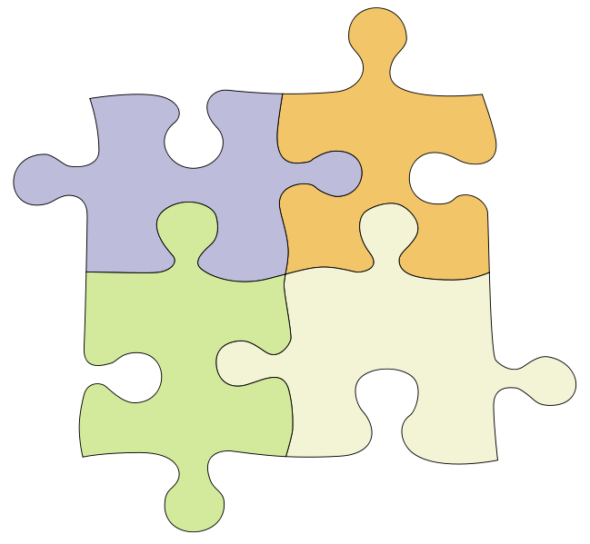
Functional decomposition
Decomposing the problem into tasks to be done.
Task #2:
1.
2.
3.
Task #1:
1.
2.
3.
4.
The Problem
Task #3:
1.
2.
3.
4.
5.
Task #4:
1.
2.
Functional decomposition is suited to problems that can be split into different tasks

Slide 16
Functional decomposition
Prescribed reading
Example applications
Environment modelling
Simulating reality
Signal processing, e.g.:
Pipelined filters: in → P1 → P2 → P3 → out
Here P1 is filled first, its result is sent to P2 while simultaneously P1 starts working on a block of new input, and so on.
Climate modelling (e.g., simultaneously running simulations for atmosphere, land, and sea)

Slide 17
Domain decomposition
Involves separating the data, or taking different ‘views’ of the same data. e.g.
View 1 : looking at frequencies (e.g. FFTs)
View 2 : looking at amplitudes
Each parallel task works on its own portion of the data, or does something different with the same data
The Data
The Data
Task1
Task2
Task3
View 1
View 2
Task1
Task2
Result
Result

Slide 18
Domain decomposition
Prescribed reading
Good to use for problems where:
Data is static (e.g., factoring; matrix calculations)
Dynamic data structures linked to a single entity (where entity can be made into subsets) (e.g., multi-body problems)
Domain is fixed, but computation within certain regions of the domain is dynamic (e.g., fluid vortices models)

Slide 19
Domain decomposition
(terms introduced in Lecture 7)
Many possible ways to divide things up. If you want to look at it visually…
continuous
Blocked (same-size partitions)
Blocked
Interlaced
Interleaved or
cyclic
Other methods can be done

Slide 20
Step 3: Granularity
EEE4120F
Granularity of the Problem
vs.
Granularity of the Parallelism

Slide 21
Step 3: Granularity of the Problem
Granularity of the problem
How big or small are the parts that the problem has been decomposed into?
How interrelated are the sub-tasks
Fine Grained:
Each calculation highly dependent on other parts of the problem space. Requires a great deal of communication.
Coarse Grained:
Each calculation largely independent of other parts of the problem space. Requires only a little communication.
: marks key point(s)
See also explanation on https://en.wikipedia.org/wiki/Granularity
Notes:
Granularity of the problem is about how big or small the parts of the problem are, or the interrelatedness of data that is used in order to obtain results.
We will see a clear example shortly demonstrating the difference what granularity is about.
I tend to think of it as follows: if you have a particular output, say X, then the granularity is how many other data elements needed to be access in order to obtain the value of X.
Consider that X might not just be a value, it may be an event or actuation that your system provides … which can then be considered as how many other inputs, data, or other events is a particular result or event, dependent on?
The interrelatedness of your data is the granularity, which can vary from very fine-grained, to very coarse-grained.
A fine-grained computation means that the solution is highly depended on many data items.
A course-grained computation means that the solution is not dependent on many data items.
Granularity can also be explained in terms of the amount of communication needed…
a fine-grained computation may need a lot of communication because any one result is highly dependent on much of the data.
a course-grained computation means little communication needed, don’t need much of the available data in order to produce a result.

Slide 22
The Ratio of Computation : Communication
This ratio can help to decide is a problem is a fine- or coarse-grained problem.
1 : 1 = Each intermediate result needs a communication operation
100 : 1 = 100 computations (or intermediate results) require only one communication operation
1 : 100 = Each computation needs 100 communication operations

Slide 23
Decomposition and Problem Granularity
Coarse grained:
Breaking problems into larger pieces
Usually, low level of task inter-dependence and fewer interrelations (e.g., can separate into parts whose elements are unrelated to other parts)
These solutions are generally easier to parallelize than fine-grained, and
Usually, parallelization of these problems provides significant benefits.
thread
#1
✓
thread
#2
✓
e.g. sequence search to find a number followed by its square root.
2
1
1
9
3
3
e.g. Computation:Communication = 100:1
(note: we’re assuming sqrt will take much computation)

Slide 24
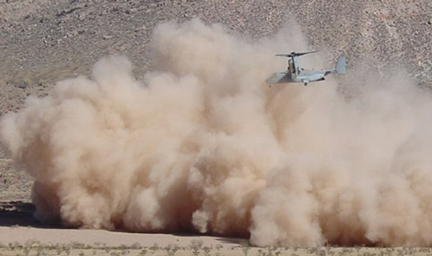
Decomposition and Granularity
Fine-grained problem:
Problem broken into pieces that have high levels of inter-dependence. Or difficult to partition the data because each result is dependent on much of the available data.
e.g.: having to look at relations between neighboring dust particles to determine how a dust cloud behaves.
e.g. Computation:Communication = 1:100
let’s next consider:
granularity of problem vs granularity of parallelism…

Slide 25
Example of fine-grained problem, coarse-grained parallelism
Fine-grained problem with coarse-grained parallelism:
Result(s) of the computation are highly dependent on much of the data… but can be done as many parallel operations.
Example
Dot-product of two vectors : result is a single scalar value – so overall obtaining result is fine-grained problem as it depends on all the other values and their ordering, but can be sub-divided into many smaller tasks that provide partial results, so has coarse-grained parallelism. a . b = a₁ x b₁ + a₂ x b₂ + … a_{n} x b_{n}
2
1
1
9
3
3
The result, a single value in this case, is fine-grained, depending on all the available data (but the computation is fairly course-grained, can be split-up into sub-tasks of a_{i} x b_{i} which are then summed)
2
1
1
9
3
3

Slide 26
Example of Coarse-grained
Course-grained
Result(s) of the computation dependent on only a small portion of the data
Example
Increment each element in a vector. a + 1 = [a₁ + 1,+ a₂ + 1, … a_{n} + 1]
Each result, which happens to be n results in this case, depends on only one item of data.

Slide 27
Decomposition and Granularity
Embarrassingly Parallel:
So coarse that there’s no or very little interrelation between parts/sub-processes
NB: also called “embarrassingly fine-grained parallel” – about to hear why…
2
3
2
1
4
0
4
6
4
2
8
0
1
2
3
4
3
2
2
4
6
8
6
4
e.g. double all the entries in a matrix.
0
1
2
3
4
3
0
2
4
6
8
6
1
0
3
2
4
1
2
0
6
4
8
2
2
2
0
3
4
1
4
4
0
6
8
2
e.g. Computation:Communication = 1:0

Slide 28
Granularity of Parallelism
Granularity of parallelism:
How small and plentiful are the tasks (computing parts or threads) the program is broken into.
It is more about the implementation.
Is not answering “how interrelated are the computations”
Is about: how small are the pieces of computing
Granularity of Problem
Granularity of Parallelism

Slide 29
Homework task
Supplementary reading
Which of the following are more fine-grained problems, and which are more coarse-grained problems?
Matrix multiply
FFTs
Decryption code breaking
(deterministic) Finite state machine validation / termination checking
Map navigation (e.g., shortest path)
Population modelling

Slide 30
Step 5: Identify Data Dependencies
In dog-think: I’m not budging from here until I’m done. Woof!
EEE4120F

Slide 31
Data dependencies
A dependency exists between statements of a program when the order of executing the statements affects the results of the program.
A data dependency is caused by different tasks accessing the same variables (i.e., memory addresses).
Dependencies are a major inhibition to developing parallel programs.
: marks key point(s)

Slide 32
Data dependencies
Common approaches to working around data dependencies:
For distributed memory architectures: tend to use synchronization points (periods when sets of shared data is communicated between tasks).
Shared memory architectures: make use of read/write synchronize operations (no sending of data, just temporarily block other tasks from reading/writing a variable).

Slide 33
Common data dependencies
Loop carried data dependence:
dependence between statements in different iterations
Loop independent data dependence:
dependence between statements in the same iteration
Lexically forward dependence:
source precedes the target lexically
Lexically backward dependence:
opposite from above
Right-hand side of an assignment precede the left-hand side
Source: http://sc.tamu.edu/help/power/powerlearn/html/ScalarOptnw/tsld036.htm

Slide 34
Part 1/3 Done
Understand the problem
Partitioning
Granularity
….
Identify data dependencies
Next two slides discusses solution to last week’s microcoding homework assignment.
Over to you to work on OpenCL prac or have an early start on Prac3

Slide 35
Further Reading / Refs
Supplementary reading
Suggestions for further reading, slides partially based / general principles elaborated in:
https://computing.llnl.gov/tutorials/parallel_comp/
http://www2.physics.uiowa.edu/~ghowes/teach/ihpc12/lec/ihpc12Lec_DesignHPC12.pdf
Some resources related to systems thinking:
https://www.youtube.com/watch?v=lhbLNBqhQkc
https://www.youtube.com/watch?v=AP7hMdnNrH4
Some resources related to critical analysis and critical thinking:
An easy introduction to critical analysis:
http://www.deakin.edu.au/current-students/study-support/study-skills/handouts/critical-analysis.php
An online quiz and learning tool for understanding critical thinking:
http://unilearning.uow.edu.au/critical/1a.html

Slide 36
Disclaimers and copyright/licensing details
I have tried to follow the correct practices concerning copyright and licensing of material, particularly image sources that have been used in this presentation. I have put much effort into trying to make this material open access so that it can be of benefit to others in their teaching and learning practice. Any mistakes or omissions with regards to these issues I will correct when notified. To the best of my understanding the material in these slides can be shared according to the Creative Commons “Attribution-ShareAlike 4.0 International (CC BY-SA 4.0)” license, and that is why I selected that license to apply to this presentation (it’s not because I particulate want my slides referenced but more to acknowledge the sources and generosity of others who have provided free material such as the images I have used).
Image sources:
Clipart sources – public domain CC0 (http://pixabay.com/)
PxFuel – CC0 (https://www.pxfuel.com/)
Pixabay
commons.wikimedia.org
Images from flickr

