Slide 1
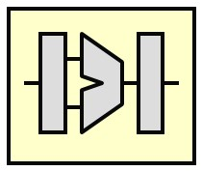
EEE4120F
High Performance
Embedded Systems
Lecture 8:
Amdahl’s Law for the Multicore Era
& Base Core Equivalents (BCE)
Presented by
Simon Winberg
Prescribed reading: L08 Hill and Marty - Amdahl Law in Multicore Era.pdf
(see READINGS on Vula)
Attribution-ShareAlike 4.0 International (CC BY-SA 4.0)
Planned to be double period lecture

Slide 2
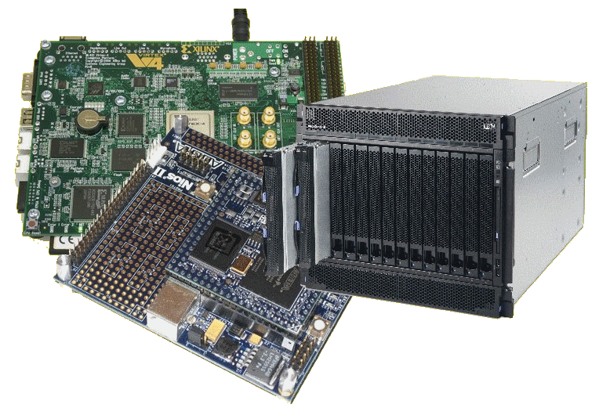
Lecture Overview
Amdahl’s Law for the Multicore Era
Base Core Equivalents (BCEs)
Calculating performance using BCEs
This presentation focuses on explaining the following prescribed reading: “L08 Hill and Marty - Amdahl Law in Multicore Era.pdf”
(see READINGS on Vula)
NB: relevant for quiz next Thursday

Slide 3
You have arrived….
…
At a point to understand …
The BCE!
The Base Core Equivalent (BCE)
So let’s get into it…

Slide 4
Designing Multicore Chips
Designers contend with single-core design options
Wakeup (of sleeping cores) – How? Economical methods?
Instruction fetch – From where? Latencies?
Instruction Decoding – CISC vs. RISC trade-offs
Variable clock speeds – esp. power saving modes
Execution unit – Pipelined? Monolithic? Shared components?
Execution modes (e.g. system, user, interrupt)
Load/Save queue(s) & data cache
Additional degrees of freedom for design of parallel architectures
How many cores? Size & features of each?
Shared caches? Cache levels?
Memory interfacing? How many memory banks? Where to place them?
On-chip interconnects: bus structures, switching fabric, ordering and priority of cores/devices?

Slide 5
Base Core Equivalent (BCE)
EEE4120F

Slide 6
BCE Abstraction
It all gets a bit complicated to keep track of the various umpteen types of processors that might be used
Therefore to theorize and predict performance expectations of a conceptualized* heterogeneous system, the concept of a Base Core Equivalent is proposed…
* i.e. where you might be toying with a variety of different type of processor solutions for a platform

Slide 7
Calculating performance using BCEs
A great many papers on the subject of Amdahl’s law
Many mention the term BCE
BCE = Base Core Equivalent, which is:
A single processing core in a multicore processor design

Slide 8
BCE: Simple Multicore Hardware Model
BCE: An abstracted hardware model to complement Amdahl’s software model
The simplified model…
Chip Hardware, abstracted as
Multiple Cores (with L1 caches)
Supporting architecture (L2/L3 cache banks, interconnect, pads, etc.)
Resources for Multiple Cores Bounded
Due to area, power, cost, or multiple factors…
Bound of N resources per chip for cores
Bound in terms of Power and Area

Slide 9
1x BCE vs. 1x R-BCE vs. Nx R-BCE
Remember that the BCE is equivalent to a basic single core processor
= 1x 1-BCE
= 16x 1-BCE
= 4x 4-BCE
It’s an abstraction, and likely not very precise. For example a 16x4-BCE may have faster comms between cores in same block and slower comms between cores in different blocks, whereas the 16x1-BCE might have the same speed comms between all cores.

Slide 10
Let me clarify that expression…
NxR-BCE means:
N = Number of megacores (or equivalent ‘core groups’) on a chip
R = Number of cores equivalent to a megacore (or num. cores in a core group)
num megacore (N)
A megacore may have – or considered to have – its own local cache (or considered as a group of cores that shares a common cache)
number of basic BCE cores (R) equivalent to this megacore
4x4-BCE

Slide 11
Take Note…
A R-BCE megacore is not necessarily physically having R x BCE smaller cores implemented and working together …
It is rather a core that has a different design and works sort-of equivalently to R x BCE cores.

Slide 12
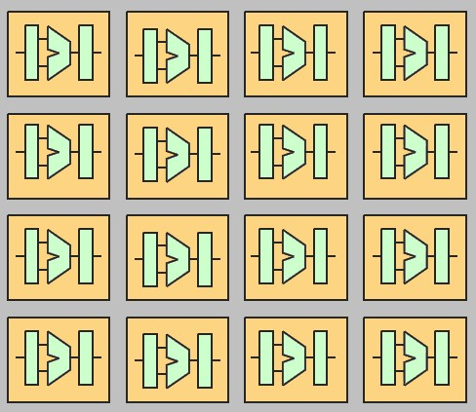
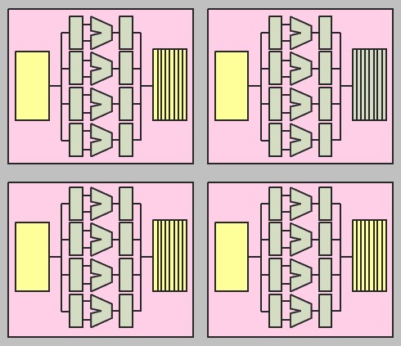
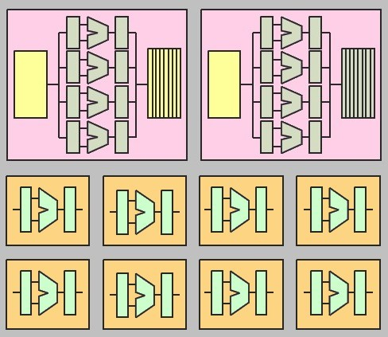
Example processor structures Symmetric vs. Asymmetric multicores
a BCE
core
with 4-BCE
(I call them megacores to emphasize it equates to multiple BCEs)
Symmetric multicore 16 one-BCE cores
Symmetric multicore 4 x 4-BCE megacores
Asymmetric multicore comprising 2 x 4-BCE cores + 8 x 1-BCE cores
Clearly can become increasingly more difficult to achieve very accurate equivalences due to the architecture structures and things like memory latencies and inter-core comms.

Slide 13
Symmetric core model
Variables:
N implemented cores per chip, n = number BCEs available
each N core consumes R BCEs resources
4 x 4-BCE, R=4,
N=4 (n=16)
16 x 1-BCE
N = 16, R=1 (n=16)
Symmetric four 4-BCE megacores
perf(R) = performance (speedup) of 1x R-BCE over 1x 1-BCE
Always perf(R) <= R (i.e. diminishing returns on increased parallelism)
Good heuristic: perf(R)=sqrt(R)

Slide 14
Modelling Performance of Symmetric Multicore Chips
Execution Time
Serial Fraction
1-F
N implemented cores per chip, n = resources in 1-BCE
R BCEs per megacore
Parallel Fraction of execution is F
Assume symmetric → all cores identical
Serial Fraction is 1-F so uses 1 megacore at rate perf(R)
Therefore: Serial time = (1 – F) / perf(R)
Parallel Fraction uses n/R megacores at rate perf(R) each
Parallel time = F / (perf(R) * (n/R)) = F *R / perf(R)*n
Therefore, w.r.t. one base core:
Implications?..
Parallel
Fraction F
1
Symmetric Speedup =
F * R
1 - F
+
perf(R)
perf(R)*n
Pretty cool don’t you think! ☺
Enhanced Cores speed Serial & Parallel

Slide 15
Calculate performance…
Model up to n=50 BCEs
NB: ensure you understand the formula on the previous slide then apply your newfound knowledge to scenarios using this tool.
Speedup →
Best speedup for F=90% and 50 BCE resources, is a ~ 6-BCE megacore.
Parallel fraction F=90%
Parallel fraction F=50%
R →
BCEs/megacore

Slide 16
Asymmetric (Heterogeneous) Multicore Chips
Symmetric Multicore required all cores equal
Let’s enhance some (not all) of the cores in the processor chip…
For Amdahl’s simplified assumptions
One Enhanced Core
Others are base cores
How does this effect our hardware model?

Slide 17
Asymmetric Multicore Chips
Chip bounded to total of n BCEs
One R-BCE megacore leaves (n-R) BCEs
Symmetric case: four 4-BCE megacores (i.e. here R=4 and n=16)
Asymmetric case: one R-BCE megacore with (n - R) 1-BCEs (i.e. one 4-BCE and 12 1-BCEs, R=4, n=16)
PS: I know it’s irritating having N and n… n = amount of resources where 1 resource = 1 BCE… and then N = number R-BCEs

Slide 18
Modelling Performance of Asymmetric Multicore Chips
Execution Time
Serial Fraction
1-F
n 1-BCE core resources per chip
1x R-BCEs , (n-R)x 1-BCEs
Parallel Fraction of execution is F
Serial Fraction still 1-F and uses 1 core at rate perf(R)
Therefore: Serial time = (1 – F) / perf(R)
Parallel Fraction F uses 1 cores at rate perf(R) and n -R cores at rate 1
Parallel time = F / (perf(R) + n – R)
Therefore, w.r.t. one base core:
Implications?..
Parallel
Fraction F
1
Asymmetric Speedup =
F
1 - F
+
perf(R)
perf(R) + (n – R)
serial part runs on enhanced core
parallel part runs concurrently on one enhanced core & other standard cores

Slide 19
Calculate performance…
I know, should be n not N.
Model up to n=64 BCEs
Parallel fraction F=99%
Speedup →
Best speedup for F=90% and 64 BCE resources, is around 20-BCE megacore.
Parallel fraction F=90%
Parallel fraction F=50%
R →
BCEs/megacore

Slide 20
Dynamic Multicore Chips
Prescribed reading
n base cores for best parallel performance
Harness R cores together for best serial performance (a bit of an optimistic dream perhaps)
Serial Case
1x n-BCE megacore
Parallel Case
n x 1-BCE cores

Slide 21
Modelling Performance of Dynamic Multicore Chips
Prescribed reading
Execution Time
n base cores per chip where R can be harnessed
1x R-BCEs or (n - R )x 1-BCEs
Parallel Fraction of execution is F
Serial Fraction 1-F uses R BCEs at rate perf(R)
Therefore: Serial time = (1 – F ) / perf(R)
Parallel Fraction F uses n BCEs at rate 1 each
Parallel time = F / n
Therefore, w.r.t. one base core:
Implications?..
Serial Fraction
1-F
Parallel
Fraction F
1
Dynamic Speedup =
F
1 - F
+
perf(R)
n

Slide 22
Calculate performance…
I know, should be n not N.
Prescribed reading
Looks wonderful! But it is realistic?
Model up to r=64 BCEs
Parallel fraction F=99%
Speedup →
Parallel fraction F=90%
Parallel fraction F=50%
R →
BCEs/megacore

Slide 23
BCE Performance Calculator – M Hill & M Marty (summary)
Prescribed reading
To apply Amdahl’s law to a multicore chip, we need
A cost model for the number and performance of cores that the chip can support.
1) assume a multicore chip can contain at most n base core equivalents (based on resources a chip designer devotes to cores & portion of code is parallelized)
2) Assume (micro-)architects have techniques for using the resources of multiple BCEs to create a core with greater sequential performance.
Let the performance of a single-BCE core be 1.
Assume architects can expend the resources of R BCEs to create a more powerful processor (i.e. a R-BCE core) with sequential performance perf(R).
Example assume perf(R) = sqrt(R) … In other words, we assume efforts that devotes R BCE resources will result in sequential performance R. Thus, architectures can double performance at a cost of four BCEs, triple it for nine BCEs, etc. illustrated by graph results …

Slide 24
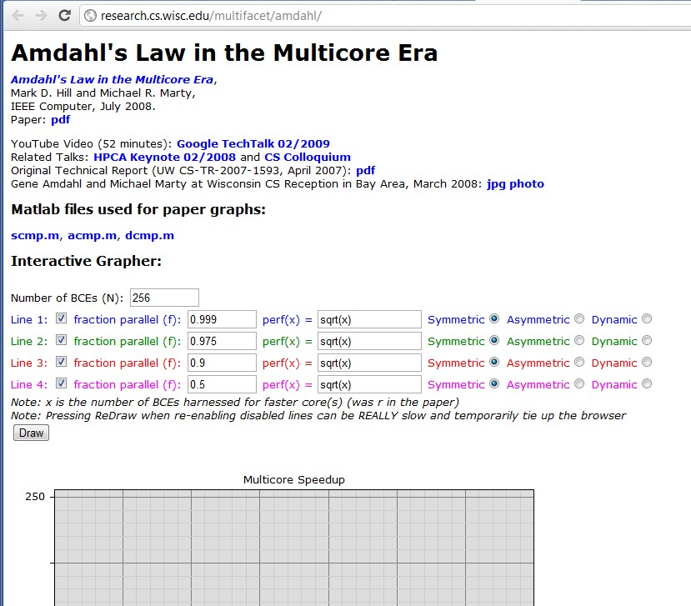
Amdahl’s Law Milticore Performance Calculator
Check out Hill and Marty’s Amdahl’s interactive grapher at:
http://research.cs.wisc.edu/multifacet/amdahl/
You can also download the OCTAVE / Matlab code to do these graphs!
Supplementary reading
How it works:
Specify #cores (n), the portion parallel code (F), type of BCE cores to use
generate example of resultant graph…
http://research.cs.wisc.edu/multifacet/amdahl/

Slide 25
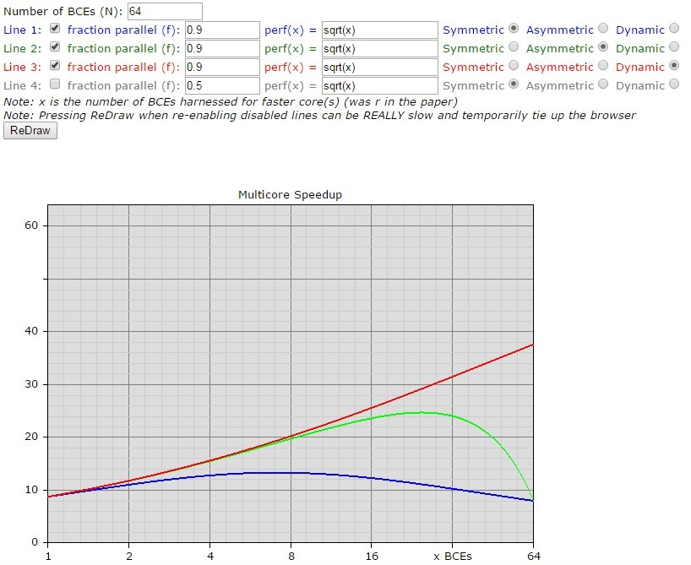
Example run of Hill and Marty’s Amdahl’s interactive grapher:
Supplementary reading
Gives a comparison of the different architecture models. Clearly Dynamic is probably always going to win.
Speedup →
R →
BCEs/megacore

Slide 26
Recommended Reading
Supplementary reading
Hill and Marty 2008: “Amdahl’s Law in the Multicore Era” Available: http://research.cs.wisc.edu/multifacet/papers/ieeecomputer08_amdahl_multicore.pdf
Good article on Wikipedia look over: http://en.wikipedia.org/wiki/Amdahl's_law
NB: do try to read this one! *
See Vula: L08 Hill and Marty - Amdahl Law in Multicore Era.pdf
* Questions on BCEs likely to to appear in test or exam

Slide 27
Further Reading / Refs
Supplementary reading
Suggestions for further reading, slides partially based / general principles elaborated in:
https://computing.llnl.gov/tutorials/parallel_comp/
http://www2.physics.uiowa.edu/~ghowes/teach/ihpc12/lec/ihpc12Lec_DesignHPC12.pdf
Some resources related to systems thinking:
https://www.youtube.com/watch?v=lhbLNBqhQkc
https://www.youtube.com/watch?v=AP7hMdnNrH4
Some resources related to critical analysis and critical thinking:
An easy introduction to critical analysis:
http://www.deakin.edu.au/current-students/study-support/study-skills/handouts/critical-analysis.php
An online quiz and learning tool for understanding critical thinking:
http://unilearning.uow.edu.au/critical/1a.html

Slide 28
Assigned Reading
For Next Thursday …
R8 Hill and Marty 2008: “Amdahl’s Law in the Multicore Era”
Find it on: Vula Resources/Readings
Thursday 5 Mar 2pm:
There will be a short quiz, and I will follow that with solutions
(end of lecture)

Slide 29
Disclaimers and copyright/licensing details
I have tried to follow the correct practices concerning copyright and licensing of material, particularly image sources that have been used in this presentation. I have put much effort into trying to make this material open access so that it can be of benefit to others in their teaching and learning practice. Any mistakes or omissions with regards to these issues I will correct when notified. To the best of my understanding the material in these slides can be shared according to the Creative Commons “Attribution-ShareAlike 4.0 International (CC BY-SA 4.0)” license, and that is why I selected that license to apply to this presentation (it’s not because I particulate want my slides referenced but more to acknowledge the sources and generosity of others who have provided free material such as the images I have used).
Image sources:
Clipart sources – public domain CC0 (http://pixabay.com/)
Pixabay
PxFuel – CC0 (https://www.pxfuel.com/)
commons.wikimedia.org
Images from flickr

