Slide 1
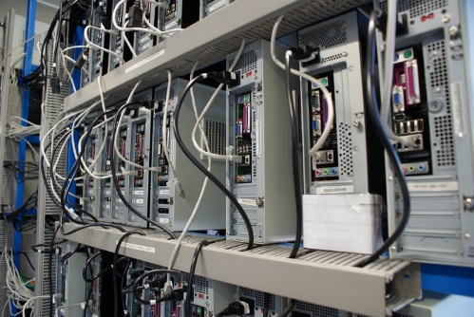
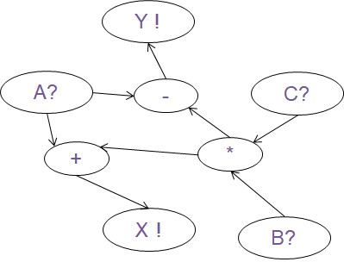
EEE4120F
High Performance
Embedded Systems
Lecture 7:
Parallel Computing Fundamentals
Presented by
Simon Winberg
Attribution-ShareAlike 4.0 International (CC BY-SA 4.0)
Planned to be double period lecture

Slide 2
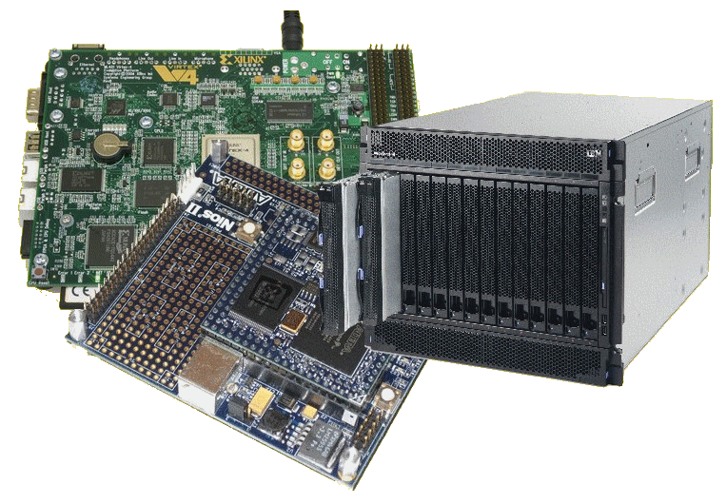
Lecture Overview
Parallel Computing Fundamentals
Large Scale Parallelism
Mainstream parallel
Classic Parallel approaches
Flynn’s Taxonomy
Some Calculations
Effective parallelism
Parallel Efficiency
Gustafson’s Law

Slide 3
Parallel Systems
Y !
A?
-
C?
+
*
X !
B?
EEE4120F: Digital Systems
Remember the spatial computing paradigm??

Slide 4
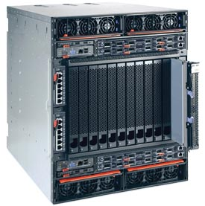
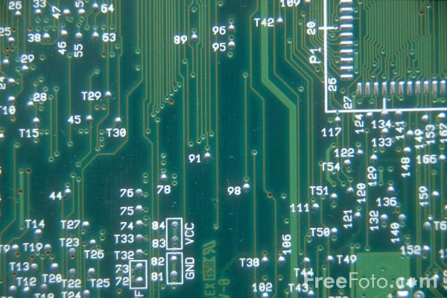
Computation Methods
Reminder …
this term
Hardware
Reconfigurable
Computer
Software
Processor
e.g. PCBs, ASICs
Advantages:
High speed & performance
Efficient (possibly lower power than idle processors)
Parallelizable
Drawbacks:
Expensive
Static (cannot change)
e.g. IBM Blade, FPGA-based
computing platform
Advantages:
Faster than software alone
More flexible than software
More flexible than hardware
Parallelizable
Drawbacks:
Expensive
Complex
(both s/w
& h/w)
e.g. PC, embedded software on microcontroller
Advantages:
Flexible
Adaptable
Can be much cheaper
Drawbacks:
The hardware is static
Limit of clock speed
Sequential
processing

Slide 5
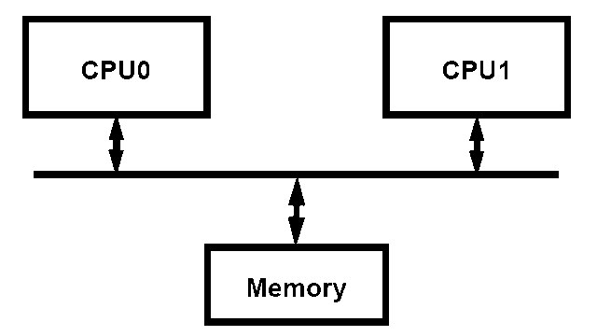
Mainstream parallel computing
Most server class machines today are:
PC class SMP’s (Symmetric Multi-Processors *)
2, 4, 8 processors - cheap
Run Windows & Linux
Delux SMP’s
8 to 64 processors
Expensive:
16-way SMP costs ≈ 4 x 4-way SMPs
Applications: Databases, web servers, internet commerce / OLTP (online transaction processing)
Newer applications: technical computing, threat analysis, credit card fraud...
SMP offers all processors and memory on a common front side bus (FSB –bus that connects the CPU and motherboard subsystems).
* Also termed “Shared Memory Processor” (but you might get 0 for giving this alternate term in a test)

Slide 6
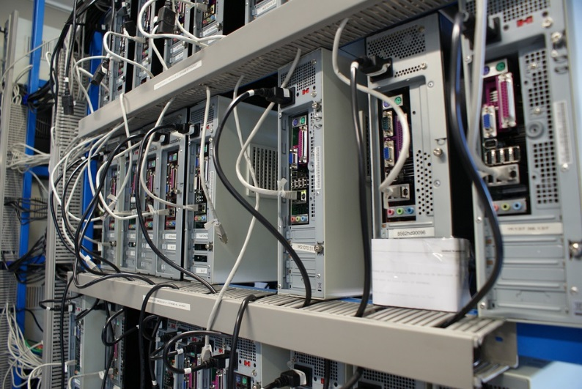
Large scale parallel computing systems
Hundreds of processors, typically as SMPs clusters
Traditionally
Often custom built with government funding (costly! 10 to 100 million USD)
National / international resource
Total sales tiny fraction of PC server sales
Few independent software developers
Programmed by small set of majorly smart people
Later trends
Cloud systems
Users from all over
E.g. Amazon EC, Microsoft Azure

Slide 7
Large scale parallel computing systems
Some application examples
Code breaking (CIA, FBI)
Weather and climate modeling / prediction
Pharmaceutical – drug simulation, DNA modeling and drug design
Scientific research (e.g., astronomy, SETI)
Defense and weapons development
Large-scale parallel systems are often used for modelling

Slide 8
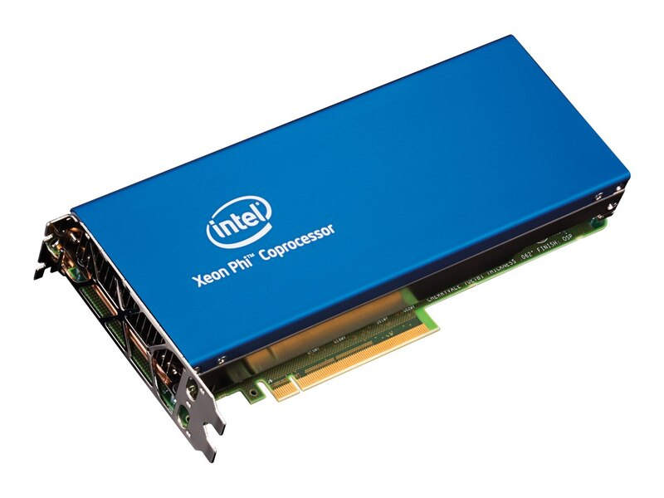
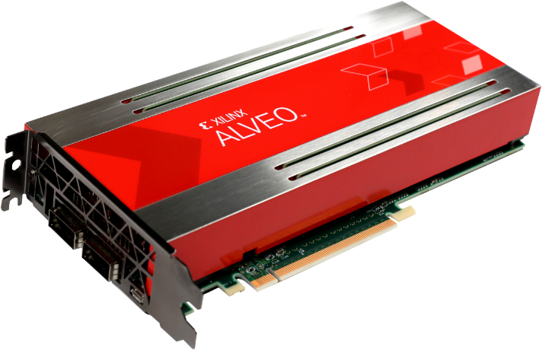
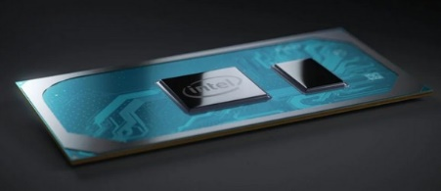
Digital Accelerators: New Practice
Digital accelerator cards (including GPGPUs) are increasing in popularity, including in data centres.
Term 2: RC / Digital Accelerators
(launched end 2018)
(ended 2019)
Xilinx Alevo: Adaptable Accelerator Cards for Data Centres
https://www.xilinx.com/products/boards-and-kits/alveo.html
HP Intel 5110P Xeon Phi Coprocessor Kit
Intel Xeon Phi
Where and why it’s no longer being made, replaced by Xeon Scalable Platform
Program with OpenCL or Xilinx’s owns accelerator design suite.
Replaced by (from 2020)
And… some of this it may involve designing specialized compute architectures for the need (using a combination of languages and tools e.g. OpenCL / Verilog, C, R, etc.)
Intel Ice Lake
(10 nm process) 10th generation core, successor for Xeon Phis.
Core i7 1068G7 (2020 debut) 4 CPU cores + 64 Iris+ GPCPU cores
* What was it said in the “Berkeley Landscape” … “Small is beautiful” and “manycore is the future of Computing”.

Slide 9
Classic Parallel
EEE4120F

Slide 10
Classic techniques for parallel programming*
Single Program Multiple Data (SPMD)
Consider it as running the same program, on different data inputs, on different computers (possibly) at the same time
Multiple Program Multiple Data (MPMD)
Consider this one as running the same program with different parameters settings, or recompiling the same code with different sections of code included (e.g., uisng #ifdef and #endif to do this)
Following this approach performance statistics can be gathered (without necessarily any parallel code being written) and then evaluated after the effect to deem the feasibility of implementing a parallel (e.g. actual pthreads version) of the program.
Can consider the SPSD (i.e. Single Program Single Data) as the case where the whole program is run once on all the data.
NB: Class Activity A
*Informally know as the lazy parallel programming model.
Notes:
Class activity A handout: context of simply program scenario that you want to have a basic parallel golden measure. It simply find min, max and average of a dataset. Then pose a SPMD approach, an MPMD approach and see to what extent either of these are better or worse then just the basic golden measure run on the whole block of data.

Slide 11
Terms
EEE4120F

Slide 12
Terms (reminders)
Observed speedup =
Parallel overhead:
Amount of time to coordinate parallel tasks (excludes time doing useful work).
Parallel overhead includes operations such as: Task/co-processor start-up time, Synchronizations, communications, parallelization libraries (e.g., OpenMP, Pthreads.so), tools, operating system, task termination and clean-up time
Wallclock time initial version
Wallclock time sequential (or gold)
=
Wallclock time refined version
Wallclock time parallel version
The parallel overhead of the lazy parallel model could clearly be extreme, considering that is would rely on manual intervention to (e.g.) partition and prepare the data before the program runs.

Slide 13
Some terms
Embarrassingly Parallel
Simultaneously performing many similar, independent tasks, with little to no coordination between tasks.
Massively Parallel
Hardware that has very many processors (execution of parallel tasks). Can consider this classification of 100 000+ parallel tasks.
{ Stupidly Parallel }
While this isn’t really an official term it typically relates to instances where a big (and possibly very complex) coding effort is put into developing a solution that in practice has negligible savings or worse is a whole lot slower (and possibly more erroneous/buggy) than if it was just left as a simpler sequential implementation.

Slide 14
Introducing to some important terms related to shared memory
Using scalar product pthreads type implementation for scenarios…
Notes:
The following slides introduce important terms that are used commonly to refer to memory partitioning methods. Each of these terms, besides contiguous – since that is no partitioning - can be refined further depending on the problem and the way that data is being stored or managed.

Slide 15
Partitioned memory
Vectors in
global / shared
memory
[a₁ a₂ a₁ a₂ … a_{m-1}]
[b₁ b₂ b₁ b₂ … b_{m-1}]
Thread 1
main()
starts
main()
sum = sum1+sum2
sum1
[a_{m} a_{m+1} a_{m+2} … a_{n}]
[b_{m} b_{m+1} b_{m+2} … b_{n}]
a
b
Thread 2
1
1
sum2
2
2
Assuming a 2-core machine
Memory access by thread

Slide 16
Interlaced* memory
Vectors in
global / shared
memory
[a₁ a₃ a₅ a₇ … a_{n-2}]
[b₁ b₃ b₅ b₇ … b_{n-2}]
Thread 1
main()
starts
main()
sum = sum1+sum2
sum1
[a₂ a₄ a₆ … a_{n-1}]
[b₂ b₄ b₆ … b_{n-1}]
a
b
Thread 2
sum2
Assuming a 2 core machine
NB: benefits of interleaving as a means to improve robustness and access of memory
interlacing vs. interleaving : see comments
Memory access by thread
* ‘Data striping’, ‘interleaving’ and ‘interlacing’ usually means the same thing but not always.
See further explanation between these on: https://wikidiff.com/interleave/interlace
Notes:
The aspect of interlaced and interleaving of memory connects also with aspects of data transfer, sampling, and communication.
Interlaced : to cross one another, like weaving e.g. /\/\/\ + \/\/\/ = XXXXX
“to cross one with another; to interweave: as, to interlace wires; hence, to mingle; to blend.” (source: https://wikidiff.com/interleave/interlace)
Interleaved : to insert between or separate at regular intervals, or data that is for different purposes. E.g. instead of sending ‘hello’ and the sequence ‘12345’ as separate messages, for potentially different purposes, e.g. the one an ping response and the other result of a calculation, the data could be interleaved as h1e2l3l4o5. The receiving system would need to know how to make use of the interleaved data and potentially separate back into its constituent parts.

Slide 17
Memory Partitioning Terms
SUMMARY
Contiguous
Partitioned (or separated or split)
Interleaved/interlaced (or alternating or data striping)
Interleaved – small stride (e.g. one word stride)
Interleaved – large strides (e.g. row of image pixels at a time)
(the ‘stride’ in data interleaving or data striping refers to the size of the blocks alternated, generally
this is fixed but could be changeable, e.g. the last stride might be smaller to avoid padding data.)

Slide 18
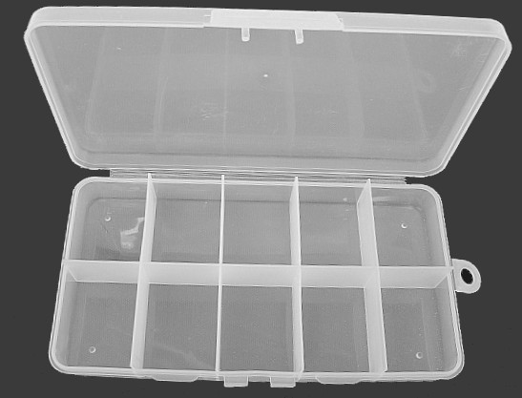
Flynns Taxonomy of Processor Architectures
Type
A
Type
B
Type
C
Type
D
Type
E
Type
F
Type
G
Type
H
Type
I
Type
J
EEE4120F

Slide 19
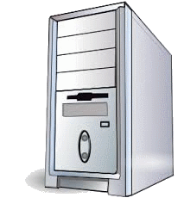
Flynn’s taxonomy
Flynn’s (1966) taxonomy was developed as a means to classify parallel computer architectures
Computer system can be fit into one of the following four forms:
SISD
Single Instruction Single Data
SIMD
Single Instruction Multiple Data
MISD
Multiple Instructions Single Data
MIMD
Multiple Instructions Multiple Data
Flynn’s
Taxon.
MI
MD
Not to be confused with the terms of “Single Program Multiple Data (SPMD)” and “Multiple Program Multiple Data (MPMD)” mentioned earlier.

Slide 20
Single Instruction Single Data (SISD)
This is (obviously) the classic von Neumann Computer: serial (not parallel) computer, e.g.:
Old style single core PC CPUs, e.g. i486
Single instruction →
One instruction stream acted on by the CPU during any one clock cycle
Single data →
Only one input data stream for any one clock cycle
Deterministic execution
x = 2 * (y + z);
0x1000
LD A,[0x2002]
0x1003
LD B,[0x2004]
0x1006
ADD A,B
0x1007
SHL A,1
0x1008
ST A,[0x2000]

Slide 21
Single Instruction Multiple Data (SIMD)
A form of parallel computer
Early supercomputers used this model first
Nowadays it has become common – e.g., used in modern computers on GPUs
Single instruction →
All processing units execute the same instruction for any given clock cycle
Multiple data →
Each processing unit can operate on a different data element
y= [1 2 3 4]
z = [2 3 4 5]
x = 2 * (y + z)
LD AX,[DX+0]
LD AX,[DX+3]
LD BX,[EX+0]
LD BX,[EX+3]
ADD AX,BX
…
ADD AX,BX
SHL AX,1
SHL AX,1
ST AX,[CX+0]
ST AX,[CX+3]
…
…
CPU 1
CPU 4

Slide 22
Single Instruction Multiple Data (SIMD)
Runs in lockstep (i.e., all elements synchronized)
Works well for algorithms with a lot of regularity; e.g. graphics processing.
Two main types:
Processor arrays
Vector pipelines
Still highly deterministic (know the same operation is applied to specific set of data – but more data to keep track of per instruction)

Slide 23
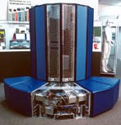
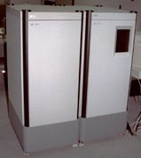
Single Instruction Multiple Data (SIMD) Examples
Vector pipelines
IBM 9000, Cray X-MP, Fujitsu vector processor, NEC SX-2, Hitachi S820, ETA10
Processor arrays
Thinking Machine CM2, MasPar MP-1 & MP-2, ILLIAC IV
Graphics processor units usually use SIMD
←Cray X-MP
←MasPar MP-1

Slide 24
Multiple Instruction Single Data (MISD)
Single data stream fed into multiple processing units
Each processing unit works on data independently via independent instruction streams
Few actual examples of this class of parallel computer have ever existed

Slide 25
Multiple Instruction Single Data (MISD) Example
Possible uses? Somewhat intellectual?
Maybe redundant! (see next slide)
Possible example application:
Different set of signal processing operations working the same signal stream
Example:
Simultaneously find the min and max input, and do a sum of inputs.
A = input
x = +MAXINT
x = -MAXINT
x = 0
If A<x then x = A
If A>x then x = A
x = x + A
…
…
…
CPU 1
CPU 2
CPU 3

Slide 26
Multiple Instruction Multiple Data (MIMD)
The most common type of parallel computer (most late model computers, e.g. Intel Core Duo, in this category)
Multiple Instruction →
Each processor can be executing a different instruction stream
Multiple Data →
Every processor may be working with a different data stream
Execution can be asynchronous or synchronous; non-deterministic or deterministic

Slide 27
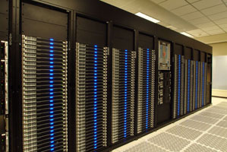
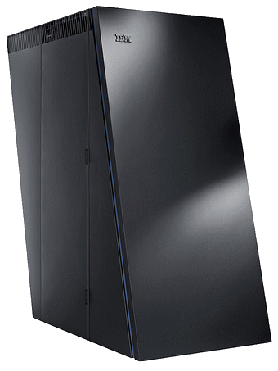
Multiple Instruction Multiple Data (MIMD)
Examples
Many of the current supercomputers
Networked parallel computer clusters
SMP computers
multi-core PCs
MIMD architectures could include all the other models. e.g.,
SISD – just one CPU active, others running NOP
SIMD – all CPUs load the same instruction but apply to different data
MISD – all CPUs load different instructions but apply it to the same data
AMD Opteron
IBM BlueGene

Slide 28
Maximum Effective Parallelism
EEE4120F

Slide 29
Significant Tradeoff:
Infrastructure & Setup Cost
vs.
Effective Parallelism
Consideration for
- hardware
- software
Maximum Effective Parallelism:
This refers to the point of the number of cores / amount of parallelism beyond which additional parallelism provides no further benefit or (worse) may reduce performance.
go parallel!

Slide 30
Significant Tradeoff:
Infrastructure & Setup Cost
vs.
Effective Parallelism
Hardware
Software
Performance
improvement
(speedup)
comms cost and time
cores / available parallelism
cores / available parallelism
Maximum Effective Parallelism:
This refers to the point of the number of cores / amount of parallelism beyond which additional parallelism provides no further benefit or (worse) may reduce performance.
cost of parallelism
startup time
cores / available parallelism
cores / available parallelism

Slide 31
Calculation Example: Maximum Effective Parallelism
Remember from Amdahl:
S = T_{S} / T_{P} (i.e. sequential time over parallel time)
You can use these equations to approximate behaviour of modelled systems.
E.g.: to represent speedup, comms overhead, cost of equipment, etc. and use calculations to estimate optimal selections. (simple example to follow)

Slide 32
Learning Activity
Quick estimation for maximum effective parallelism
Solution follows shortly!
Please try it for your self, or work with a buddy to think about how to respond to this question.

Slide 33
Learning Activity Answer
N | Proc (ms) | Comms (ms) | Total (ms)
1 | 100.000 | 0 | 100.000
2 | 50.000 | 10 | 60.000
4 | 25.000 | 20 | 45.000
8 | 12.500 | 40 | 52.500
16 | 6.250 | 80 | 86.250
32 | 3.125 | 160 | 163.125
64 | 1.563 | 320 | 321.563
Could do some rough calculations (or use binary search)…
check:
N=2,
N=64,
N=8,
N=4 ✓

Slide 34
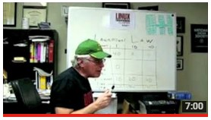
Multi processors and sequential setup time
2nd part of Amdahl’s law video
Understanding Parallel Computing (Part 2): The Lawn Mower Law LinuxMagazine
If you haven’t already watched this please do!
Amdahl2.flv

Slide 35
Parallel Efficiency (E_{par})
We can think of the efficiency of various things, e.g. power systems, motors, heaters etc. We can also think of the efficiency of parallel computing…
Parallel Efficiency
Defined as the:
ratio of speedup (S) to the number of processors (p)
Parallel Efficiency measures the fraction of time for which a processor is usefully used.
An efficiency of 1 is ideal (>1 means you may be harnessing energy from another dimension ☺)

Slide 36
Parallel Efficiency (E_{par})
Parallel Efficiency
p = number processors
T_{s} = exe time of the seq. alg.
T_{p} = exe time of the parallel alg. with p processors used
S_{p}= speedup (linear being the realistic ideal)
super-linear
speedup
(awesome!)
S_{p}
linear speedup
sub-linear speedup
p (number cores)

Slide 37
Gustafson’s Law *
Gustafson's law =
The theoretical speedup in latency of the execution of a task at fixed execution time that can be expected of a system whose resources are improved.
A follow-up to Amdahl's Law
formulation:
Speedup S gained by N processors (instead of just one) for a task with a serial fraction s (not benefiting from parallelism) is as follows:
S = speedup, N = cores, s = serial portion
Using different variables, can be formulated as:
S_{latecy} = theoretical speedup in latency of the execution of the whole task
s = speedup in latency of part of the task benefiting from improved parallelism
p = % of workload before the improvement that will be speeded up.
* also referred to, more fairly, as the Gustafson–Barsis's law

Slide 38
Gustafson’s Law
This is a plot of
s going from 0.5 to 2
s = 2
p going from 10% to 100%
s = 1.5
As you can see, the latency is reduced (i.e. S_{latency} increased) as s increases and p increases.
But for e.g. a real speedup of 2 you actually need p=100% (i.e. the entire workload improved) to achieve it.
s = 1.25
s = 1
s = 0.5
s = speedup in latency of part of the task benefiting from improved parallelism
s = 0.25
p = % of workload before the improvement that will be speeded up.
Gustafson’s law can be more useful to real-time embedded systems because it look more towards improving the response time of a system.

Slide 39
Glimpse into Next Lecture
Amdahl’s Law Revisited:
Applying refinements for the heterogeneous, multicore era of computing….
The next lecture helps you understand the prescribed reading, a highly influential paper, that brings Amdahl’s Law more accurately into the 21st century.

Slide 40
End of Lecture
FREE Creative Commons License
COUNTRY BOY
Music: https://www.bensound.com

Slide 41
Disclaimers and copyright/licensing details
I have tried to follow the correct practices concerning copyright and licensing of material, particularly image sources that have been used in this presentation. I have put much effort into trying to make this material open access so that it can be of benefit to others in their teaching and learning practice. Any mistakes or omissions with regards to these issues I will correct when notified. To the best of my understanding the material in these slides can be shared according to the Creative Commons “Attribution-ShareAlike 4.0 International (CC BY-SA 4.0)” license, and that is why I selected that license to apply to this presentation (it’s not because I particulate want my slides referenced but more to acknowledge the sources and generosity of others who have provided free material such as the images I have used).
Image sources:
Clipart sources – public domain CC0 (http://pixabay.com/)
PxFuel – CC0 (https://www.pxfuel.com/)
FreeSVG – CC0 public dimain images (https://freesvg.org/)
Pixabay
commons.wikimedia.org
Images from flickr

