Slide 1
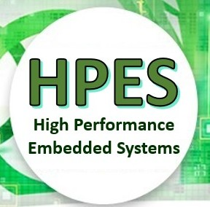
EEE4120F
High Performance
Embedded Systems
Lecture 6:
Performance benchmarking, Metrics, Profiling & Testing
Lecturer:
Simon Winberg
benchmarking
Attribution-ShareAlike 4.0 International (CC BY-SA 4.0)
Planned as short recorded lecture
Notes:
Audio narrations have been left in some of the slides, these are provided as a means to just supplement some of the information, you do not need to listen to them (press on the speaker icon if you want to listen to the annotation).
The lecture sessions will present the slides and provide an opportunity for questions and discussion of the topics.

Slide 2
Outline for Lecture
Performance benchmarking
Metrics of Performance
Average Cycles Per Instruction (ACPI)
Cost vs. Performance
SWAP
Profiling code (Reading: Valgrind)

Slide 3
Reminder: Performance Benchmarking
“Don’t loose sight of the forest for the trees…”
Generally, the main objective is to make the system faster, use less power, use less resources…
Most code doesn’t need to be parallel.
Important questions are…

Slide 4
Benchmarking: what to test
What can be benchmarked? For DSP and HPC…
Compiler
Converts High Level Language to Assembly language thus we benchmark compiler efficiency, such as how efficient is the generated assembly code?
The Processor
Code in hand-crafted/inspected assembly (to make comparisons fair)
Operating System
Interrupt latencies, overhead of operating system calls, limits on devices, kernel size, availability of services and facilities such as support for virtual memory and paged memory.
Platform
Scalability of memory. Peripheral limits. Interfaces supported. Power use. Power saving features. OS’s supported.
Applications (e.g. representative operations for certain application domains – think ‘DWARFS’ as in Berkeley paper)

Slide 5
Benchmarking: what is usually measured
For DSP/HPEC systems we typically benchmark:
Cycle count
Data and Program memory usage
Execution time
Power consumption (has recently become a common thing to report on)

Slide 6
Benchmarking Techniques
EEE4120F

Slide 7
Metrics of Performance
Application
Operations per second (OPS)
Programming language
Expressiveness*
Code density
Processing system
MIPS: Million Instructions Per Second GIPS: Giga (i.e. 10⁹) IPS
MFLOPS: Million FLoating point OPerations per Second GFLOPS: Giga (10⁹) FLOPS TFLOPS: Terra (10¹²) FLOPS
Datapath
MBps: Megabytes per second or GBps
Function unit / processor hardware
Cycles per second (CPS) (based on clock rate)
* Felleisen, M., 1991. On the expressive power of programming languages.Science of computer programming, 17(1-3), pp.35-75.

Slide 8
Aspects of CPU Performance
CPU time = Seconds = Instructions x Cycles x Seconds
Program Program Instruction Cycle
Property of system used to rating aspect on left
Aspect of processing rated | Instruction Count (IC) | Cycles Per Instruction (CPI) | Clock
Program Size | 
Computer |  | 
Instruction Set |  |  *
Organization |  |  | 
Technology |  |  | 
Note that this is only a few examples of aspects that may want to be rated in regards to what performance a CPU achieves. And there are also many more properties that may be used in doing this rating accurately (e.g. number registers may impact program size).
* Some instructions may of course take multiple cycles … see next slides for ACPI
Hint: Sorry to say, but something like this is hard to resist in setting test questions!
Notes:
CPU Performance metrics can be viewed from multiple perspectives.
Thinking just about how many instructions a processor can get through in a given time duration is not necessarily a meaningful measure, depending on the type of processor and application concerned.
For example, you could be comparing a CISC processor to a RISC processor. The RISC processor may complete an instruction at twice the speed it takes for the CISC processor. But, the RISC might still end up taking ten times longer to add up a sequence of floating point numbers compared to the CISC.
But, the CISC may take ten times longer than the RISC to forward data from one port to another.
Which processor has better performance?
You probably see the issue… It depends on the aspect, or performance, of processing that you are interested in.
You may be more interested in how fast it runs a particular program.
Or how many instructions a program takes.
The table here indicates on the left the aspect that you may be interested in. The other columns indicates commonly available properties of a processor (e.g. found in the datasheet). The ticks indicate which aspect on the right is a default (or one or the first things) considered in rating that aspect.

Slide 9
Average Cycles Per Instruction: processors with varying clocks per instruction
Average Cycles Per Instruction (ACPI)
CPI = Cycles / Instruction Count
= (CPU Time * Clock Rate) / Instruction Count
n
i.e. all instructions I₁ to I_{n}
where CPI_{i} is the cycles needed to complete instruction I_{i}
CPU time = CycleTime * Σ CPI_{i} * I_{i}
i = 1
“Instruction Frequency” (F_{i}) (how often particular instruction is invoked)
n
ACPI = Σ CPI_{i} * F_{i} where F_{i} = I_{i}
i = 1
Instruction Count
(You can read more on https://en.wikipedia.org/wiki/Cycles_per_instruction, but only the basics of this slide is examinable.)

Slide 10
Example: Calculating ACPI
Operation | Frequency (F_{i}) | CPI_{i} | CPI_{i} * F_{i} | Time %
Store | 10% | 2 | 0.2 | 13%
Load | 20% | 2 | 0.4 | 27%
Branch | 20% | 2 | 0.4 | 27%
ALU | 50% | 1 | 0.5 | 33%
ACPI | 100% |  | 1.5 | 100%

Slide 11
Summarizing Performance
Arithmetic mean (weighted * arithmetic mean) tracks execution time (n = number runs):
Σ(T_{i})/n or Σ(W_{i}*T_{i})
Harmonic mean (weighted harmonic mean) of rates (e.g., R = MFLOPS) tracks execution time:
n/ Σ(1/R_{i}) or n/ Σ(W_{i}/R_{i})
Normalized execution time useful for scaling performance
e.g. X times faster than a Pentium4
Arithmetic mean impacted by choice of reference machine (e.g. MIPS-1 processor)
Use the geometric mean for comparison:
Σ(T_{i})^1/n
Independent of chosen machine…
but not good metric for total execution time
* Weighting assigns particular value (or priority of importance to certain runs)
T_{i} = time of run i

Slide 12
Cost/Performance: The Relationship of Cost to Price?
Recurring Costs
Component Costs
Direct Costs, recurring costs: labor, purchasing, warranty, scraping
Non-Recurring Costs or Gross Margin
R&D, equipment maintenance, machine and test equipment rentals, marketing, sales, financing cost, pretax profits, taxes, etc. etc.
Average Discount to get List Price
Allowing for volume discounts and/or retailer markup

Slide 13
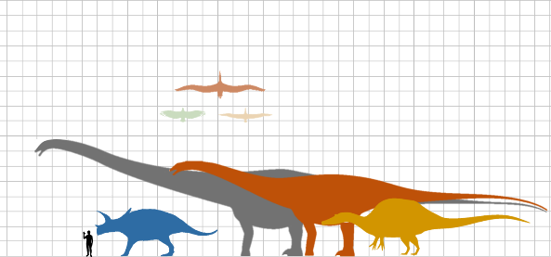
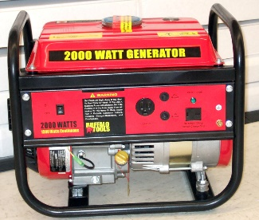
Remember SWAP
Benchmarking between platforms and implementations can also be in terms of:
Size – footprint/size the circuit or product takes up
Weight – how heavy product is (also concerns for the connectedness/dependencies – like a friend who brings tons of baggage on the hiking trip and you end up having to carry it) … And
Power – how much power the product uses, which implies its level of mobility and cost in keeping it running, etc.
very beeg
tiny

Slide 14
Profiling Code
EEE4120F HPES

Slide 15
Profiling
Code profiling or Software profiling or Program profiling =
A process of dynamic program analysis (rather than ‘static code analysis’*) that investigates the program’s behavior by gathering data related to its execution (e.g. stack use, O/S calls, etc.) while the program executes.
The purpose:
Usually profiling is done to analysis which sections of a program to optimize, in order to increase its overall speed, decrease its memory requirement, decrease its power consumption … or a optimize around a combination of these aspects.
* static code analysis is a code quality inspection and bug finding method. Typically done as a manual code reviews, not running the code but reading over the code.

Slide 16
Reasons for profiling code
Prescribed: read on your own
Better understanding how your program runs on the architecture
Reduced hardware & maintenance cost
Learn how to be a better coder
Develop better programs
80/20 rule in efficient code development
80% of runtime uses only 20% of the code

Slide 17
Profiling pitfalls
Prescribed: read on your own
Pre-optimization might be a costly waste of time (WoT)
Optimizing the 80% of the code that runs 20% of the time may be a WoT
Not adequately understanding the architecture or application workload
Over optimizing code (e.g. making 4ms into 1ms when you don’t need less than 5ms)
Can overcomplicate code
Not understanding the bottlenecks

Slide 18
Common software bottlenecks
Prescribed: read on your own
Typical bottlenecks
CPU
Memory
Disk
Lock contention (processes flighting over devices)
Network
External resources / IO
Databases access, etc…

Slide 19
Command-line tools for simple profiling on Linux
Prescribed: read on your own
top, htop (useful for threaded apps)
strace
Intercepts and records system calls, which are called by a process and the signals which are received by a process
vmstat (virtual memory statistics)
reports info on processes, memory, paging, IO blocks, traps, disks and CPU activity
dstat (enhancement of vmstat)
View (or report for a period) all of your system resources, you can e.g. compare disk usage in combination with interrupts from your IDE controller, or compare the network bandwidth numbers directly with the disk throughput. *
time (very simple but useful sanity check!)
When command finishes, prints info on timing statistics about the program: (i) elapsed real time between invocation and termination, (ii) the user CPU time, and (iii) the system CPU time.
If you have not tried time already, you are seriously missing out… Quick! Find a Linux computer and try it out!
* May need to install, not always standard on Linux. Reference and further info at: https://linux.die.net/man/1/dstat

Slide 20
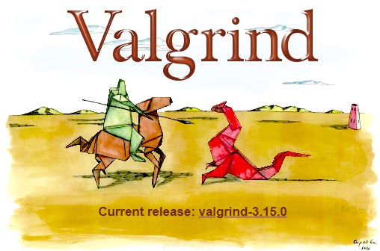
Valgrind : open-source profiler
Valgrind: an instrumentation framework for building dynamic analysis tools.
There are Valgrind tools that can automatically detect many memory management and threading bugs, and to profile your programs in detail.
Can also use Valgrind to build new dynamic analysis / code profiling tools.
The Valgrind distribution includes six production-quality tools:
memory error detector
2x thread error detectors
cache and branch-prediction profiler
call-graph generator
branch-prediction profiler
heap profiler
Reading task:
read ‘About’ page for Valgrind (very useful): https://valgrind.org/info/about.html
Find out more and possibly try it out by visiting:
https://valgrind.org/

Slide 21
Prac 1 - reasoning
Prac1 is not just about testing
Why correlation is used in the intro:
The purpose here is that for later pracs, or parts of the project, you may want to use correlation to compare the results of different implementations (i.e. to compare a dodgy prototype to a trusted ‘golden measure’, using e.g. Julia, OCTAVE or MATLAB to do correlations and other stats to check your prototype)
Using Latex… I suggest either
TexStudio : https://www.texstudio.org/
Overleaf : https://www.overleaf.com/
Next lecture will say a bit more about prac reports, planning project report etc.

Slide 22
closing
remarks & reminders…

Slide 23
End of Lecture

Slide 24
Disclaimers and copyright/licensing details
I have tried to follow the correct practices concerning copyright and licensing of material, particularly image sources that have been used in this presentation. I have put much effort into trying to make this material open access so that it can be of benefit to others in their teaching and learning practice. Any mistakes or omissions with regards to these issues I will correct when notified. To the best of my understanding the material in these slides can be shared according to the Creative Commons “Attribution-ShareAlike 4.0 International (CC BY-SA 4.0)” license, and that is why I selected that license to apply to this presentation (it’s not because I particulate want my slides referenced but more to acknowledge the sources and generosity of others who have provided free material such as the images I have used).
Image sources:
Wikipedia (open commons)
http://www.flickr.com
http://pixabay.com/
Forrest of trees: Wikipedia (open commons)

