Slide 1
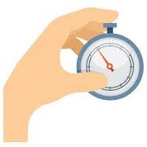
EEE4120F
High Performance
Embedded Systems
Lecture 5:
Performance Benchmarking &
Wall Clock Timing
Lecturer:
Simon Winberg
Attribution-ShareAlike 4.0 International (CC BY-SA 4.0)
Planned as short recorded lecture
Notes:
Audio narrations have been left in some of the slides, these are provided as a means to just supplement some of the information, you do not need to listen to them (press on the speaker icon if you want to listen to the annotation).
The lecture sessions will present the slides and provide an opportunity for questions and discussion of the topics.
Image source: https://www.vectorportal.com

Slide 2
Outline for Lecture
Towards performance benchmarking
Simple benchmarking techniques

Slide 3
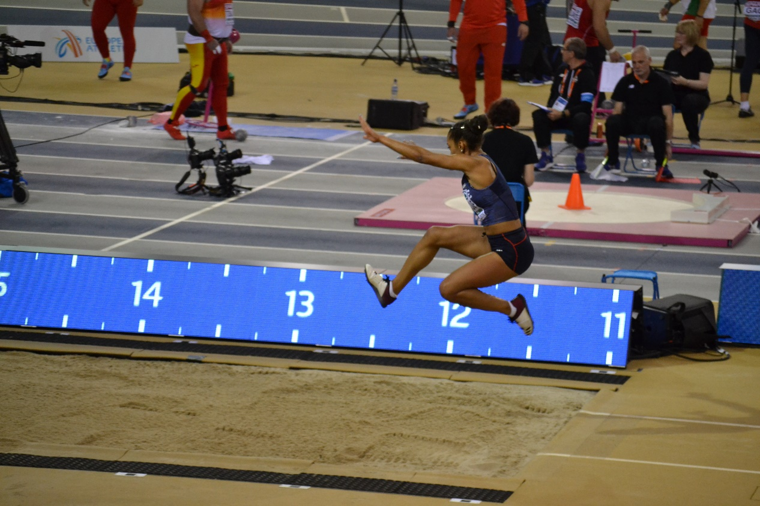
Performance Benchmarking
EEE4120F HPES

Slide 4
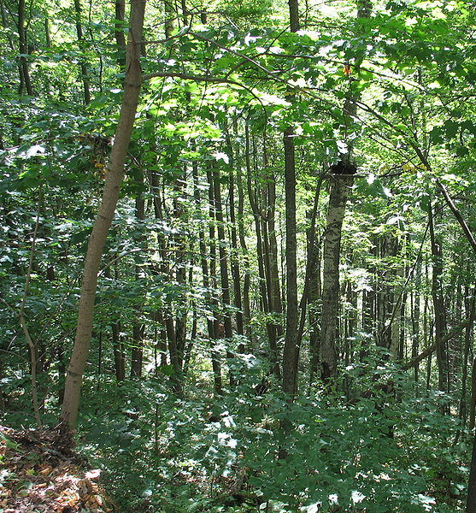
Performance Benchmarking
“Don’t loose sight of the forest for the trees…”
Generally, the main objective is to make the system faster, use less power, use less resources…
Most code doesn’t need to be parallel.
Important questions are…

Slide 5
Important questions
Should you bother to design a parallel algorithm?
Is your parallel solution better than a simpler approach, especially if that approach is easier to read and share?
Major telling factor is:
Real-time performance measure
Or “wall clock time”

Slide 6
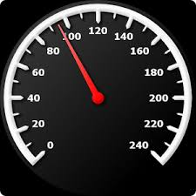
Benchmarking
MIPS
Process of measuring performance of a digital system
A program (or systematic approach) that Quantitatively evaluates performance, cost and computer hardware and software resources (among other things) of a computing solution
Benchmark suites – sets of benchmark programs designed to get a comprehensive view of the performance of a computer system for executing a variety of representative processing operations.
Suitable benchmark
A meaningful representation of what the system can do
Helps select of an effective system
Indicates a measure of what one system can do compared to other options
Notes:
These are useful tips to consider for the course project, as well as the pracs leading to that.

Slide 7
Wall clock time
Generally the most accurate: use a built-in timer, which is directly related to real time (e.g., if the timer measures 1s, then 1s elapsed in the real world)
Technique:
unsigned long long start; // store start time
unsigned long long end; // store end time
start = read_the_timer(); // start timer / tic
DO PROCESSNG
end = read_the_timer(); // end timer / toc
.. Output the time measurement (end-start), or save it to an array if printing will interfere with the times. Note: to avoid overflow, used unsigned vars.
See file:
Cycle.h
Cycles.c

Slide 8
StdC: gettimeofday
gettimeofday
Very portable, part of the StdC library
Should be available on any Linux system
Returns time in seconds and microseconds since midnight 1 Jan 1970
Uses struct timeval comprising
tv_sec : number of seconds
tv_usec : number of microseconds*
Converting to microseconds will use huge numbers, rather work on differences
* Word of caution: some implementations always return 0 for the usec field!!
On Cygwin, the resolution is only in milliseconds, so tv_usec in multiples of 1000.
Not provided in DevC++.
Notes:
You may want to use this in your OpenCL applications

Slide 9
gettimeofday example
See timing.c code file
#include <stdio.h>
#include <sys/time.h>
#include <time.h>
struct timeval start_time, end_time; // variables to hold start and end time
int main() {
int tot_usecs;
int i,j,sum=0;
gettimeofday(&start_time, (struct timezone*)0); // starting timestamp
/* do some work */
for (i=0; i<10000; i++)
for (j=0; j<i; j++) sum += i*j;
gettimeofday(&end_time, (struct timezone*)0); // ending timestamp
tot_usecs = (end_time.tv_sec-start_time.tv_sec) * 1000000 +
(end_time.tv_usec-start_time.tv_usec);
printf("Total time: %d usec.\n", tot_usecs);
}

Slide 10
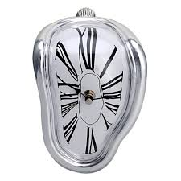
What is wrong about using only wall clock time?
It can provide a false impression of how effective your solution is – at least doesn’t give a ‘full picture’ …
Typically do tests after the system has ‘warmed up’* (cache loaded) by running the same data multiple times
May show the solution is quicker… but at what costs? e.g.:
Speed improved but accuracy sacrificed?
Development effort vs. execution speed improvement?
Resource costs for upgrading vs. costs saved by remaining with the old version?
Power usage? Does the new solution need more power (per execution, also on average including idle time)
Maintainability? (e.g. is the new version more complex?)
Environment impact? (Does the upgrade result in waste that could be environmentally detrimental)
* But this can be a very false impression too, e.g. cache etc pre-set with needed data.

Slide 11
Benchmarking: what to test
What can be benchmarked? For DSP and HPC…
Compiler
Converts High Level Language to Assembly language thus we benchmark compiler efficiency, such as how efficient is the generated assembly code?
The Processor
Code in hand-crafted/inspected assembly (to make comparisons fair)
Operating System
Interrupt latencies, overhead of operating system calls, limits on devices, kernel size, availability of services and facilities such as support for virtual memory and paged memory.
Platform
Scalability of memory. Peripheral limits. Interfaces supported. Power use. Power saving features. OS’s supported.
Applications (e.g. representative operations for certain application domains – think ‘DWARFS’ as in Berkeley paper)

Slide 12
Next Lecture …
We get more into depth of
Metrics for performance
Some specialized concepts (e.g. the ‘ACPI’ measure for a processor core)
Methods to summarising performance (commonly seen in performance reports)
SWAP
Profiling code designs*
* Only a brief flavour of profiling techniques, would need to be a course on its own to do properly.
Notes:
This lecture was aimed to provide you an initial flavour of benchmarking. In the next lecture, the aim is to get into more depth of performance analysis and benchmarking. Accordingly, we will look at: metrics of performance. Some specialized concepts. Such as the A C P I. Methods to summarize performance (such as average performance). The S W A P concept. And a view on code profiling methods.

Slide 13
closing
remarks & reminders…

Slide 14
No quiz next week
Have a look at:
Valgrind About Page
Read About page for Valgrind (very useful): https://valgrind.org/info/about.html

Slide 15
End of Lecture

Slide 16
Disclaimers and copyright/licensing details
I have tried to follow the correct practices concerning copyright and licensing of material, particularly image sources that have been used in this presentation. I have put much effort into trying to make this material open access so that it can be of benefit to others in their teaching and learning practice. Any mistakes or omissions with regards to these issues I will correct when notified. To the best of my understanding the material in these slides can be shared according to the Creative Commons “Attribution-ShareAlike 4.0 International (CC BY-SA 4.0)” license, and that is why I selected that license to apply to this presentation (it’s not because I particulate want my slides referenced but more to acknowledge the sources and generosity of others who have provided free material such as the images I have used).
Image sources:
Wikipedia (open commons)
https://www.vectorportal.com
http://www.flickr.com
http://pixabay.com/
Forrest of trees: Wikipedia (open commons)

