Slide 1
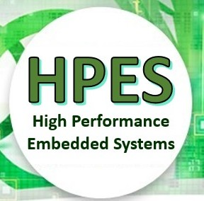
EEE4120F
High Performance
Embedded Systems
Lecture 4:
OpenCL
How to Program
In OpenCL
A Language for Programming Digital Accelerators
Presented by
Simon Winberg
Some slides have voice annotations
Attribution-ShareAlike 4.0 International (CC BY-SA 4.0)

Slide 2
EEE4120F Lab Sessions / Bookings?
Term 1: Thursday 3pm - 5pm (Blue Lab)
Tuesday 11am – 12pm (catchup/additional slot)
Term 2: same (presumably)
Note: there was availability of Monday 11am also (wanted Mon or Tue option, not both)

Slide 3
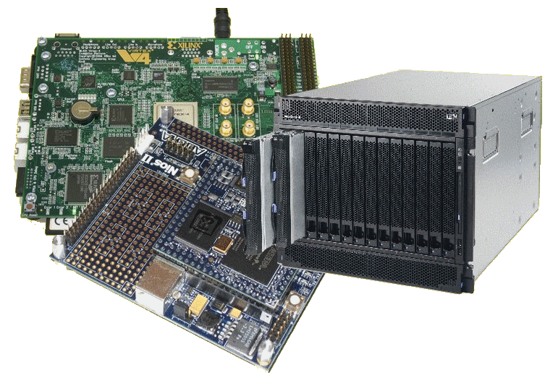
OpenCL Lecture Overview
Why OpenCL
Brief overview of OpenCL
Abstractions & platform model
OpenCL Scenario
OpenCL Programming (Preparation for Prac 2)
The following slides are based on a presentation prepared by Dr. Suleyman Demirsoy, DSP Technology Specialist, Intel Programmable Solutions Group
See also paper in reading list: “06502816 - OpenCL Overview, Implementation, and Performance Comparison.pdf”
(this paper is supplementary reading, not prescribed)
Licensing details last slide

Slide 4
Note: to save time and avoid boredom, some of these slides are assigned as:
Prescribed reading
Supplementary reading
May come up in a test
Won’t be examined

Slide 5
Why OpenCL?
EEE4120F

Slide 6
Why OpenCL…
Main reason is because there’s massive Increasing demands for more functionality and performance
… and clients also want it soon (i.e. asap to beat the competition etc).
But it’s not just that, it’s also to try and streamline and perhaps even mitigate the complexity of modern designs.

Slide 7
OpenCL – for acceleration & other kernels
It is also a response for needs to cater for
BIG DATA
HIGHLY INTEGRATED SYSTEMS
SPECIAL-PURPOSE ACCELERATORS

Slide 8
OpenCL – for acceleration & other kernels
OpenCL is not (currently) meant for creating most of the application code.
It is designed around developing accelerated kernels that are highly parallel or exercise the specialized hardware (not necessarily an application accelerator)
The diagram on right explains where OpenCL fits in (it is the same as to where Digital Accelerators generally fit in to a computer system)
Host Computer
Application Code
mainly ‘glue code’ & GUI / IO
Reused Libraries
lots of data
Active kernel
Inactive kernels
Application Accelerator

Slide 9
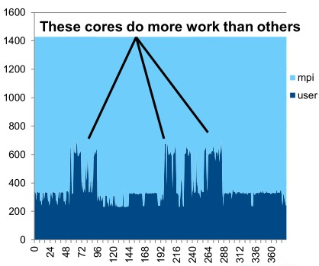
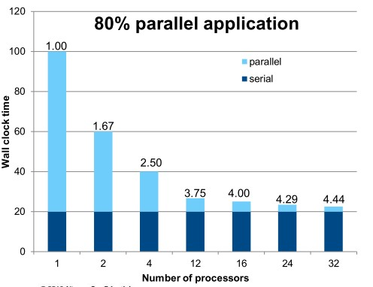
Why OpenCL…
Not all applications scale well linearly
Not all apps load balance across all cores equally
LIMITED SCALABILITY
POORLY BALANCED

Slide 10
Why OpenCL…
Heterogeneous Computing Systems as a potential solution to the problems of limited scalability and balancing
Distribute your different processing needs among processing cores better suited to the particular types of processing.
workload
Essentially like matching the equipment with the task
Definition: Heterogeneous computing refers to systems that use more than one kind of processor. These are systems that gain performance not just by adding the same type of processors, but by adding dissimilar processors, usually incorporating specialized processing capabilities to handle particular tasks (or entire applications).

Slide 11
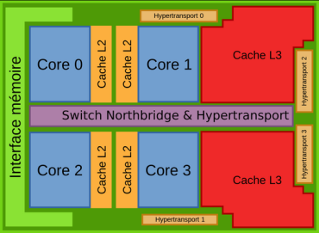
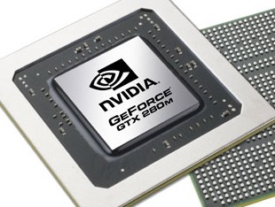
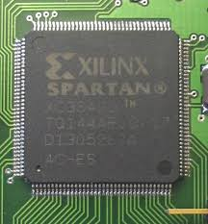
Examples of devices form which heterogeneous computing systems are composed
Multi-core, general purpose, central processing units (CPUs)
Include multiple execution units ("cores") on the same chip
Digital Signal Processing (DSPs) processors
Optimized for the operational needs of digital signal processing
Graphics Processing units (GPUs)
Heavily optimized for graphics processing
Field Programmable Gate Arrays (FPGAs)
Custom architectures for each problem solved
SoC FPGAs combine CPU+FPGA in single device

Slide 12
Challenges to developers
Various applications becoming bottlenecked by scalable performance requirements
e.g. Object detection and recognition, image tracking and processing, cryptography, cloud, search engines, deep packet inspection, etc…
Overloading CPUs capabilities
Frequencies capped
Processors keep adding additional cores
Need to coordinate all the cores and manage data
Source: points based on course notes by B. Subramanian, Department of Computer Science, University of Texas, Austin

Slide 13
Challenges to developers (cont.)
Product life cycles are long
GPUs lifespan is short (which goes with the problem of getting replacements of the same model in the future)
Require re-optimization and regression testing between generations
(not limited to accelerators/GPUs!! It could be some cryptic control code for a robot, e.g. multiple processors of an integrated device)
Maintaining coherency throughout scalable system
Support agreement for GPUs costly
Power dissipation of CPUs and GPUs limits system size
Source: points based on course notes by B. Subramanian, Department of Computer Science, University of Texas, Austin

Slide 14
OpenCL – abstractions and platform model
EEE4120F

Slide 15
Overview of OpenCL
Open standard for parallel programming across heterogeneous devices
Devices can consist of CPUs, GPUs, embedded processors etc. – uses all the processing resources available
Includes a language based on C99 for writing kernels and API used to define and control the devices
Parallel computing (or hardware acceleration*) through task-based and data-based parallelism
* Which is more generic e.g. if the hardware is faster but not necessarily more parallel

Slide 16
Purposes of OpenCL
Use all computational resources of the system via a consistent programming language
Greater platform independence
Provides both a data and task parallel computational model
A programming model which abstracts the specifics of the underlying hardware
Much flexibility in specifying accuracy of floating-point computations
Supports desktop, server, mobile, custom, etc.

Slide 17
The OpenCL Platform Model
This could simply be your workstation PC or a network server
Host connected to one or more OpenCL devices
Device consists of one or more cores
Execution per processor may be SIMD or SPMD*
Contexts group together devices and enable inter-device communication
HOST
Context
Device A - CPU
Device B - GPU
Context
Device C - DSP
* Single Program, Multiple Data - where cores are running the same program but not necessarily the same instructions at the same time
Slide adapted from course notes by B. Subramanian, Department of Computer Science, University of Texas, Austin

Slide 18
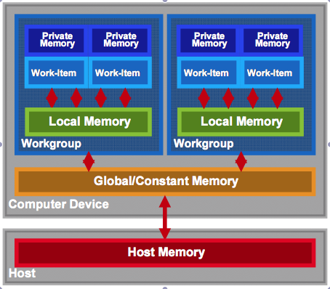
OpenCL Memory model
Prescribed reading
Private memory: available per work item
Local memory: shared in workgroup
NB: No synchronization between workgroups
Synchronization possible between work items in a common workgroup
Global/constant memory accessible by any work-items (no guarantee to be synchronized)
Host memory: access through the CPU
PICe (usually)
Memory management is explicit…
Data moved from: host->global->local and back

Slide 19
OpenCL Memory model
Prescribed reading
Private memory: available per work item
Local memory: shared in workgroup
NB: No synchronization between workgroups
Synchronization possible between work items in a common workgroup
Global/constant memory accessible by any work-items (no guarantee to be synchronized)
Host memory: access through the CPU
PICe (usually)
Memory management is explicit…
Data moved from: host->global->local and back

Slide 20
OpenCL Memory model
Prescribed reading
Private memory: available per work item
Local memory: shared in workgroup
NB: No synchronization between workgroups
Synchronization possible between work items in a common workgroup
Global/constant memory accessible by any work-items (no guarantee to be synchronized)
Host memory: access through the CPU
PICe (usually)
Memory management is explicit…
Data moved from: host->global->local and back

Slide 21
OpenCL Memory model
Prescribed reading
Private memory: available per work item
Local memory: shared in workgroup
NB: No synchronization between workgroups
Synchronization possible between work items in a common workgroup
Global/constant memory accessible by any work-items (no guarantee to be synchronized)
Host memory: access through the CPU
PICe (usually)
Memory management is explicit…
Data moved from: host->global->local and back

Slide 22
OpenCL Memory model
Prescribed reading
Private memory: available per work item
Local memory: shared in workgroup
NB: No synchronization between workgroups
Synchronization possible between work items in a common workgroup
Global/constant memory accessible by any work-items (no guarantee to be synchronized)
Host memory: access through the CPU
PICe (usually)
Memory management is explicit…
Data moved from: host->global->local and back

Slide 23
OpenCL Memory model
Prescribed reading
Private memory: available per work item
Local memory: shared in workgroup
NB: No synchronization between workgroups
Synchronization possible between work items in a common workgroup
Global/constant memory accessible by any work-items (no guarantee to be synchronized)
Host memory: access through the CPU
PICe (usually)
Memory management is explicit…
Data moved from: host->global->local and back

Slide 24
Advantages of the OpenCL JIT* Compiler
HLS (high level synthesis) phase leverages the OpenCL compiler
You can (if you want to) still specify and adjust:
High performance datapaths
Automatic pipelining
New QoR enhancements as they are developed
DSPB back-end optimizations
Memory optimizations
In addition to:
Control constraints (latency, fmax, area, …)
Control interfaces (stall, valid, Avalon-MM, …)
Control architecture (memory configuration, scheduling, …)
IP core verification flows
Code.c
IP optimizations
executables
* JIT = Just In Time

Slide 25
OpenCL Coding
EEE4120F

Slide 26
OpenCL Programming Model
Prescribed reading
Kernel
basic unit of execution – data parallel
Program
collection of kernels and related functions
Kernels executed across a collection of work-items
one work-item per computation
Work-items
Independent processing tasks; grouped into workgroups
Workgroups
Work-items that executed together on one device
Workgroups are executed independently can take place simultaneously or via specific schedule
Applications structuring
Queue kernel instances for execution in-order, but they may be executed in-order or out-of-order
Work items and OpenCL memory model

Slide 27
OpenCL Objects (work task elements)
Prescribed reading
Devices: multiple cores on CPU/GPU together taken as a single device
Kernels executed across all cores in a data-parallel manner
Contexts: Enable sharing between different devices
Devices must be within the same context to be able to share
Queues: used for submitting work, one per device
Buffers: simple chunks of memory like arrays; read-write access
Images: 2D/3D data structures
Access using read_image(), write_image()
Either read or write within a kernel, but not both

Slide 28
OpenCL Kernel Objects
Declared with a __kernel qualifier
Encapsulate a kernel function
The kernel objects created after the executable is built
Execution
Set the kernel arguments
Enqueue the kernel
Kernels are executed asynchronously
Events used to track the execution status
Used for synchronizing execution of two kernels
clWaitForEvents(), clEnqueueMarker() etc.

Slide 29
OpenCL Program Objects
Encapsulate
A program source/binary
List of devices and latest successfully built executable for each device
List of kernel objects
Kernel source specified as a string can be provided and compiled at runtime using clCreateProgramWithSource() – platform independence
Overhead – compiling programs can be expensive
OpenCL allows for reusing precompiled binaries

Slide 30
OpenCL Overall Pipeline
A view on how some of the objects fit in to the execution model

Slide 31
OpenCL C Language
(can skip this slide, may be useful to refer to when writing a OpenCL program)
C99 (previously ‘C9X’) is an informal name for ISO/IEC 9899:1999, a past version of the C programming language standard. It extends the previous version (C90) with new features for the language and the standard library. Helps implementations make better use of available computer hardware and compiler technology.
Source & more info: https://en.wikipedia.org/wiki/C99
Derived from ISO C99
Non standard headers, function pointers, recursion, variable length arrays, bit fields
Added features: work-items, workgroups, vector types, synchronization
Address space qualifiers
Optimized image access
Built-in functions specific to OpenCL
Data-types
Char, uchar, short, ushort, int, uint, long, ulong
Bool, intptr_t, ptrdiff_t, size_t, uintptr_t, half
Image2d_t, image3d_t, sampler_t
Vector types – portable, varying length (2,4,8,16), endian safe
Char2,ushort4,int8,float16,double2 etc.
Many of these are recognizable from C!
Supplementary reading

Slide 32
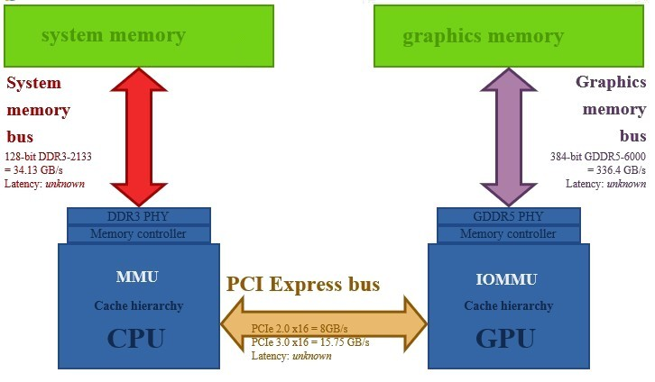
OpenCL Programming
GPU/CPU
bottleneck
EEE4120F
How to code an OpenCL kernel…

Slide 33
OpenCL C Language: dealing with address spaces
Supplementary reading
Address spaces
Kernel pointer arguments must use global, local or constant
Default for local variables is private
Image2d_t and image3d_t are always in global address space
Global variables must be in constant address space
NB: Casting between different address spaces undefined
(skip in lecture, may be useful to refer to when writing a OpenCL program)

Slide 34
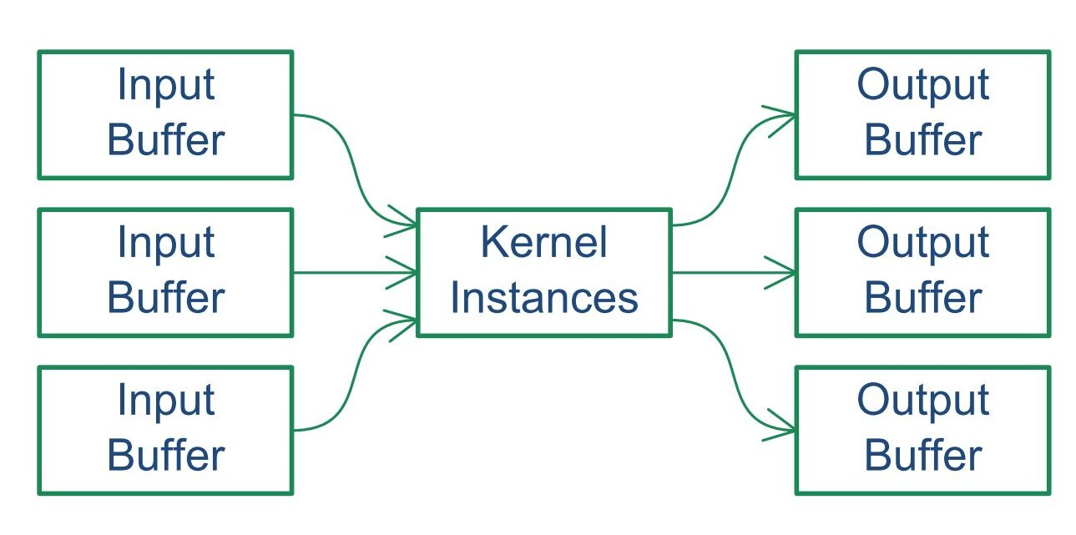
Conceptual view of how an OpenCL kernel fits in
Prescribed reading
Similar to
vertex buffers
and textures
Similar to
depth and
frame buffers
Similar to
vertex and fragment shaders
Set up & transfer buffers to GPU
(2) Invoke the kernel
(3) Transfer output buffer to CPU
… comparing to GPU / CUDA type approach …

Slide 35
OpenCL C Language
Prescribed reading
Work-item and workgroup functions
get_work_dim() : number dimensions of tasks, returns 1 for a queue added with clEnqueueTask
get_global_size() : work-item ID
get_group_id(), get_local_id() :
Vector operations and components are pre-defined
Kernel functions
get_global_id() – gets the work item ID
Conversions
Explicit – convert_destType<_sat><_roundingMode>
Reinterpret – as_destType
Scalar and pointer conversions follow C99 rules
No implicit conversions/casts for vector typs
See image on slide 25.
Many of these are not so common in C!
(won’t be asked about in tests)
(skip in lecture, may be useful to refer to when writing a OpenCL program)
https://www.khronos.org/registry/OpenCL/sdk/1.0/docs/man/xhtml/clEnqueueTask.html

Slide 36
Initialisation – on CPU side
Get platform ID
Get device ID
Create Context
Load kernel .cl code file(s)
Create OpenCL program (may have multiple kernels, provide list of kernel names)
Build program
Compile kernels function (creates a kernel from one program function)
Create command queue to the target device
Create memory buffer(s) that both host and target can access
Set up kernel memory arguments (to send to kernel)
Enqueue kernel, added to list of kernels to deploy on target
Get data from output buffer
Do any checks / further processing on output obtained
Wait for kernel queue to ﬁnish
Wait for the OpenCL system to ﬁnish performing the commands in the queue and the release the kernel, memory, queues, program and context.

Slide 37
OpenCL Kernel .cl Code Example
/** This Kernel function has one buffer that is defined as a float array. It also has a constant input n. */
__kernel void KernelFunctionName (
__global float* x, // float array to process
const unsigned int n ) // number of elements in x
{
// get the core number and
const int i = get_global_id(0); // number of this work item
const int g = get_group_id(0); // group that work item is in
// if the x array is long enough, just put this item’s group
// number into the array at index of work item number
if (i<n) x[i] = g;
}
Put this in a file called e.g. Kernel.cl

Slide 38
Think of method to check kernel
Generally, it is useful to have an equivalent implementation, which gives an accurate result, for testing the kernel function (e.g. ‘Golden Measure’ written in Python).

Slide 39
Coding each step
Prac2.1 will take you through the process of setting up an OpenCL kernel
Thanks to Chris Hill for EEE4120F OpenCL Prac2 updates and refinements.

Slide 40
Info & Procedure for Prac2.1
Each student should run through the prac.
The bluelab is planned to be set up for remote access, the machines would need to be shared via ssh remote login.
The machines each have a small but fast SSD (so keep a separate main copy of your files)

Slide 41
Run the OpenCL version
A brief view of Prac2.1 to be given in the lecture…

Slide 42
Compare CPU & GPU kernel results
E.g. comparing results obtained from the (e.g.) Python sequential implementation to those generated by the parallel kernel version.

Slide 43
Further Reading
Supplementary reading
R Wright, N Haemel and G Sellers
OpenGL SuperBible, 6 th ed
Addison-Wesley, 2014, ISBN 978-0-321-90294-8
A Munshi, B R Gaster, T G Mattson, J Fung and D Ginsburg
OpenCL Programming Guide
Addison-Wesley, 2012, ISBN 978-0-321-74964-2
Mac Developer Library
OpenCL Hello World Example
Altera
OpenCL SDK for FPGA

Slide 44
closing
remarks & reminders…

Slide 45
Coding Kernels: OpenCL, C++ → HDL
EEE4120F

Slide 46
Advantages of OpenCL vs C++
Supplementary reading
OpenCL
C++ → HDL translators
Targets CPU, GPU and FPGAs
Target user is Software developer
Implements FPGA in software development flow
Performance is determined by resources allocated
Host Required
Targets FPGA
Target user is FPGA designer
Implements FGPA in traditional FPGA development flow
Performance is defined and amount of resource to achieve is reported
Host not required
(skip in lecture, may be useful to refer to when writing a OpenCL program)

Slide 47
CUDA vs OpenCL correspondence
Supplementary reading
CUDA
OpenCL
Thread
Thread-block
Global memory
Constant memory
Shared memory
Local memory
__global__ function
__device__ function
__constant__ variable
__device__ variable
__shared__ variable
Work-item
Work-group
Global memory
Constant memory
Local memory
Private memory
__kernel function
no qualification needed
__constant variable
__global variable
__local variable
(skip in lecture, may be useful to refer to when writing a OpenCL program)

Slide 48
End of Lecture

Slide 49
Disclaimers and copyright/licensing details
I have tried to follow the correct practices concerning copyright and licensing of material, particularly image sources that have been used in this presentation. I have put much effort into trying to make this material open access so that it can be of benefit to others in their teaching and learning practice. Any mistakes or omissions with regards to these issues I will correct when notified. To the best of my understanding the material in these slides can be shared according to the Creative Commons “Attribution-ShareAlike 4.0 International (CC BY-SA 4.0)” license, and that is why I selected that license to apply to this presentation (it’s not because I particularly want my slides referenced but more to acknowledge the sources and generosity of others who have provided free material such as the images I have used).
Image sources:
Wikipedia (open commons) commons.wikimedia.org
flickr.com
Gadgets, Block diagrams for Altera OpenCL models – fair usage
public domain CC0 (http://pixabay.com/)

