Slide 1
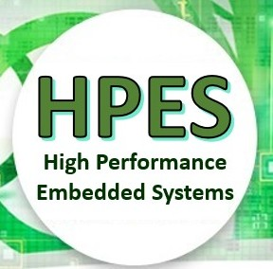
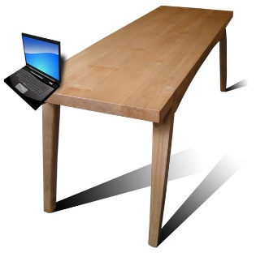
EEE4120F
High Performance
Embedded Systems
Lecture 3:
Edge computing; Microprocessor vs. FPGA-based RC solutions
Lecturer:
Simon Winberg
Edge Computing
Attribution-ShareAlike 4.0 International (CC BY-SA 4.0)
Notes:
Audio narrations have been left in the slides, these are provided as a means to just supplement some of the information, you do not need to listen to them.
The lecture sessions will present the slides and provide an opportunity for questions and discussion of the topics.

Slide 2
Outline for Lecture
Considerations for EDGE computing (connection to direction of this course)
Computing solutions: HW vs SW vs RC
Latest Intel chipsets
Towards digital accelerators (e.g. Alveo)
Tools that we will be using
Closing Remarks & Intermission

Slide 3
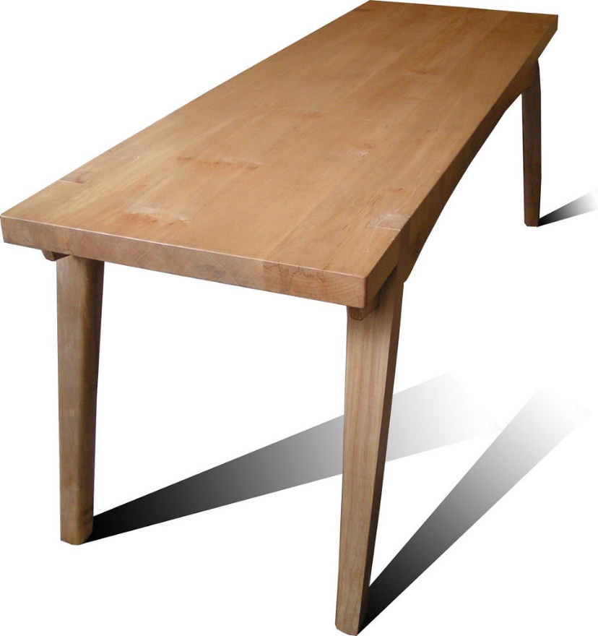
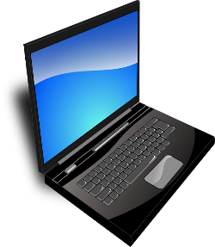
Edge Computing
EEE4120F HPES

Slide 4
Edge Computing
Edge computing (a precise definition):
A distributed computing paradigm that brings computation (and possibly data storage) closer to where it is needed, as a means to improve response times and save bandwidth. *
Alternate definition:
“edge computing” is any type of computer program that delivers low latency nearer to the requests.
It something of a swing away from the “in the cloud” thinking… there are problems with everything being in the cloud such as needing to get data (e.g. sensor data) to the cloud and results back from it.
* Ref and recommended read: https://www.cloudwards.net/what-is-edge-computing/
** Dilley, John, et al. "Globally distributed content delivery." IEEE Internet Computing 6.5 (2002): 50-58.

Slide 5
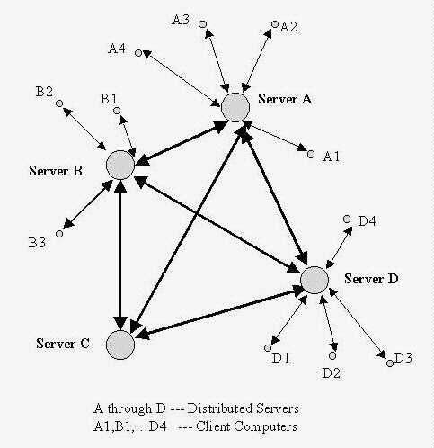
Edge Computing “Another name for networked embedded systems?”
A ‘rediscovery’ in a way that doing things at the edges (leaves) of a network may work out better than drawing it in to a central compute point
But with the advantage of being connected to a network (e.g. bring in data from other nodes)
The concept of a ‘smart embedded sensor’ or a sub-sensor net (i.e. a distribution of distributed nets) may work better in some cases.
Some benefits of edge, e.g.
Reduce risks (can do stuff without internet access)
Improve response rates
Better manage load (not having to do the processing centrally and distribute the results)
Improved reliability
Distribution of distributed nets

Slide 6
HPES and Edge Computing
Probably obvious to realize that many Edge Computing solutions involve HPES
To achieve the ‘smartness’ of an edge computing device, you may need substantial compute power… and if you want small and low-power, then you’re probably going to do it using HPES
HPES
Edge Sensor

Slide 7
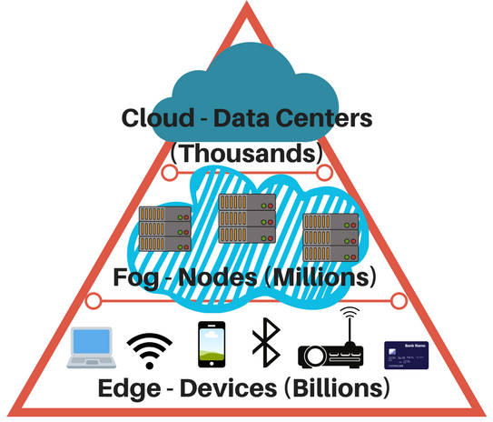
Edge and Friends
Fog computing:
Moves the computing closer to the network edge, reducing data traffic, latency etc.
A compromise between cloud and edge
Cloud computing:
You already know…
It’s centralizing the data and processing
e.g. proliferation of IoT devices

Slide 8
Nice to know about Edge Computing but… let’s get
back to:
processing and computer hardware issues

Slide 9
Question:
Do you sometimes feel that despite
having a wizbang multicore PC,
it still just isn’t keeping up well
with the latest software demands?...
…
Anyone else beside me feel that way?
Major software
Processor cores

Slide 10
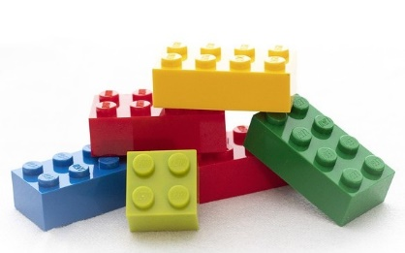
… It maybe so because:
Your software doesn’t leverage full potential of your hardware or maybe
Your hardware should be leverageable to suite your software
super specialized
CPUs at idle
vs.
vs.
heavily laden single CPU
reconfigurable hardware with specialized software

Slide 11
Special Hardware
vs.
Microprocessor-based
vs.
RC / FPGA-based
Solutions

Slide 12
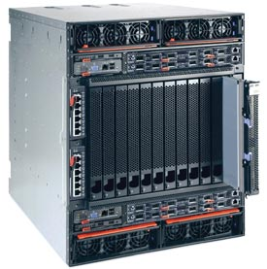
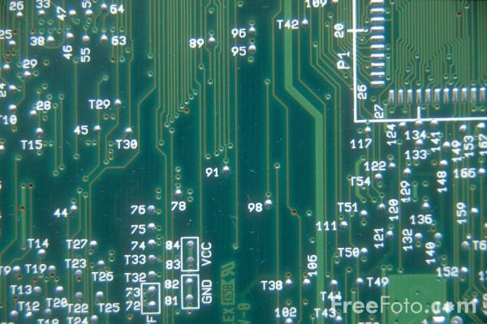
Computation Methods
this term
Hardware
Reconfigurable
Computer
Software
Processor
e.g. PCBs, ASICs
Advantages:
High speed & performance
Efficient (possibly lower power than idle processors)
Parallelizable
Drawbacks:
Expensive
Static (cannot change)
e.g. IBM Blade, FPGA-based
computing platform
Advantages:
Faster than software alone
More flexible than software
More flexible than hardware
Parallelizable
Drawbacks:
Expensive
Complex
(both s/w
& h/w)
e.g. PC, embedded software on microcontroller
Advantages:
Flexible
Adaptable
Can be much cheaper
Drawbacks:
The hardware is static
Limit of clock speed
Sequential
processing

Slide 13
Supplementary reading
Useful video:
Latest Intel Chipsets
https://youtu.be/TK7eOrgOISc
“9th Gen Intel CPU Comparison — i5 vs i7 vs i9 Benchmarks”
Core i9: “Intel Core i9 Explained“ https://youtu.be/suQnh1TvGHw?list=TLPQMjIwMjIwMjAkrwJfYkr9qA

Slide 14
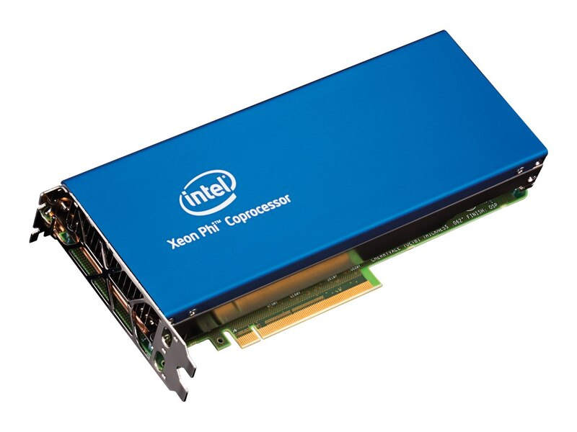
Supplementary reading
Intel’s Xeon Phi
Exciting Stuff!
at a hefty price tag
which a GPU will probably beat dramatically for most things
(but some motivation for OpenCL)
https://youtu.be/I0U6ZMeVrB4?list=TLPQMjIwMjIwMjAkrwJfYkr9qA

Slide 15
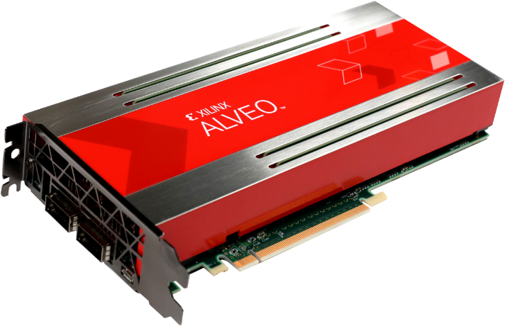
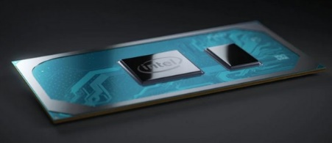
Digital Accelerators: New Practice
Digital accelerator cards (including GPGPUs) are ever increasing in popularity, including use in data centres.
(launched end 2018)
(ended 2019)
Xilinx Alevo: Adaptable Accelerator Cards for Data Centres
https://www.xilinx.com/products/boards-and-kits/alveo.html
HP Intel 5110P Xeon Phi Coprocessor Kit
Intel Xeon Phi
Where and why it’s no longer being made, replaced by Xeon Scalable Platform
Program with OpenCL or Xilinx’s owns accelerator design suite.
Replaced by (from 2020)
And… some of this it may involve designing specialized compute architectures for the need (using a combination of languages and tools e.g. OpenCL / Verilog, C, R, etc.)
Intel Ice Lake
(10 nm process) 10th generation core, successor for Xeon Phis.
Core i7 1068G7 (2020 debut) 4 CPU cores + 64 Iris+ GPCPU cores
* What was it said in the “Berkeley Landscape” … “Small is beautiful” and “manycore is the future of Computing”.

Slide 16
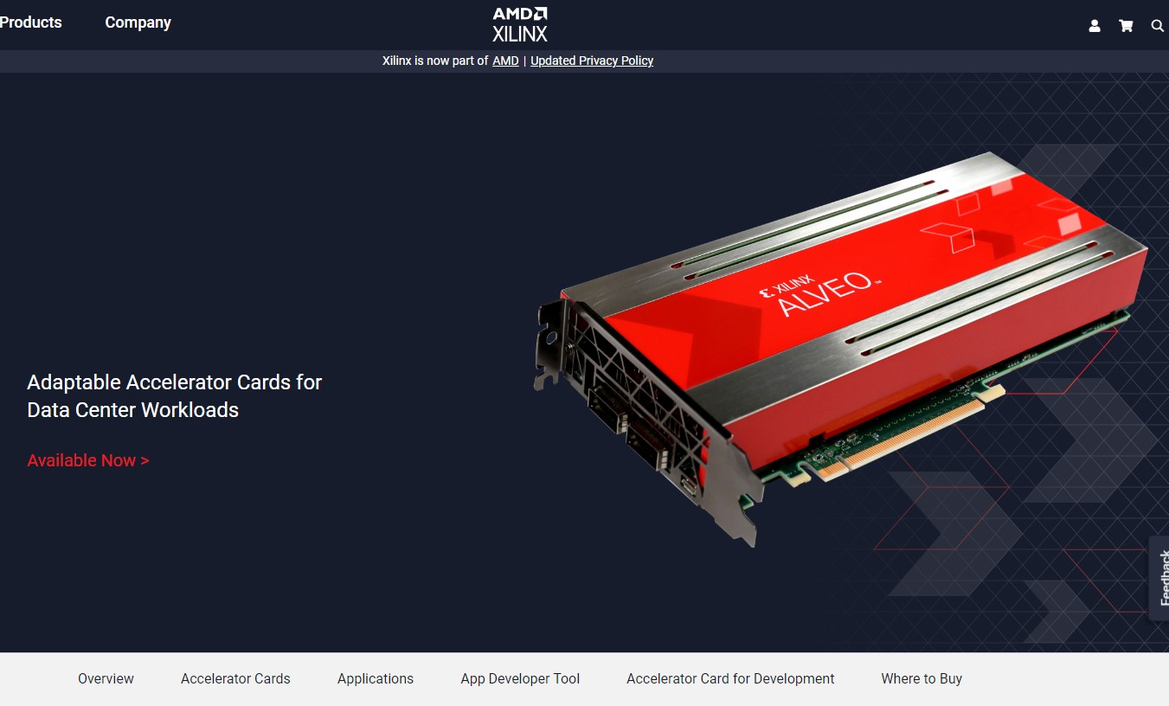
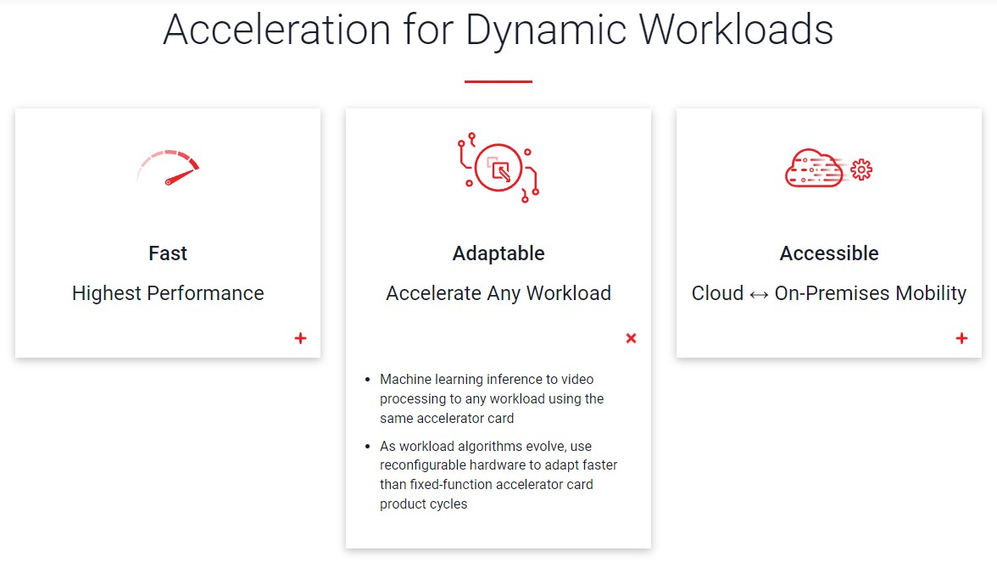
AMD Xilinx Alveo
Latest awesome
R.C. processing card
← watch this!
https://youtu.be/IJDSclTjgBU

Slide 17
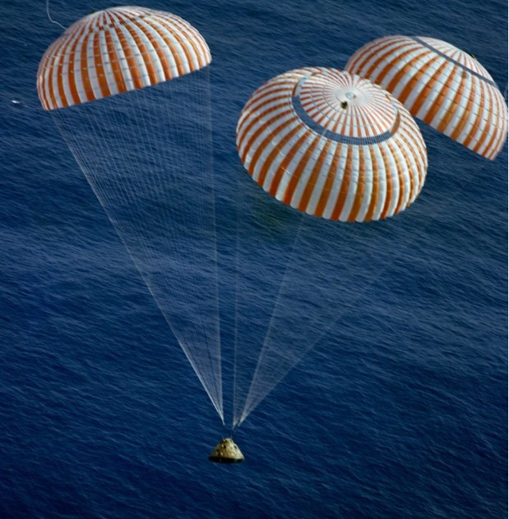
but now back to Earth …

Slide 18
Tools that we will be using
Julia / OCTAVE
C / C++ (for host and coordination)
OpenCL (for GP* digital accelerator)
Verilog HDL (i.e. to design our own special-purpose processor or digital accelerator)
✓
Hope you’re suitable ready!
…
* GP = General Purpose (e.g. GPGPU is for running instructions on a GPU that aims to be useful for very general types of processing)

Slide 19
About Pracs & Prac 2
Status of Prac1 completion?
Prac2: OpenCL
Recommend attempting to install nVidia or Intel or AMD OpenCL drivers on your own PC if have an OpenCL compatible device
For coding suggest Code::Blocks https://www.codeblocks.org/
OR: DevC++ http://dev-cpp.com/
Limited PC currently available in BlueLab, need to share operational machines. Will be provided Linux remote login.

Slide 20
closing
remarks & reminders…

Slide 21
Assigned Reading
Test Tomorrow!
Read L01b: Asanovic et al.,A view of the parallel computing landscape (recommended easier read)
Copy in resources
There will be a short quiz, and I will follow that with solutions
Read About page for Valgrind (very useful): https://valgrind.org/info/about.html

Slide 22
Intermission!
then…
Onwards to lecture 4

Slide 23
End of Lecture 3

Slide 24
Disclaimers and copyright/licensing details
I have tried to follow the correct practices concerning copyright and licensing of material, particularly image sources that have been used in this presentation. I have put much effort into trying to make this material open access so that it can be of benefit to others in their teaching and learning practice. Any mistakes or omissions with regards to these issues I will correct when notified. To the best of my understanding the material in these slides can be shared according to the Creative Commons “Attribution-ShareAlike 4.0 International (CC BY-SA 4.0)” license, and that is why I selected that license to apply to this presentation (it’s not because I particulate want my slides referenced but more to acknowledge the sources and generosity of others who have provided free material such as the images I have used).
Image sources:
Wikipedia (open commons)
http://www.flickr.com
http://pixabay.com/
Forrest of trees: Wikipedia (open commons)

