Slide 1
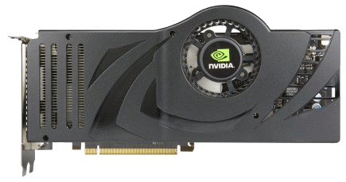
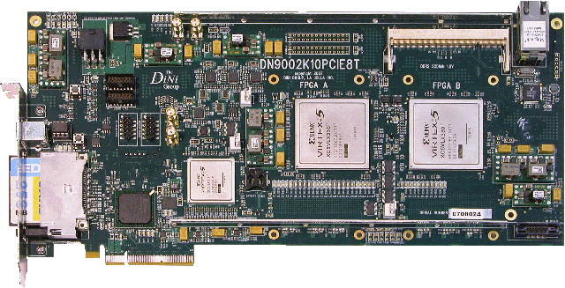
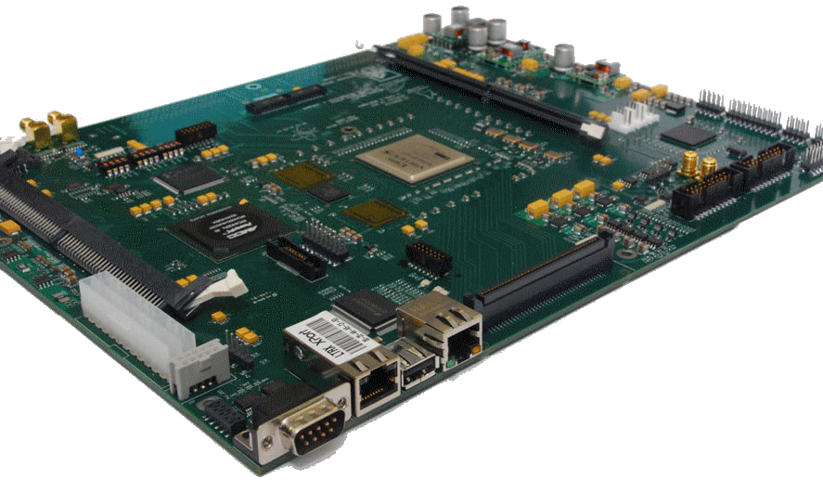
EEE4120F
NOTE: lecture to be recorded*
High Performance
Embedded Systems
Lecture 1
Meet & Greet
* Participation in and attendance of this recorded lecture is voluntary.
Lecturer:
Dr. Simon Winberg
Notes:
Greetings! Welcome to EEE4120F “High Performance Embedded Systems”. This course has been redesigned to be better suited the structure according to the new timetable used this year.
I would like to point out that the lectures are generally recorded, I avoid recording on class test periods or periods assigned to non-lecture type activities.
We well get into more course business and procedures shortly.
This main point of this initial lecture session is intended as an opportunity to tell you about this course. Prac times and general logistics plans about the course will be discussed first in the first “Learning Plans” meeting. For most weeks of term I will generally start with a recap of the plan for the week, what assignments and pracs you should be working on or nearing submission time. I will usually also send out an announcement on Mondays indicating brief plans for the week.
Let’s proceed with the introduction and overview of this HPES course.

Slide 2
Lecture recording
bla bla
NOTE:
Please note that these lectures are being recorded and to be made available on Amathuba or MS Teams.

Slide 3
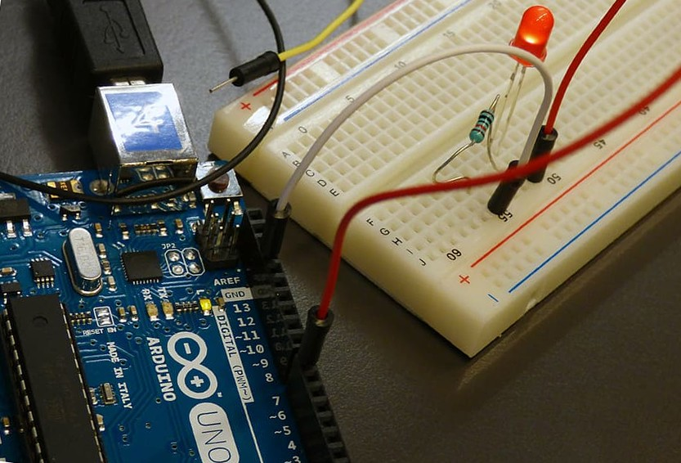
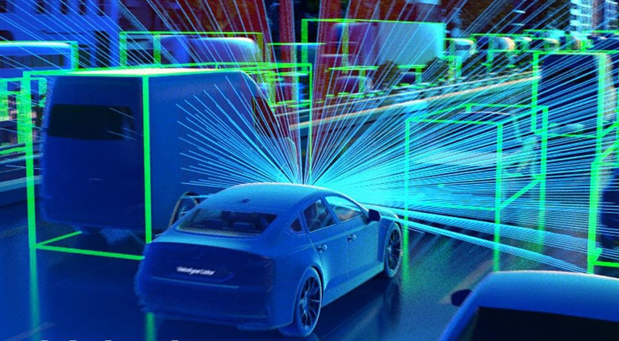
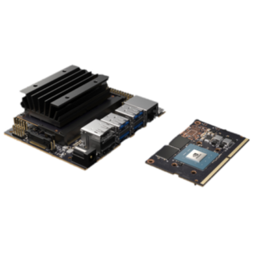
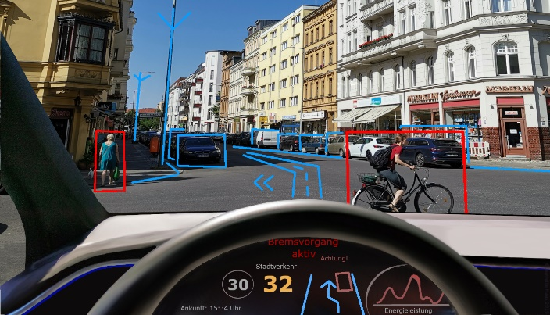
ES vs HPES
Embedded Systems (ES)
vs
High-Performance
Embedded Systems (HPES)*
underlying compute tech
*High-Performance Embedded Computing (HPEC) is a term used frequently instead of HPES. HPECS also. You can choose, but for this course sticking to HPES.

Slide 4
Skills needed for ES vs. HPES?!
For focusing on Embedded Systems (as in the classic concept)
sequential programming
skills to gather and use
comms
HW/SW interfacing
(NB: this is just a relative image, not the full set of skills!!)
ES Skills &
Knowledge
Circuit design
Consider this a development team, not necessarily just an individual
Of course there is more to it than that… but what about HPES development??

Slide 5
Skills needed for ES vs. HPES?!
For focusing on High-Performance Embedded Systems
sequential programming
skills to gather and use
parallel computing
HW/SW interfacing
HDL coding
(NB: this is just a relative image, not the full set of skills!!)
Accelerator Design
DWARFS
HPES Skills & Knowledge
comms
Soc
Circuit design
Consider this a development team, not necessarily just an individual
Of course there is more to it than that… but you surely get the ‘picture’.

Slide 6
The Learning Model
…
HPES knowhow
Well, it’s not about having some refreshing juice to build understanding…
Learning is (currently) more involved than that, so how will learning be done?
* Image source: Learning By Becris In the Conceptual Mixed 1 Collection https://thenounproject.com/term/learning/2021779/
Notes:
Some of the computing approaches, like talking about ‘Golden Measures’ you might feel that you get can't get that out of my head, and it really sink in and is useful for debating and analyzing computation. Others, well hopefully you might remember some characteristics of the terms and techniques presented, even though it may need some recapping or revamping according to latest technologies.

Slide 7
Staff Intro
LECTURER
A/Prof Simon Winberg E-mail: simon.winberg@uct.ac.za Office: Menzies 6.13
TEACHING ASSISTANT
Zaakir Ebrahim E-mail: EBRMUH018@myuct.ac.za
TUTORS
Dean Makoni E-mail: MKNDEA002@myuct.ac.za
Umutesa Munyurangabo E-mail: MNYUMU002@myuct.ac.za

Slide 8
Learning Model
The course handout outlines the approach that will be used…
in summary:
…
but too many words, could illustrate the general notion …
Blended, Online, Class Attendance Optional
Combination of …
Differentiated Instruction: using a variety of resources from which to learn
Expeditionary learning: where students can try different approaches to learn a topic
Essentially a combination of activities, resources, assignment, assessments.
The Implementation …

Slide 9
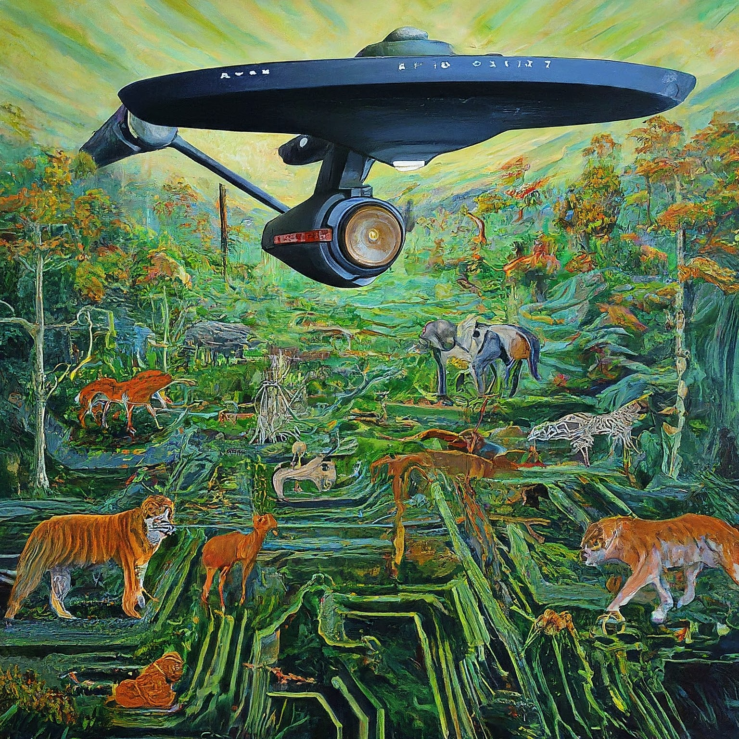
You, with a good secure
vantage point of strange
new ‘digital worlds’ …
The Mission: To Explore Strange New (for some) digital designs
e.g. Design elements that might play nice together, or not.
Acknowledgement: Image generated using https://gemini.google.com/app

Slide 10
Acknowledgement: Image generated using https://gemini.google.com/app
At least, to start with
Then there’s issue of
assignments and group
Project, GA, test… etc.

Slide 11
Learning Model
Learning is often more effective if a regular routines is followed. We will try for that!
Prac methods and times??? To discuss!
The Weekly Routine
Tuesday Homeroom (16h00-18h00)
Lecture, possible quiz, sometimes a seminar, group activity
Next consignment of learning, review readings, learning tasks
Thursday Homeroom / Red lab (16h00-18h00)
Homeroom group work, practical work, tutorials, tool methods
Tutors available to assist, sometimes quiz/tes
Discord monitored (Red lab only available 15h00-17h00)
Thursday RedLab (partly used?)
Term1: Red lab available 2pm-4pm (but Linux not available)
Term2: Red lab available 9am-11am (but Linux not available)
Wednesday (no bookings)
Not used (can add e.g. tutorial room booking)

Slide 12
Method for Queries
The tutors, TA and lecture will use Discord for both prac queries and other course related queries and online discussions. This helps to efficiently handle direct queries from students.
Also a MS Teams for general messages
This is to avoid masses of emails being posted to the lecturer and/or TA, which can mean queries being lost among seas of other emails causing slow responses.
For questions or comments you don’t want share with class: email lecturer or TA directly, ensure clear subject line, e.g. EEE4120F query: <brief subject>

Slide 13
Discord Link
Open up from:
https://discord.gg/HgKX2Ab6
Note: This link will self-destruct in a few days, so join in the Discord server soon
Take note of the introductory announcements and directions

Slide 14
Short Quizzes? And rules.
Yes, that’s the approach we’re going to attempt. It has worked well in the past to encourage students to engage with the learning material and activities on a regular basis leading to better performance, and hopefully having an added advantage of reducing your stress levels.
There won’t be quizzes every week, you will be told a week before of a scheduled quiz so that you usure to be prepared.
Solutions to quizzes usually discussed in lecture session after the quiz, memo shared online
Quiz options and rules …

Slide 15
Quizzes Options and rules
You can request to skip all quizzes and have your quiz mark weight moved to the exam
You need to do this prior to DP finalization
You can miss one quiz per term without needing an excuse (e.g. doctor’s certificate). Missing more that one quiz/term → 0 for that quiz, or you can discard all quiz marks and have added exam weight.
There won’t be quizzes every week, you will be told a week before of a scheduled quiz so that you can to be prepared.
Solutions to quizzes are usually discussed in lecture session after the quiz, memo shared online

Slide 16
Tests? Besides quizzes?
Yes, but not necessarily how you may have expected it.
Two shorter class tests & one longer:
Test | Date and Venue
GA2 Comprehension Test | See course handout
GA2 Validation Essay
There are venue-based tests. And isn’t just about theories and possibly remembering stuff from lectures/readings. It’s going to involve proposing solutions, design strategies, critiquing solutions, various things where we will test your understanding and skills in the subjects of this course. Comprehension Test depends on Prac1 and Prac3.

Slide 17
Practical Work
Certainly, pracs are big part of this course
Prac1 is individual work
The Pracs can be worked on whenever you like, but keep to due dates! (disclaimer note: tutors can only assist with pracs that related to scheduled prac sessions, if you decide start early on pracs you cannot expect tutor to provide support until the scheduled release date for the prac concerned).
One course project:
YODA Project

Slide 18
EEE4120F Marks Breakdown
MARKS:
See next slide…
DP:
Pass GA2 assignment and tests
Minimum 40% overall class average to write the final exam

Slide 19
Marks Breakdown (16 credits)
Practicals: 15%
4 practicals: Golden Measure in MATLAB/OCTAVE; MATLAB Parallel Computing Toolkit; OpenCL project-based learning; OpenMPI collaborating nodes HDL prac leading to project activities
GA assessment & tests : 5%
Comprehension test based on pracs 1,3, technical essay; this is a DP requirement for EEE4120F.
Tests : 15%
5% quizzes (can move to exam), 10% class test (‘exam prep test’). Venue-based test. No make-up tests. Tests you miss (including class test) has it’s weight moved to exam.
Project : 15%
Blog; Status update; Draft Report; Final report; Demo
Final exam : 50%
Venue-based exam

Slide 20
Practical Support using Discord
Discord https://discord.com/ you have likely use before (e.g. in EEE3096S), and we will be using it in this course also as an online platform for working collaboratively on pracs/projects and for tutors being able to provide you support.
The details of connecting up to the Discord server for this course will be announced.
For working online collaboratively on projects with teammates you can decide what tool you prefer, that is flexible. But connecting with lecture/TA/tutors for discussing project artefacts and the like we encourage use of Discord.
Prac1 done individually
Other Pracs planned to be done as a team of two
(we do not encourage teams of more than two, but if for some reason you cannot find a teammate and an existing team is allowing you to join them, then please get permission by emailing lecture or TA)

Slide 21
Pracs Day(s)?
You can choose when & where to work on pracs and assignments
Thursday 4pm-6pm assigned as homeroom where venue available to work on pracs
Redlab available Thursdays 3pm-5pm
Help us decide when best to have tutor monitoring Discord to provide you prac guidance and assistance outside regular lab/homeroom times.

Slide 22
Prac 1
You can start this any time
Use your own PC (especially this week)
Redlab can be used for Prac1
Individual work (mainly)
Will get back to Prac1 momentarily! …

Slide 23
The wh’s of this course:
what, why, when, where?

Slide 24
HPES :
High Performance Embedded Computing Systems
We’re going to follow the content of HPES systems in a somewhat top-down fashion, moving from application through to implementing application accelerators and other nitty grittys of these type of systems
Canonical framework illustrating key subsystems and components of a high performance embedded computing (HPEC) system.
Image adapted from: Martinez, D.R., Bond, R.A. and Vai, M.M. eds., 2018. High performance embedded computing handbook: a systems perspective. CRC press.

Slide 25
Class handout
Available on Amathuba
details
boring
details

Slide 26
Objectives & …
EEE4120F High Performance Embedded Systems
Relevance of EEE4120F to You

Slide 27
The Objectives
Equip you with expertise and knowledge of the state-of-the-art.
Apply and build on knowledge from previous courses, taking it to a new level.
Work on exciting and interesting projects that will help to…
Prepare you for a high-flying high-tech career!!

Slide 28
Relevance to you…
You’ll be expected to graduate with good knowledge of the fundamental + some experience with the latest techniques and technology.
But more than that… intent as a “capping course”, that draws on prior knowledge; provide an “upwards push” towards taking things further on your own in your future career or studies.

Slide 29
Reading Material
A selection of academic papers, links and other resources will be provided to support your learning.
See Readings in Amathuba for these articles

Slide 30
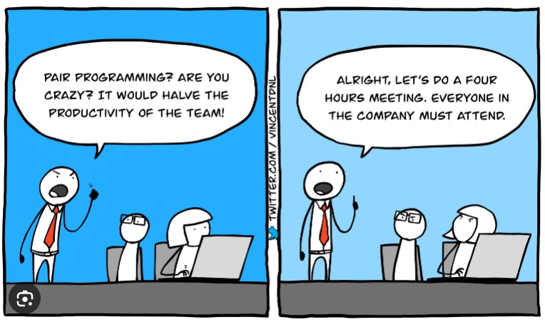
When do pracs start?
Planning to start Prac1 today!
Like in a moment!
All got a laptop? If not, then ‘XP’ style it*.
But first:
TEAManology terms, syllabus, pracs, GA2, proj.
*Extreme Programming (XP) is a form of Agile software development, which often includes working in pairs, e.g. pair programming, where one developer may be at the keyboard, applying changes / coding, and the other may be more observing and commenting (may different approaches for ‘paired work’).
Further info at: https://en.wikipedia.org/wiki/Extreme_programming

Slide 31
HPES TEAManology 3 Types of Teams:
Study Buddies Team (SBT)
An optional thing, but suggested strategy
Small team of peers to helps each other learn
Prac Assignment Group (PAG) *
Independently or as a team of 2
YOda Group (YOG)
4 members. Form prior to starting YODA project
* Disclaimer: You or your teammate may need to give impromptu explanations or demonstrations of what you have done to demonstrate that you both know what you are doing (if the one member seems clueless then you might both get marks deducted). The lecturer may also do random spot checks to request students to do brief prac oral tests.

Slide 32
EEE4120F Syllabus in brief
TERM 1 THEME:
Microprocessor-based parallel HPES
Embedded Parallel Computers
TERM 2 THEME:
Reconfigurable
Computing using FPGAs
High Performance Embedded Systems (HPES)
GA2: Conceptual Assignment
YODA Project
Not for the timid.
Underlying Knowledge
Your existing knowledge & prerequisites
Software Engineering, Programming, etc. (CS courses)
Digital Logic, etc. (from ES1 or equivalent)
Embedded Systems ES2 (EEE3096S)
Notes:
Here I’ve shown HPES connects in with other courses, and embedded systems. Indeed an HPES is one of the most complex and involved instances of an embedded system. In essence, the course is meant to be a “capping course”, building upon your existing expertise in designing and developing digital systems, and also giving you a “push” towards honing your abilities and skills for a high-tech future.
You can see that the course comprises two main themes: reconfigurable computing, and microprocessor-based parallelism. These themes correspond to the two main trends of HPEC and embedded computing in general. The first theme is about building dedicated systems from scratching, building up to a sophisticated system, using basic underlying digital logic and programmable logic devices. The second theme takes a more top-down approach, repurposing and interconecting larger computing blocks that are comprised of microprocessors or configurable microcontoller systems.

Slide 33
Lab Practicals
# | Title
 | TERM 1 PRACS
1 | MATLAB/OCTAVE: basic operations, graphing, implement function.
2 | MATLAB Parallel Computing Toolkit {may change to OpenMPI}
3 | OpenCL: SIMD on GPUs
 | (Optional) pThreads dynamic: dynamic partitioning and speed comparison to static partitioning
 | TERM 2
4 | Simulation-based IP Core Integration Using iVerilog or Vivado
 | YODA Project
… | Remainder of the prac sessions will swing to working on Your Own Digital Accelerator (YODA) project. (Prac4 due early in Term 2)
Links to recommended C / C++ tutorials if you haven’t used C much before:
http://www.cplusplus.com/doc/tutorial/

Slide 34
GA2 Task and Assessment
A tiny (5%) but crucial part of your mark
Something the SBT team can help with
The purpose is to
Evaluate you on achieving GA2 ← NB
GA2= Application of scientific and engineering knowledge
It is for DP! (only DP for engineering students)
The approach:
The
Literature
Given a reading related to a natural phenomenon.
Demonstrate comprehension of this
Given a desired engineering product / problem related to this phenomenon
Explain how you would (applying your engineering skills) to develop a solution
The combination of a written test (for #2) and a lab practical (for #4) is used to evaluate this.
Use skills learned in lectures & pracs

Slide 35
Readings
Readings related to lecture topics will be suggested, students can also use the Chat to suggest additional resources to help learning etc (any of these sort of posting will be reviewed and commented on by the lecture/TA)

Slide 36
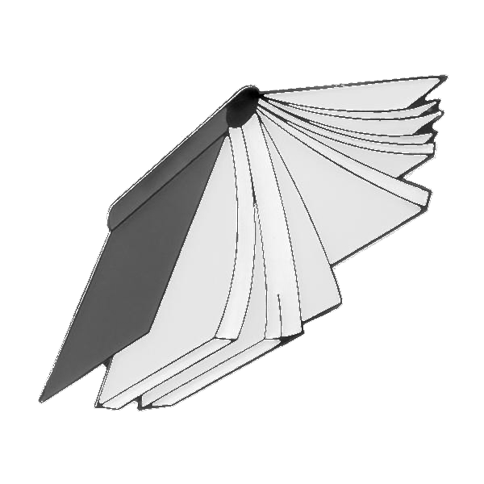
Heads-up on Reading Task 1…
Reading 1 (do before lecture next week*)
See Resources/Readings on Amathuba site
R01: L01 Berkeley 2006 - Landscale of Parallel Computing Research
Asanovic et al. “The Landscape of Parallel Computing Research: A View from Berkeley”
R01b: L01b Berkeley 2009 - A View … by Asanovic et al (AD)
Newer, more concise and better illustrated take on these issues
Suggestion:
There are many useful concepts explained here, but I’d suggest reading R01 quickly (various details can be skipped) and read R01b more closely
* quiz to connect with this

Slide 37
Course Project
EEE4120F

Slide 38
Project in this course…
fairly BIG project – implementing a digital accelerator on FPGA/GPU
I’m open for new project ideas!
Current list of topics: http://ocw.ee.uct.ac.za/courses/EEE4120F/YODA.html
Thoughts on
Final year projects? Eeeek!!
Various 4th year projects on offer, can share link if interest:
idea
If YOU have an idea of a project you want to suggest (within my area of expertise) I’d consider supervising it and adding it to my list of BSc projects offered. *
* Would need to prepare a description and discuss it with me pref. early March.

Slide 39
You can finish the slideshow here…
But please remember to do Quiz 0 (handout and will share on Amathuba)
… or you can continue to see some (in some cases) inspiring points about HPES and its job-market in SA and elsewhere.
optional
To Prac1
Emergency Stop Button

Slide 40
Some thoughts &
Inspirations…
HPES Job Market
FREE Creative Commons License
UKULELE
Music: https://www.bensound.com
Click to get to it…

Slide 41
Some inspiration & food for thought…
What are You Considering…
My
Boss
Your own startup
vs.
Work for someone
vs.
Postgraduate work
research
industry
Decide later?

Slide 42
Consider the pros & cons
Postgraduate work
Like researching & experimenting; initially pay not as good though.
Might want to dev. own product, get support from adviser & community, lab space
May lead to better job options later
Work for someone
Gain experience, very beneficial; but likelihood of doing further study tends to diminish over time
Working for yourself?
Nice idea and big possibilities ☺..
but more risky ☹
hmmm

Slide 43
Thinking about your own business
Why?!
Toying with an idea of starting your own business? Then ask yourself:
Why do you want to go into business?
List your reasons; pros & cons..
What is the right business for you?
Your ambitions; your work ethic; Your emotions; Your connections
What niche/new product will you provide?
And is a business right for you?
High-tech products super highway
You?

Slide 44
Your own business (harsh) realities
What resources are needed? (equipment, software, people, space)
How long before it’s self-sustaining?
How much cash does it need?
How will it make a profit? (business model)
Where can I get the finances / should I get a business loan? *
All the while maintaining your own living expenses?
* As a graduate (esp. young graduate like most of you will be soon) with a good idea or IP and promising business plan, then there’s actually many options (at least for SA citizens), where you don’t need to commit your own or family’s hard earned cash, e.g. using an incubator or somehow having the government / venture capitalist give you a chance (but in exchange for a cut of the future earnings and/or demonstrating that you business will be creating jobs).

Slide 45
Some harsh realities
Where is there work for computer engineers?
(Most especially high-paid ones!)

Slide 46
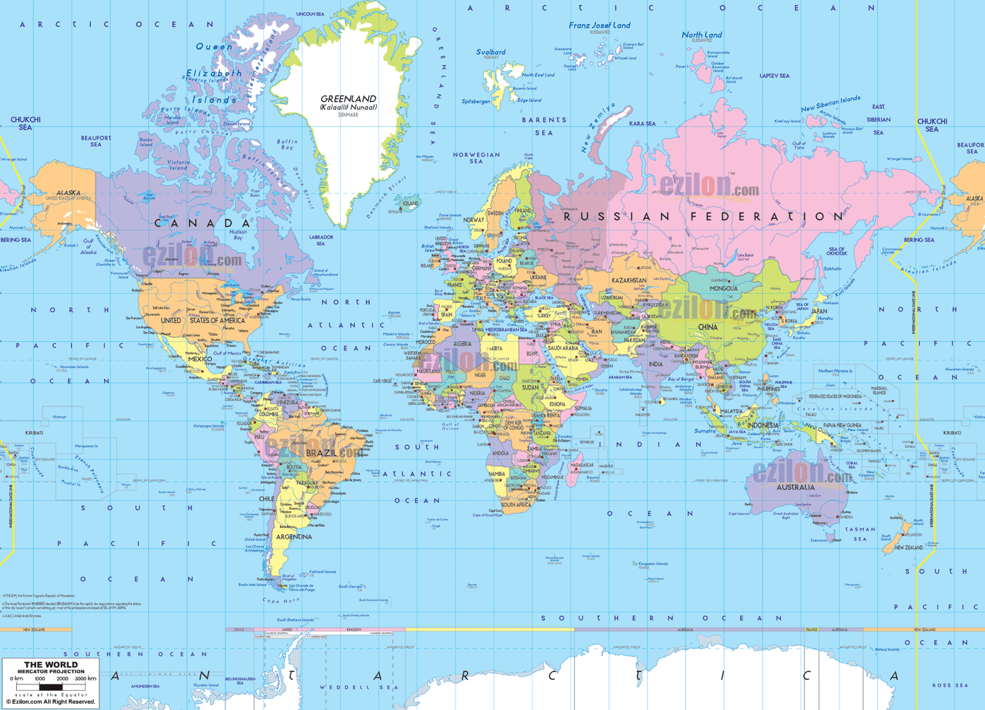
Map of the world – where are the EC jobs?
You are here

Slide 47
Where the jobs are…
(incl. Australia)
& other North
American nations
Oh, really?! Well, I’d like a second opinion… I wonder who or what I should ask for that?
Data based on: Cass, S. 2007. “Where the jobs are”, In IEEE Spectrum: 44(2). pp 51-57
Note: in the case of continent the flag represents the country with the largest electronics industry

Slide 48
… Probably the same who or what to ask spring to all of your minds too…

Slide 49
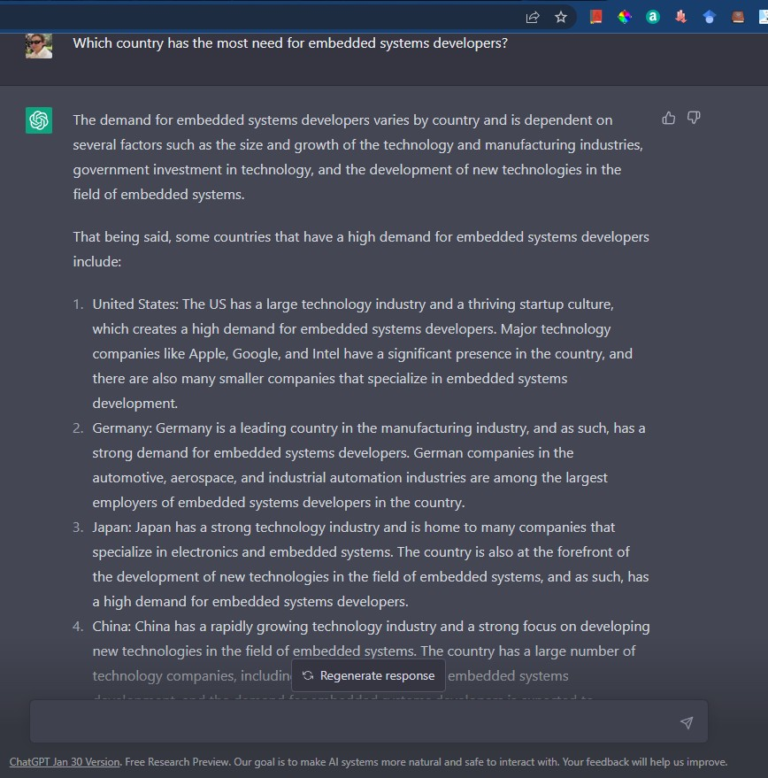
USA
Europe
Pretty much
agreement!
Asia

Slide 50
Some realities
Where is work for computer engineers?
Most in: USA, Europe (& UK), China and India
But opportunities in RSA … (see next slide)
Good news: – if you’re skilled
Outsourcing: 40% * (esp. consumer/custom products)
World shortage of good skills in embedded and high-performance developers
Worldwide desire for electronic products and faster processing
Increase in specialized/embedded computer systems, getting increasingly complex & interconnected, rather than becoming simplified and easier…
* based on statistics of survey done by: Cass, S. 2007. “Where the jobs are”, In IEEE Spectrum: 44(2). pp 51-57

Slide 51
Embedded Systems/HPES in SA?
A range of industries doing work in this area
Government e.g.:
SA Radio Astronomy Observatory (SARAO) / SKA
South African National Space Agency (SANSA)
iThemba LABS, CSIR
Private e.g.:
Reutech, Denel Dynamics, Tellumat (Defence, Air traffic, Security, …), Cybicom Atlas Defence
Anglo American (mining tech & IoT), DetNet SA (mining tech)
SCS Space, BlueCube, Alphawave, Simera-Sense (IoT and processing)
Where to start a business?
Certainly there is serious work happening in this area locally! And it could skyrocket* if business conditions were favourable … at present SA does not offer very favourable business conditions, too many risks etc. This also restrains expansion of existing business.
*and achieving skyrocketing, in the physical sense, tends to need a good bit of power.

Slide 52
Are these job statistics something to worry about?
That depends…
Graduate in engineering/CS that did well seem to find work wherever they would like to be (with some obvious limitations*).
Although many of our graduates end up doing nothing related to their degree (e.g. financial consultancy), it doesn’t mean there aren’t plenty jobs out there that would use the skills you have learned in your programme.
In all, getting your BSc will most likely be worth all the effort ☺
* Certain countries have next to zero – or less – work going on related to computer system development (by ‘less’ you can interpret however you like; which could be smelting down old machines to extract metals).

Slide 53
Reminder… try quiz0 if haven’t done yet

Slide 54
End of lecture 1
Summary:
You and I have (hopefully) managed to find the correct venue ☺
We discussed a number of relevant, and some not-so pertinent, issues
You’re hopefully been fired up with ideas of
- considering projects to work on this year
- thinking about postgrad study
- considering your own business / finding work & gaining experience
Lecture 1: Meet & Greet

