Slide 1
YODA - ASG
DIGITALLY ACCELERATED ARITHMETIC SEQUENCE GENERATOR
PRESENTED BY:
PHILIPPUS SCHOLTZ & ASIF PARKER
MAY 2016
Notes:
Introduce team members and topic

Slide 2
Overview
INTRODUCTION
CONCEPTUAL DESIGN
PROTOTYPE IMPLEMENTATION
TEST RESULTS
CONCLUSION
Notes:
Describe overview and who is presenting what sections

Slide 3
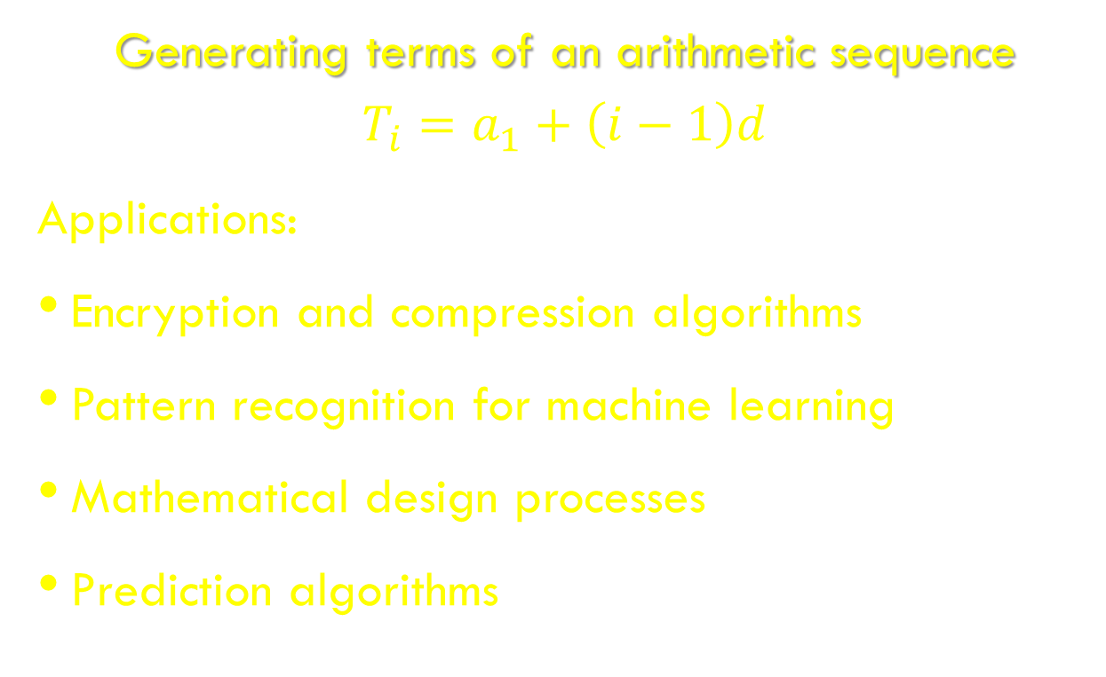
introduction
Generating terms of an arithmetic sequence
$$T_{i}=a_{1}+\left(i−1\right)d$$
Applications:
Encryption and compression algorithms
Pattern recognition for machine learning
Mathematical design processes
Prediction algorithms
Notes:
Concept description: digitally accelerated arithmetic sequence generator
What is an arithmetic sequence? Formula to generate terms
Why ASG?
Applications of arithmetic sequence generation

Slide 4
Modular overview
Parallel arithmetic units (M)
Single control unit
Off-the-shelf Ethernet core (100 Gbps)

Slide 5
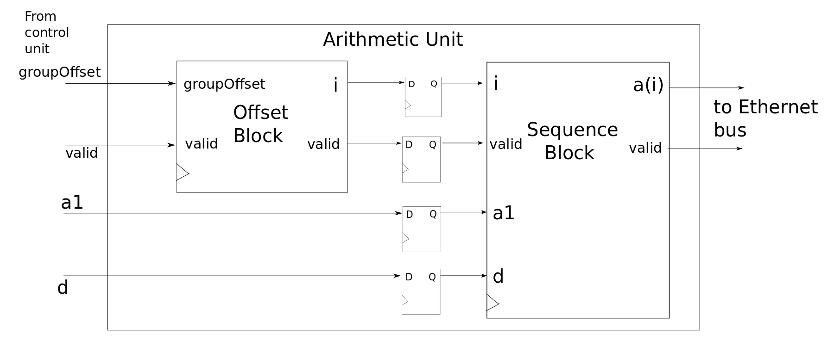
Arithmetic unit
Receives groupOffset from control unit
(and global sequence parameters)
(groupOffset + N)’th element emerges from pipeline

Slide 6
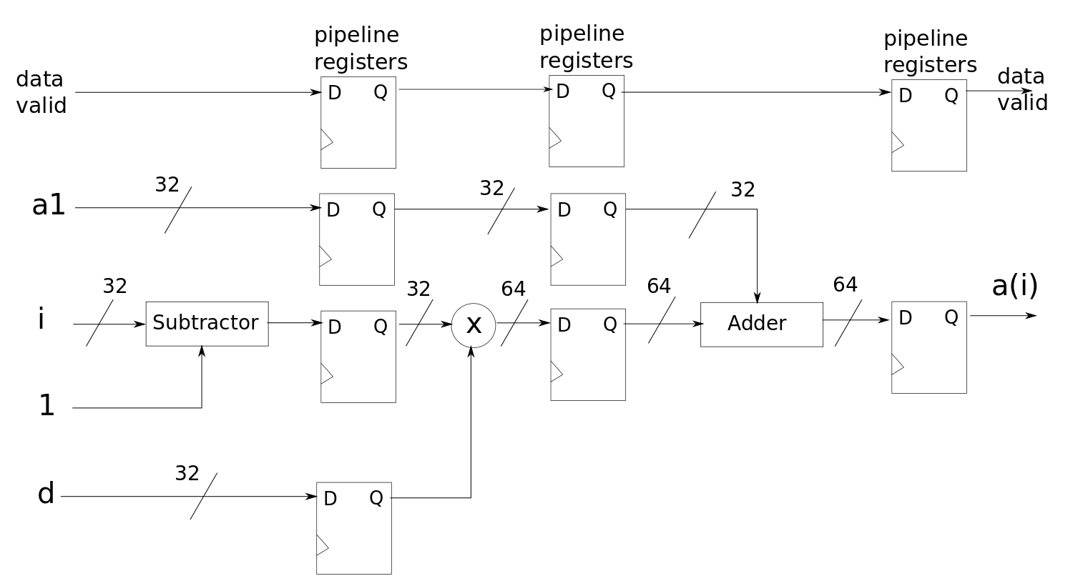
Sequence block
Calculates a single sequence element
Pipelined for improved throughput
“i” comes from offset block
Offset block: just an adder

Slide 7
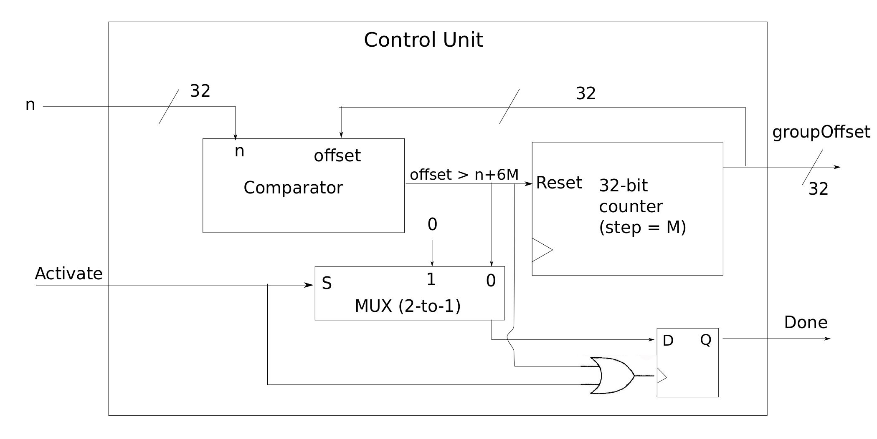
Control unit
Increments groupOffset in steps of M
Raises ‘done’ flag when complete
Resets on rising ‘activate’

Slide 8
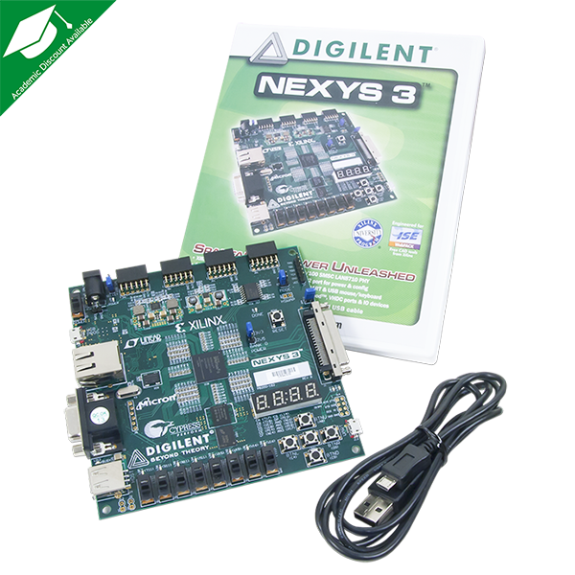
PROTOTYPE IMPLEMENTATION
Hardware platform
FPGA – Digilent Nexys 3 evaluation board
Design constraints:
Unsigned
64 bit
Positive
Integers
Notes:
What hardware is being used?
What design constraints were imposed on the prototype?

Slide 9
PRORTOTYPE IMPLEMENTATION
Most of conceptual design implemented
Notes:
What parts of the conceptual design were carried through to the prototype?
What was different? UART instead of Ethernet (used for validation of the sequence generation)

Slide 10
Testing the prototype
Golden measure:
Program written in C
Sequential execution
Measure processing runtime of program

Slide 11
Testing the prototype
Prototype test:
Input parameters (a1, i, and d)
Enabled an I/O pin to be default high
Pull the I/O pin low when processing occurs and set it back to high when done processing
Measured pulse width on an oscilloscope

Slide 12
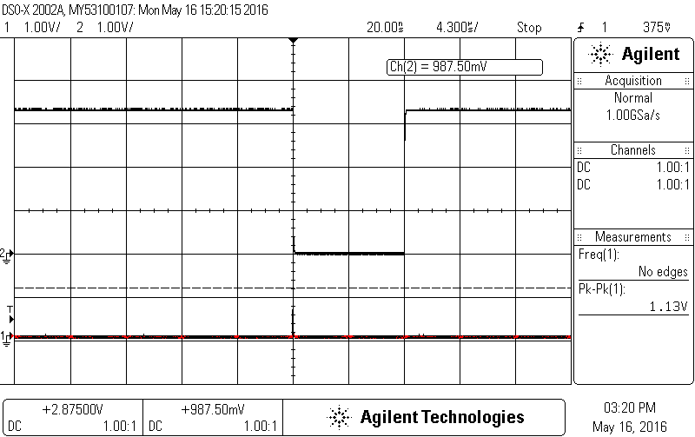
TEST RESULTS
8.6e-6[s]
Activate
20 arithmetic units
a1 = 255
d = 10
i = 1 000 000
Notes:
An example of oscilloscope output measurement (proof of testing)

Slide 13
TEST RESULTS
Number of terms | Golden measure runtime [s] | Prototype runtime [s] | Speedup
1 | ≈ 0 | 142e-9 | 0.00
10 | 2.7e-7 | 142e-9 | 1.90
100 | 6.5e-7 | 191e-9 | 3.40
1 000 | 2.8e-6 | 640e-9 | 4.38
10 000 | 3.5e-5 | 5.14e-6 | 6.81
100 000 | 2.84e-4 | 17.3e-6 | 167.06
1 000 000 | 5.39e-3 | 8.6e-6 | 295.34
10 000 000 | 27.27e-3 | 19.4e-6 | 1405.67
100 000 000 | 275.5e-3 | 28.9e-6 | 9532.87
Notes:
Test results for a range of n values
Exponentially increasing speedup
Prototype faster than golden measure
This was what we wanted to achieve

Slide 14
CONCLUSION
Valid algorithm
Successful prototype results
Speedup obtained for prototype
Notes:
What did we achieve?
Was it successful? Why?

Slide 15
Future enhancements
Use a larger FPGA to accommodate more arithmetic modules and memory blocks
Implement high speed parallel output data transfer to host computer using 100Gb Ethernet
Extend design to accommodate floating point numbers and negative numbers
Notes:
What more can be done with t

Slide 16
QUESTIONS?

